Slide 1
Class Project
Alicia, Bobby, Joe, Alan
June 2, 2018

Slide 2
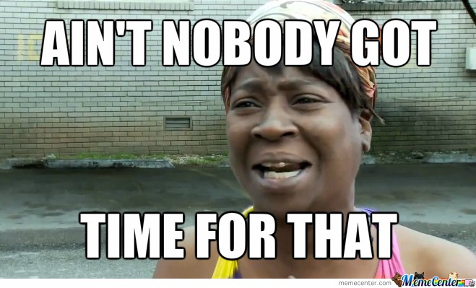
The Problem
Looking at videos and tour dates of your favorite artist on two different websites is less than ideal.

Slide 3
The solution
Our app embeds a sample music video of artist and displays future tour dates.

Slide 4
Code

Slide 5
Code

Slide 6
Code

Slide 7
Code

Slide 8
Challenges encountered
Started with Marvel and Underarmour APIs, but had difficulty obtaining API keys.
Wikipedia API was challenging to make work.
The YouTube API has some copyright issues with artists from major labels. And many videos do not display in third party apps.

Slide 9
Future improvements
Change logic so that ajax calls are more robust and finds a new videos when copyright issues are encountered.
Include a feature that provides suggestions based on what a user types into the search bar.
Find an API to access biographical information.

