Slide 1
Programming for Engineering 2
Week 14 : Final Presentation
PC
Information of team
x
Team
A2
Member1 : Seo Jinchan
Member2 : Kim Chanyoung
Member3 : Jose Alan Barraza Villaverde
OK

Slide 2
What is the Problem?
Explanation of our team project(SW)
Process and results of the program
Let’s watch it together(Launch the program)

Slide 3
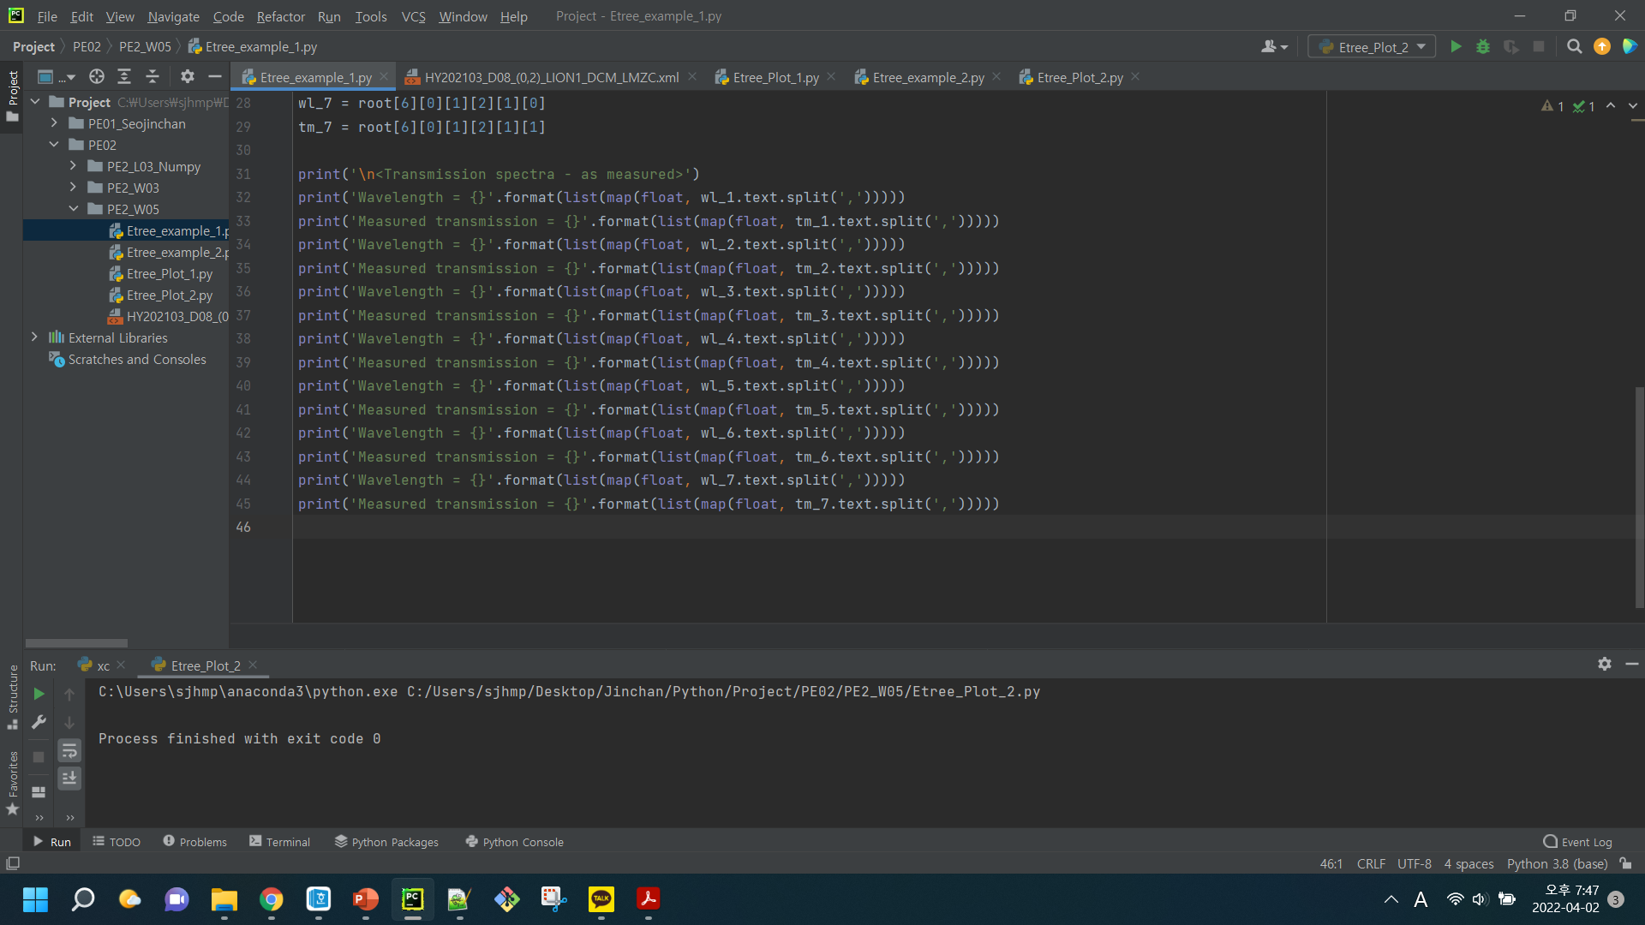



What is the mission?
What is the mission?
x
What is the mission?
Explanation of function used in source code
How to solve this mission
Future Work
Data from XML
Make a graph visually
Notes:
이번주 목표는 저번시간에 얻은 XML 데이터를 바탕으로 그래프를 그려 자료를 시각화하는 것입니다.

Slide 4
Explanation of function used in source code
Explanation of function used in source code
x
What is the mission?
Explanation of function used in source code
1. import matplotlib.pyplot as plt
How to solve this mission
Future Work
2. plt.subplot(‘rows’, ‘columns’, ‘location’)
3. plt.plot(‘x_value’, ‘y_value’, ‘graph style')
4. plt.fill_between(‘x_value’, ‘y_value’, alpha=‘transparency’, color=‘color_name')
5. plt.title(‘title_name’), plt.legend()
6. plt.xlabel(‘label_name’), plt.ylabel(‘label_name’)
7. plt.ticks(fontsize=‘size’), plt.yticks(fontsize=‘size’)
8. plt.show()
Notes:
각 함수의 역할 및 의미
그래프를 그리기 위한 matplotlib.pyplot 라이브러리 불러오기
그래프를 그리기 위한 공간 생성 및 위치 설정
그래프 작성
그래프의 면적 색칠하기
그래프의 제목 및 범례 설정
그래프의 x축,y축 및 축제목 설정

Slide 5
How to solve this mission
x
How to solve this mission
What is the mission?
Explanation of function used in source code
import xml.etree.ElementTree as etree import matplotlib.pyplot as plt xml_file = etree.parse("HY202103_D08_(0,2)_LION1_DCM_LMZC.xml") # load xml file root = xml_file.getroot() # get root(element) of file # setting of font font_axis = { # font setting for axis label 'family' : 'monospace', # font style 'weight' : 'bold', # font weight 'size' : 16 # font size } font_title = { # font setting for title 'family' : 'monospace', # font style 'weight' : 'bold', # font weight 'size' : 25 # font size }
How to solve this mission
Future Work
Notes:
저번시간에 xml 데이터를 불러오는 작업을 진행했으므로 해당 내용에 대한 설명은 생략하고 그래프 관련 코드에 대해서만 설명
첫번째로 축레이블과 제목의 폰트를 설정해주는 딕셔너리를 먼저 만들어준다.
이때 family는 글씨체, weigh는 글씨 두께, size는 글씨 크기

Slide 6
How to solve this mission
x
How to solve this mission
What is the mission?
Explanation of function used in source code
# Voltage-Current vol, cur = [], [] # reset the value of Voltage and Current plt.subplot(1, 2, 1) # Make a space for graphing in the first row and column of dimension of (1, 2) for i in root.iter(): # Return iterator for the root element if i.tag == 'Voltage': vol = list(map(float, i.text.split(',')))
# if tag name is 'Voltage', save voltage value as list form
elif i.tag == 'Current': cur = list(map(float, i.text.split(',')))
# else if tag name is 'Current', save current value as list form plt.plot(vol, list(map(abs, cur)), 'co-’)
# Draw the graph vol-cur with color cyan, dotted lines, and circular marks
plt.fill_between(vol, list(map(abs, cur)), alpha=0.2, color='skyblue’) # Fill the area of the graph with color of skyblue with transparency of 0.2
How to solve this mission
Future Work
Notes:
Subplot으로 그래프가 그려질 공간을 설정한다.
Voltage를 x축, Current를 y축으로 설정하여 색은 cyan이고 동그라미 모양의 마커를 가진 실선의 그래프를 그린다.
그리고 0.2의 투명도를 가진 하늘색으로 그래프의 면적을 색칠한다.

Slide 7
How to solve this mission
x
How to solve this mission
What is the mission?
Explanation of function used in source code
# Setting of graph plt.title('IV-analysis', fontdict=font_title) # Write a label with a setting of font_title
plt.xlabel('Voltage[V]', labelpad=15, fontdict=font_axis)
# Write a label with a setting of axis and a margin of 15pt plt.ylabel('Current[A]', labelpad=15, fontdict=font_axis)
# Write a label with a setting of axis and a margin of 15pt
plt.yscale('log') # Set the y-axis scale to log type
plt.xticks(fontsize=12) # Set the font size of axis value plt.yticks(fontsize=12) # Set the font size of axis value
How to solve this mission
Future Work
Notes:
다음의 함수들로 제목, 축 제목, y축 scale, 축 값의 폰트 설정을 바꾼다.

Slide 8
How to solve this mission
x
How to solve this mission
What is the mission?
# Wavelength-Transmission wl, tm = [], [] # reset the value of wavelength and transmission DC_bias = -2.0 # initial value of DC bias plt.subplot(1, 2, 2)
# make a space for graphing in the first row and second column of dimension of (1, 2) plot_color = ['lightcoral', 'coral', 'gold', 'lightgreen', 'lightskyblue', 'plum'] # Make a color list color_number = 0 # the initial order of color list for i in root.iter(): # Return iterator for the root element if i.tag == 'WavelengthSweep': # if tag name is 'WavelengthSweep' if i.attrib.get('DCBias') == str(DC_bias): # and if value of attribution 'DC bias' is DC_bias wl = list(map(float, i.find('L').text.split(','))) # save wavelength value as list form tm = list(map(float, i.find('IL').text.split(','))) # save transmission value as list form plt.plot(wl, tm, plot_color[color_number], label=f'DCBias = {DC_bias}V') # Draw the graph of wl-tm with color of color list, label of DC bias DC_bias += 0.5 # add 0.5 to DC bias value color_number += 1 # add 1 to color number
Explanation of function used in source code
How to solve this mission
Future Work
Notes:
Wavelength-Transmission 그래프의 경우 color list를 만들어 for 반복문을 통해 그래프마다 각기 다른 색을 지정하여 그래프를 그린다.

Slide 9
How to solve this mission
x
How to solve this mission
What is the mission?
Explanation of function used in source code
# Reference elif i.tag == 'Modulator': # else if tag name is 'Modulator' if i.attrib.get('Name') == 'DCM_LMZC_ALIGN': # and if attribution name is 'DCM_LMZC_ALIGN' wl = list(map(float, i.find('PortCombo').find('WavelengthSweep').find('L').text.split(','))) # find the value of wavelength and save the value as list form tm = list(map(float, i.find('PortCombo').find('WavelengthSweep').find('IL').text.split(','))) # find the value of transmission and save the value as list form
plt.plot(wl, tm, color='#7f7f7f', linestyle=':', label='Reference') # Draw the graph of reference with color of color list, label of DC bias
How to solve this mission
Future Work
Notes:
Reference 그래프와 같이 color=＇#7f7f7f＇, linestyle=＇:＇와 같은 방법으로도 그래프의 스타일을 바꿀 수 있다.

Slide 10
How to solve this mission
x
How to solve this mission
What is the mission?
Explanation of function used in source code
plt.title('Transmission spectra - as measured', fontdict=font_title)
# Write a label with a setting of font_title
plt.xlabel('Wavelength[nm]', labelpad=15, fontdict=font_axis)
# Write a label with a setting of axis plt.ylabel('Measured transmission[dB]', labelpad=15, fontdict=font_axis)
# Write a label with a setting of axis
plt.xticks(fontsize=12) # Set the font size of axis value plt.yticks(fontsize=12) # Set the font size of axis value
plt.legend(loc='lower center', ncol=2, fontsize=13) # Make a legend with location of lower center, 2 column, and font size of 13pt plt.show()
How to solve this mission
Future Work
Notes:
Voltage-Current 그래프와 같이 제목, 축 제목, y축 scale, 축 값의 폰트 설정을 바꾸고 추가적으로 범례를 설정한 뒤 그래프를 출력한다.

Slide 11
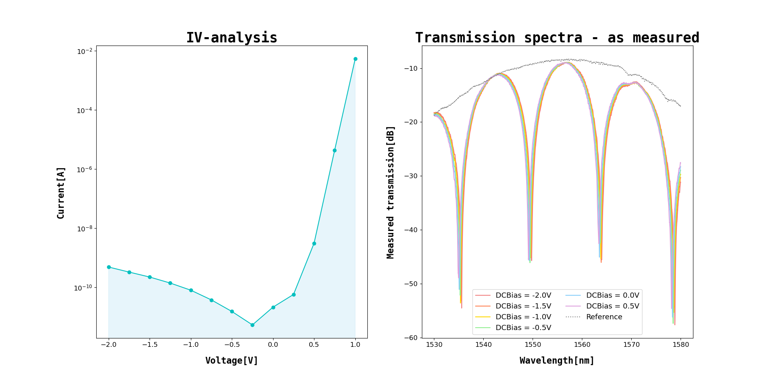
How to solve this mission
x
How to solve this mission
What is the mission?
Explanation of function used in source code
How to solve this mission
Future Work
Notes:
그 결과 다음과 같은 그래프를 얻을 수 있다.

Slide 12
Future Work
Future Work
x
What is the mission?
Explanation of function used in source code
Fitting the data using Numpy
How to solve this mission
Future Work
Example
Notes:
다음 시간에는 아래 예제처럼 그래프를 fittin하는 시간을 가져보도록 할 것 이다.

Slide 13
Thank you for listening
Notes:
Thank you for listening

