Slide 1
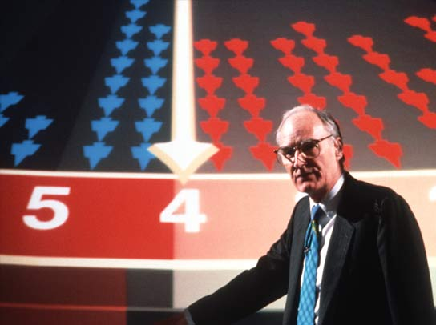

Slide 2
Peter Snow swings both ways

Slide 5


Slide 6
FPTP Swing for Election 2010
Data scraped from http://ukpollingreport.co.uk/
3916 queries over 6 hours
Web service withdrawn due to abuse - oops

Slide 7
AV Awesomeometer
3916 combinations of main party share
  531 constituencies
    Calculate winner
    Apply rules to transfer losing votes to second choice
    Calculate results again
    Transfer again
    Calculate results again
  Collate constituency results and plot the national winner
  http://refusingthedefault.blogspot.com

Slide 8
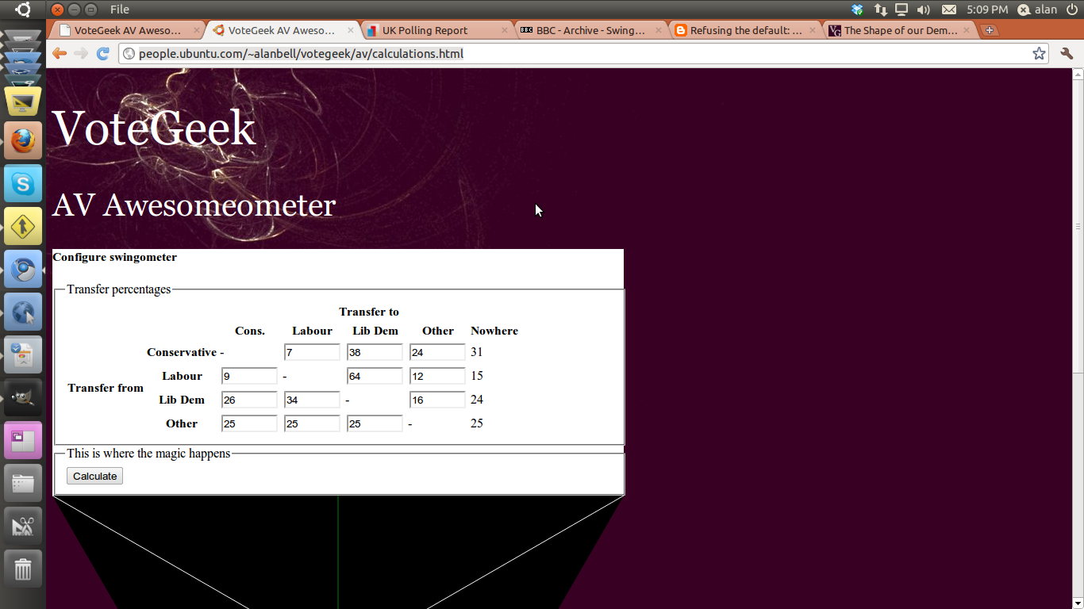

Slide 9
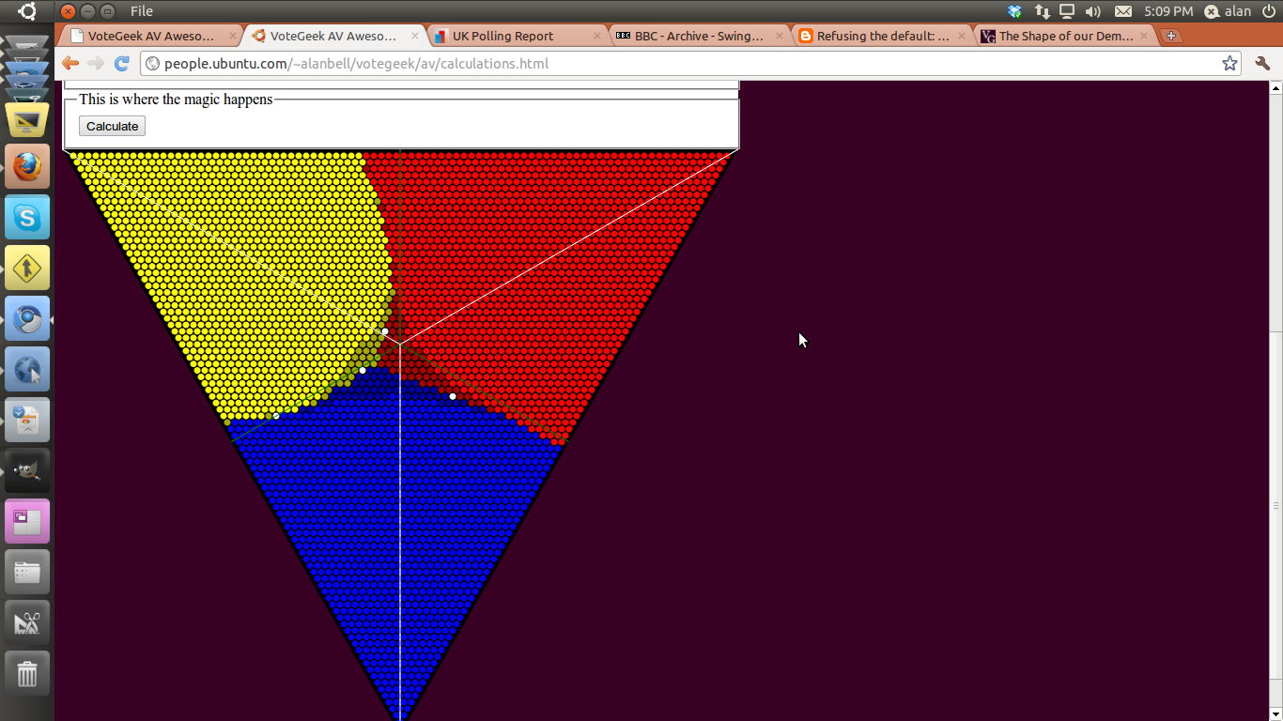
AV results based on polling data for second preferences

Slide 10
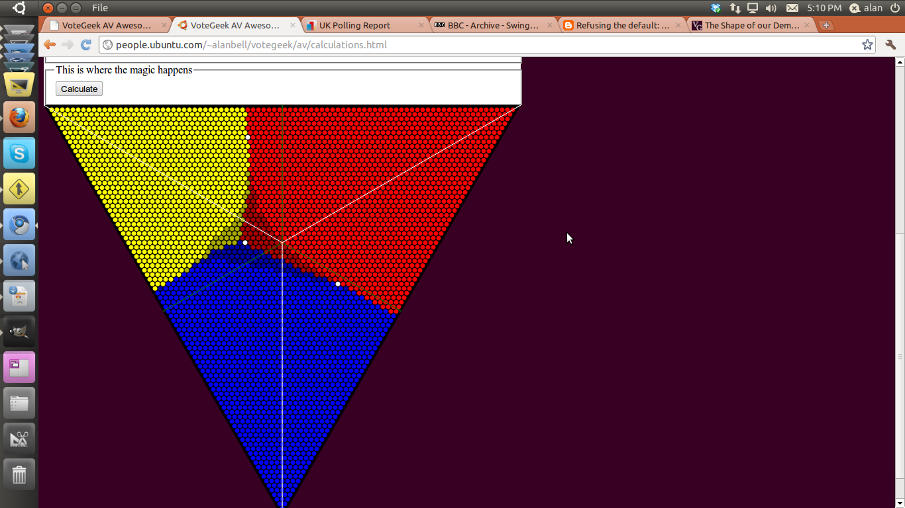
Collapse of all transfer votes to Lib Dem

Slide 11

Labour second choice goes to Conservatives

Slide 12
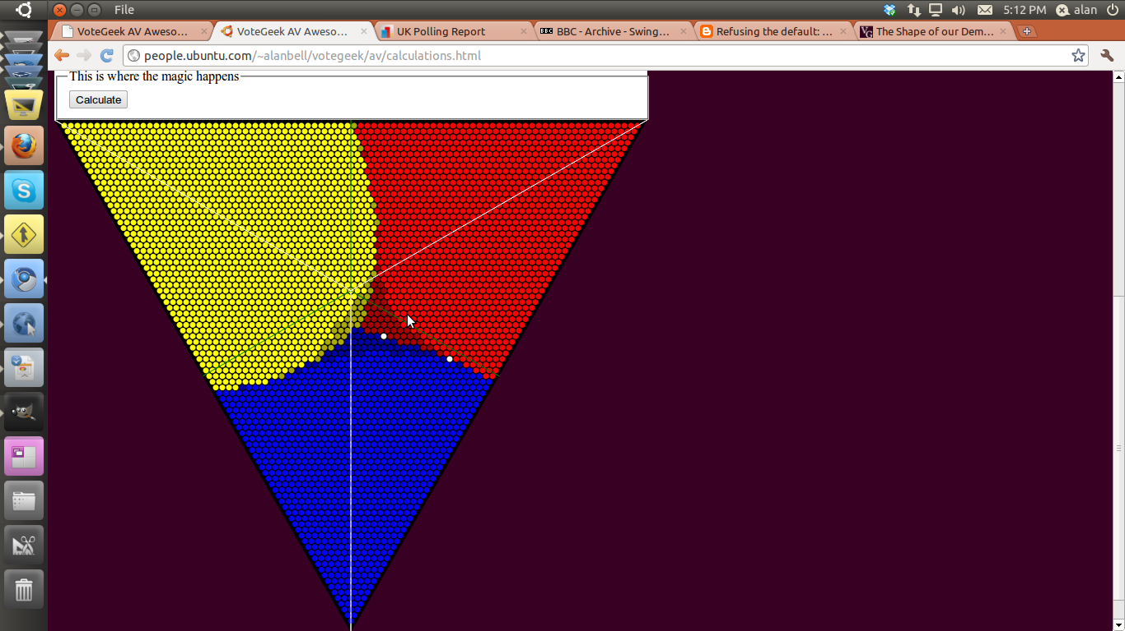
Lib Dem pick up all the “other” second votes

