Slide 1
COMP90024 – Team 58
Zisu Geng - zisu.geng@student.unimelb.edu.au Wenbin Cao - wenbin.cao@student.unimelb.edu.au Haopeng Yan - haopeng.yan@student.unimelb.edu.au Zhijun Chen - zhijun.chen@student.unimelb.edu.au Zemin Yu - zemin.yu@student.unimelb.edu.au
GitHub Repo: https://github.com/AlanChaw/90024

Slide 2
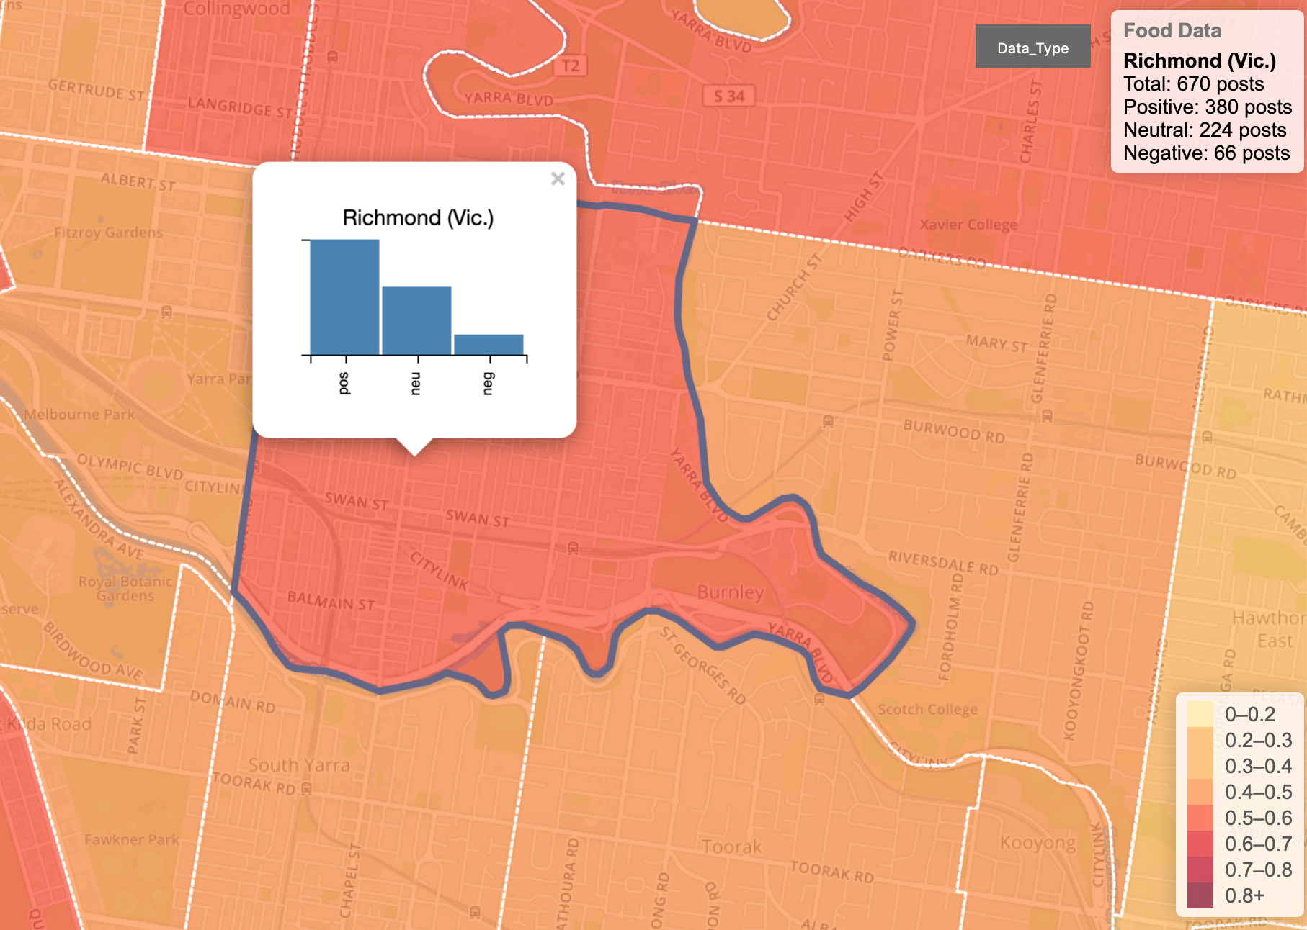
Scenarios
Tweets in Melbourne
From existing CouchDB and Twitter Developer.
Divide into suburbs.
Scenarios - Greedy
Tweets talk about food.
Tweets talk about shopping.
Tweets talk about jobs.
Sentiment Analysis
Positive / Negative / Neutral

Slide 3
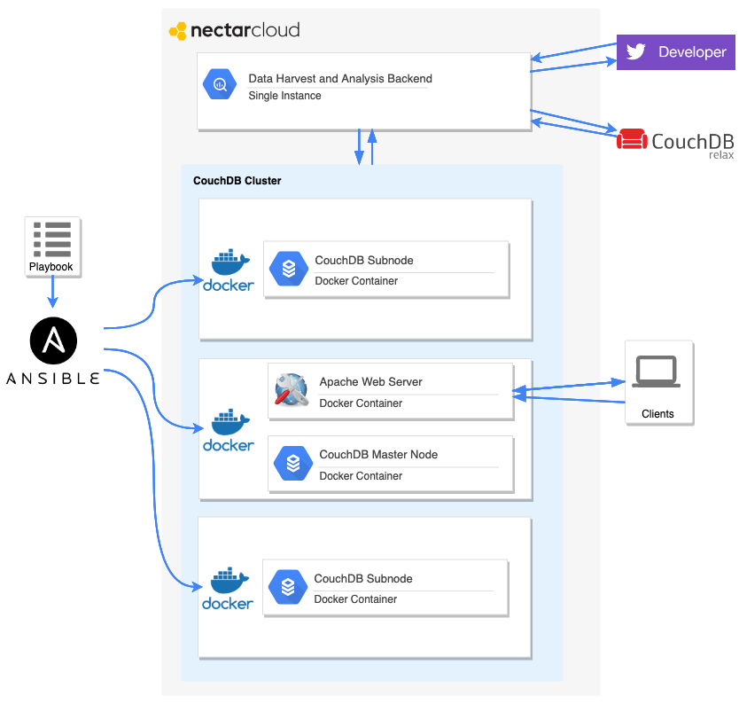
System Design
1 stand-alone instance
Data harvest
Preprocess and analysis
3 instances for CouchDB cluster
Deployed by Ansible script
Run in Docker Containers
MapReduce views
RESTful APIs for frontend
No independent backend required

