Slide 1
COMP 90024 – Team 58
Zisu Geng - zisu.geng@student.unimelb.edu.au Wenbin Cao - wenbin.cao@student.unimelb.edu.au Haopeng Yan - haopeng.yan@student.unimelb.edu.au Zhijun Chen - zhijun.chen@student.unimelb.edu.au Zemin Yu - zemin.yu@student.unimelb.edu.au
GitHub Repo: https://github.com/AlanChaw/90024

Slide 2
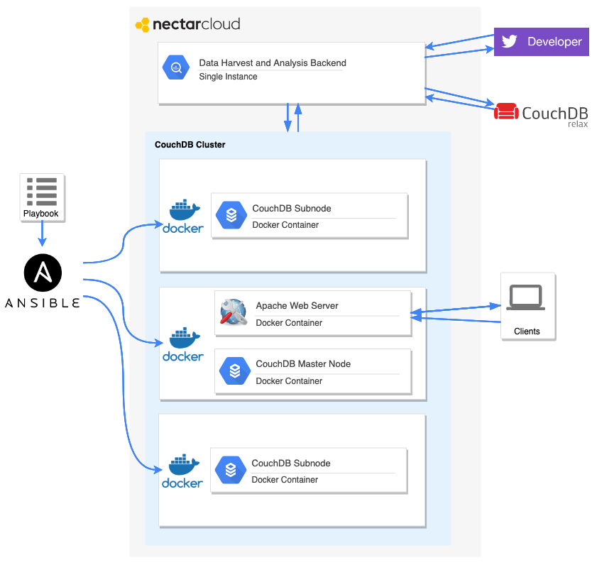
System Architecture

Slide 3
Web Frontend and Scenarios
YouTube URL: https://www.youtube.com/watch?v=BDCcR_rYeBE&feature=youtu.be

