Slide 1

The BitTorrent Protocol
By, Nikhilesh Rao

Slide 2

Contents
Introduction
BitTorrent and Other approaches
Working of BitTorrent
Terminologies
Architecture of BitTorrent
Vulnerabilities of BitTorrent
Conclusion

Slide 3
Introduction
Overview
BitTorrent is a peer-to-peer file sharing protocol used to distribute large amounts of data.
A user can obtain multiple files simultaneously without any considerable loss of the transfer rate.
History
BitTorrent was created by a programmer named Bram Cohen in April 2001.
Before this was invented, there were other techniques for file sharing but they were not utilizing the bandwidth effectively.

Slide 4
BitTorrent and Other approaches
Other P2P Methods
A Typical HTTP File Transfer
The BitTorrent Approach

Slide 5
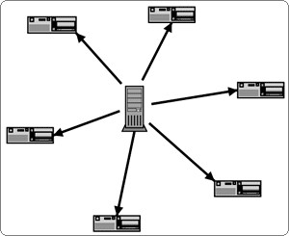
HTTP File Transfer

Slide 6
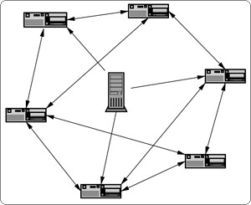
BitTorrent Approach

Slide 7
Terminology
Torrent
Peer
Leeches
Seed
Reseed
Swarm
Tracker
Share ratio
Distributed copies
Choked
Interested
Snubbed
Optimistic unchoking

Slide 8
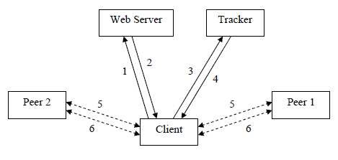
Working of BitTorrent
A typical BitTorrent System :

Slide 9
Architecture of BitTorrent
The BitTorrent protocol can be split into the following five main components:
Metinfo File - a file which contains all details necessary for the protocol to operate.
Tracker - A server which helps to manage the BitTorrent protocol.
Peers - Users exchanging data via the BitTorrent protocol.
Data - The files being transferred across the protocol.
Client - The program which sits on a peer’s computer and implements the protocol.

Slide 10
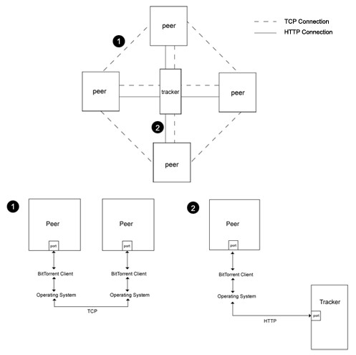
Architecture[2]

Slide 11
Metainfo File
When someone wants to publish data using the BitTorrent protocol, they must create a metainfo file. This file is specific to the data they are publishing, and contains all the information about a torrent, such as the data to be included, and IP address of the tracker to connect to.
Example :
{'info': {'piece length': 131072, 'length': 38190848L, 'name':
'Cory_Doctorow_Microsoft_Research_DRM_talk.mp3', 'pieces':
'\xcb\xfaz\r\x9b\xe1\x9a\xe1\x83\x91~\xed@\.....', } 'announce':
'http://tracker.var.cc:6969/announce', 'creation date': 1089749086L }

Slide 12
Bencoding
Bencoding is used by bittorrent to send loosely structured data between the BitTorrent client and a tracker. Bencoding supports byte strings, integers, lists and dictionaries.
Examples of bencoding:
4:spam // represents the string "spam"
i3e // represents the integer "3"
l4:spam4:eggse // represents the list of two strings: ["spam","eggs"] d4:spaml1:a1:bee // represents the dictionary {"spam" => ["a" , "b"] }

Slide 13
Tracker
A tracker is a HTTP/HTTPS service and typically works on port 6969. The address of the tracker managing a torrent is specified in the metainfo file, a single tracker can manage multiple torrents.
The parameters accepted by the tracker are:
Info_hash
Peer_id
Port
uploaded

Slide 14
Tracker[2]
Downloaded
Left
Compact
Event
Ip: (optional)
Numwant: (optional)
Key: (optional)
Trackerid: (optional)

Slide 15
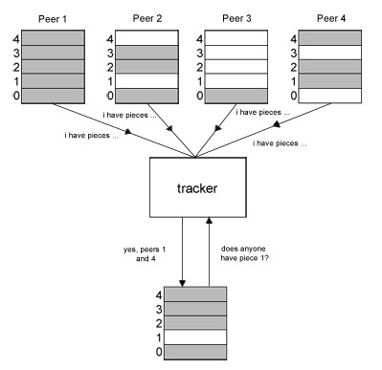
Tracker[3]
A tracker can be pictorially represented as given below :

Slide 16
Peers
Piece Selection
Random First Piece
Endgame Mode
Peer Distribution
Choking
Optimistic Unchoking
Communication Between Peers

Slide 17

Data
BitTorrent is very versatile, and can be used to transfer a single file, of multiple files of any type, contained within any number of directories. File sizes can vary hugely, from kilobytes to hundreds of gigabytes.
Piece Size:
  The most common piece sizes are 256kb, 512kb and 1mb. The number of pieces is therefore: total length / piece size.
  For example, a 1.4Mb file could be split into the following pieces. This shows 5 * 256kb pieces, and a final piece of 120kb.

Slide 18
BitTorrent Clients
A BitTorrent client is an executable program which implements the BitTorrent protocol.
It runs together with the operating system on a user’s machine, and handles interactions with the tracker and peers.
The client sits on the operating system and is responsible for controlling the reading / writing of files, opening sockets etc.

Slide 19
Vulnerabilities of BitTorrent
Attacks on BitTorrent:
  Pollution attack
  DDOS attack
  Bandwidth Shaping
      Solutions:
        Pollution attack
        DDOS attack
        Bandwidth Shaping

Slide 20
Conclusion
BitTorrent’s application in this information sharing age is almost priceless. However, it is still not perfected as it is still prone to malicious attacks and acts of misuse. Moreover, the lifespan of each torrent is still not satisfactory, which means that the length of file distribution can only survive for a limited period of time. Thus, further analysis and a more thorough study in the protocol will enable one to discover more ways to improve it.

Slide 21
Thank You for your time !!

