Slide 1
Intro To Machine Learning

Slide 2
What is Machine Learning
Wikipedia:
Machine learning is a subset of artificial intelligence … to give computers the ability to progressively improve performance on a specific task, with data, without being explicitly programmed

Slide 3
Why Should we Care?
Medicine
Diagnosis
Treatment efficacy
Finance
Market prediction
Marketing
Google Search
Tinder/Uber/Netflix
Manufacturing
Image Based Defect Analysis
Failure Prediction
Transportation
Self Driving Cars

Slide 4
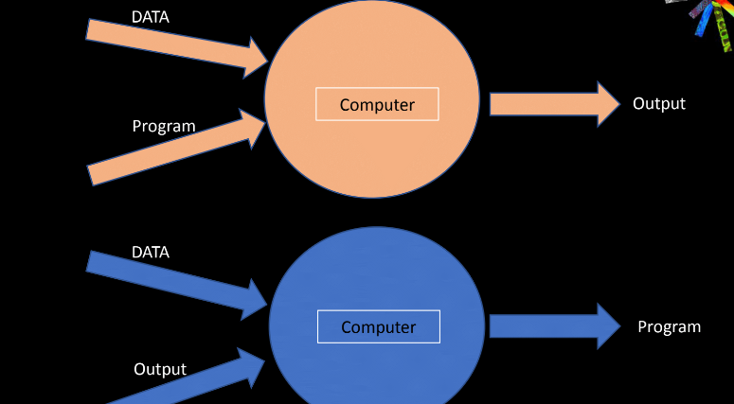
What is Machine Learning
Source: Adnan Tufail

Slide 5
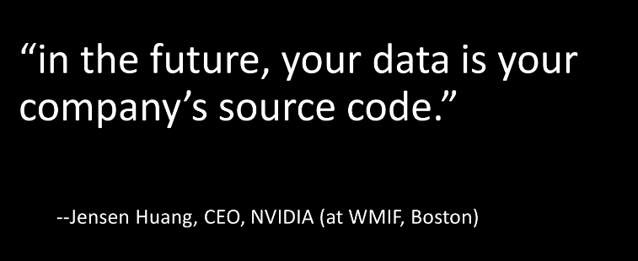
What is Machine Learning

Slide 6
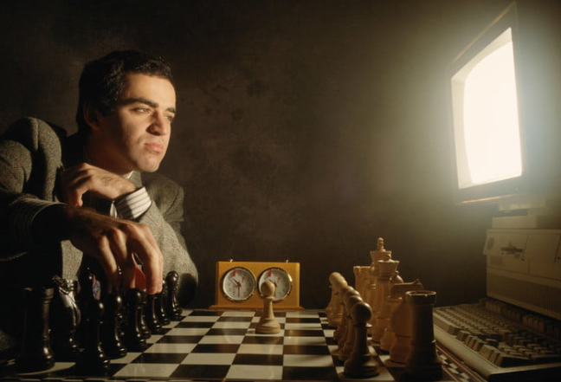
Man versus Machine: Chess
Feb 10, 1996 First time Deep Blue beat Kasparov
Not modern ML
Kasparov claimed some moves ‘too creative’ for a machine, claimed fraud
Today, open source Stockfish plays at ELO 3390 (1200, 2000, 25-2700, 2842)

Slide 7
About Go (the game)
Chess is about 500 years old
Go is at least 2500 years old
10¹⁷⁰ go positions
10¹⁹ grains of sand on earth
10²¹ molecules of water in a drop
10⁷⁸ to 10⁸² atoms in the universe
10⁴⁵ chess positions

Slide 8
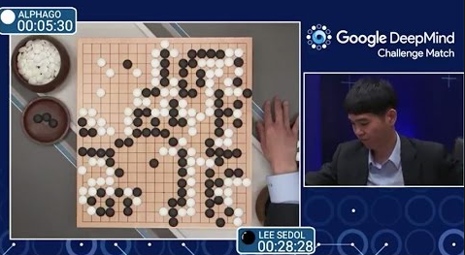
Man Vs Machine: Go
2 Decades pass before modern ML applied
Oct 2015 - Alpha Go beat Mr Fan Hui (Euro champ)
March 2016 - Alpha Go beat Mr Lee Sedol (World champ)
October 2017 – Alpha Go Zero paper published in Nature

Slide 9
Alpha Go Zero
December 2017 – Alpha Zero taught chess, in 24 hours better than

Slide 10
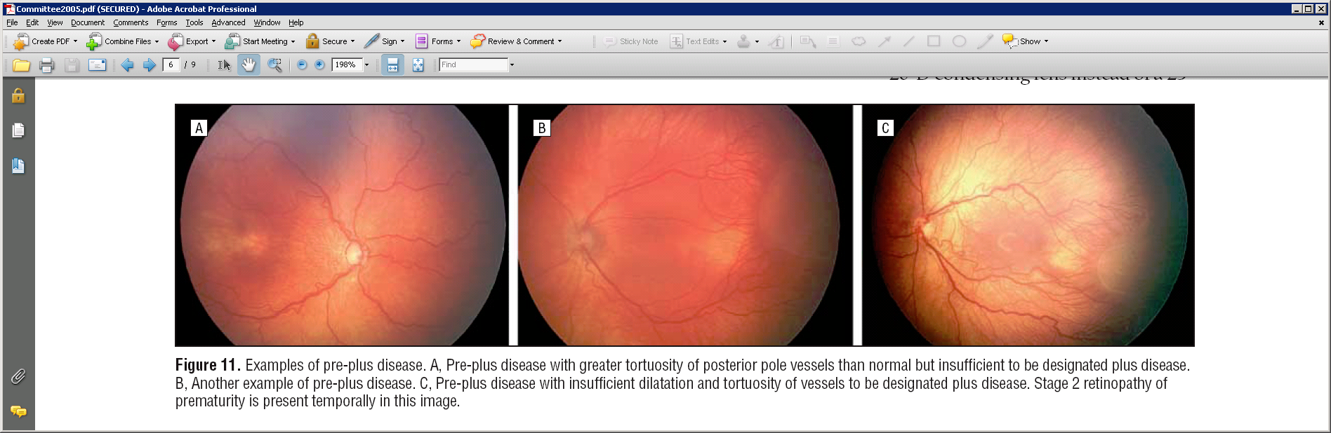
Retinopathy of Prematurity

Slide 11
So, what is it again?
Let’s start with 2 problem types
Regression
Predicting Results Based on Data
E.g. least squares
Classification
Is it a picture of a bunny, banana or boat?

Slide 12
Colab 1: Linear Regression
Why Colab?
GPU ready
Python ready
Why python?
Numpy, scipy, scikit learn, pandas
Python is hot for science

