Slide 1
F# For Data
PyData NYC 11/29/2017
Jamie Dixon
Tom Porter

Slide 2
F# Overview
Strongly Typed
Functional-First. Can Support OO and Imperative
.Net language – interop with C# and VB.NET
General Purpose, Open Sourced, and X-Plat
Created by MSFT Research in 2005. Now version 4.x

Slide 3
F# Overview: Inferred Typing
Type system ensures correctness and prevents bug
Inferred means compiler figures it out for you
Person p = new Person(“Jamie”, 42, Gender.Male);
p = Person(“Jamie”,42,Gender.MALE)
let p = new Person(“Jamie”, 42, Gender.Male)
Not just for data structures, everything is inferred and typed: arguments*, return values, functions them selves, etc..
*Sometimes the compiler can’t figure out what you are doing, so you need to give it a hint (myString:string)

Slide 4
F# Overview: Immutable
let x = 3 + 4 binds the value 7 to x
let x = 7 + 6 throws a compiler error
x = 7 + 6 resolves to “false”
let dogNames = [“Max”;”Charlie”;”Buddy”]
let newDogNames =
dogNames |> seq.map(fun d -> d + “ the dog”)
dogNames = dogNames |> seq.map(fun p -> p + “ the dog”) throws a compiler error
https://www.rover.com/blog/100-most-popular-male-female-dog-names-2016/

Slide 5
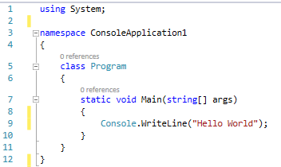
F# Overview: Minimalistic
No semi-colons
No curly braces
White space has meaning
Use the REPL, not test apps or unit tests

