Slide 1
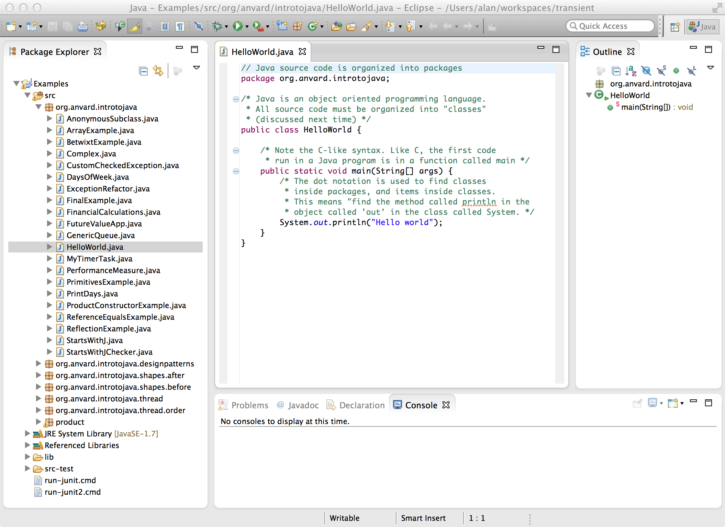
Classes
Packages

Slide 2
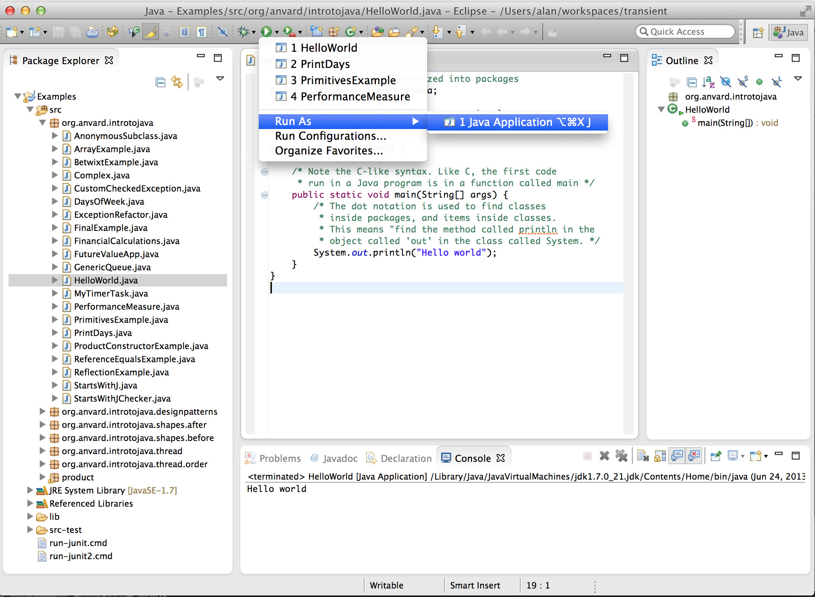
Handles everything required to run the application using the ‘main’ in this class
Console window (input and output)

Slide 3
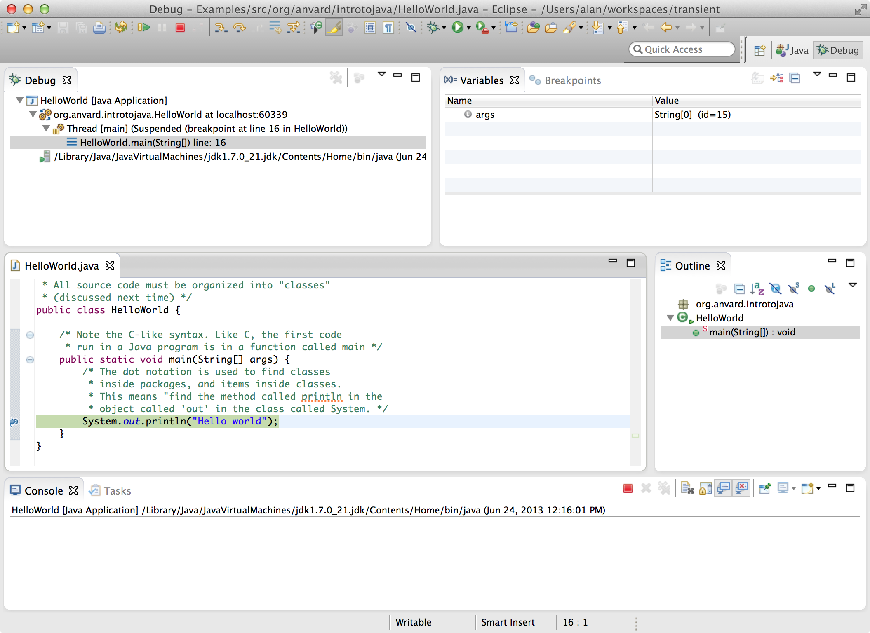
Threads
Variables
Call stack

