Slide 1
iPhone 16 Pro
Discover the Future of Innovation
Apple

Slide 2
iPhone 16 Pro
Trade-In and Pricing: Receive $180–$650 credit towards iPhone 16 Pro when trading in an iPhone 12 or newer.
Design and Durability: Grade 5 titanium design with microblasted texture, available in four finishes including Desert Titanium.
Display and Camera: New Super Retina XDR displays with 48MP Ultra Wide and 5x Telephoto cameras.
Performance and Battery: Up to 27 hours video playback.
Additional Features: Advanced Apple Intelligence, enhanced accessibility, environmental and ethical considerations.

Slide 3
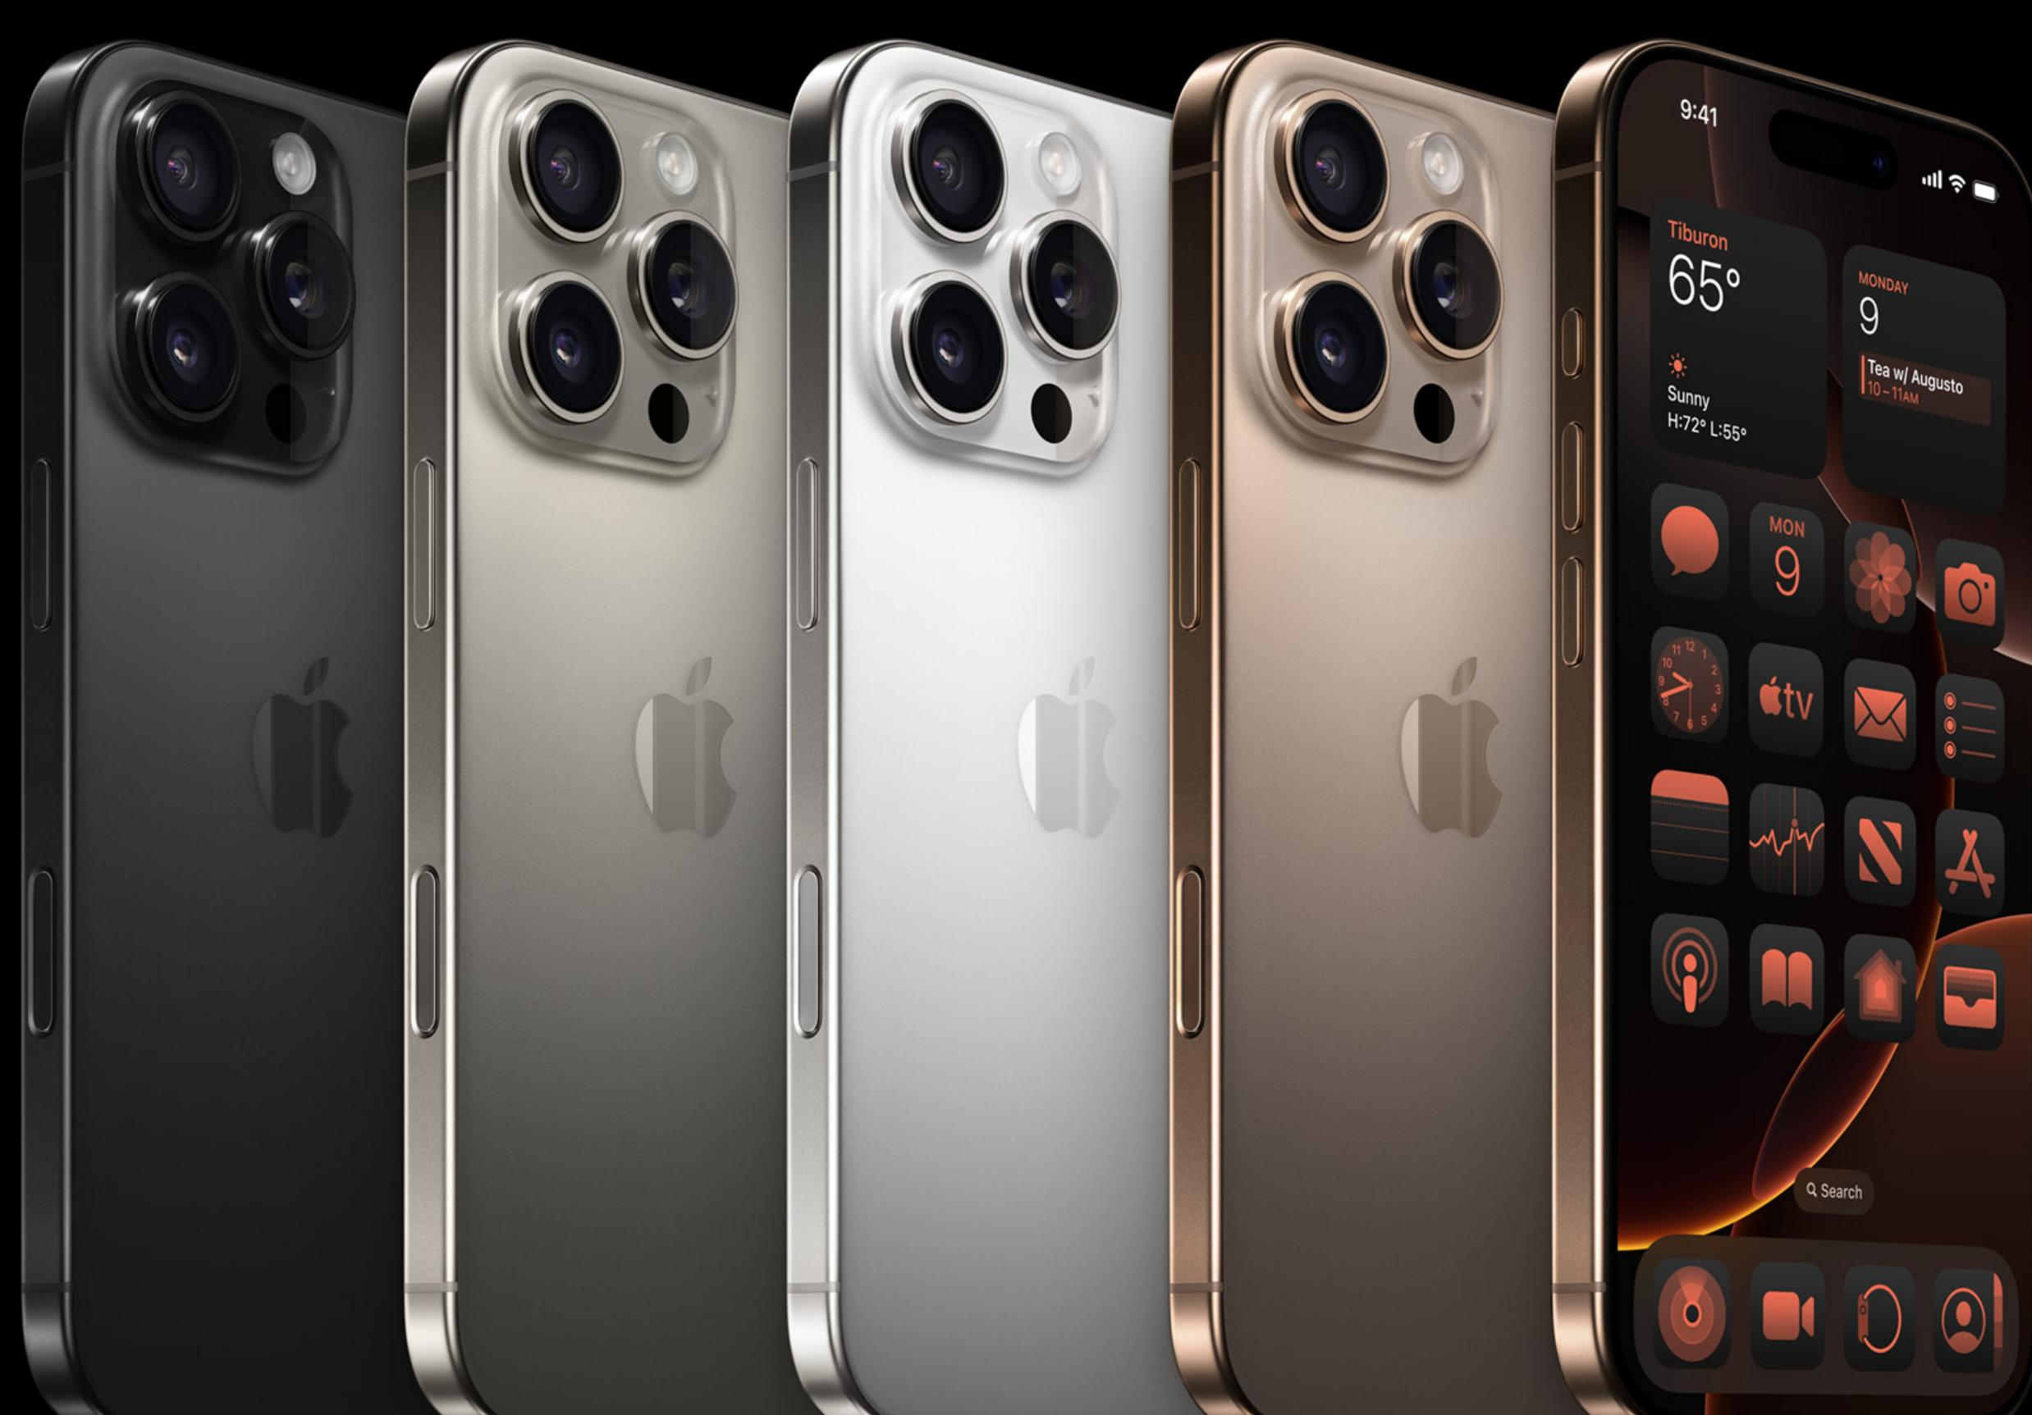
Design and Durability
The iPhone 16 Pro features a Grade 5 titanium design with a microblasted texture, combining strength with a lightweight build.
Available in four finishes, including the new Desert Titanium, the iPhone 16 Pro is splash, water, and dust resistant, and comes with the latest-generation Ceramic Shield for enhanced durability.

Slide 4
Display and Camera Features
New display technology offers thinner borders and larger 6.3-inch and 6.9-inch Super Retina XDR displays, providing an immersive viewing experience.
The 48MP Ultra Wide camera captures high-resolution photos and videos with advanced features like autofocus and ProRAW support. The 5x Telephoto camera provides sharper close-ups, even from a distance.

Slide 5
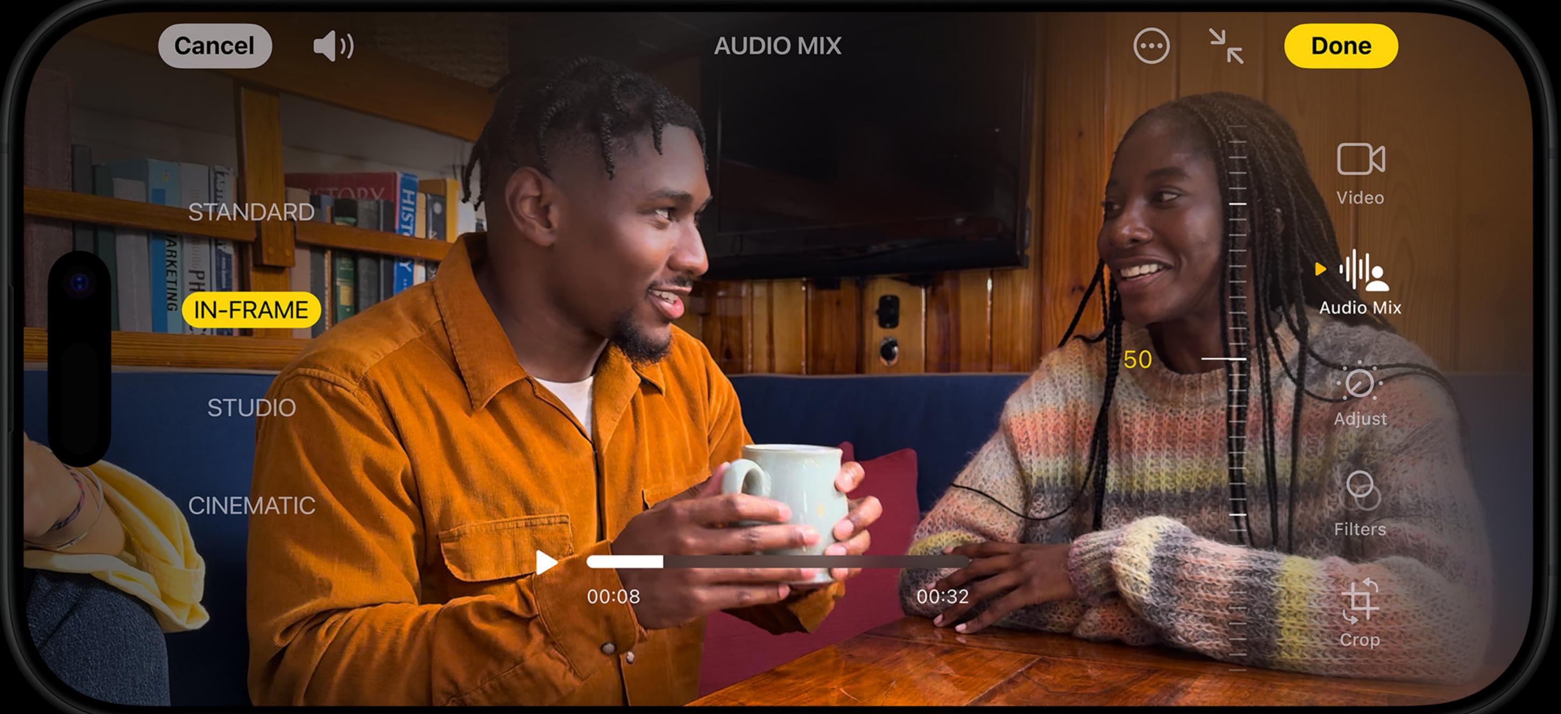
Apple Intelligence: Personal and Private
Apple Intelligence is a personal intelligence system that assists in writing, self-expression, and task completion. It is designed with privacy at its core, ensuring your data is safe and private at every step.
Features include on-device processing and Private Cloud Compute, which keep your data secure and private. Enjoy the benefits of advanced AI without compromising your personal information.

Slide 6

Performance and Battery Life
The A18 Pro chip features a faster Neural Engine, improved CPU and GPU, and increased memory bandwidth. It offers advanced video and photo capabilities, the best graphics performance for gaming, and hardware-accelerated ray tracing in iOS 18.
The iPhone 16 Pro provides extended battery life, with the Pro Max model offering up to 33 hours of video playback. Fast wireless charging supports up to 25W using a 30W power adapter, allowing up to 50% charge in approximately 30 minutes.

Slide 7
Additional Features and Accessibility
Satellite Connectivity: Stay connected in remote areas.
Privacy and Security: Secure your data with end-to-end encryption.
Accessibility: Features for all users, including Eye Tracking and Music Haptics.
Satellite SOS: Text emergency services when cell service is unavailable.
Vocal Shortcuts: Voice commands to enhance usability.

Slide 8
Environmental and Ethical Considerations
All Apple data centers run on 100% renewable energy.
The iPhone 16 Pro uses over 95% recycled lithium in the battery, 100% recycled gold in the USB-C connector, and 100% recycled copper in the MagSafe charger.
Packaging is 100% fiber-based and thinner, reducing carbon impact for shipping.
Apple prioritizes ethical practices with the use of recycled materials and sustainable packaging.
Privacy and security are paramount, ensuring user data is protected and inaccessible to anyone, including Apple.

Slide 9
Thank You for Joining Us
We hope you enjoyed learning about the iPhone 16 Pro.
For further inquiries, please contact:
Customer Support: support@apple.com
Stay tuned for more exciting updates from Apple!

