Slide 1
Introduction | typical recommendation algorithm | NCF | TransR | GCN | Conclusion
From Matrix to Deep Knowledge Graph:
A Multifaceted Approach to Recommendation Systems
Group member:
Tong Shenyang (leader), Wang Pengxin, Zhan Xiangcheng

Slide 2







Introduction | typical recommendation algorithm | NCF | TransR | GCN | Conclusion
Typical Recommendation algorithms
Neural Network Filtering
Knowledge Graph Completion
Recommendation system
……
A review on methedology

Slide 3
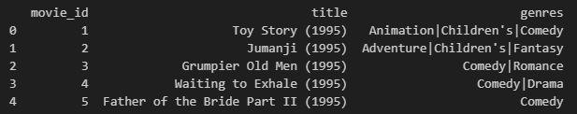






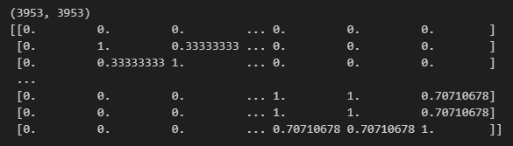

Introduction | typical recommendation algorithm | NCF | TransR | GCN | Conclusion
Content-based filtering
Ml-1M:
Separate the genres of the movies into 18 different movie types.
Convert the data into a sparse matrix composed of (movie_id, genre) pairs, and calculate its cosine similarity.
0 | 0 | 1 | 0 | 1
1 | 0 | 0 | 1 | 0
1 | 1 | 0 | 0 | 0
0 | 1 | 0 | 1 | 1
1 | 0 | 1 | 1 | 0
0 | 1 | 0 | 0 | 1
1 | 0 | 1 | 1 | 0
0 | 1 | 0 | 0 | 1
0 | 1 | 0 | 1 | 1
1 | 0 | 1 | 1 | 0

Slide 4

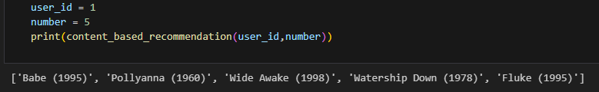
Introduction | typical recommendation algorithm | NCF | TransR | GCN | Conclusion
Content-based filtering
Potentially liked.
Choose any user, record the movies they already like as movie A, then sum all column values corresponding to the row of movie A in the similarity matrix.
0 | 1 | 0 | 0 | 1
1 | 0 | 1 | 1 | 0
0 | 1 | 0 | 0 | 1
0 | 1 | 0 | 1 | 1
1 | 0 | 1 | 1 | 0
Already
liked.
Similarity score
2 | 0 | 2 | 2 | 0
sort
Similarity score
2 | 2 | 2 | 0 | 0
Movie index
0 | 1 | 2 | 3 | 4
Movie index
0 | 2 | 3 | 1 | 4

Slide 5
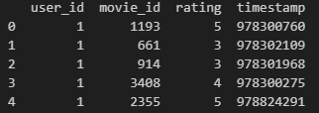
Introduction | typical recommendation algorithm | NCF | TransR | GCN | Conclusion
Item-based collaborative filtering
Ml-1M:
Convert the data into a sparse matrix composed of (movie_id, user_id) = rating pairs, and calculate its cosine similarity.
0 | 0 | 3 | 0 | 2
5 | 0 | 0 | 5 | 0
2 | 1 | 0 | 0 | 0
0 | 3 | 0 | 4 | 5
5 | 0 | 4 | 2 | 0
0 | 1 | 0 | 0 | 1
1 | 0 | 1 | 1 | 0
0 | 1 | 0 | 0 | 1
0 | 1 | 0 | 1 | 1
1 | 0 | 1 | 1 | 0

Slide 6

Introduction | typical recommendation algorithm | NCF | TransR | GCN | Conclusion
Item-based collaborative filtering
Select any user, record the movies they already like as movie A, then allocate weights based on the user's ratings for the movies. Sum up all the movie ratings.
Predicted rating
0 | 1 | 0 | 0 | 1
1 | 0 | 1 | 1 | 0
0 | 1 | 0 | 0 | 1
0 | 1 | 0 | 1 | 1
1 | 0 | 1 | 1 | 0
Rated
$$Predicted rating=\frac{\sum{movie_value∗rating}}{\sum{rating}}$$
Predicted rating
3 | 1 | 5 | 5 | 2
sort
Predicted rating
5 | 5 | 3 | 2 | 1
Movie index
0 | 1 | 2 | 3 | 4
Movie index
2 | 3 | 0 | 4 | 1

Slide 7
Introduction | typical recommendation algorithm | NCF | TransR | GCN | Conclusion
User-based collaborative filtering
Ml-1M:
Convert the data into a sparse matrix composed of (user_id, movie_id) = rating pairs, and calculate its cosine similarity.
0 | 0 | 3 | 0 | 2
5 | 0 | 0 | 5 | 0
2 | 1 | 0 | 0 | 0
0 | 3 | 0 | 4 | 5
5 | 0 | 4 | 2 | 0
0 | 1 | 0 | 0 | 1
1 | 0 | 1 | 1 | 0
0 | 1 | 0 | 0 | 1
0 | 1 | 0 | 1 | 1
1 | 0 | 1 | 1 | 0

Slide 8
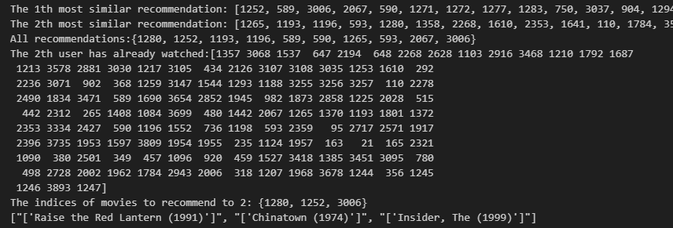
Introduction | typical recommendation algorithm | NCF | TransR | GCN | Conclusion
User-based collaborative filtering
Sort by similarity matrix and identify users B, C, and D most similar to user A. Recommend movies liked by users B, C, and D to user A.
Potentially liked movies
0 | 1 | 0 | 0 | 1
1 | 0 | 1 | 1 | 0
0 | 1 | 0 | 0 | 1
0 | 1 | 0 | 1 | 1
1 | 0 | 1 | 1 | 0
Self
Similarity
1 | 0 | 1 | 1 | 0
sort
Similarity
1 | 1 | 1 | 0 | 0
User index
0 | 1 | 2 | 3 | 4
User index
2 | 3 | 0 | 4 | 1

Slide 9
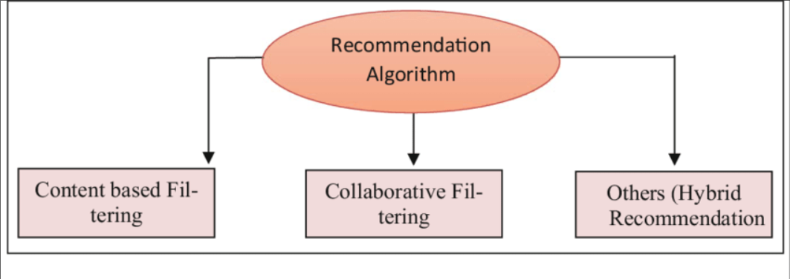
Introduction | typical recommendation algorithm | NCF | TransR | GCN | Conclusion
The Problems of typical recommendation algorithms
matrix factorization techniques
cannot capture nonlinear relationships and complex patterns
limited effectiveness in dealing with large-scale data and cold start issues

Slide 10
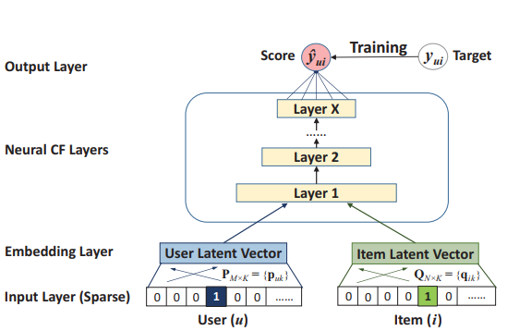
Introduction | typical recommendation algorithm | NCF | TransR | GCN | Conclusion
Neural Collaborative Filtering
nonlinear relationships and complex patterns
better scalability and adaptability
handle large-scale data and cold start problems
High performance in multiple recommendation system competitions

Slide 11
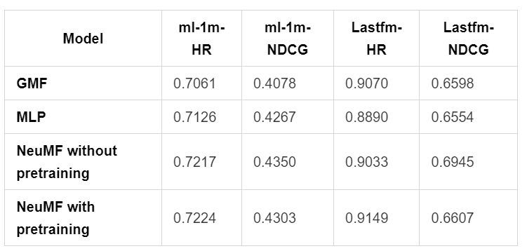
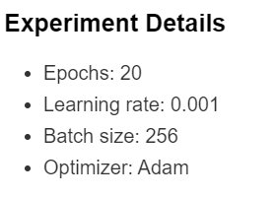
Introduction | typical recommendation algorithm | NCF | TransR | GCN | Conclusion
Experiment Results

Slide 12
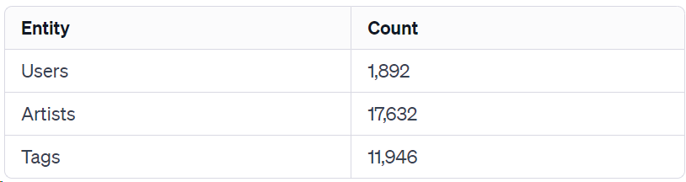
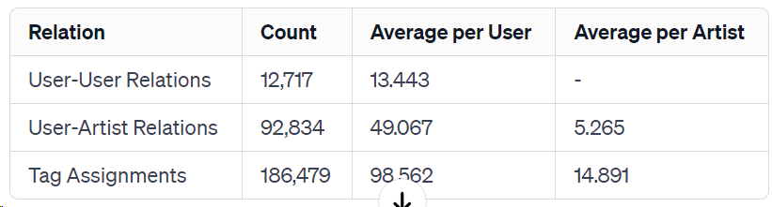
Introduction | typical recommendation algorithm | NCF | TransR | GCN | Conclusion
LastFM Dataset
Notes:
So, what is LM? LM is the language models. We can define a LM model as P-Sita-x, where Sita is parameters and x is the input word sequences. Here we only talk about autoregressive LM models. We give 2 examples. x1: I like to eat hamburgers and x2: I like to eat pop music. Obviously, we need P-Sita-x1 greater than P-Sita-x2.

Slide 13
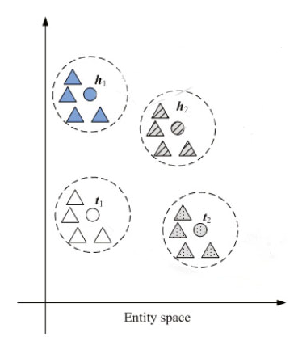
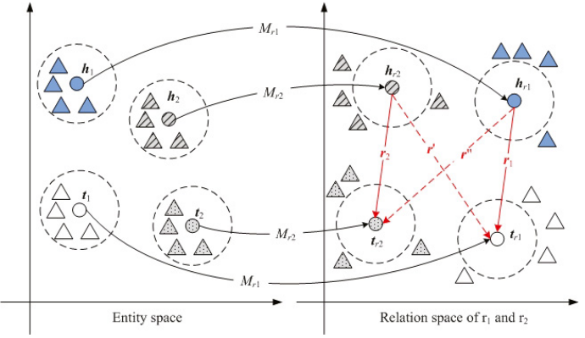
Introduction | typical recommendation algorithm | NCF | TransR | GCN | Conclusion
Entity Embedding & Projection
Step 1: embed entities into Entity space
Entity
Embedded vector
Relation1 vector
Relation2 vector
Step 2: project onto Relation space
Notes:
So, what is LM? LM is the language models. We can define a LM model as P-Sita-x, where Sita is parameters and x is the input word sequences. Here we only talk about autoregressive LM models. We give 2 examples. x1: I like to eat hamburgers and x2: I like to eat pop music. Obviously, we need P-Sita-x1 greater than P-Sita-x2.

Slide 14
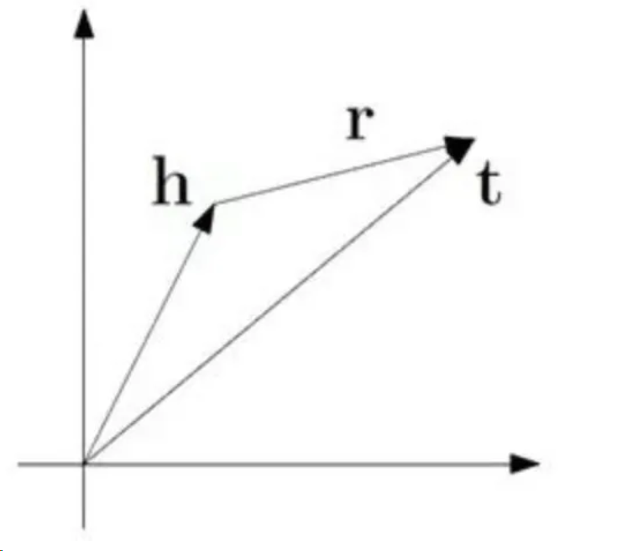
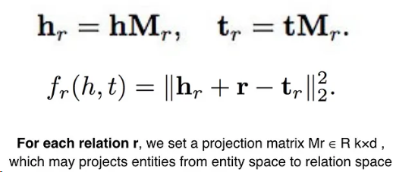
Introduction | typical recommendation algorithm | NCF | TransR | GCN | Conclusion
Representation Learning — Translate Model
Head | Relation | Tail
Pompon | Listen to | Jay Chou
Pompon | Friend | Anny
Anny | Friend | Joseph
TranR = Translate + Relation
In the relation space
Notes:
So, what is LM? LM is the language models. We can define a LM model as P-Sita-x, where Sita is parameters and x is the input word sequences. Here we only talk about autoregressive LM models. We give 2 examples. x1: I like to eat hamburgers and x2: I like to eat pop music. Obviously, we need P-Sita-x1 greater than P-Sita-x2.

Slide 15
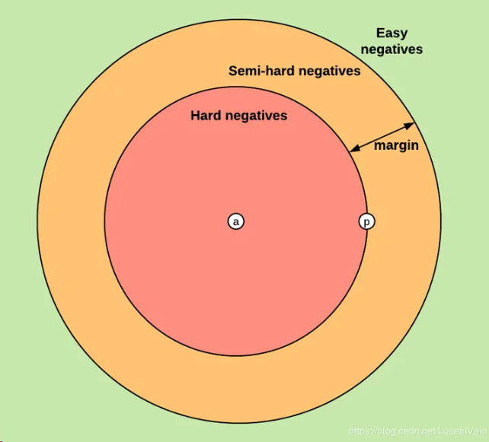
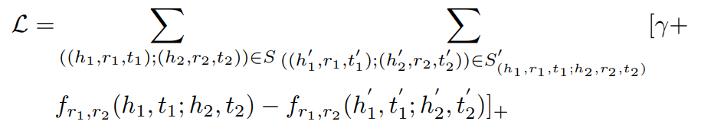
Introduction | typical recommendation algorithm | NCF | TransR | GCN | Conclusion
Margin Loss and Negative Sampling
 | Positive | Negative
Head | Pompon | Pompon
Relation | Listen to | Listen to
Tail | Jay Chou | Drake, Taylor Swift……
A tradeoff between recall and precision!
Notes:
So, what is LM? LM is the language models. We can define a LM model as P-Sita-x, where Sita is parameters and x is the input word sequences. Here we only talk about autoregressive LM models. We give 2 examples. x1: I like to eat hamburgers and x2: I like to eat pop music. Obviously, we need P-Sita-x1 greater than P-Sita-x2.

Slide 16
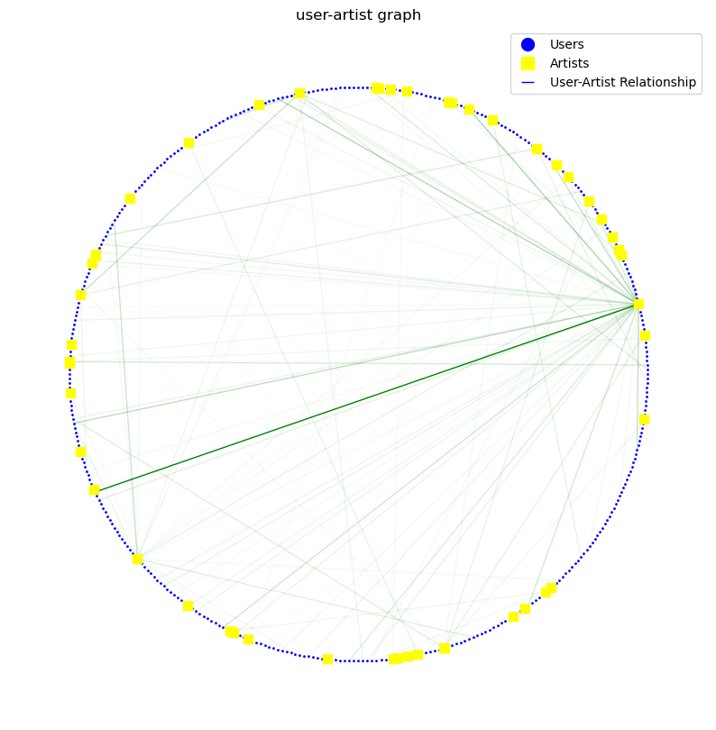
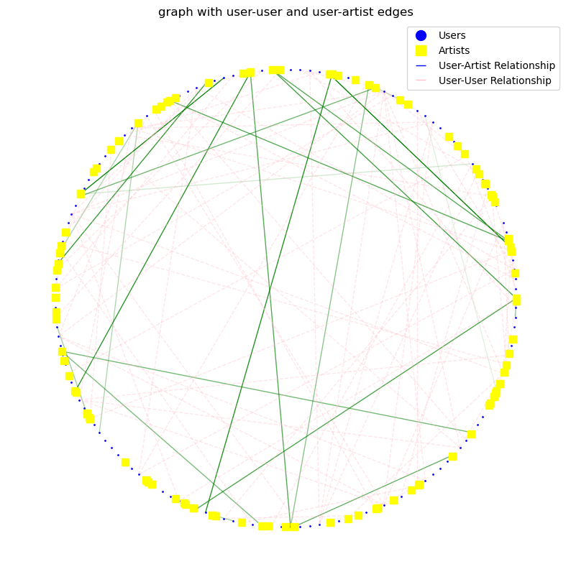
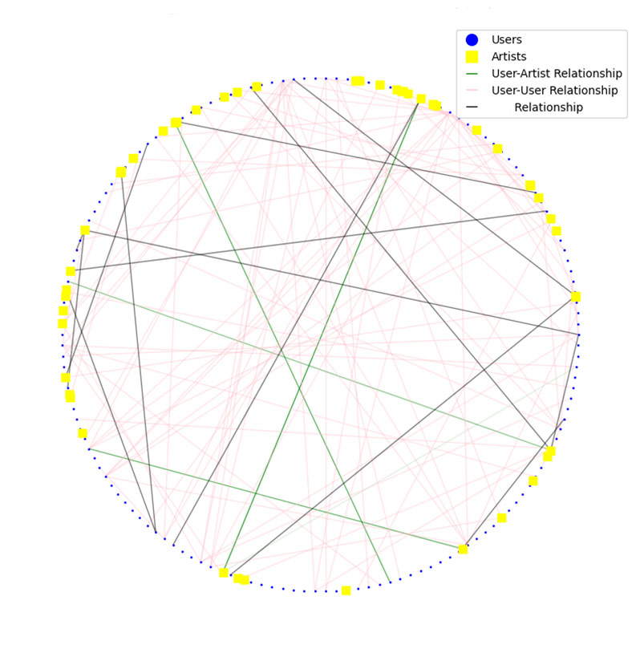
Introduction | typical recommendation algorithm | NCF | TransR | GCN | Conclusion
Result Visualization and Problems
Dimension Disaster
Hard to express continuous relationship
Notes:
So, what is LM? LM is the language models. We can define a LM model as P-Sita-x, where Sita is parameters and x is the input word sequences. Here we only talk about autoregressive LM models. We give 2 examples. x1: I like to eat hamburgers and x2: I like to eat pop music. Obviously, we need P-Sita-x1 greater than P-Sita-x2.

Slide 17
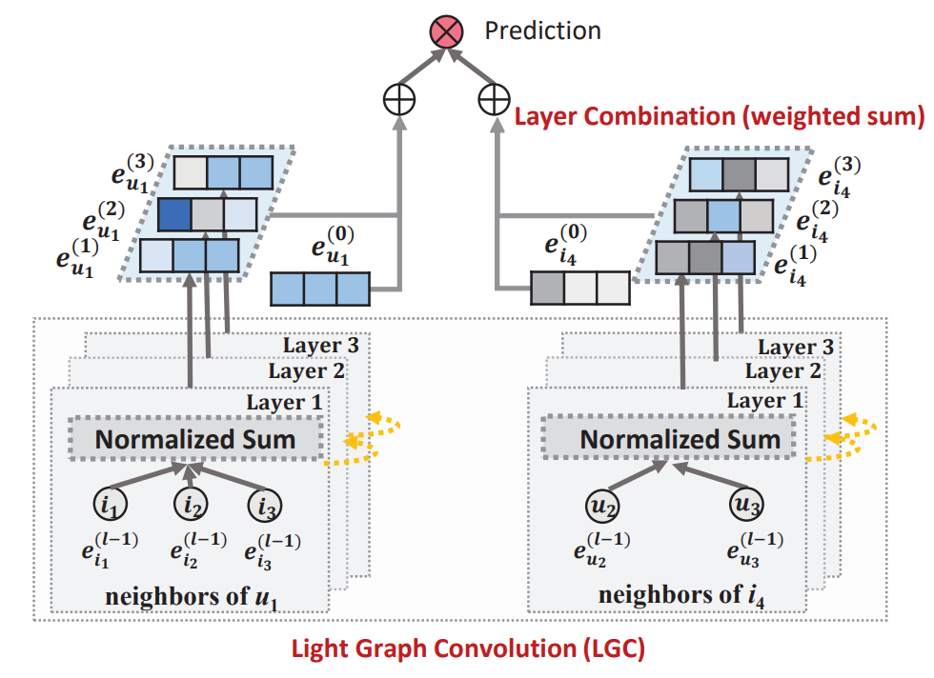
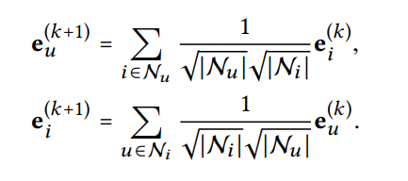
Introduction | typical recommendation algorithm | NCF | TransR | GCN | Conclusion
graph neural network-based recommendation algorithms
LightGCN :Simplifying and Powering Graph Convolution Network for Recommendation
The paper analyzed NGCF and found that feature transformations and non-linear activations did not benefit collaborative filtering tasks. Surprisingly, removing these elements actually improved model performance. Consequently, the paper introduced a new structure, LightGCN, containing only the basic structure of GCN—neighborhood aggregation—for collaborative filtering.
The graph convolution operation in LightGCN
Notes:
So, what is LM? LM is the language models. We can define a LM model as P-Sita-x, where Sita is parameters and x is the input word sequences. Here we only talk about autoregressive LM models. We give 2 examples. x1: I like to eat hamburgers and x2: I like to eat pop music. Obviously, we need P-Sita-x1 greater than P-Sita-x2.

Slide 18
Introduction | typical recommendation algorithm | NCF | TransR | GCN | Conclusion
graph neural network-based recommendation algorithms
- Regarding the handling of the ml-1m dataset, in summary, we grouped the user-movie-rating pairs in rating.dat by user and transformed them into the format user-[movie1, movie2,...].
- For processing the last-fm dataset, apart from similar processing to ml-1m, we needed to include additional data regarding relationships between users. This data was present in user_friends.dat and was imported into the model along with the rest of the data.
Notes:
So, what is LM? LM is the language models. We can define a LM model as P-Sita-x, where Sita is parameters and x is the input word sequences. Here we only talk about autoregressive LM models. We give 2 examples. x1: I like to eat hamburgers and x2: I like to eat pop music. Obviously, we need P-Sita-x1 greater than P-Sita-x2.

Slide 19
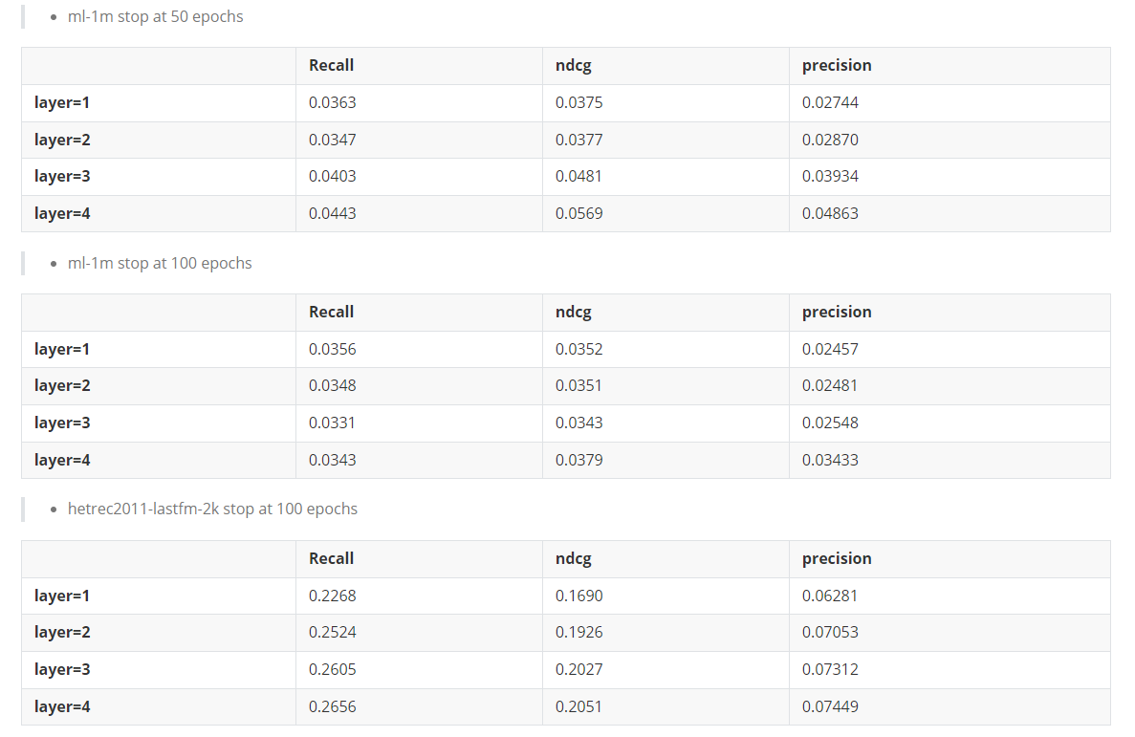
Introduction | typical recommendation algorithm | NCF | TransR | GCN | Conclusion
graph neural network-based recommendation algorithms
all metrics is under :
topks=20
decay=1e-4
learning rate=0.001
seed=2020
recdim=32
Notes:
So, what is LM? LM is the language models. We can define a LM model as P-Sita-x, where Sita is parameters and x is the input word sequences. Here we only talk about autoregressive LM models. We give 2 examples. x1: I like to eat hamburgers and x2: I like to eat pop music. Obviously, we need P-Sita-x1 greater than P-Sita-x2.

Slide 20
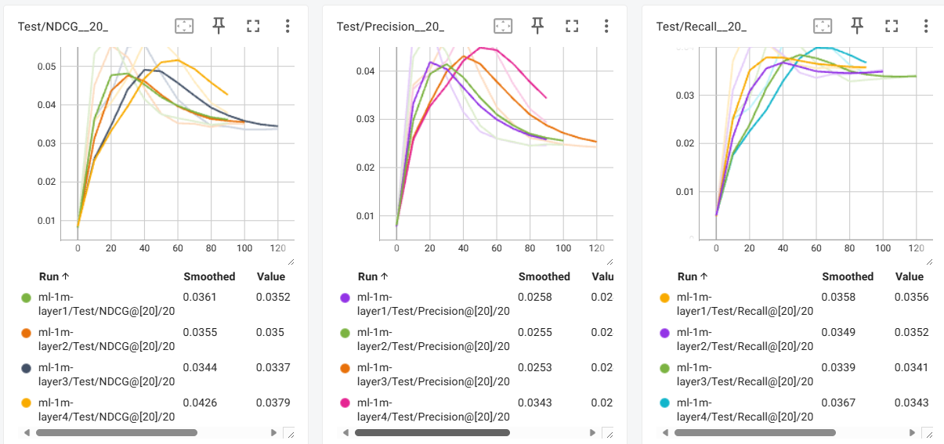
Introduction | typical recommendation algorithm | NCF | TransR | GCN | Conclusion
ML-1M Result
Notes:
So, what is LM? LM is the language models. We can define a LM model as P-Sita-x, where Sita is parameters and x is the input word sequences. Here we only talk about autoregressive LM models. We give 2 examples. x1: I like to eat hamburgers and x2: I like to eat pop music. Obviously, we need P-Sita-x1 greater than P-Sita-x2.

Slide 21
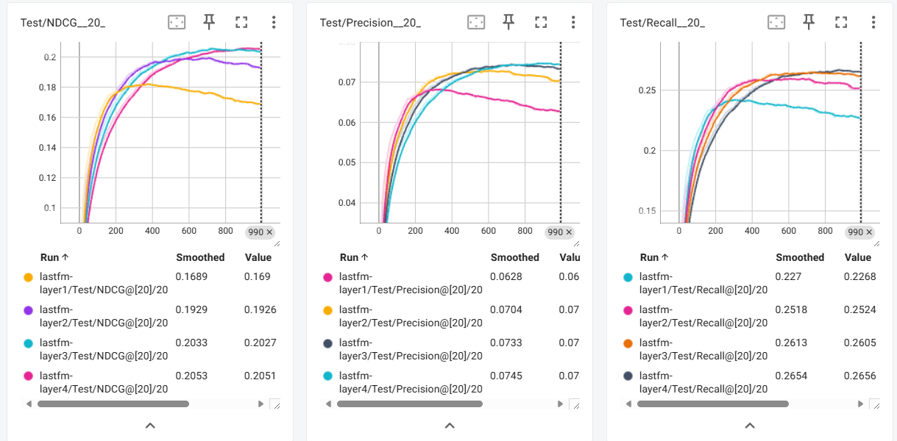
Introduction | typical recommendation algorithm | NCF | TransR | GCN | Conclusion
LastFM Result
Notes:
So, what is LM? LM is the language models. We can define a LM model as P-Sita-x, where Sita is parameters and x is the input word sequences. Here we only talk about autoregressive LM models. We give 2 examples. x1: I like to eat hamburgers and x2: I like to eat pop music. Obviously, we need P-Sita-x1 greater than P-Sita-x2.

Slide 22
Thanks

