Slide 1


Week 4 Workshop:
Sensors and Actuators
3707ICT Automation and IoT

Slide 2
From Reading Pins to Sensing and Acting
In Week 3 your board read a button and drove an LED. This week it measures the real world and acts on it.
Learning outcomes
Sensors: explain what a sensor is and classify its output signal
Signals: tell digital, analog, PWM and protocol devices apart
Reading: get temperature and humidity from a DHT22 into the ESP32
Actuators: drive a servo, and know when a driver or relay is needed
Automation: build rule-based control from one and many conditions
The loop you will build
Environment
→ Sensor (DHT22)
→ Microcontroller (ESP32)
→ Control logic
→ Actuator (servo)
→ Environment
Learn a concept, then build it: five hands-on tasks grow into one system — connect → read → attach → automate → extend.

Slide 3
Workshop Roadmap
Part | Topic | What you take away
A | Sensors and actuators | What each one does, and how they pair up
B | Signals and the DHT22 | Digital vs analog, the ADC, and this week's sensor
C | Tasks 1–2 | Wire the DHT22, then read it every two seconds
D | Actuators and the servo | On/off, PWM, and how a servo takes its position
E | Task 3 | Attach the servo to the same circuit
F | Control logic + Tasks 4–5 | Thresholds, hysteresis and rule-based automation
Each block of theory is followed straight away by the task that uses it — all in Wokwi, no physical hardware needed.

Slide 4
The Three Blocks of an Embedded System
Every automation system in this course is a variation on this chain.
signal
data
command
Physical
environment
Sensor
measures it
Microcontroller
decides
Actuator
acts on it
the action changes the environment — and the sensor measures it again
Sensor side
Physical quantity → electrical signal the ESP32 can read.
Actuator side
Control signal → a physical change in the environment.
Input can also come from a user (buttons, an app) or from the network (Wi-Fi, MQTT).

Slide 5
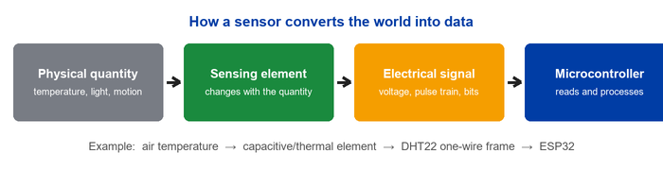
What Is a Sensor?
A sensor detects or measures a physical quantity and converts it into a signal an electronic system can process.
Quantity | Typical sensor | Quantity | Typical sensor
Temperature / humidity | DHT22, BME280 | Motion | PIR
Light | LDR, photodiode | Distance | Ultrasonic, ToF
Acceleration / rotation | MPU6050 | Sound, image | Microphone, camera

Slide 6
What Is an Actuator?
An actuator takes a control signal from the microcontroller and produces a physical change in the environment.
Motion
DC motor, stepper
Position
Servo motor
Switching
Relay, solid-state relay
Light
LED, lamp
Sound
Buzzer, speaker
Flow / heat
Solenoid valve, heater
A transducer converts one form of energy into another. A sensor is an input transducer; an actuator is an output transducer.

Slide 7
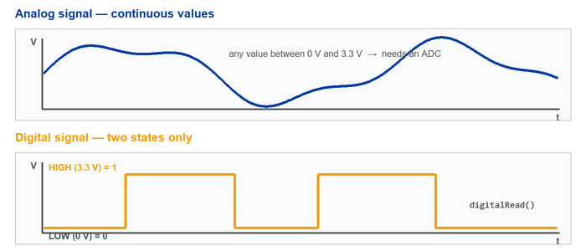
Analog and Digital Signals
Digital
Two valid states only.
Read directly with digitalRead().
Immune to small voltage noise.
Analog
Any value in the range.
Needs an ADC to become a number.
Noise changes the reading.
The DHT22 is digital, but with its own one-wire protocol — not a simple HIGH/LOW pin.

Slide 8
Reading a Sensor with a Microcontroller
If the sensor is… | You use… | In code
Two-state digital | A GPIO pin in INPUT mode | digitalRead(PIN)
Analog voltage | An ADC channel | analogRead(PIN) → 0 … 4095
Vendor protocol | A driver library that handles the timing | dht.readTemperature()
A bus device (I²C / SPI) | The bus peripheral plus a library | Wire.begin(), SPI.begin()
Why Task 1 installs two libraries
The DHT22 encodes 40 bits as pulse widths on a single wire, with timing measured in microseconds.
DHT sensor library decodes that frame; Adafruit Unified Sensor is the shared base class it depends on. Without both, the sketch will not compile.

Slide 9
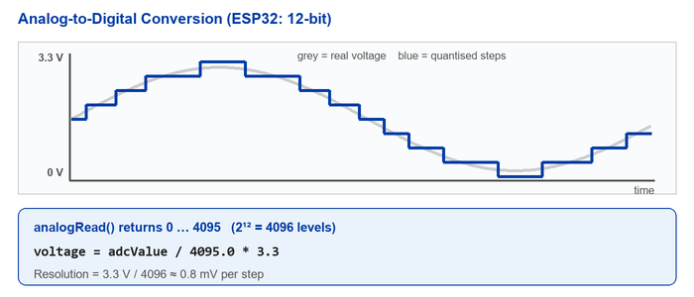
ADC — Turning a Voltage into a Number
On the ESP32
12-bit ADC → 0 … 4095
Reference ≈ 3.3 V
ADC1 (GPIO 32–39) keeps working while Wi-Fi is on
ADC2 conflicts with Wi-Fi
Worked example
Reading = 2048
2048 / 4095 × 3.3 ≈ 1.65 V

Slide 10
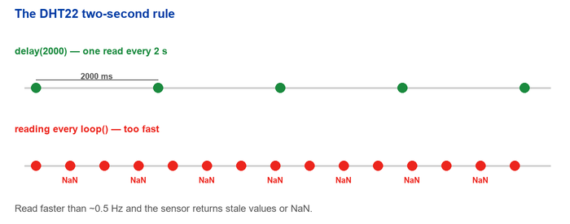
The DHT22 — This Week's Sensor
Property | Reference value
Supply | ≈ 3–5 V
Temperature range | ≈ −40 … 80 °C
Humidity range | ≈ 0 … 100 % RH
Signal | Digital, single-wire vendor protocol
Minimum read interval | ≈ 2 seconds (≈ 0.5 Hz)
Pins (bare sensor) | VCC, DATA, NC, GND
One read every two seconds — no faster
Two practical rules
Read no faster than once every 2 s — otherwise you get a stale value or NaN. Every sketch this week calls delay(2000).
A bare DHT22 needs a 4.7–10 kΩ pull-up on DATA; breakout modules and the Wokwi part already include it.

Slide 11
Before You Wire Anything
Five questions
Is the device digital, analog, PWM or on a bus?
Does it use I²C, SPI, UART or its own protocol?
Is the signal pin 3.3 V or 5 V?
Does it need a pull-up or pull-down resistor?
Do I have enough pins, timers and ADC channels?
Logic level
The ESP32 runs at 3.3 V logic.
For a 5 V output, use a divider, a level shifter, or pick a 3.3 V module.
Current
A GPIO pin carries a signal, not power.
Never power motors, pumps, solenoids, bare relay coils or several servos straight from a pin.
Two supplies? Then tie the grounds together, unless they are properly isolated.

Slide 12
The Five Tasks — One System, Built Up in Stages
Task | What you add | New hardware | New code
1 | Connect a DHT22 and initialise it | DHT22 on GPIO 15 | DHT.h, dht.begin()
2 | Read and display values every 2 s | — (same circuit) | readTemperature(), isnan()
3 | Attach a servo motor | Servo on GPIO 13 | ESP32Servo.h, attach()
4 | One rule: open the vent above 30 °C | — (same circuit) | if / else, myServo.write()
5 | Three states from two measurements | — (same circuit) | if / else if / else, &&, ||
Every task reuses the previous circuit. Baud rate is 115200 throughout, and every sketch waits 2000 ms between DHT22 reads.

Slide 13
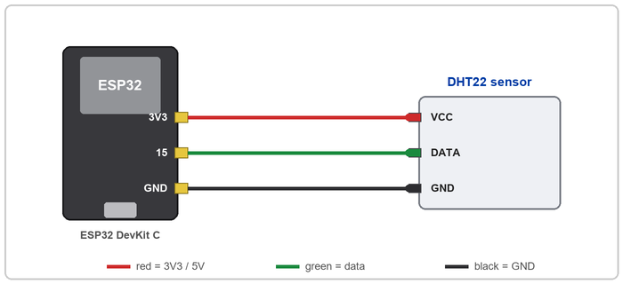
Task 1 — Connect the DHT22
DHT22 | ESP32
VCC | 3V3
DATA / SDA | GPIO 15
GND | GND
Libraries to install
DHT sensor library
Adafruit Unified Sensor
Both by Adafruit. The Wokwi part includes the pull-up.
Wire colours match the project file: red = 3V3, green = data, black = GND.
Serial Monitor at 115200 baud.

Slide 14
Task 1 — The Sketch
#include <DHT.h>
#define DHTPIN 15
#define DHTTYPE DHT22
DHT dht(DHTPIN, DHTTYPE);
void setup() {
Serial.begin(115200);
delay(1000);
Serial.println("Initializing DHT22 sensor...");
dht.begin();
Serial.println("DHT22 sensor initialized.");
}
void loop() {
// Sensor readings will be added in Task 2
}
Line by line
#define DHTPIN 15
names the data pin.
DHT dht(DHTPIN, DHTTYPE);
creates the driver object.
dht.begin();
prepares the pin and its timing.
loop() stays empty — readings arrive in Task 2.
Success looks like
Initializing DHT22 sensor...
DHT22 sensor initialized.
A compile error means a library is missing.

Slide 15
Task 2 — Read and Display the Values
void loop() {
delay(2000);
float humidity = dht.readHumidity();
float temperature = dht.readTemperature();
if (isnan(humidity) || isnan(temperature)) {
Serial.println("Failed to read from "
"DHT22 sensor!");
return;
}
Serial.print("Humidity: ");
Serial.print(humidity, 2);
Serial.print("% | Temperature: ");
Serial.print(temperature, 2);
Serial.println(" °C");
}
How it works
delay(2000)
respects the sensor's minimum interval.
||
either invalid value aborts the cycle.
return
leaves loop() early; Arduino calls it again.
print(value, 2)
gives two decimal places.
Serial Monitor shows
Humidity: 50.00% |
Temperature: 24.00 °C
…or, on a bad read:
Failed to read from DHT22

Slide 16
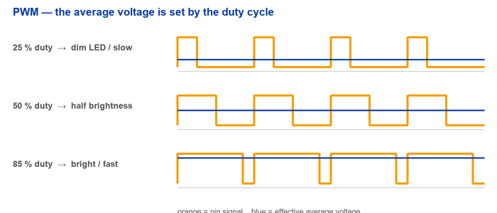
Driving an Actuator: On/Off, or Anywhere In Between
Duty cycle
The fraction of each period the pin spends HIGH.
0 % = off, 100 % = fully on.
Used for LED brightness, motor speed and heater power.
digitalWrite(PIN, HIGH); // fully on
digitalWrite(PIN, LOW); // fully off
ledcWrite(channel, duty); // anywhere between
The pin only ever outputs 0 V or 3.3 V — switching fast enough makes the average behave like an in-between voltage.

Slide 17
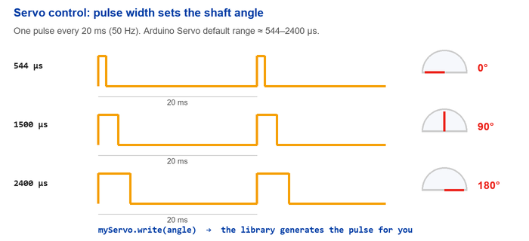
Servo Motors — Position from Pulse Width
Inside a servo
Gearbox
Control circuit
Position feedback sensor
Output shaft, ≈ 0–180°
Three wires
Red = power
Black / brown = GND
Yellow / orange = signal
A servo pulse is not the same as analogWrite() — both use PWM, but the servo reads pulse width, not duty cycle.

Slide 18
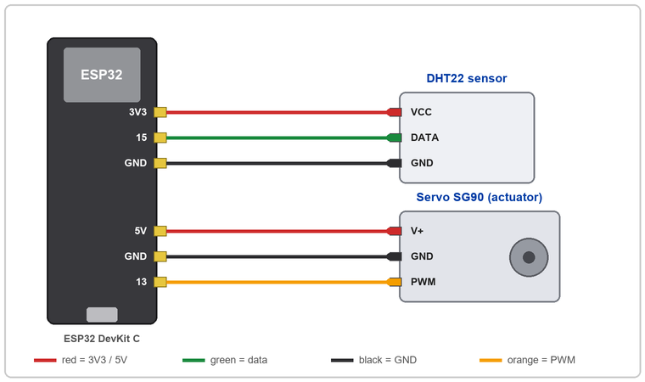
Task 3 — Add the Servo Motor
Device | Pin | ESP32
DHT22 | VCC | 3V3
DHT22 | DATA | GPIO 15
DHT22 | GND | GND
Servo | V+ | 5V
Servo | GND | GND
Servo | PWM | GPIO 13
New in the sketch
#include <ESP32Servo.h>
Servo myServo;
myServo.attach(13);
Both devices share the ESP32 ground — that is what makes the signals mean anything.

Slide 19
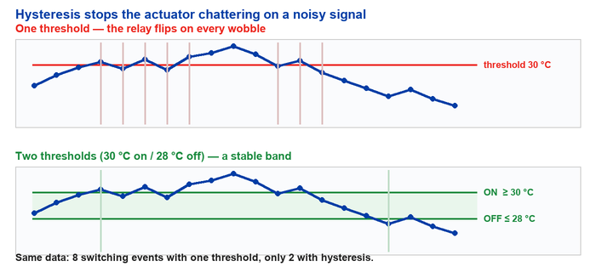
Thresholds and Hysteresis
The problem
A real signal wobbles around the threshold.
A single threshold makes the actuator switch on every wobble — noisy, and hard on a relay or servo.
Fix: switch on at one value and off at a lower one.
The Week 4 notes use 30 °C on / 28 °C off as the worked example of a hysteresis band.

Slide 20
Task 4 — One Rule, One Decision
Objective
Above 30 °C the vent opens to 90°; at or below it, the vent closes to 0°.
Temperature | Servo | Meaning
> 30 °C | 90° | Vent open
≤ 30 °C | 0° | Vent closed
const float TEMP_THRESHOLD = 30.0;
if (temperature > TEMP_THRESHOLD) {
myServo.write(90); // vent open
} else {
myServo.write(0); // vent closed
}
Closed loop at last
The DHT22 measures, the ESP32 decides, the servo acts — and the next reading sees the result.
The isnan() guard from Task 2 still runs first — never let invalid data reach the decision.

Slide 21
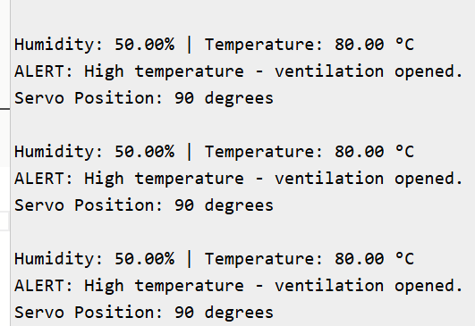
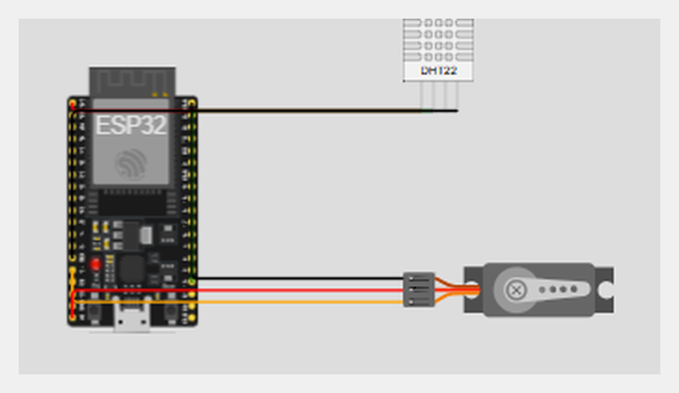
Task 4 — Testing and Expected Result
How to test in Wokwi
Start the simulation.
Click the DHT22 part.
Drag the temperature slider above 30 °C.
Confirm the alert message and the servo at 90°.
Drag it back to 30 °C or below.
Confirm the normal message and the servo at 0°.
Above the threshold: alert, then servo 90°
Below the threshold
System normal - ventilation closed.
Servo Position: 0 degrees
The servo driven to the open position

Slide 22
Task 5 — Multiple Conditions
Replace the single threshold with a decision engine that weighs temperature and humidity together.
State | Condition | Servo | Operating mode
A — Critical high | temp > 35.0 || hum > 80.0 | 180° | Maximum speed mode
B — Warning moderate | temp > 28.0 && hum > 50.0 | 90° | Standard ventilation mode
C — Safe | neither condition is true | 0° | Standby idle mode
|| — OR
Either condition alone triggers the critical state.
&& — AND
Both must be true before the warning state applies.

Slide 23
Task 5 — The Decision Engine
float hum = dht.readHumidity();
float temp = dht.readTemperature();
// isnan() guard, then the [Sensor Scan] line
if (temp > 35.0 || hum > 80.0) {
myServo.write(180);
Serial.println("STATUS: CRITICAL HIGH"
" - Maximum speed mode");
Serial.println("Servo Position: 180 degrees");
} else if (temp > 28.0 && hum > 50.0) {
myServo.write(90);
Serial.println("STATUS: WARNING MODERATE"
" - Standard ventilation mode");
Serial.println("Servo Position: 90 degrees");
} else {
myServo.write(0);
Serial.println("STATUS: SAFE"
" - Standby idle mode");
Serial.println("Servo Position: 0 degrees");
}
Why the order matters
else if only runs when the test above it was false.
At 36 °C and 90 % RH both conditions are true — checking critical first is what makes the servo go to 180° instead of 90°.
Always test the most severe state first.
Variables are named temp and hum, as the task requires.

Slide 24
Common Problems and How to Fix Them
Symptom | Likely cause | Fix
DHT22 returns NaN | Wrong pin, no pull-up, read too fast | Check wiring; keep the interval ≥ 2 s
Nothing in the Serial Monitor | Baud rate mismatch | Set the monitor to 115200
Sketch will not compile | A library is missing | Install DHT, Unified Sensor and ESP32Servo
ESP32 resets when the servo moves | Supply cannot deliver the current | Separate 5 V supply, common ground
Servo jitters constantly | Noisy supply or unstable pulses | Add a capacitor; check the signal wire
Relay works backwards | The module is active-low | Invert HIGH and LOW
Actuator switches on and off rapidly | Signal wobbling on one threshold | Add hysteresis — two thresholds

Slide 25
Extension Challenges — and Where We Go Next
Build on this week
Replace delay(2000) with a non-blocking millis() timer.
Add hysteresis: open at 30 °C, close only below 28 °C.
Swap the servo for a relay and invert the logic for an active-low module.
Map temperature onto a continuous servo angle instead of three steps.
Go further
Add an LDR on an ADC pin and only ventilate during the day.
Add a PIR and hold the vent closed when the room is empty.
Print a CSV line per cycle and plot it from the Serial Monitor.
Publish the readings over Wi-Fi, connecting back to Week 2.
You can now read a sensor, validate its data, and drive an actuator from your own rule.
Next week: Automation Systems and Control Concepts.

