Slide 1
Time-Based Memory Coherence
Alan Mujumdar

Slide 2
Hypotheses
Cache coherence without coherence messaging
Time-based coherence
Runs existing software
Competitive performance
Complies with
RMO consistency
Offers cache
side-channel masking

Slide 3
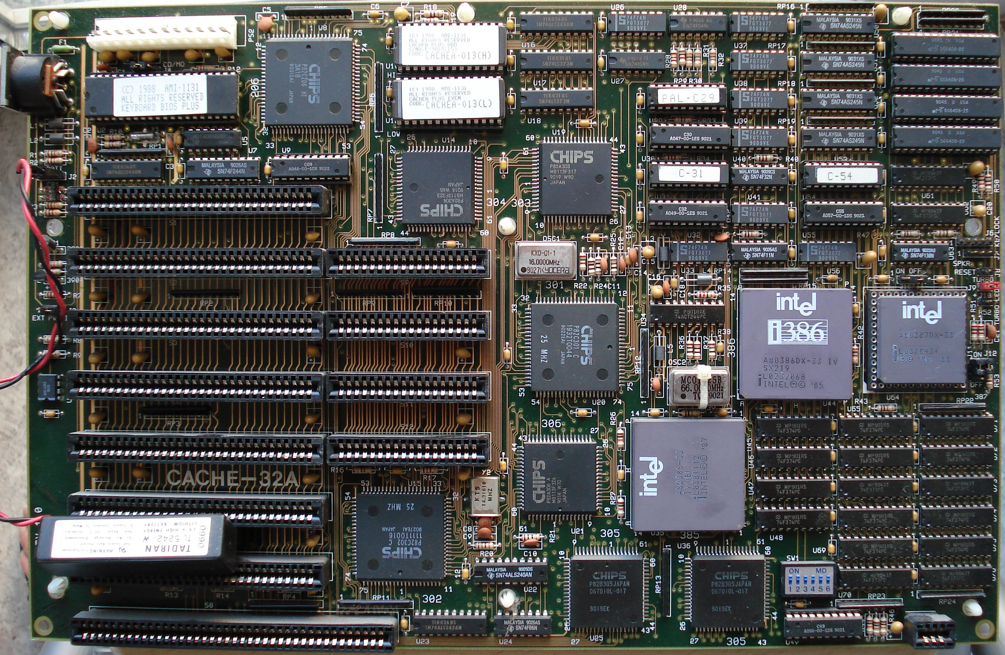
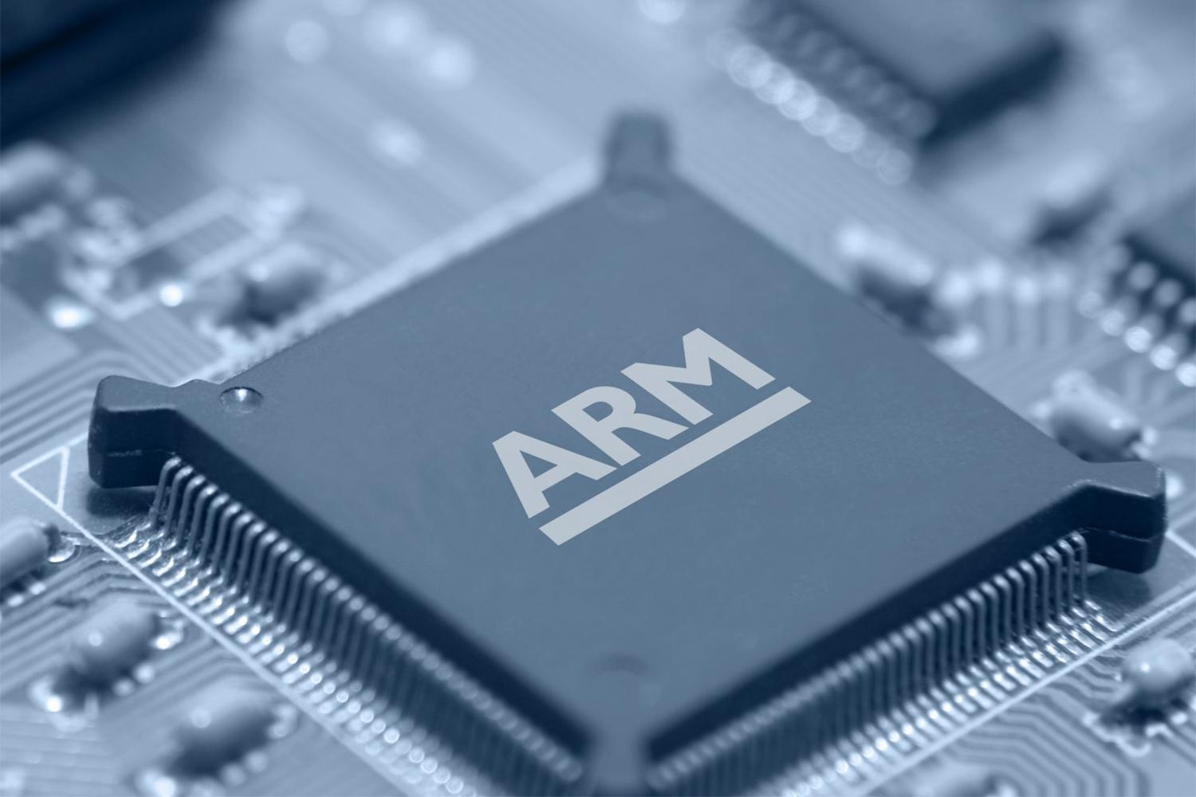
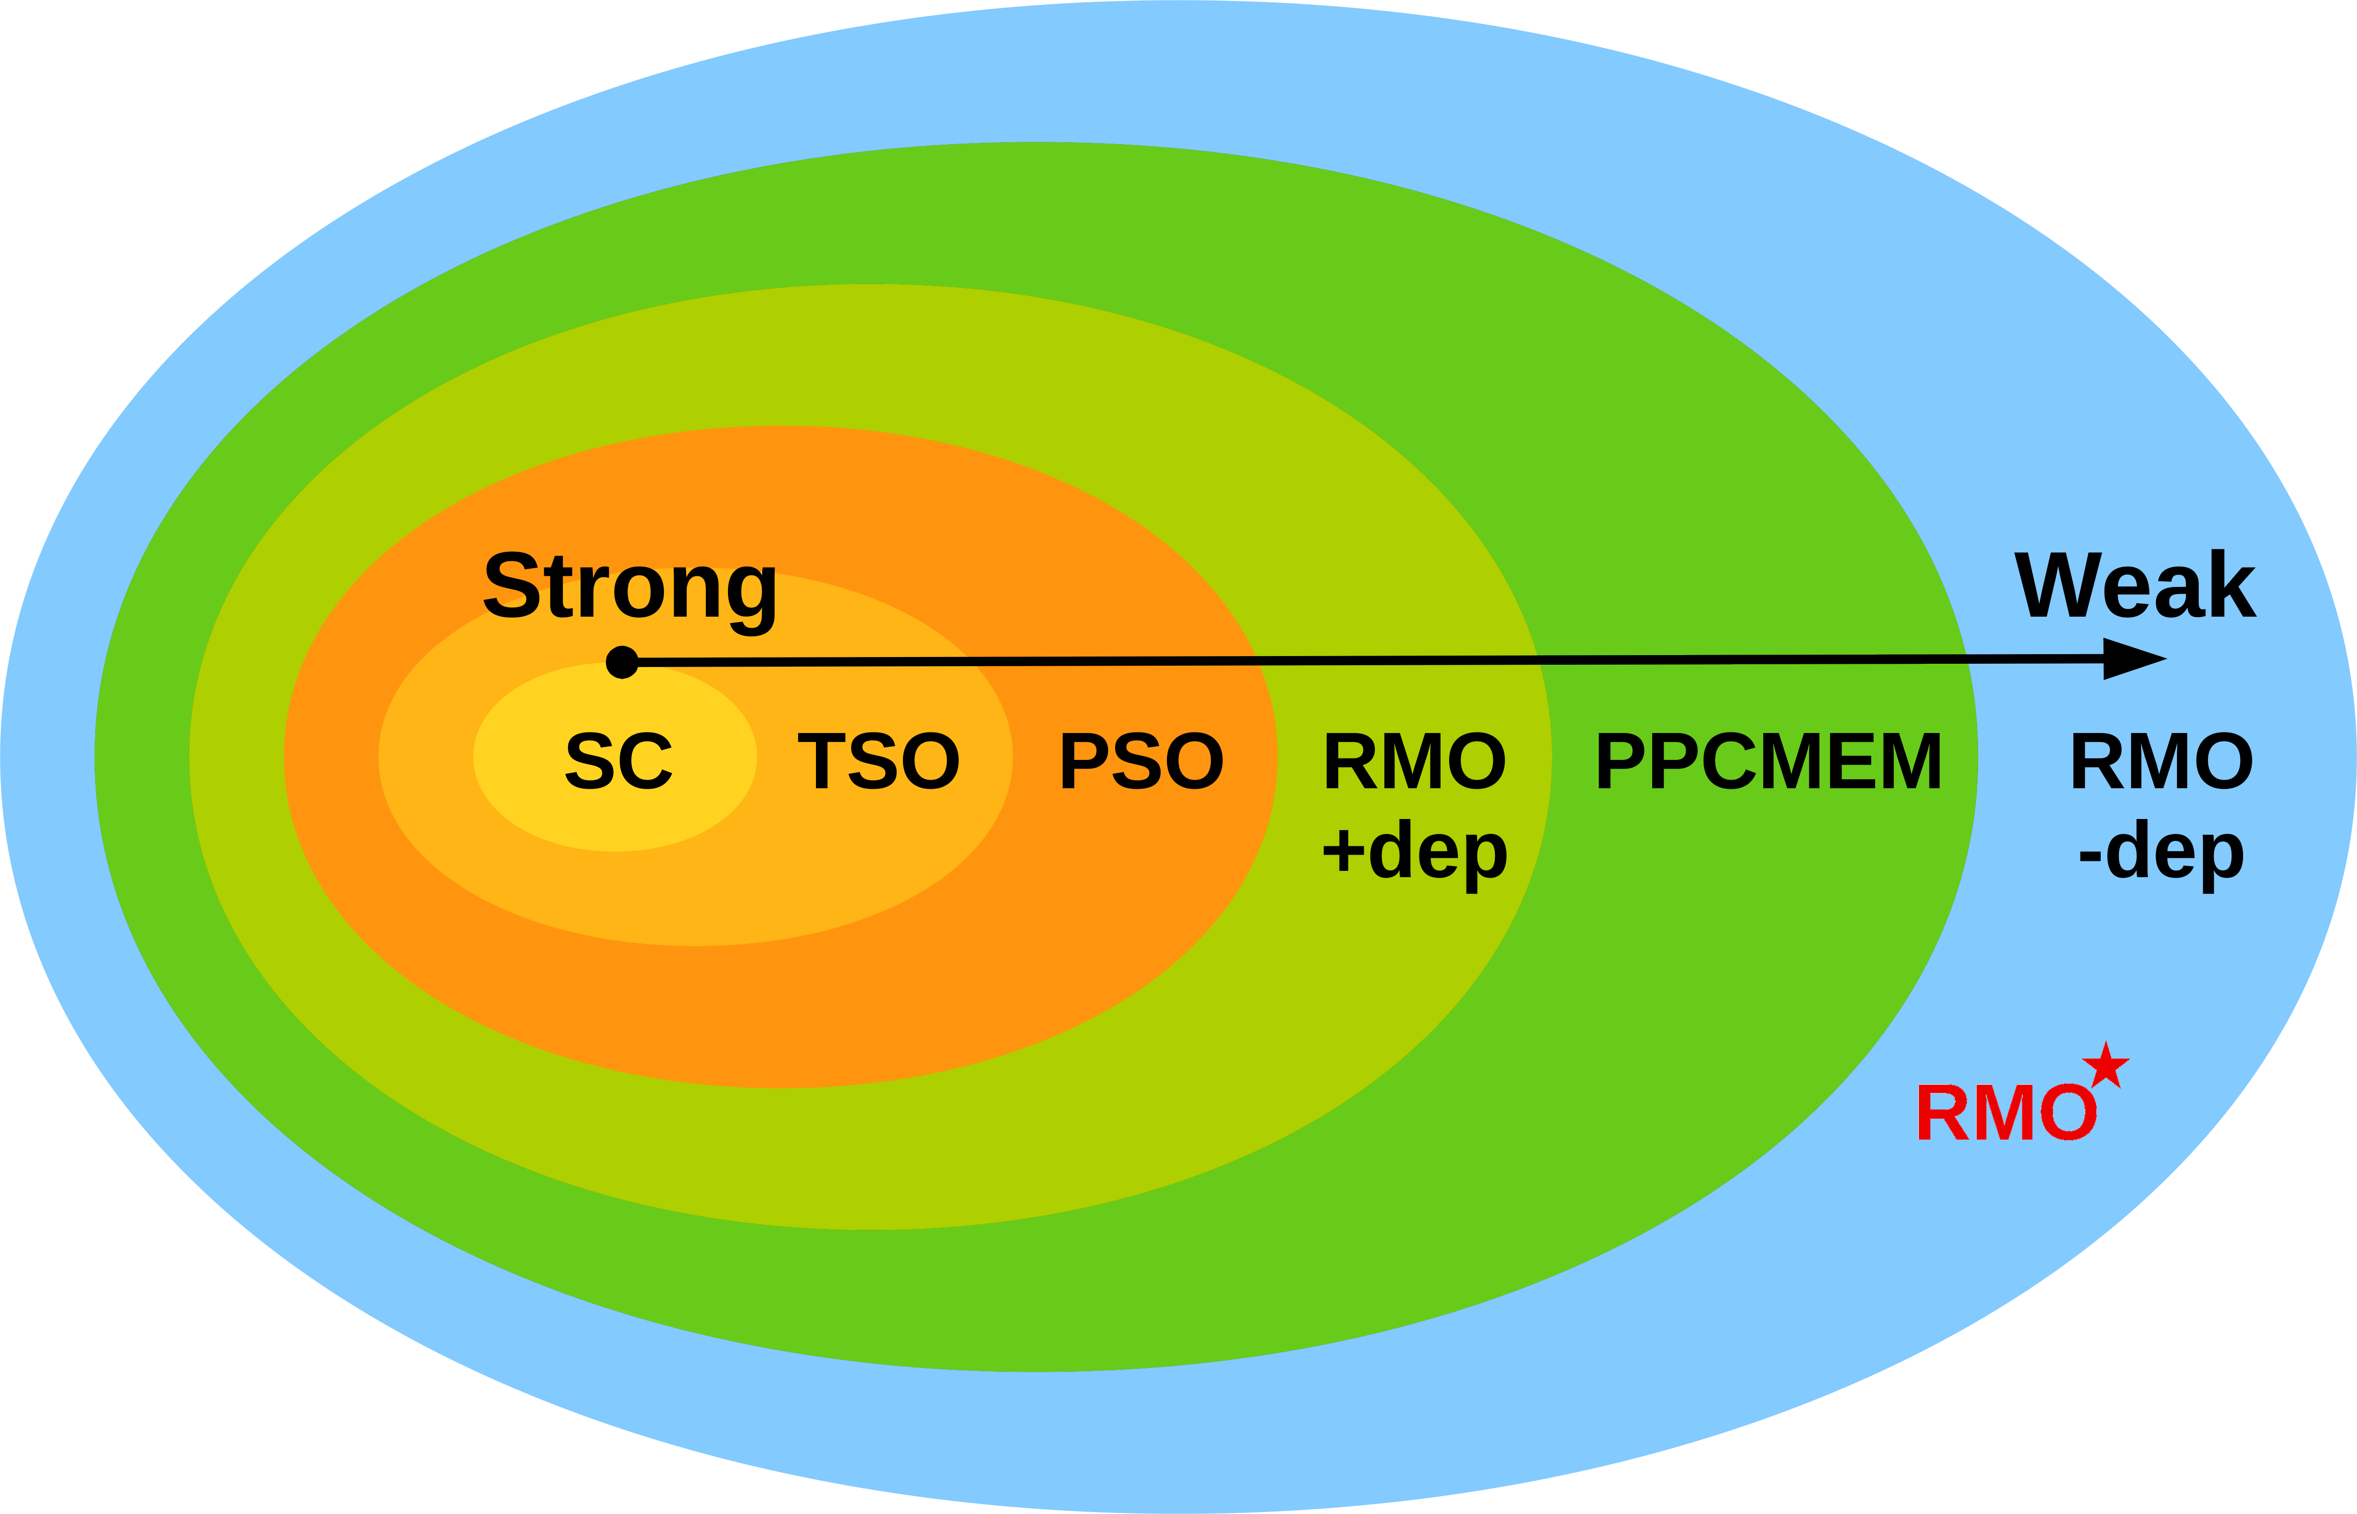
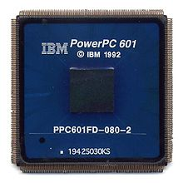
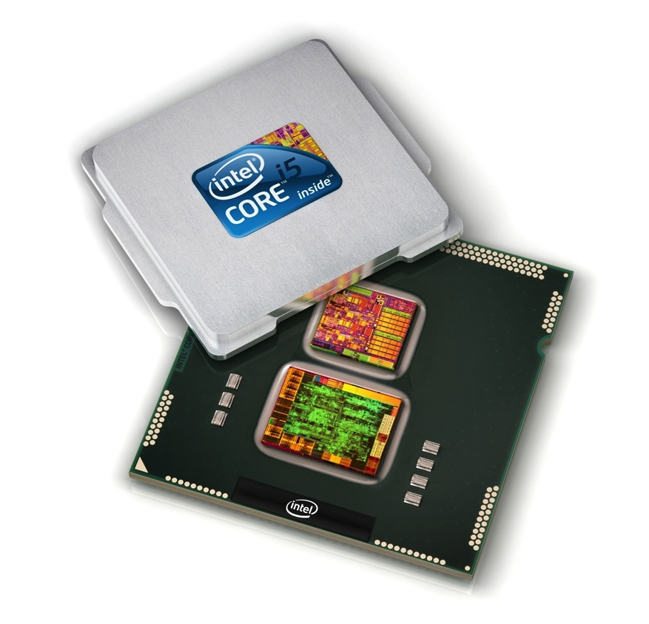
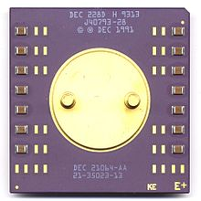
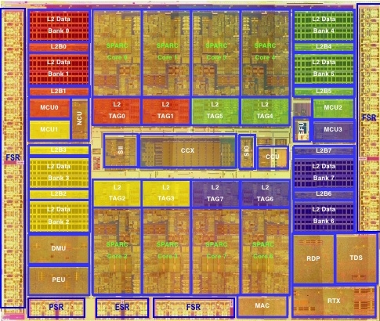
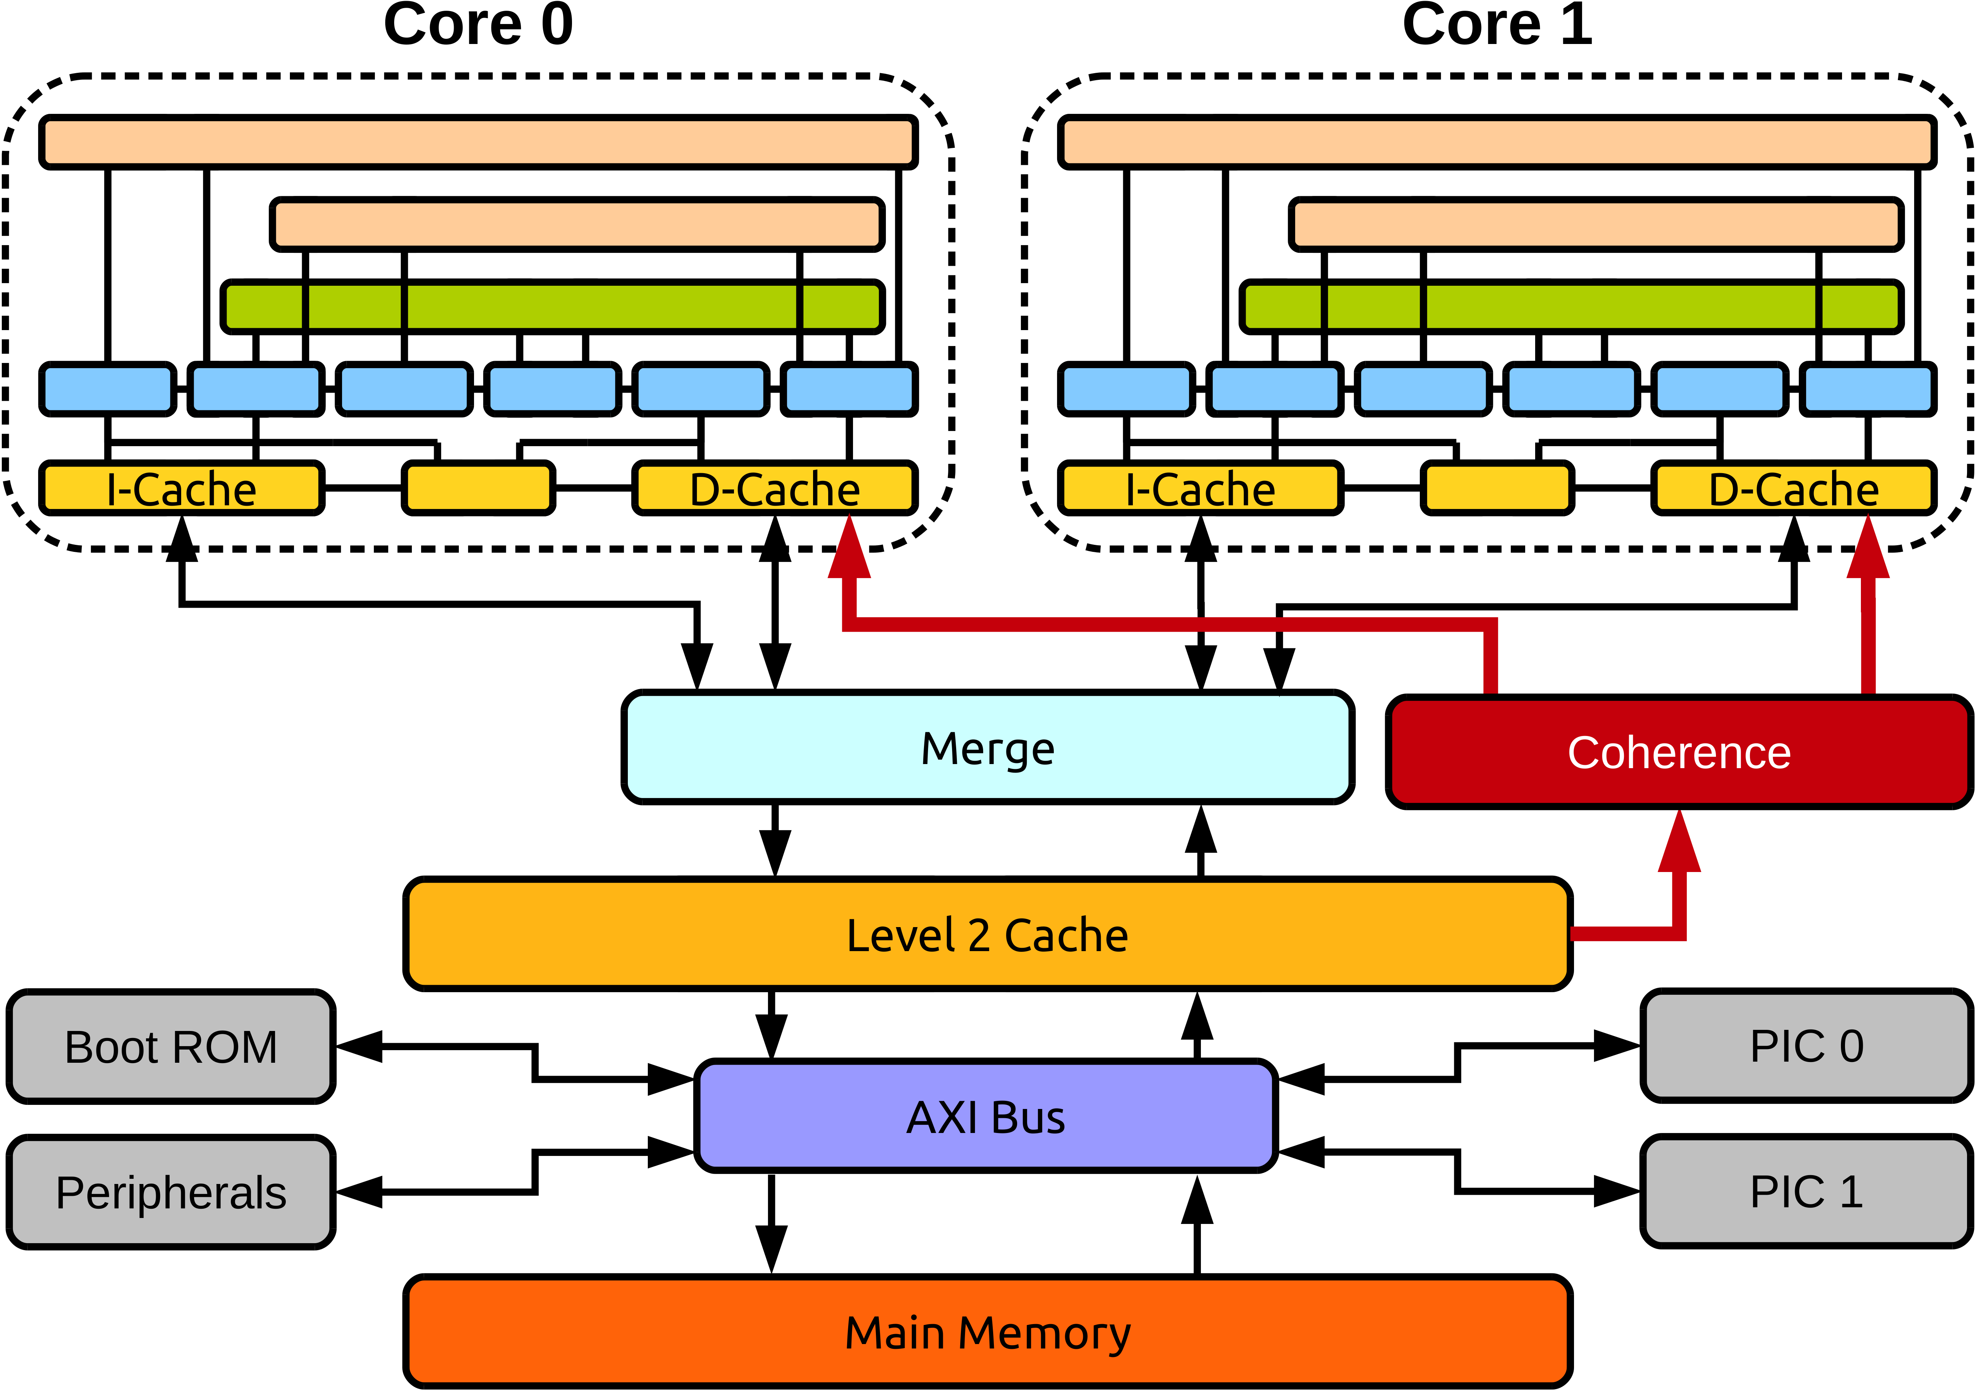
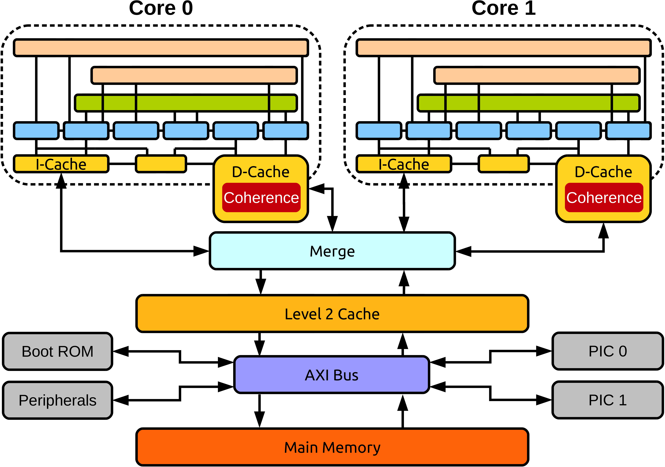
Memory Consistency
Dual 386
ARM
PowerPC
Intel x86
DEC Alpha
SPARC TSO
BERI: Directory
BERI: Time-Based
Notes:
RMO +dep isn't actually a subset of PPCMEM.
They are both somewhat orthogonal.
RMO(star) should not be in a separate oval.
Instead it should just be some text.

Slide 4
BERI Deliverables
Time-based
Novel approach
Directory-based
Baseline performance
Running FreeBSD OS
  Testing: CHERI-Test, AXE, CHERI Litmus
  Evaluation: FreeBSD, Splash-2, CHERI Litmus
  Additional evaluation: side-channel attacks

Slide 5
Time-Based Coherence
  Each cache line has a lifespan – timer imposed
  Reading an expired line causes a reload
  Synchronisation instructions soft-flush the cache
Memory consistency
compliance
Frequent SYNCs
degrade performance
Software agnostic
progress guarantee
Memory communication
overheads
No shared memory
storage overheads
Private cache
storage overheads

Slide 6
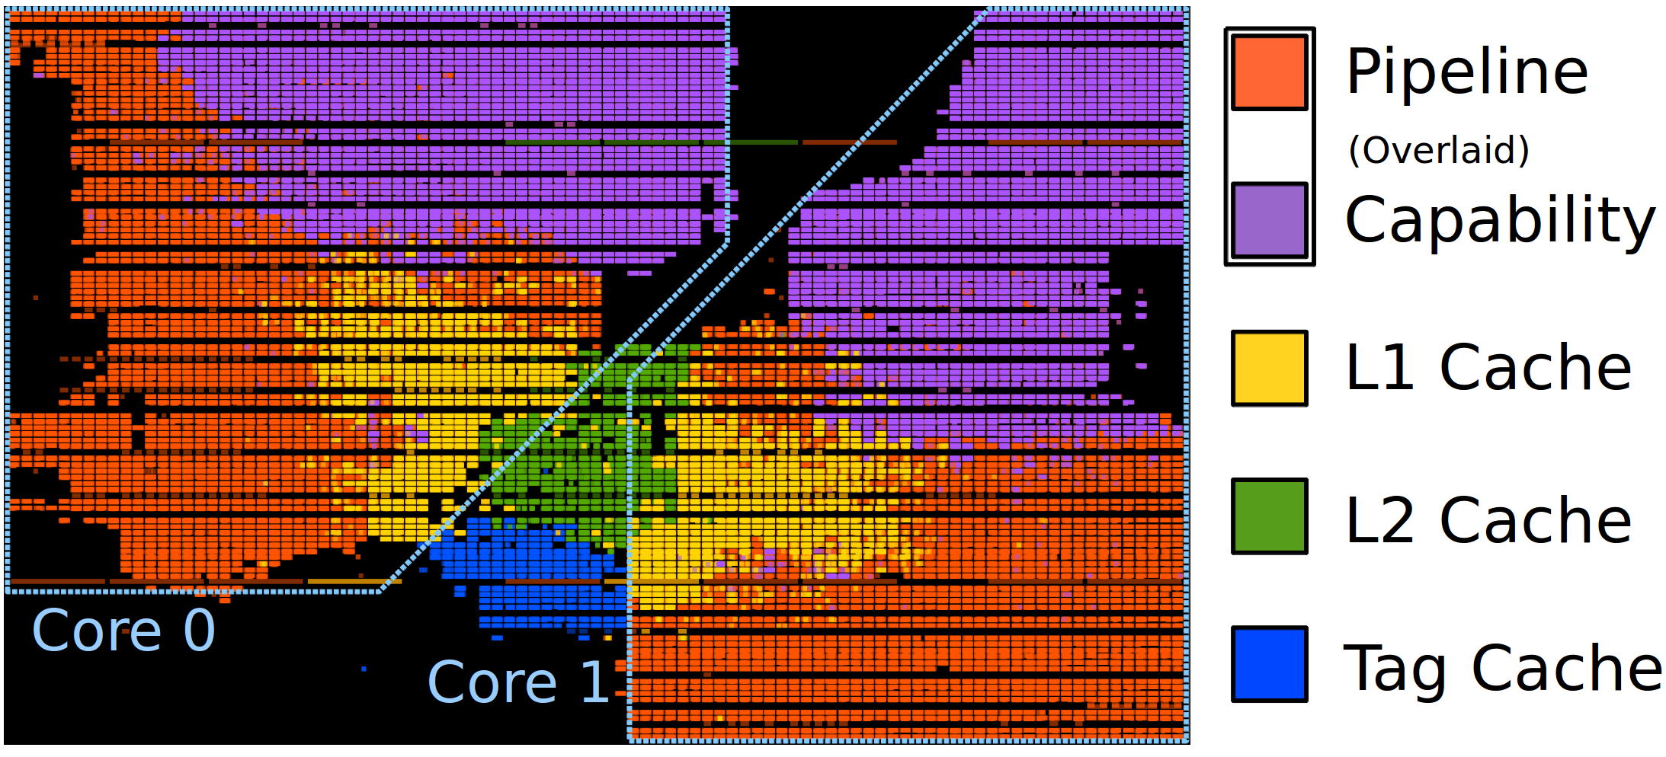
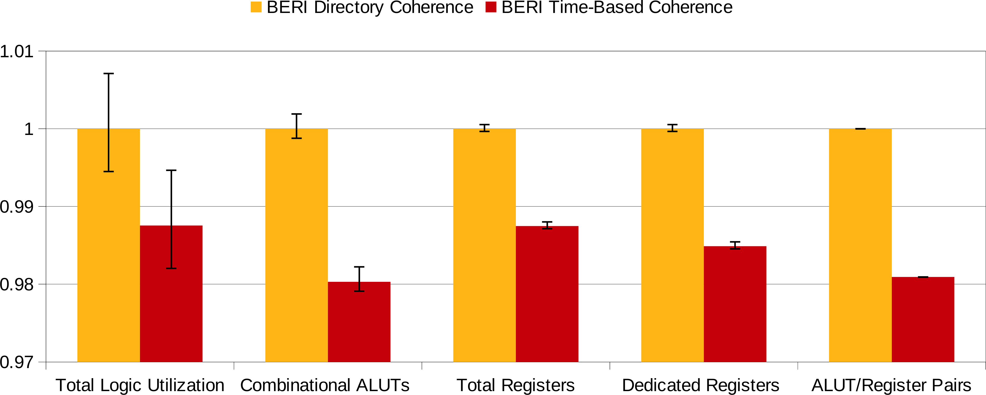
FPGA Complexity
Synthesis
Overheads

Slide 7
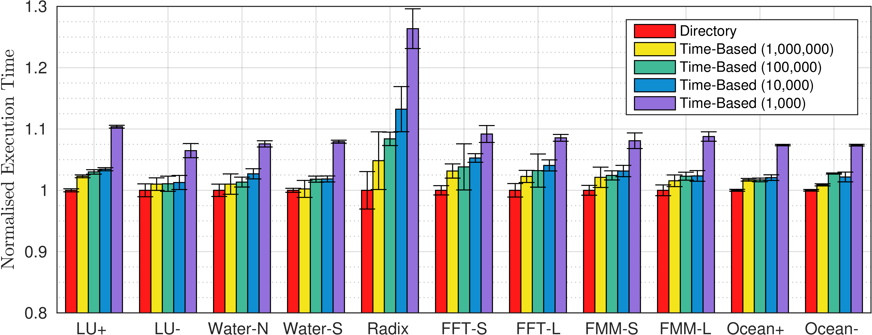
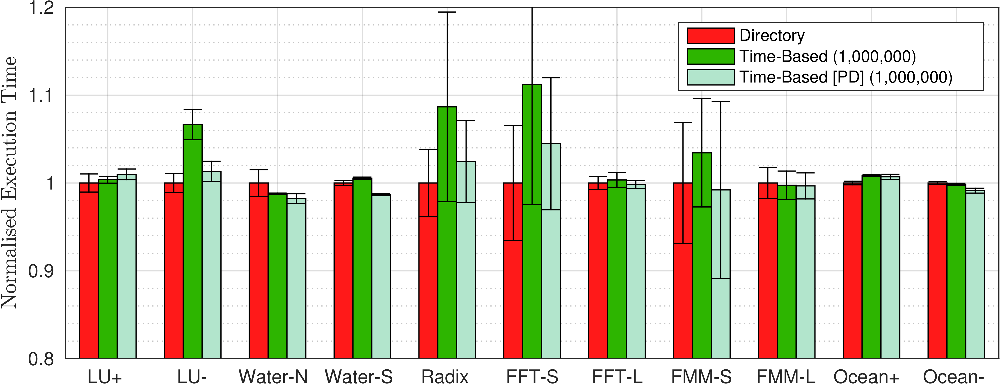
Results
  Performance
  Optimisation
  Workload
  Cache size
  Scalability
  Energy
  Simplicity
2 software threads
16 software threads
Splash-2 Benchmarks

Slide 8
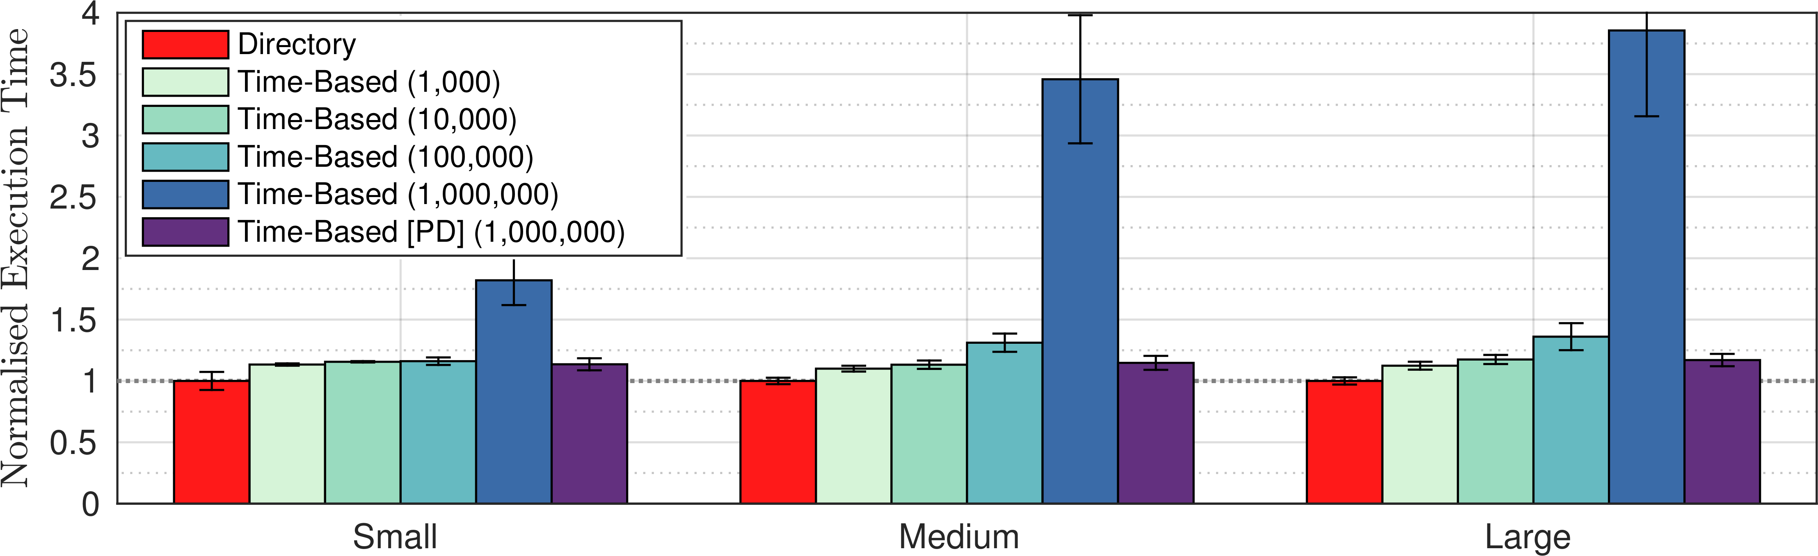
Results
CP on FreeBSD
Polling hampers the
time-based model
Dataset Size
Splash-2
Polling detection is
still beneficial

Slide 9
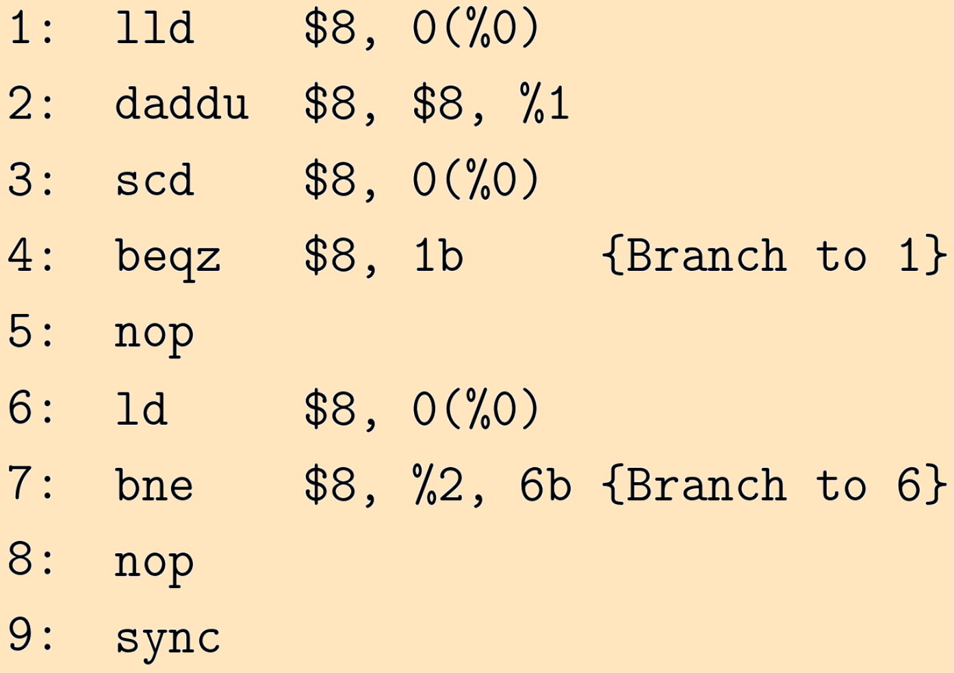
Time-Based – Polling Detection
No polling detector
LL/SC loop
L2 cache access
Polling loop
L1 cache access
Possible stale data
No issues for hardware supporting strong memory consistency

Slide 10
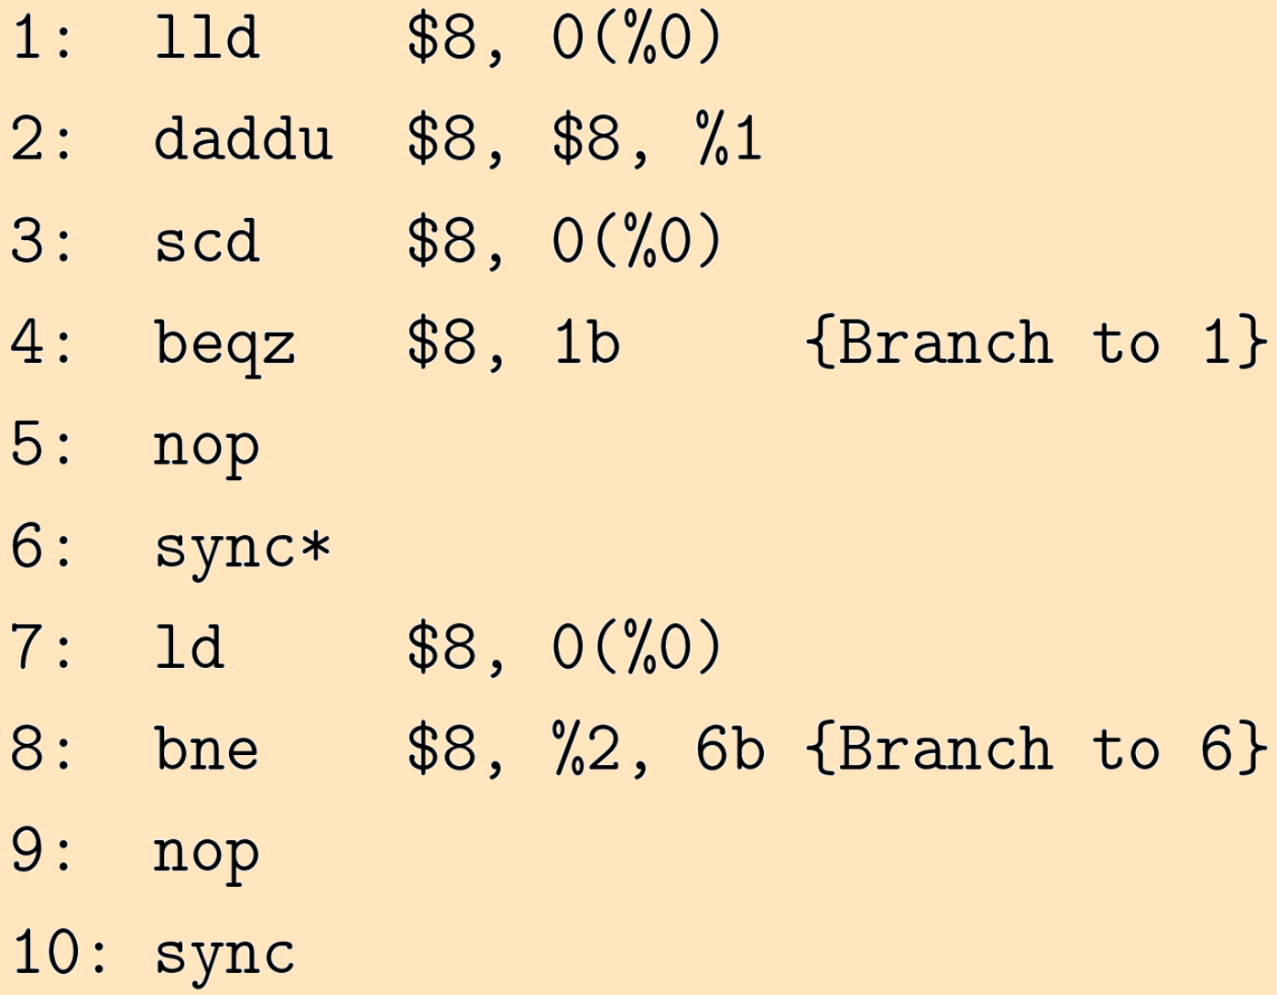
Time-Based – Polling Detection
No polling detector
LL/SC loop
L2 cache access
Polling loop
L1 cache flush
L2 cache access
No stale data
Software solution for time-based coherence polling issue

Slide 11
Time-Based – Polling Detection
Polling detector used
LL/SC loop
L2 cache access
Polling loop
L1 cache access
Read to unmodified
data detected
L2 cache access
Hardware solution for time-based coherence polling issue

Slide 12
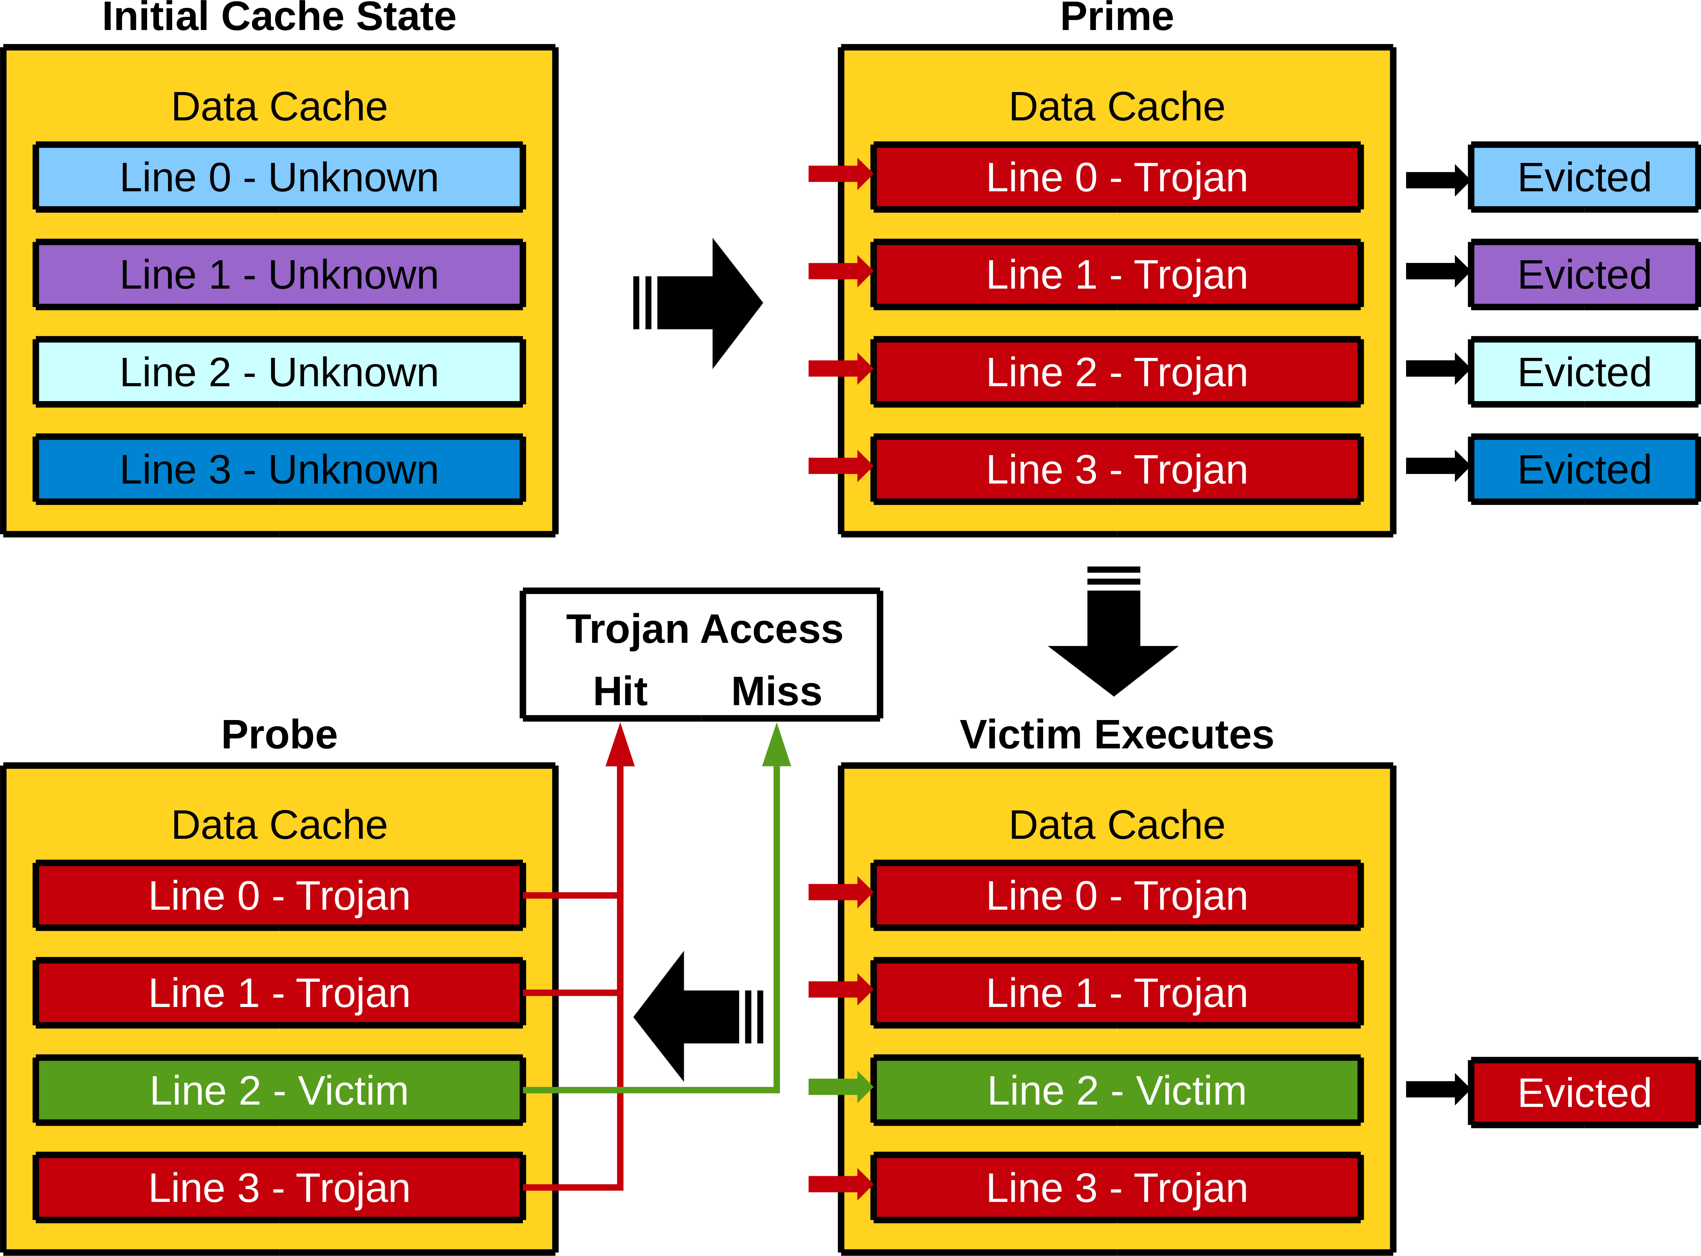
Cache Side-Channel Attacks

Slide 13
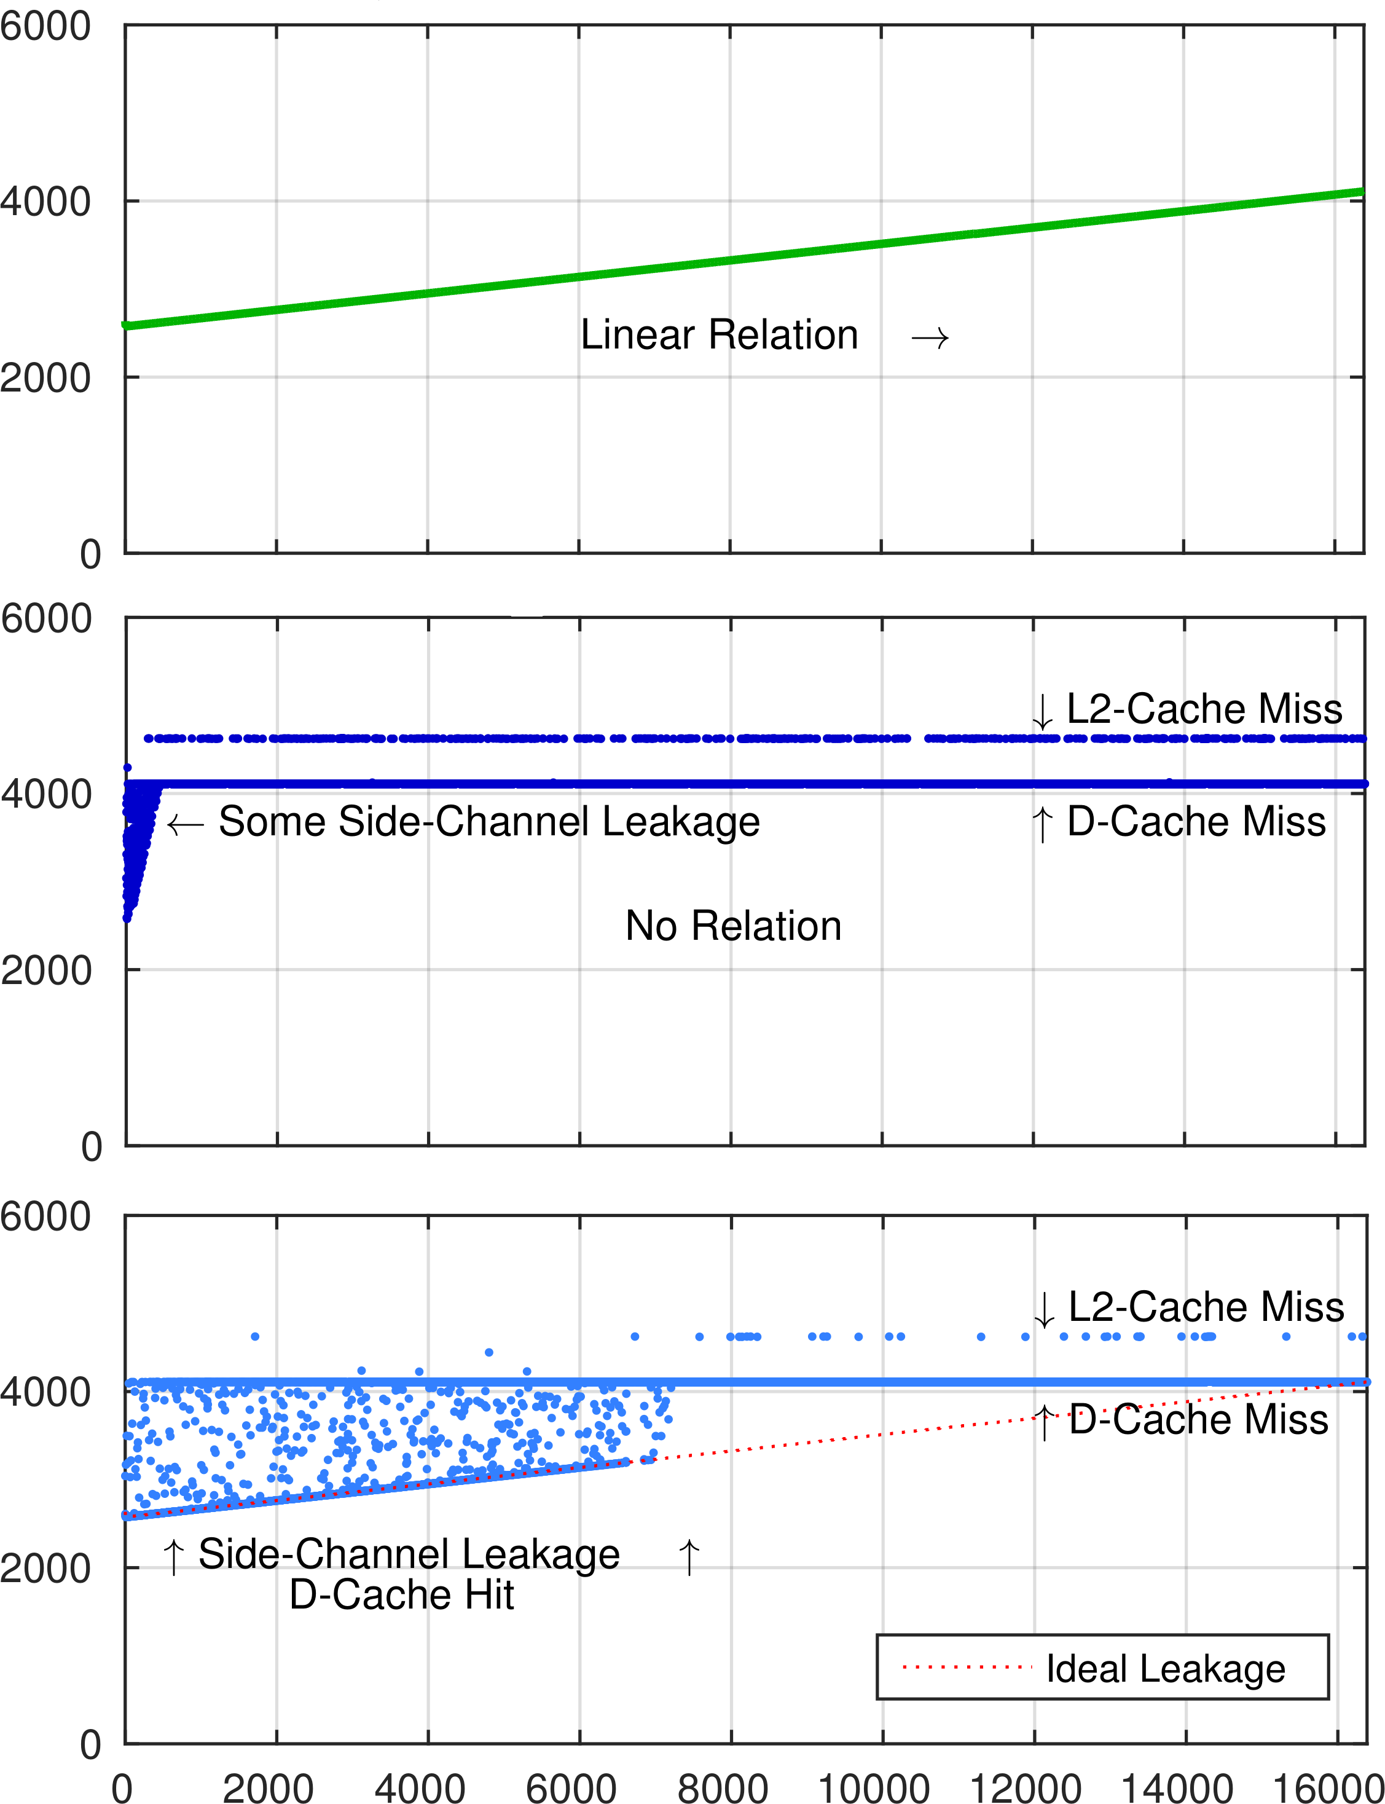
Cache Side-Channel Attacks
  Directory-base coherence
Displays ideal leakage
  Time-base coherence
Time-out: 10,000 cycles
Trojan memory access latency
Frequent self-invalidates
  Time-base coherence
Time-out: 100,000 cycles
Less frequent self-invalidates
Victim dataset size

Slide 14
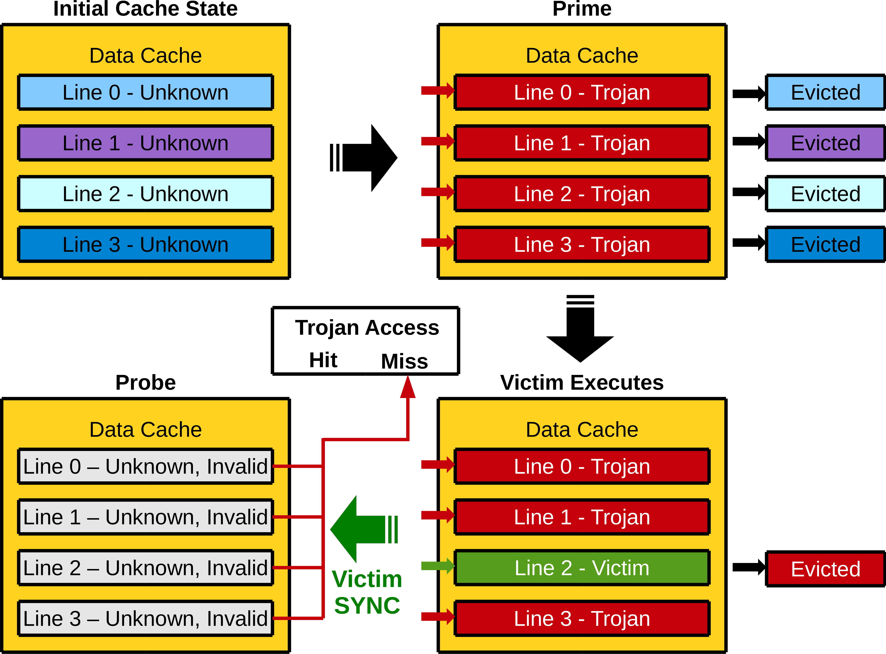
Cache Side-Channel Attacks

Slide 15
Conclusion
  Coherence without messaging
  Time-based self-invalidation works
  FreeBSD runs time-based coherence
  Performance can be competitive
  Provides side-channel masking
Two BERI
multiprocessor
designs
Bringing up
FreeBSD on
multi-BERI
BERI
testing

Slide 16
Additional Slides

Slide 17
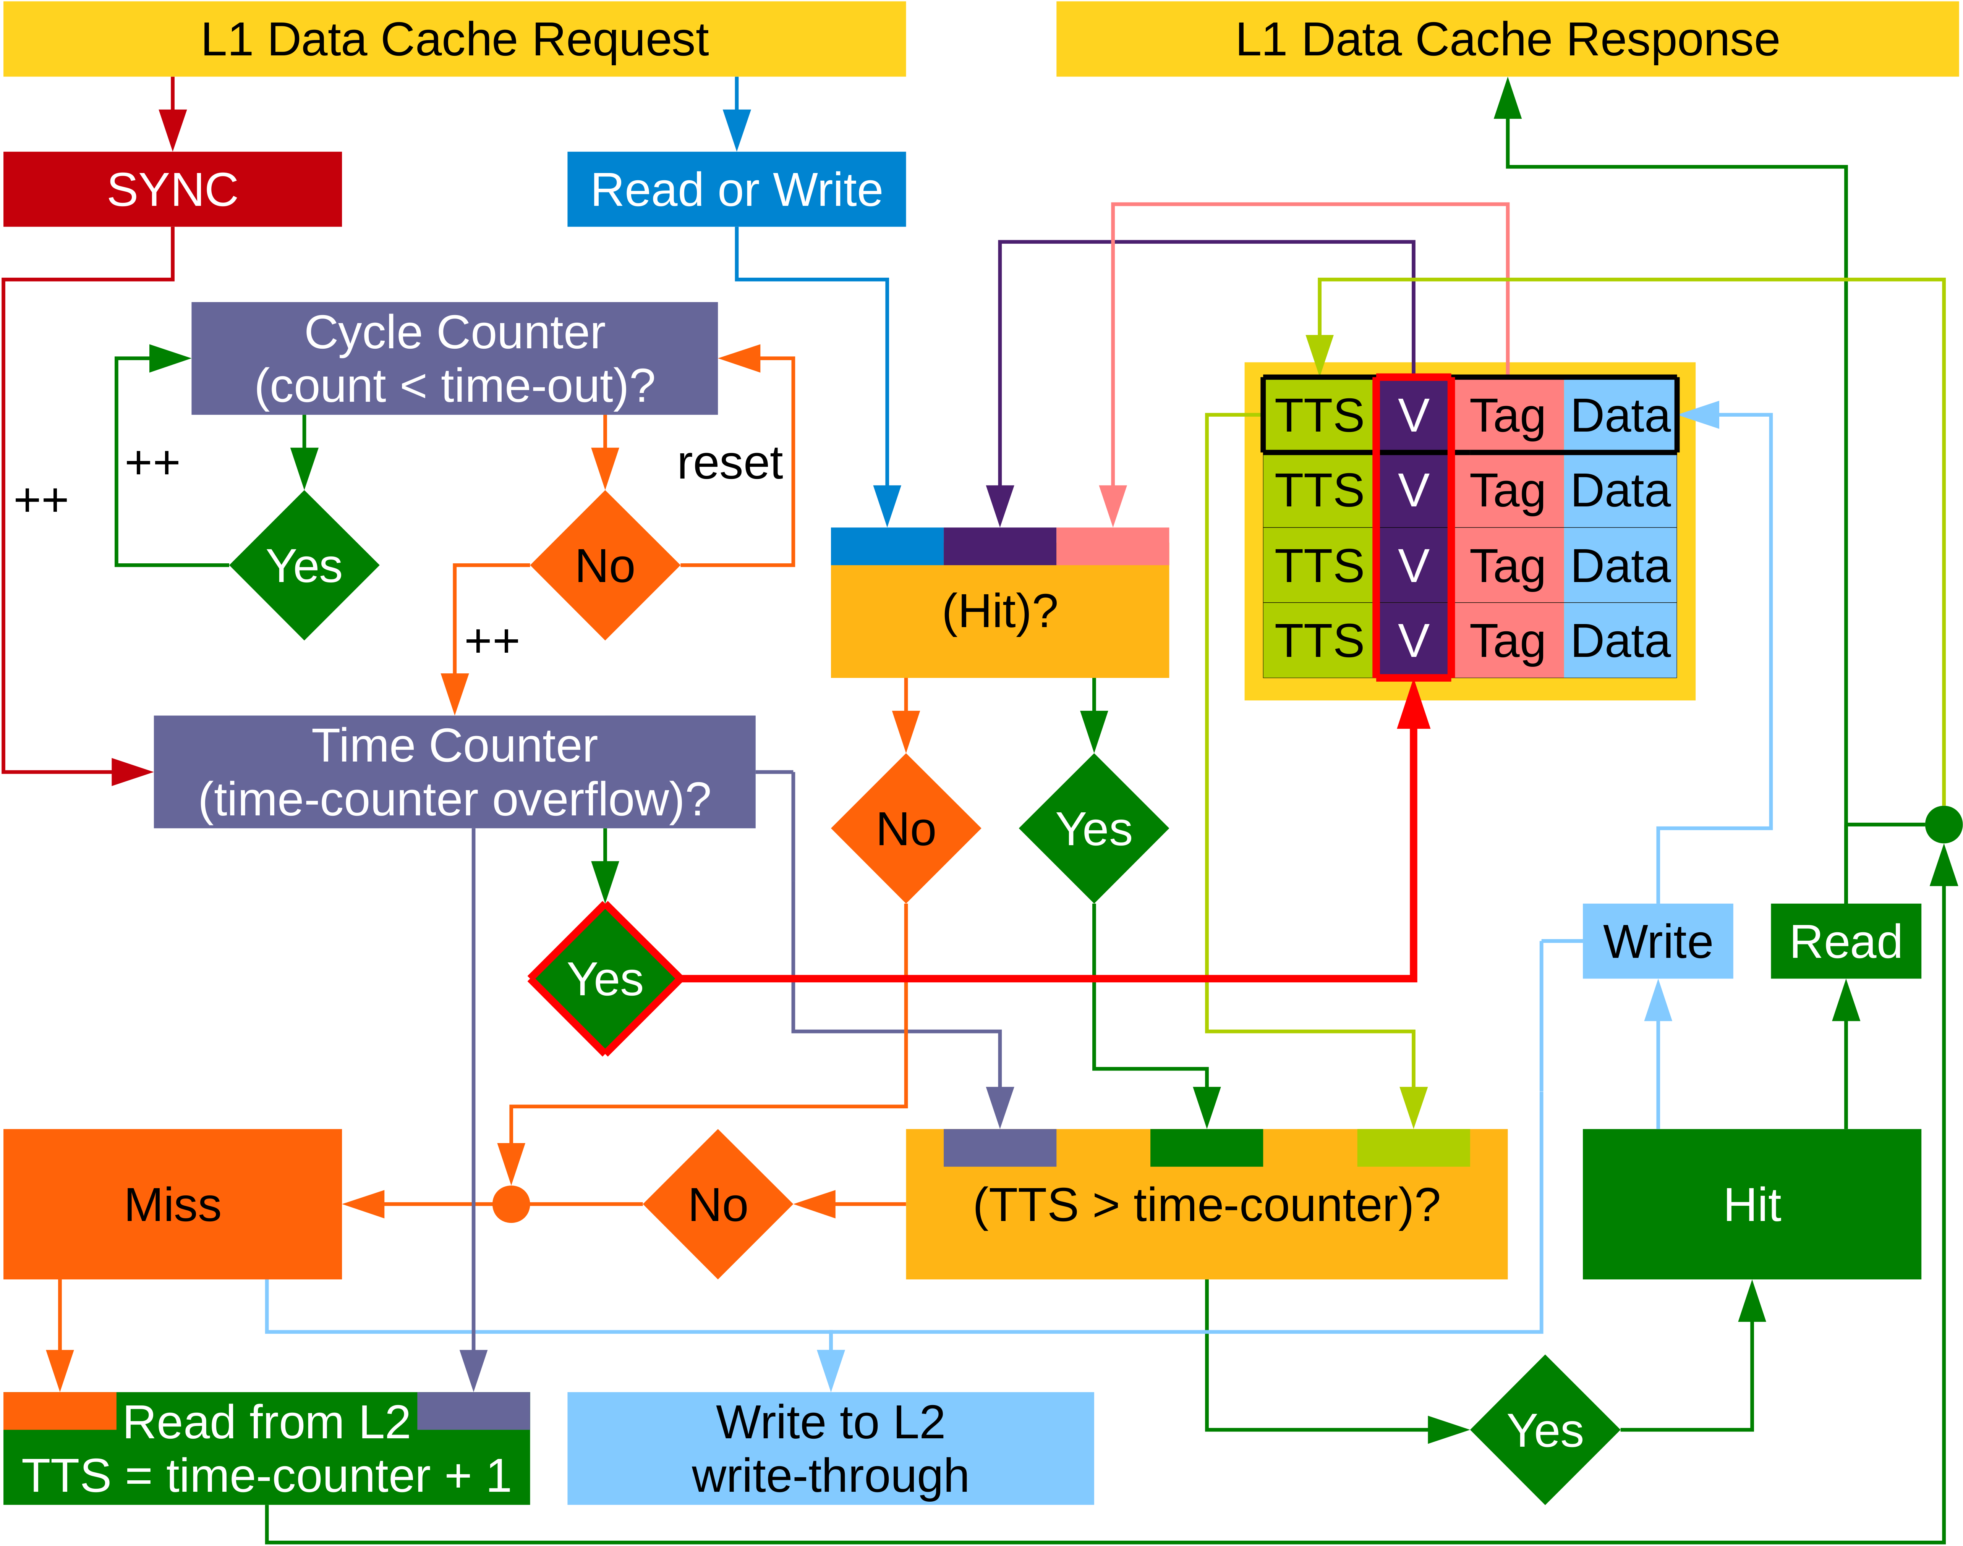
Time-Based Coherence

