Slide 1
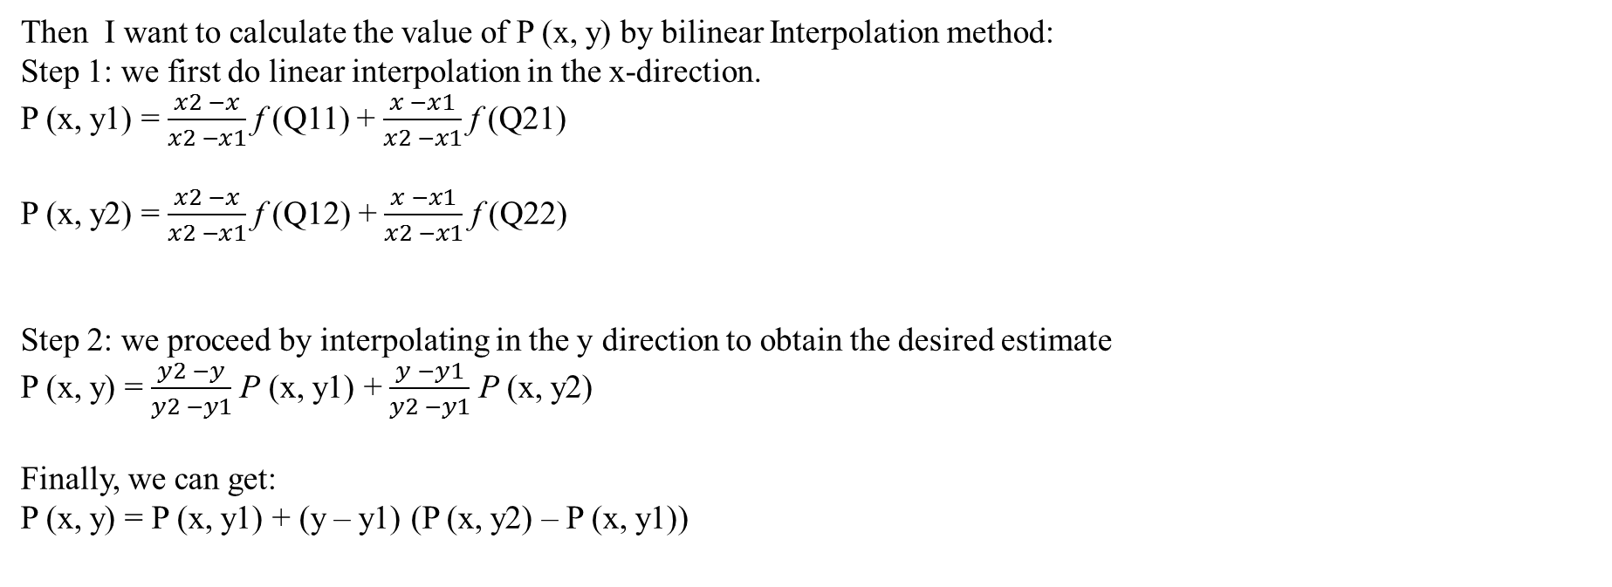
Bilinear Interpolation Calculation:
Q21
P = P0 + Pn + $∆Pn$
Q11
The shape of coords is (npoints, 2)
Q11 = (x1, y1) – coords_lt (left-top) = tf.cast(tf.floor(coords), ‘int32’)
Q22 = (x2, y2) – coords_rb (right-bottom) = tf.cast(tf.ceil(coords), ‘int32’)
Q12 = (x1, y2) – coords_lb (left-bottom) = tf.stack([coords_lt[:, 0], coords_rb[:, 1]], axis = 1)
Q21 = (x2, y1) – coords_rt (right-top) = tf.stack([coords_rb[:, 0], cords_lt[:, 1]], axis = 1)
P
Q12
Q22
Then I want to calculate the value of P (x, y) by bilinear Interpolation method:
Step 1: we first do linear interpolation in the x-direction.
P (x, y1) = $\frac{x2 −x}{x2 −x1}$ f (Q11) + $\frac{x −x1}{x2 −x1}$ f (Q21)
P (x, y2) = $\frac{x2 −x}{x2 −x1}$ f (Q12) + $\frac{x −x1}{x2 −x1}$ f (Q22)
Step 2: we proceed by interpolating in the y direction to obtain the desired estimate
P (x, y) = $\frac{y2 −y}{y2 −y1}$ P (x, y1) + $\frac{y −y1}{y2 −y1}$ P (x, y2)
Finally, we can get:
P (x, y) = P (x, y1) + (y – y1) (P (x, y2) – P (x, y1))
We have known that x2 – x1 = 1,
Then P (x, y1) = (x2 – x) f (Q11) + (x – x1) f (Q21)
Let x2 – x = x2 – x1 + x1 –x, so we can get:
P (x, y1) = (x2 – x1) f (Q11) + (x – x1) (f (Q21) - f (Q11) )
= f (Q11) + (x – x1) (f (Q21) - f (Q11))
As the same computation method we obtain:
P (x, y2) = f (Q12) + (x – x1) (f (Q22) - f (Q12))
f (Q11) = tf.gather_nd(input, coords_lt) – vals_lt
f (Q22) = tf.gather_nd(input, coords_rb) – vals_rb
f (Q21) = tf.gather_nd(input, coords_lb) – vals_rt
f (Q12) = tf.gather_nd(input, coords_rt) – vals_lb

Slide 2
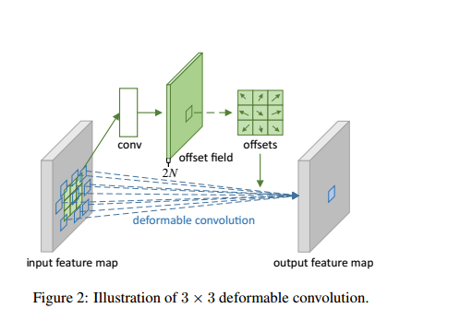
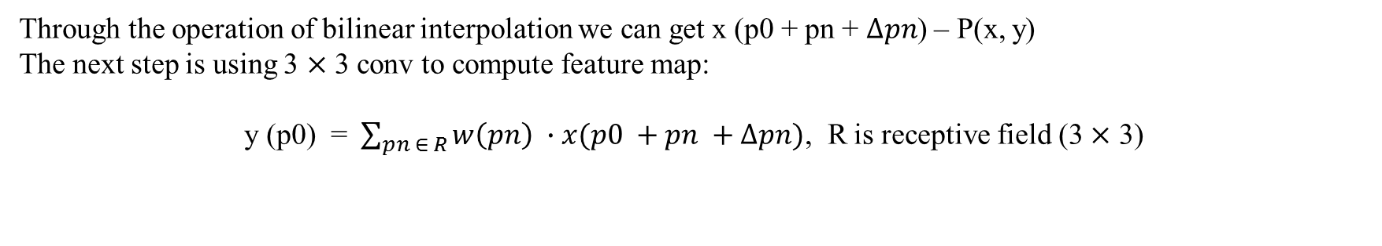
Through the operation of bilinear interpolation we can get x (p0 + pn + $∆pn$) – P(x, y)
The next step is using 3 $×$ 3 conv to compute feature map:
y (p0) = $\sum_{pn ∈ R}{w\left(pn\right) }∙x(p0 +pn +∆pn)$, R is receptive field (3 $×$ 3)

Slide 3
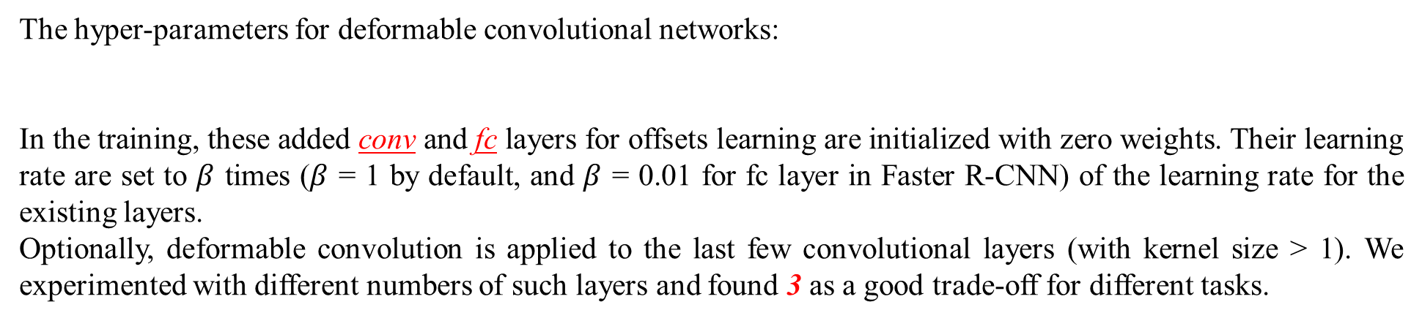
The hyper-parameters for deformable convolutional networks:
In the training, these added conv and fc layers for offsets learning are initialized with zero weights. Their learning rate are set to $β$ times ($β$ = 1 by default, and $β$ = 0.01 for fc layer in Faster R-CNN) of the learning rate for the existing layers.
Optionally, deformable convolution is applied to the last few convolutional layers (with kernel size > 1). We experimented with different numbers of such layers and found 3 as a good trade-off for different tasks.

