Slide 1
How to Statically Type Your JavaScript Code Using Flow.js
Alan Munson, Senior Software Developer
CoStar Research

Slide 2





Static Typing in JavaScript Using Flow
Who is CoStar?
Largest Commercial Real Estate Information & Analytics
Most Heavily Trafficked Digital Rental Marketplace
Most Heavily Trafficked Business for Sale Marketplace
Most Heavily Trafficked Commercial R.E. Marketplace
Most Heavily Trafficked Rural Land for Sale Marketplace
Notes:
Leading provider of commercial real estate analytics, information and online marketplaces
Publicly held company, had about 20-25% growth year over year. We hit $1B in revenue and our goal is to grow to $2B by 2020.
Headquartered in Washington, DC, CoStar has ~3700 employees in 80 offices across 7 countries
Largest and most comprehensive database of commercial real estate information – data used to compute GDP!
CoStar data powers the $17 trillion world of real estate
Apartments.com is the #1 most visited apartment listing network, with 45 million monthly visits

Slide 3



































Static Typing in JavaScript Using Flow
Who is CoStar?
~200,000 CLIENTS
Notes:
CoStar delivers sale, lease, property, tenant, contact, reporting and industry information to over 200,000 clients
83% of the nation’s commercial real estate transactions involve a CoStar subscriber
Top 95% of the leading 1,000 brokerage firms use CoStar

Slide 4
Static Typing in JavaScript Using Flow
Topics
Static typing
What is it, why do we need it?
Flow
Goals, comparison to TypeScript, how to add Flow
Flow type system
Optional: $ git clone https://github.com/AlanMunson/flow-examples.git
Flow with React / Redux
Best Practices / Key Takeaways

Slide 5
Static Typing in JavaScript Using Flow
What is static typing?
Question:
If you could do one thing that would make you as much as 15% more productive, would you do it?
A recent study found: “... that using Flow or TypeScript could have prevented 15% of the public bugs for public projects on GitHub...” *
Notes:
* From “To Type or Not to Type: Quantifying Detectable Bugs in JavaScript”, Gao et al., ICSE 2017 (http://earlbarr.com/publications/typestudy.pdf)

Slide 6
Static Typing in JavaScript Using Flow
What is static typing?
Analysis of code at design/compile-time, not run-time
Multiple ways to accomplish this:
Programmer assigns types to all variables
Compiler deduces types from usage
Languages using static typing – C++, C#, Java, Haskell
Notes:
C# can do both static and deductive analysis (e.g. var type)

Slide 7
Static Typing in JavaScript Using Flow
Why do we need static typing?
Early error checking – helps prevent certain types of runtime failures
Provide code intelligence / intellisense
Improve code maintainability

Slide 8
Static Typing in JavaScript Using Flow
What types of bugs does static typing catch?
Implicit type casting / type coercion
3 + “1” => “31” // Not 4!
Missing properties / values
const foo = {}; foo.bar(); // TypeError: foo.bar is not a function
const baz = { name: “Bob” }; baz.naem; // Error: cannot get ‘baz.naem’
Use of incorrect types const addItUp = (a, b) => a + b; addItUp(“1”, “2”); // Output: “12”, not 3!

Slide 9
Static Typing in JavaScript Using Flow
What is Flow?
Open-source static type checker for JavaScript, created by Facebook
Design goals were precision and speed:
Wanted accurate error checking without excess noise
Did not want Flow slowing development down
Type checking is opt-in not mandatory
Works by “flowing” typed data through code
Analyzes resulting data types
Identifies potential issues
Used on Facebook’s entire JavaScript code base!
Notes:
More information
Facebook’s original announcement of Flow: https://code.fb.com/web/flow-a-new-static-type-checker-for-javascript/
Why and how Facebook built Flow: https://flow.org/en/docs/lang/

Slide 10
Static Typing in JavaScript Using Flow
How does Flow compare with TypeScript?
Similarities
Both have type systems
Both can infer types
Most type names are the same (e.g. ‘string’)
Near-identical type declaration syntax let foo: string; type Foo = { bar: number };
Differences
TypeScript is a language – superset of Javascript
TypeScript is more permissive by default than Flow, but can be fixed using noImplicitAny / strictNullChecks
TypeScript is AST directed
Builds collection of discovered types
Unknown types cause problems – declare as any type? Error?
Flow is Graph directed
Builds collection of discovered & unknown types
Infers unknown types after considering types that “flow” through
Notes:
For more information, refer to “Adopting Flow & TypeScript - A comparison between the two on-boarding processes”, James Kyle (@jamiebuilds), (https://jamie.build/adopting-flow-and-typescript.html)

Slide 11
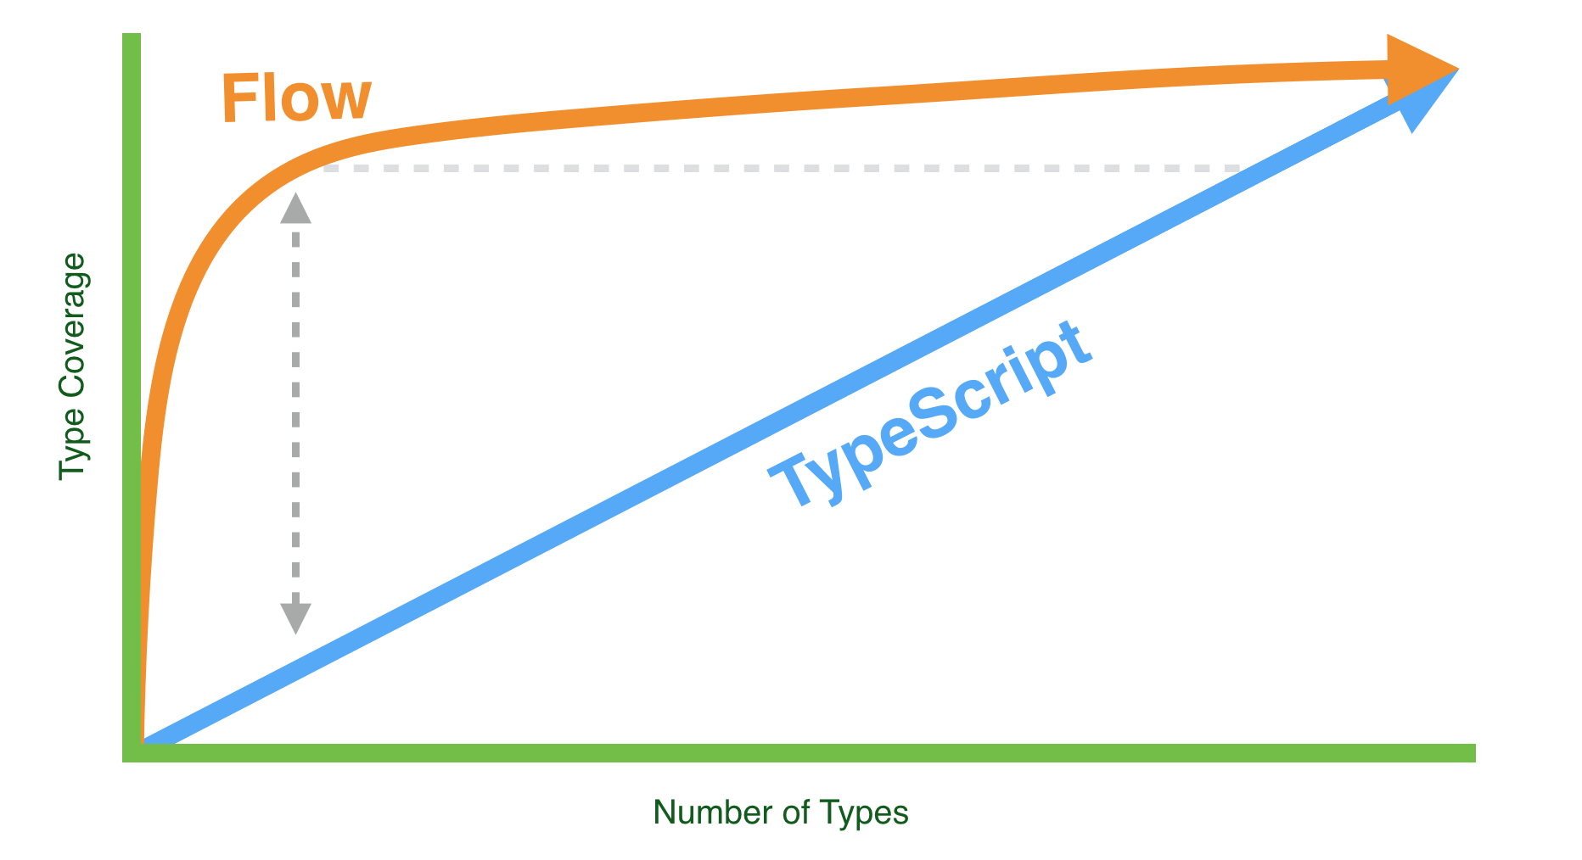
Static Typing in JavaScript Using Flow
How does Flow compare with TypeScript?
Adding Flow or Typescript to existing codebase
Flow
Lots of instant coverage
Adding type annotations improves coverage, but at diminishing cost
Typescript
Not as much instant coverage
Coverage increases linearly as you add type annotations
Notes:
* Chart from “Adopting Flow & TypeScript - A comparison between the two on-boarding processes”, James Kyle (@jamiebuilds), (https://jamie.build/adopting-flow-and-typescript.html)

Slide 12
Static Typing in JavaScript Using Flow
How do you use Flow?
With Babel: install babel-cli, flow-bin, babel-preset-flow packages
With flow-remove-types: install flow-remove-types, flow-bin
Optional: install eslint-plugin-flowtype package to validate Flow usage
Optional: install flow-typed package, add libraries’ Flow typedefs
Add // @flow declaration only to files ready to be checked
Add Flow type annotations to your code as needed
Start Flow server to analyze code
Fix any errors that Flow reports
That’s it!
Notes:
To disable Flow static type checking in a file, use the // @noflow declaration. This is useful if you have added eslint-plugin-flowtype and need to disable checking in specific files.
To disable Flow warnings on a particular line of code, precede the line of code with the // $FlowFixMe declaration.

Slide 13
Static Typing in JavaScript Using Flow
How does Flow work?
Flow checks files annotated with // @flow
Flow reports errors to console (or IDE plugin)
During transpilation, all Flow types are removed
Distributed code is type-less Javascript (but has been checked by Flow!)
If creating module and want to ship typedefs, include into build pipeline: $ flow gen-flow-files ./src –out-dir dist OR use Macil/flow-copy-source npm package
Notes:
Both flow gen-flow-files and the flow-copy-source scripts copy the original source files to the destination directory, but change the extension to .flow.
When Flow parses included libraries and discovers .flow files, it will consume those types for your benefit.

Slide 14
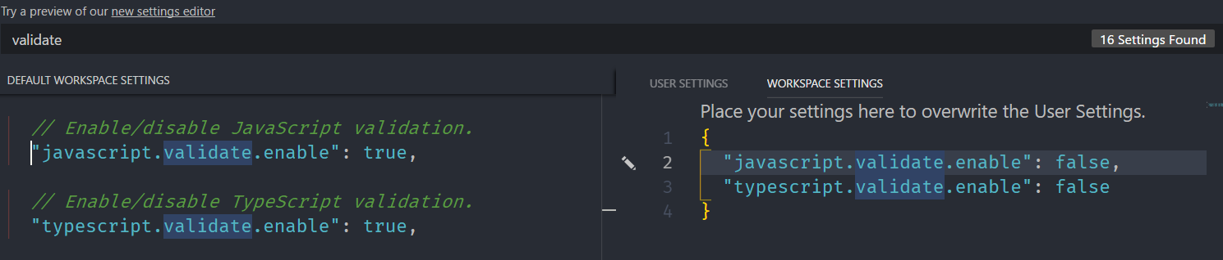

Static Typing in JavaScript Using Flow
IDE Configuration – VS Code
Disable javascript and typescript validation
Add extension flowtype.flow-for-vscode
Notes:
JavaScript and TypeScript validation interfere with the Flow plugin.
Can also install gcazaciuc.vscode-flow-ide

Slide 15
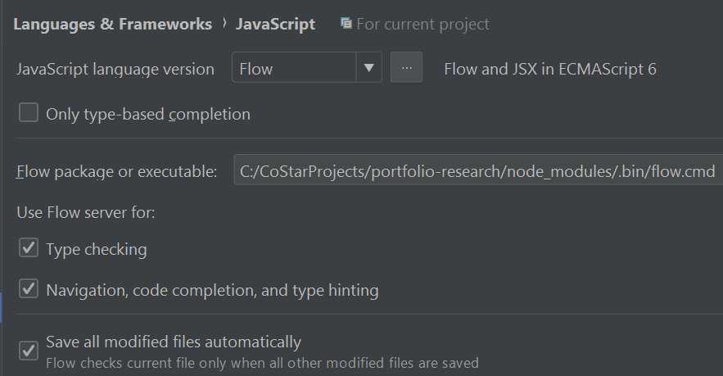
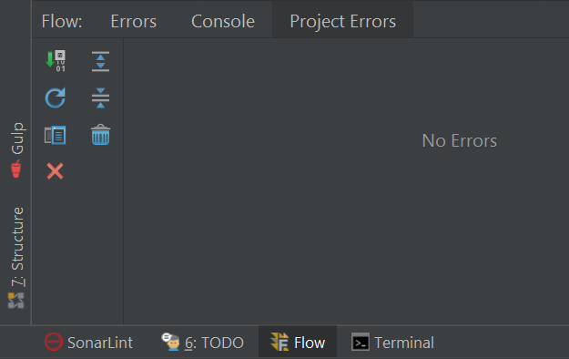
Static Typing in JavaScript Using Flow
IDE Configuration – Web Storm
Configure Settings > Languages & Frameworks > Javascript to use Flow
Add a .flowconfig to see Flow tab in project

Slide 16
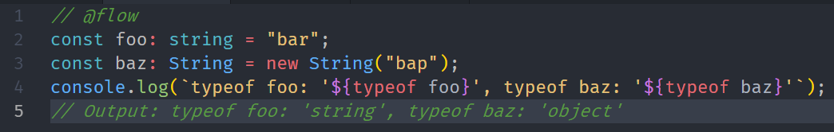
Static Typing in JavaScript Using Flow
Flow Typing – Primitive types
Booleans, strings, numbers, null, undefined (void), symbols
Primitive types can be literals (true, “Hello”, 42, …) or they can be wrapper classes (new String(“Goodbye”))
Note that types for literals are lower case, wrapper types are upper-case
Sample project demonstrating Flow typing: https://github.com/AlanMunson/flow-examples

Slide 17
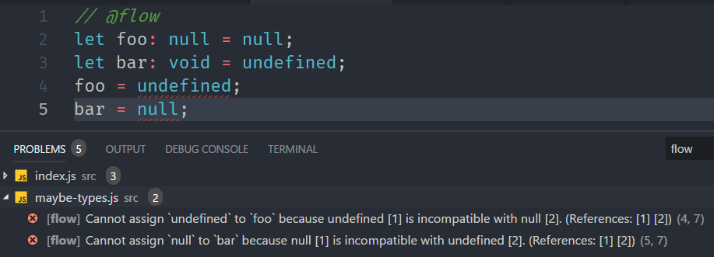
Static Typing in JavaScript Using Flow
Flow Typing – Null and undefined
Null and undefined are the types null and void in Flow
Note that Flow considers null and void to be different types

Slide 18
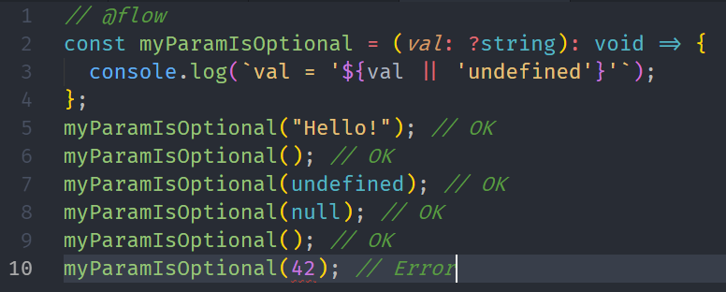
Static Typing in JavaScript Using Flow
Flow Typing – Maybe types
A maybe type’s value is optional - can use the typed value, null, or undefined
Preface the type name with ?

Slide 19
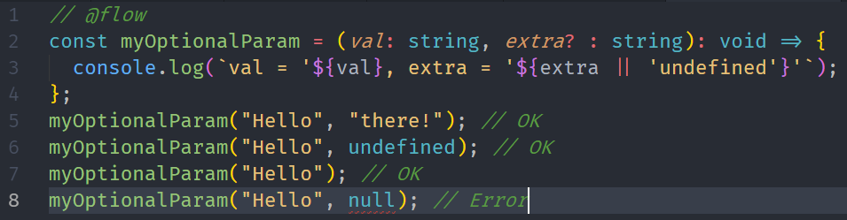
Static Typing in JavaScript Using Flow
Flow Typing – Optional parameters
Functions may have optional parameters – param may have typed value or undefined but NOT null
Preface the parameter name with ?

Slide 20
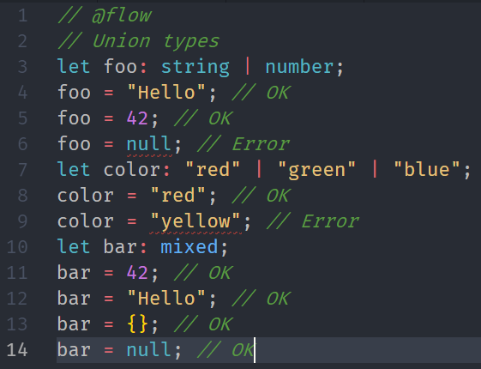
Static Typing in JavaScript Using Flow
Flow Typing – Mixed types
Types can be comprised of multiple types, the Flow term is union types
Union types can be comprised of other types or literals
The mixed type can be anything including null

Slide 21
Static Typing in JavaScript Using Flow
Flow Typing – Any types
The any type is unsafe and is considered a bad practice
Use of the any type may not catch potential errors
Only use the any type in the following situations:
In the process of converting existing code to using Flow types and currently blocked by Flow checking (try to fix your types eventually)
When you are certain your code works and for some reason Flow is unable to type check it correctly (hopefully a Flow update will be able to resolve)
Sometimes necessary when casting one type to a different type
Prevent leaking any by casting types away from any

Slide 22
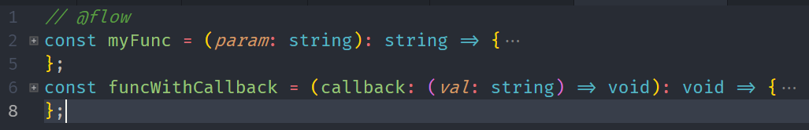
Static Typing in JavaScript Using Flow
Flow Typing – Function types
Functions have parameter types and a return type
Parameters may be optional or maybe types
Note that there is a syntax for declaring a function type

Slide 23
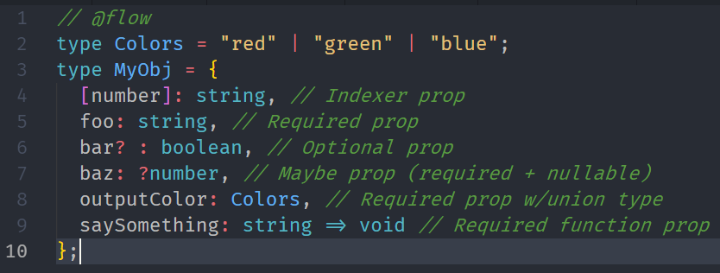
Static Typing in JavaScript Using Flow
Flow Typing – Object types
Object typing uses syntax similar to Javascript
Object properties are typed like variables or functions

Slide 24
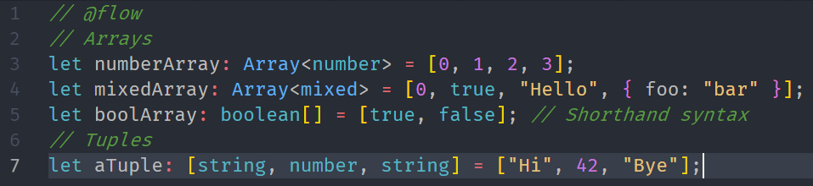
Static Typing in JavaScript Using Flow
Flow Typing – Array and tuple types
Array / Tuple elements can be typed like variables
Note that array access is unsafe – Flow cannot verify value exists (yet)
Tuple elements can have different types
Flow verifies tuple length and type of the element accessed
Careful – ?Type[] is the equivalent of ?Array<T> and not Array<?T>
Notes:
If you want to make it Array<?T> you can use parenthesis like: (?Type)[]

Slide 25
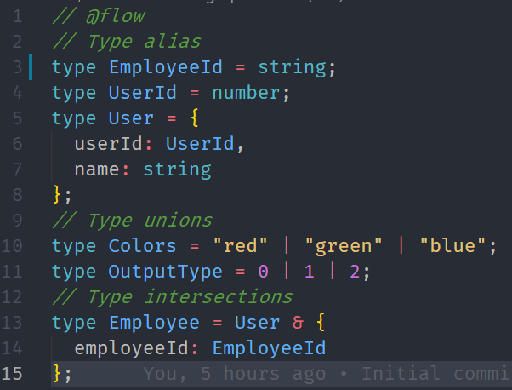
Static Typing in JavaScript Using Flow
Flow Typing – Aliases, unions, and intersections
Type Alias: Existing types can be declared as new types
Unions: Type can be multiple types or even multiple literal values
Intersections: Type can be comprised of other types

Slide 26
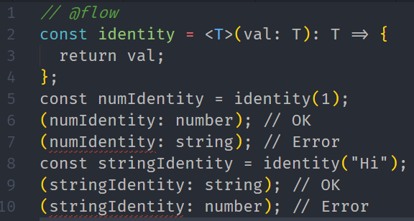
Static Typing in JavaScript Using Flow
Flow Typing – Generics
Flow supports generic types
Generic types may be used with classes or functions
Flow typing in React uses generic types for Props and State

Slide 27
Static Typing in JavaScript Using Flow
Flow and React – Typing components
React import – need to import as namespace if using React types
import * as React from “react”;
React class definitions require props & state types
Note: Don’t need default props types after v0.53
class MyComponent extends React.Component<Props, State> {
React stateless functional components are typed like functions in Flow const MyComponent = (props: Props) => {
Use default props as usual to supply values for props
React provides utility types for help with typing components
React.Node, React.Element<typeof Component>, React.Ref<typeof Component>, …
Notes:
Every component needs to define Props type
Components using state must define State type

Slide 28
Static Typing in JavaScript Using Flow
Flow and React – Typing Redux
State, Actions, and Reducers need Flow types
State – type as you would other objects but mark as immutable
Actions – type Flux Standard Actions and other actions
Each action should have specific type (using constant)
Create union type of all action types needed for your reducer
Reducers
State type is passed in state param, returns new State type
Actions union type is passed in actions param
May have to cast action to correct type to keep Flow happy

Slide 29
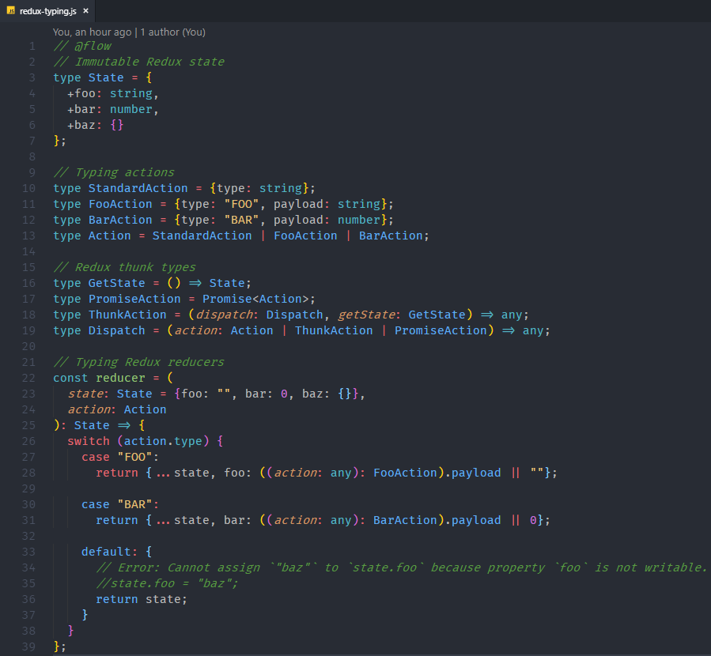
Static Typing in JavaScript Using Flow
Flow and React – Typing Redux
Notes:
Redux state should be typed
Redux state properties should be marked as immutable

Slide 30
Static Typing in JavaScript Using Flow
Flow Typing – Typing Packages
External packages (ex: React)
Install flow-typed package: https://github.com/flow-typed/flow-typed
$ flow-typed install
Commit flow-typed modules to project repo
Internal packages / modules
Export Flow type definitions
export type Foo = { bar: string };
Generate .flow type files for consumption by other clients* **
$ flow gen-flow-files [OPTIONS] [FILE]
Or: $ flow-copy-source
Ship the .flow files along with your distributed source
Notes:
* “Shipping Flowtype Definitions in NPM Packages”, Patrick Stapfer, (https://medium.com/netscape/shipping-flowtype-definitions-in-npm-packages-c987917efb65)
** Script to create .flow files, Macil/flow-copy-source, (https://github.com/Macil/flow-copy-source)

Slide 31
Static Typing in JavaScript Using Flow
Best Practices
Flow-ify files that are ready to be checked: // @flow
To disable type checking in a file, use // @noflow
To disable Flow warnings on a line of code, precede line with // $FlowFixMe
Move type imports to top, underneath flow annotation (convention)
Add types / annotations, types start with initial cap type MyType = string;
Type Redux and component state as immutable type State = { +foo: string };
Prefer specific types to more general types let foo: FooType; vs let foo: {};

Slide 32
Static Typing in JavaScript Using Flow
Key Takeaways
Beware the following:
Nullable vs. optional props
Optional properties / parameters
Component refs – must be defined & typed in class (they are nullable!)
React.Ref<typeof Component> *or* button: ?HTMLButtonElement;
Primitive vs. object types --> string vs. String
Object literals vs. defined types let foo: bar = {}; // <-- this doesn't work if bar has non-optional props
import * as React vs. import React
The any type is generally bad!

Slide 33
Static Typing in JavaScript Using Flow
Key Takeaways
Small codebases
You probably don’t need Flow*
Add Flow if planning to expand code
Large codebases
Start small – Flow-ify one file at a time
Cover key areas first – features, modules, components, etc.
Use tools to help
IDE plugins
flow-typed: https://github.com/flow-typed/flow-typed
apollo-cli: https://github.com/apollographql/apollo-cli
Notes:
* See “You Might Not Need TypeScript (or Static Types)”, Eric Elliott (https://medium.com/javascript-scene/you-might-not-need-typescript-or-static-types-aa7cb670a77b)

Slide 34
Static Typing in JavaScript Using Flow
Alan Munson - About Me
Contact
GitHub: https://github.com/AlanMunson
Twitter: @AlanMunsonTech
LinkedIn: https://www.linkedin.com/in/alanmunson/
Email: amunson@costar.com
Interested in employment?
Email me or Kyler Sullivan: ksullivan@costar.com
Useful
Sample Flow project: https://github.com/AlanMunson/flow-examples
Slide deck:
https://github.com/AlanMunson/flow-examples/blob/master/docs/flow-typing.pptx

