Slide 1
CSCI-UA-102-011-Spring-2025
Data Structures
Recitation - 1
Rasmika Billa
(01/24/2025)

Slide 2
Overview
Office hour + contact
1. Office hour: Tuesday 1:00 - 3:00PM, Location: 60FifthAve Room 204
2. Email: rb5719@nyu.edu
Grading
1. Mid-Term: 20%
2. Final: 30%
3. Quizzes: 30% (6-8)
4. Programming: 20%
Recitation logistics
1. Attendance and participation are required. No recordings.
2. Practice problems
Not graded. But it’s supposed to help you with quizzes.
You should work out the practice problems in groups.
3. Quizzes (20 minutes before the end of the recitation)
The content is going to be related to the materials of the week. I will not answer questions regarding the quiz before it takes place.
I will provide my answer before the end of day on Friday (I will try to provide it before 6 PM).
Quizzes should be done by individuals.
CSCI-UA-102-011-Spring-2025

Slide 3
Agenda
Download Eclipse
https://www.eclipse.org/downloads/packages/
Groups (5 mins)
Form Groups of 4
Each group will be given a problem that should be solved among them
After discussing one of the group member has to present the solution
3. OOP - Inheritance
CSCI-UA-102-011-Spring-2025

Slide 4
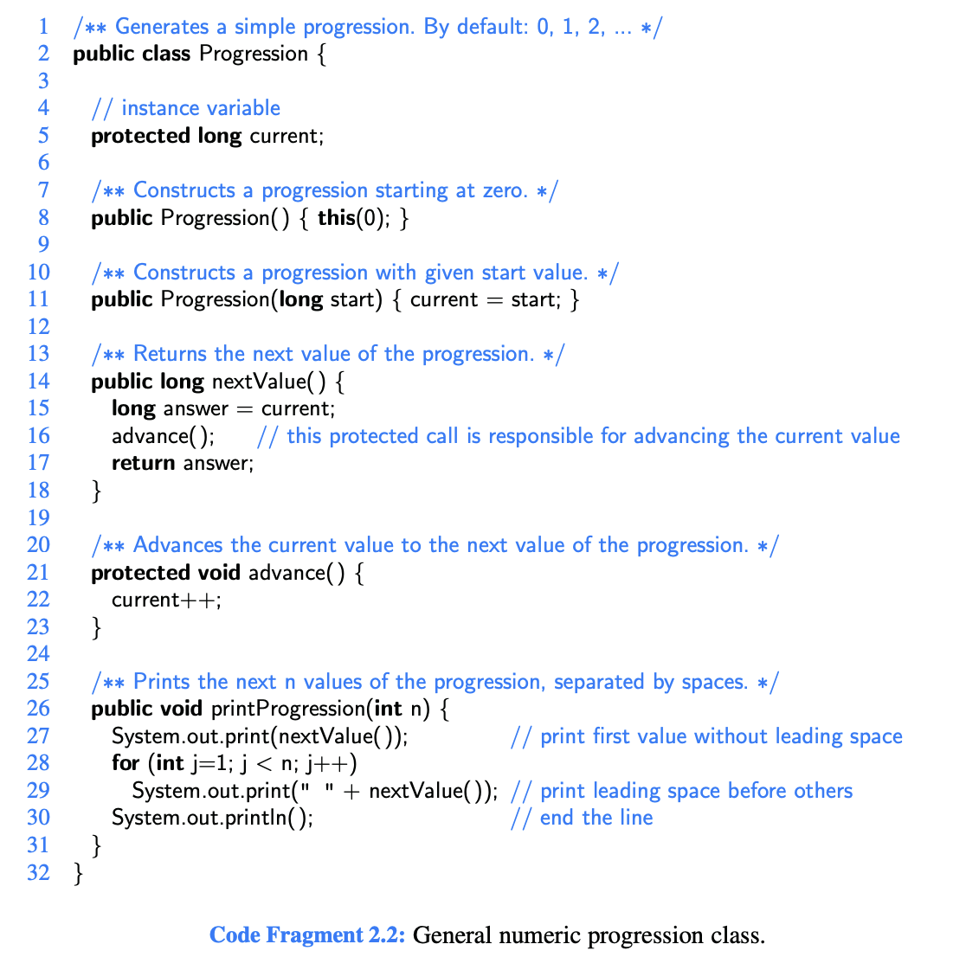
Encapsulation : current (Line 5)
Constructors : Progression() (Line 8,11) Progression(long start)
Line 2: Class begins.
Line 5: Variable ‘current’ is declared has current value of the progression
Line 8-11: Constructor initialization
Line 14-17: nextValue() returns the current value advances the progression
Line 21-23: advance() increments current by 1
Line 26-31: printProgression() ` Prints first n values of the progression.
Progression prog = new Progression(); prog.printProgression(5); //0 1 2 3 4
CSCI-UA-102-011-Spring-2025

Slide 5
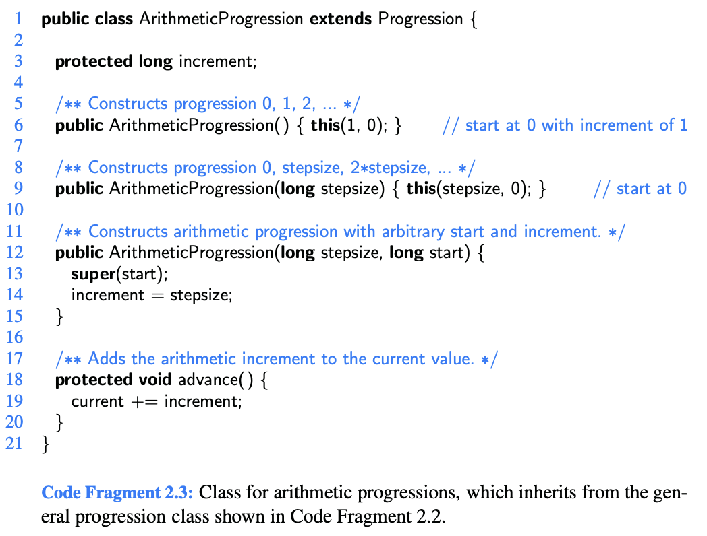
Inheritance: extends Progression (Line 1)
Line 2: ArithmeticProgression class Subclass of Progression.
Line 3: Variable increment Store the step size.
Lines 6-9: Constructors Sets a default increment 1, starting from 0.
Takes a custom step size and starts at 0.
Allows arbitrary start values, increments.
Line 13: Superclass (Progression) = super(start)
Lines 18-20: The advance() method is overridden to add the increment to the current value, advancing the progression by the step size.
ArithmeticProgression arithProg = new ArithmeticProgression(3); arithProg.printProgression(5); // 0 3 6 9 12
CSCI-UA-102-011-Spring-2025

Slide 6
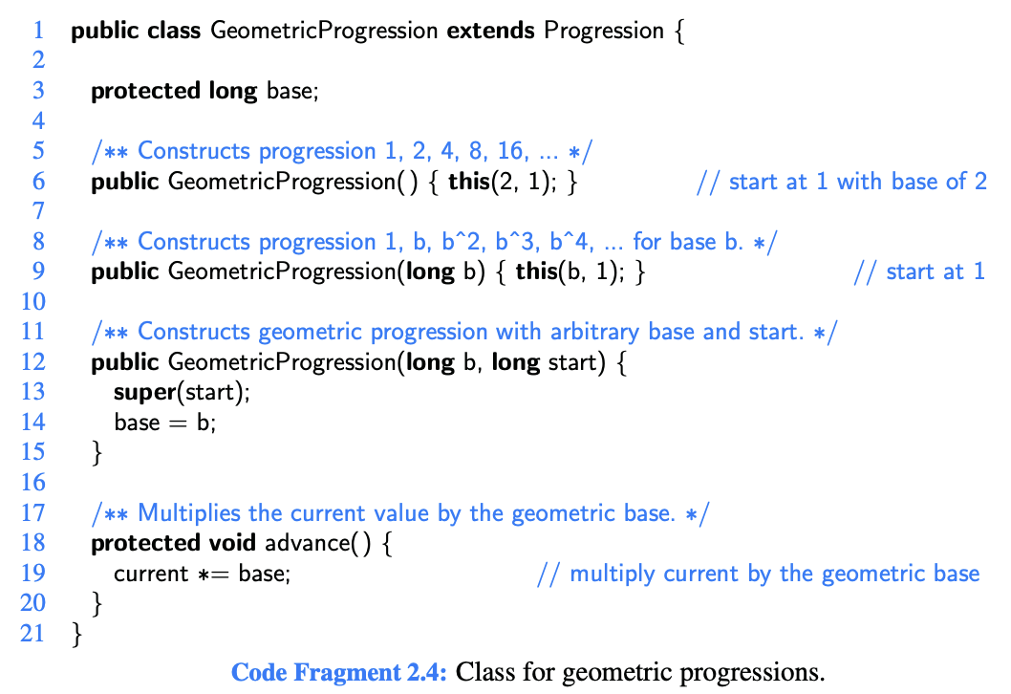
Inheritance: extends Progression (Line 1)
Line 2: GeometricProgression class Inheriting from Progression.
Line 3: Variable base Store the base (or multiplier) Lines 6-9: Constructors Sets to start at 1 with a base of 2.
Takes a custom base and starts at 1.
Allows both the base and starting value to be customized.
Line 13: Superclass (Progression) = super(start)
Lines 18-20: The advance() method multiplies the current value by base to move to the next term in the geometric progression.
GeometricProgression geoProg = new GeometricProgression(3); geoProg.printProgression(5); //1 3 9 27 81
CSCI-UA-102-011-Spring-2025

Slide 7
Problem Statements (10-15 mins)
Q2.10 - Group 1
Q2.11 - Group 2
Q2.12 - Group 3
Q2.13 - Group 4
Q2.17 - Group 5
Q2.21 - Group 6
Q2.24 - Group 7
Q2.29 - Group 8
CSCI-UA-102-011-Spring-2025

