Slide 1
CSCI-UA-102-011-Spring-2025
Data Structures
Recitation - 2
Rasmika Billa
(01/31/2025)

Slide 2
Note
Office hours: Tuesday 1:00 - 3:00PM, Location: 60FifthAve Room 204
Slides and Materials will be uploaded in the next week (Details will be mailed)
No Quiz Today
CSCI-UA-102-011-Spring-2025

Slide 3
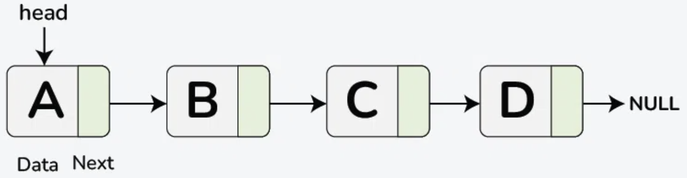
LinkedList
public class Node {
int data;
Node next;
public Node(int data)
{
this.data = data;
this.next = null;
}
}
public static void traverseLinkedList(Node head)
{
// Start from the head of the linked list
Node current = head;
// Traverse the linked list until reaching the end
while (current != null) {
// Print the data of the current node
System.out.print(current.data + " ");
// Move to the next node
current = current.next;
}
System.out.println();
}
Types of Linked List:
Singly Linked List
Doubly Linked List
Circular Linked List
Operations on Singly Linked List:
Traversal
Searching
Length
Insertion:
Insert at the beginning
Insert at the end
Insert at a specific position
Deletion:
Delete from the beginning
Delete from the end
Delete a specific node
Node Structure
Traversal
Source: https://www.geeksforgeeks.org/singly-linked-list-tutorial/
CSCI-UA-102-011-Spring-2025

Slide 4
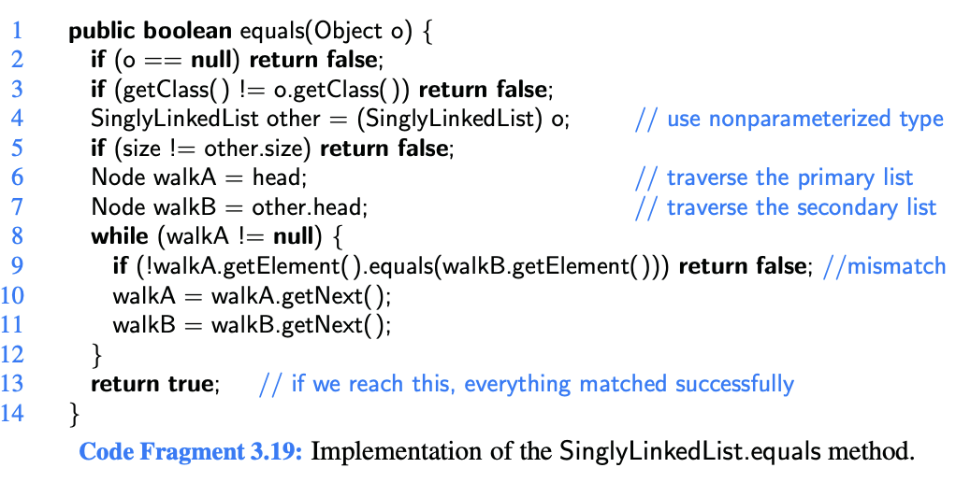
Singly LinkedList
Check whether the current list is equal to another list based on the elements stored in the nodes and their order!
Line 1: Method Signature
Line 2: Null Check
Line 3: Class Comparison Check
Line 4: Casting Object
Line 5: Size Check
Line 6-7: Traverse Primary and secondary List
Line 8-12: Comparing Elements in both Lists
CSCI-UA-102-011-Spring-2025

Slide 5
Problem Statements (15-20 mins)
Q3.26 - Group 1
Q3.25 - Group 2
Q3.18 - Group 3
Q3.17 - Group 4
Q3.12 - Group 5
Q3.9 - Group 6
Q3.6 - Group 7
Q3.5 - Group 8
All – Q3.28
We will start the presentation in 10 mins
Explain your problem statement and approach
CSCI-UA-102-011-Spring-2025

Slide 6
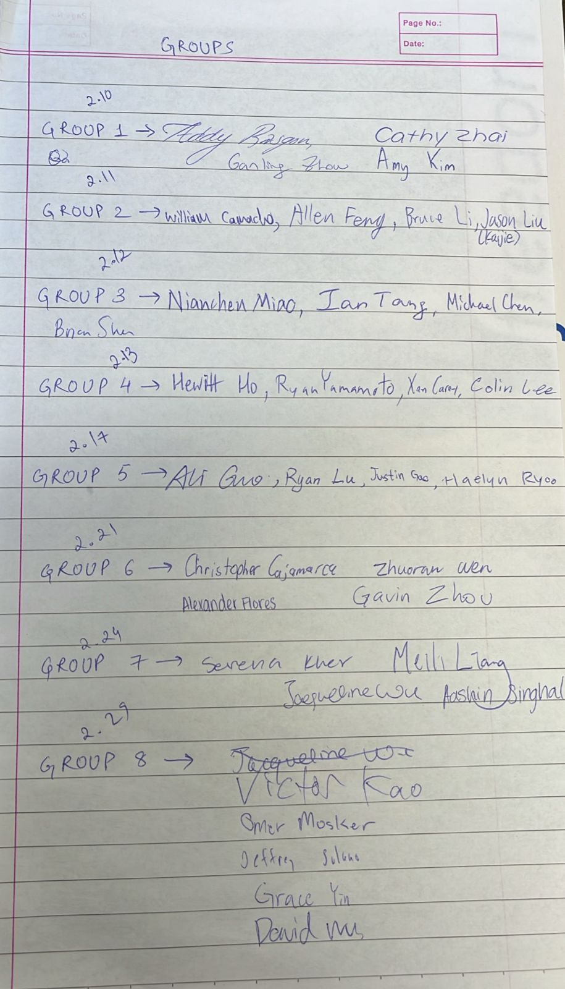
CSCI-UA-102-011-Spring-2025

