Slide 1

A
7
Q
Predicting Injury-Producing
NYC Motor Vehicle Collisions
I ♥ NYC data
Multi-table crash, vehicle, and person data
0.860
0.893
PR-AUC on held-out 2025 crashes
ROC-AUC with XGBoost
Alan Nemkovsky • Section 05 • an1078
1
Notes:
Hi everyone, my name is Alan Nemkovsky. For this project, I studied New York City motor vehicle collision records and asked whether we can predict when a reported crash produces at least one injury or fatality. The main idea is not just to use one crash table. I linked the crash records with vehicle-level and person-level records, then turned those linked tables into one collision-level modeling dataset. The headline result is that the best model, XGBoost, reached a PR-AUC of about 0.860 and a ROC-AUC of about 0.893 on crashes from 2025, which were held out from training. I’ll walk through the data, the leakage controls, the models, and what the results tell us.

Slide 2
The question
Can linked NYC records predict injury-producing crashes?
Target
injury_or_fatality = 1
when at least one injury or fatality is recorded at the crash level
One row per collision
Crash table
Vehicle table
Person table
Temporal test: train 2021–2024, test 2025
Alan Nemkovsky • Section 05 • an1078
2
Notes:
The research question is simple: using the information available in these public NYC records, can we predict whether a crash is injury-producing? The target is defined at the crash level, so it equals one when the crash record reports at least one injury or fatality. A key part of the project is that the three CSV files all share a collision ID. I used that ID to join the crash, vehicle, and person data, but I did not simply join everything row by row. Instead, I aggregated vehicles and people up to one row per collision. The evaluation is also temporal: models learn from 2021 through 2024, then the final test is 2025. That makes the setup more realistic than a random split.

Slide 3
Data footprint
2.26M
4.53M
5.95M
513K
40.2%
crash rows
vehicle rows
person rows
collision-level rows after cleaning
positive target rate
Relational join key
Average linked records per crash
COLLISION_ID
2.02 vehicles • 3.47 persons
Large public CSVs stay out of GitHub; the repo contains reproducible code and instructions.
Alan Nemkovsky • Section 05 • an1078
3
Notes:
The raw data was large. The crash file had about 2.26 million rows, the vehicle file had about 4.53 million rows, and the person file had about 5.95 million rows. After filtering to the modeling period and aggregating to the collision level, the final table had 513,035 rows and 94 columns. The positive class rate was about 40 percent, meaning injury-producing crashes were common enough to model, but the task was still imbalanced enough that accuracy alone would be misleading. I also kept the raw CSVs out of the GitHub package because they are large public files. The repo is designed so someone can download the same CSVs, place them locally, and rerun the full pipeline.

Slide 4
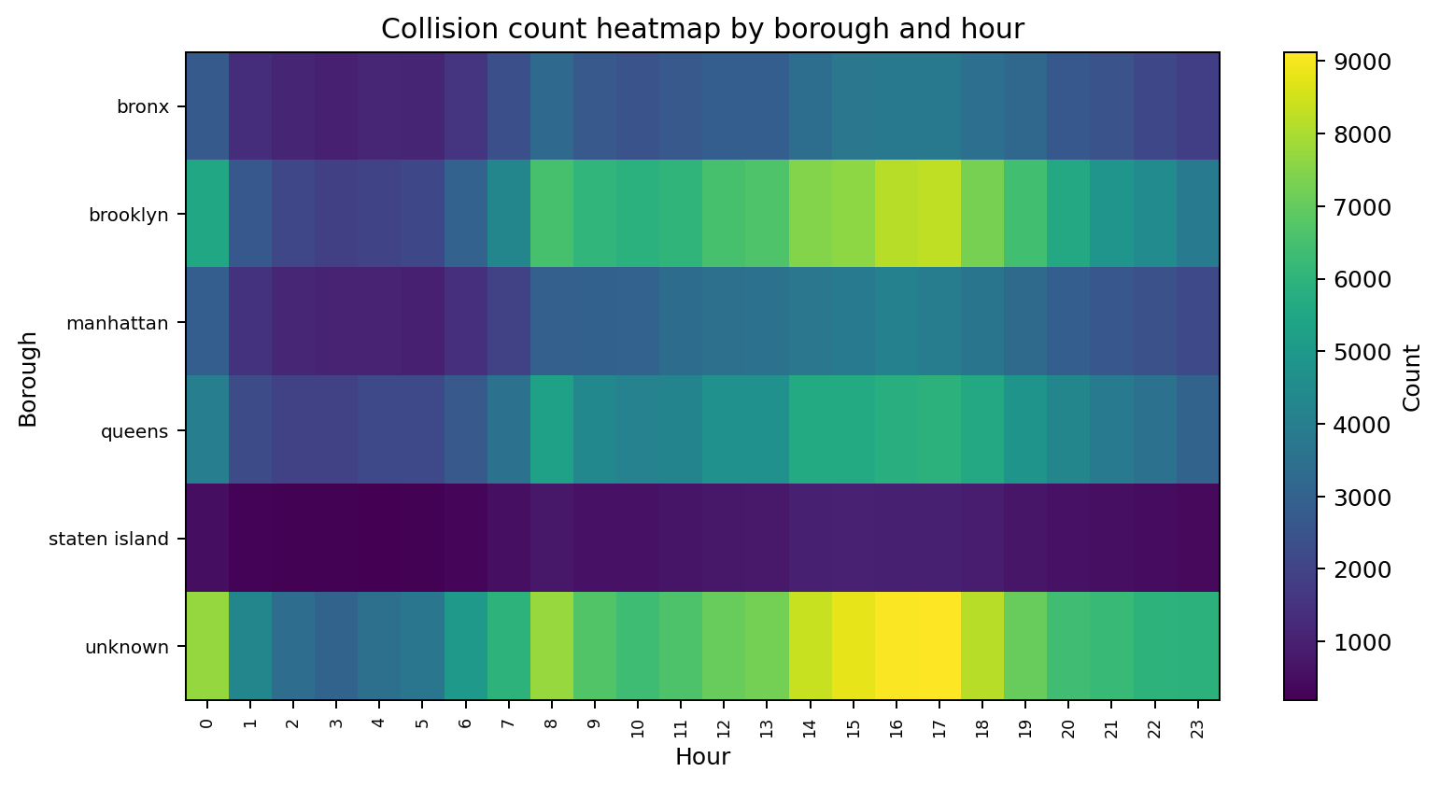
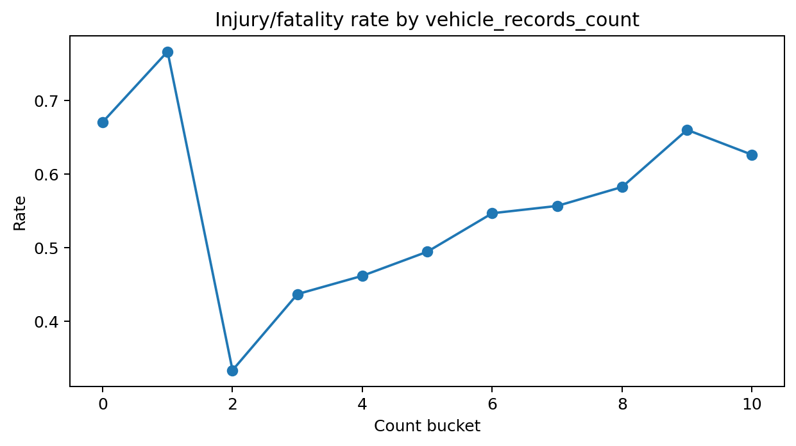
EDA: crashes are not random in time or place
Two visual clues
Timing clusters by borough
Involvement count carries severity signal
Alan Nemkovsky • Section 05 • an1078
4
Notes:
Before modeling, I checked whether the data had structure. Two patterns stood out. First, the borough-by-hour heatmap shows that crash timing is not uniform. Different boroughs have different time profiles, which supports using temporal and location features. Second, the involvement figure shows that the number and type of linked records contain severity information. For example, collisions with certain vehicle or person involvement patterns have noticeably different injury rates. This is the first sign that the vehicle and person tables are not just extra data; they contain signal that the crash table alone does not fully capture.

Slide 5
Method: build signal without leaking the answer
Crash context
Vehicle aggregates
Person aggregates
time, borough, ZIP group, coordinates, factors
counts, vehicle mix, pre-crash movement
road-user roles, ages, pedestrian/cyclist flags
Leakage-controlled feature matrix
Removed injury counts, bodily injury, complaints, ejection, emotional status
Alan Nemkovsky • Section 05 • an1078
5
Notes:
The most important method decision was leakage control. Since the target is whether a crash produced an injury or fatality, I could not allow outcome descriptions to become predictors. So the final features came from three groups. The crash table provided context, like time, borough, ZIP group, coordinates, and contributing factors. The vehicle table provided aggregates like the number of vehicles, vehicle mix, and movement patterns. The person table provided aggregates like the number of people involved, road-user roles, age summaries, and pedestrian or cyclist involvement. But direct injury descriptions, bodily injury fields, complaint fields, ejection, emotional status, and injury counts were removed from the predictors. That makes the model a real prediction task rather than a shortcut.

Slide 6
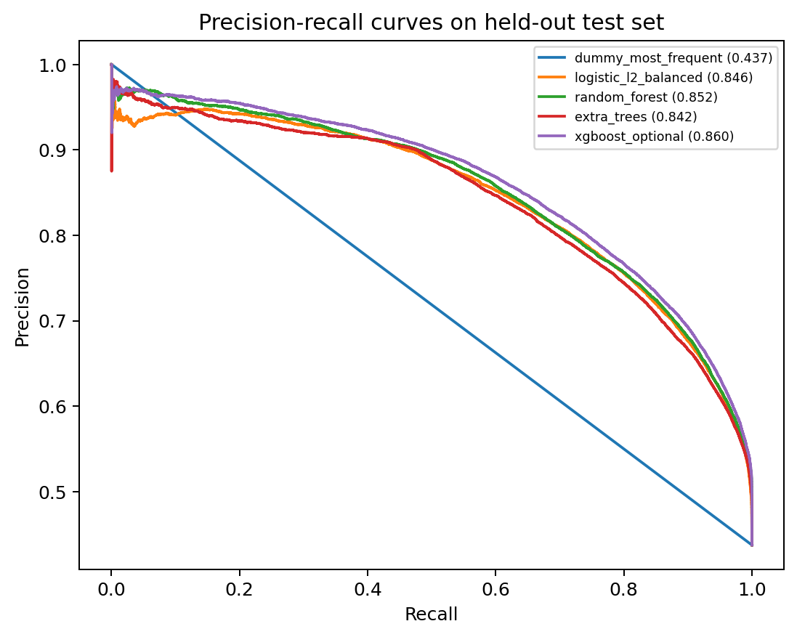
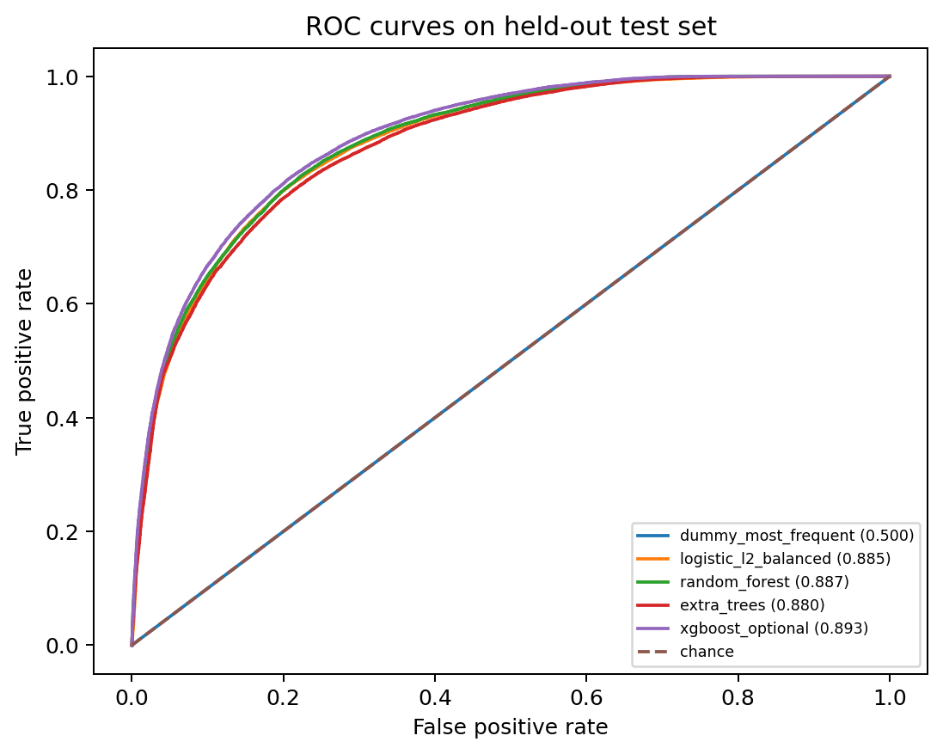
Model comparison: 2025 holdout set
XGBoost
0.860
0.893
0.787
0.839
Learned models greatly outperform the dummy baseline.
best by PR-AUC
PR-AUC
ROC-AUC
F1
Recall
Alan Nemkovsky • Section 05 • an1078
6
Notes:
For evaluation, I compared several models on the held-out 2025 data. The best model was the optional XGBoost model. It reached a PR-AUC of 0.860 and a ROC-AUC of 0.893. I focus on PR-AUC because it is more informative for this kind of binary outcome than raw accuracy. The model also had an F1 score of about 0.787 and recall of about 0.839. That means it was able to identify a large share of injury-producing crashes, although this is still a retrospective classifier and not something I would claim is ready for deployment. The important takeaway is that the learned models beat the dummy baseline by a wide margin.

Slide 7
Ablation: each linked table adds value
PR-AUC by feature set
Crash only
0.656
Crash + vehicle
0.794
Crash + person
0.829
Full linked model
0.846
Main message
The person and vehicle tables add predictive structure.
Alan Nemkovsky • Section 05 • an1078
7
Notes:
This is probably the most important result for the project design. The crash-only logistic regression model had a PR-AUC of about 0.656. When I added vehicle aggregates, performance increased to about 0.794. When I added person aggregates, it increased to about 0.829. With all linked features together, it reached about 0.846 for the logistic regression ablation. This shows that the relational workflow mattered. The vehicle and person tables are not just making the dataset bigger; they add information about who and what was involved in the collision, which helps explain injury risk.

Slide 8
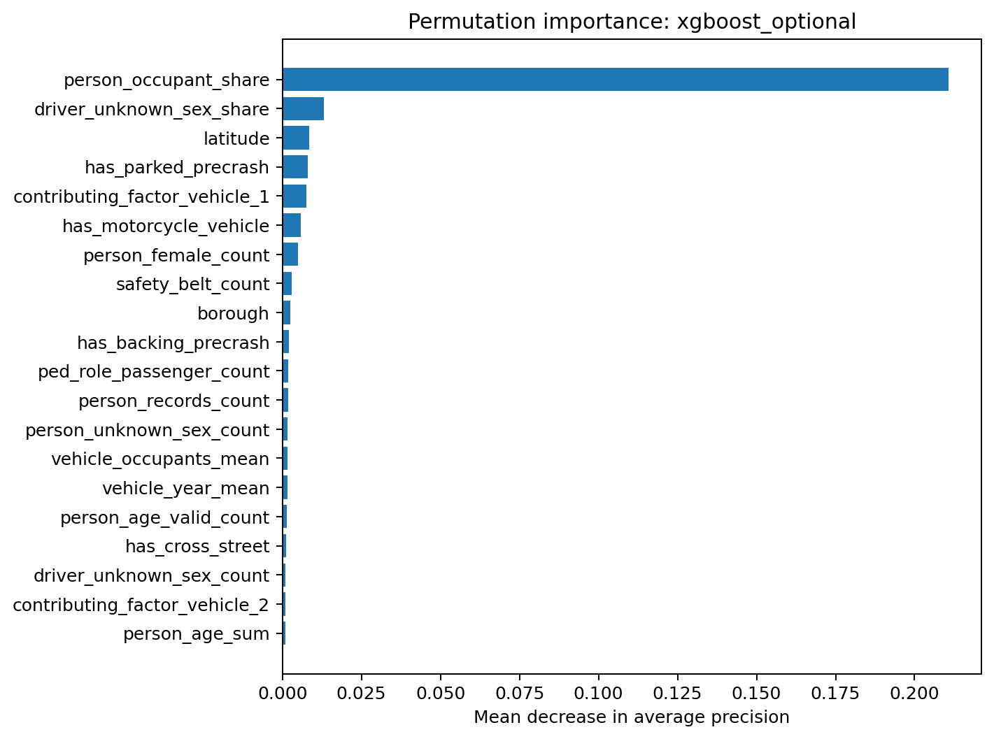
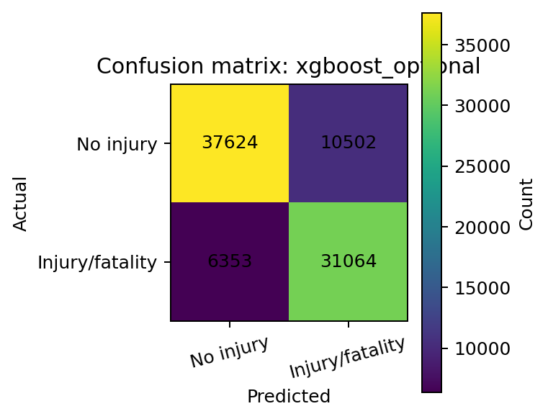
Model behavior: predictive, not causal
Interpret carefully
Top features summarize exposure, reporting, road-user mix, and location context.
Alan Nemkovsky • Section 05 • an1078
8
Notes:
The feature importance and confusion matrix help explain how the best model behaved. The important caution is that feature importance is not causation. A feature can be predictive because it captures location context, reporting patterns, exposure, road design, or the mix of road users. For example, person and vehicle involvement features are strongly predictive, but that does not mean the feature itself causes injury. It means that the linked record pattern contains information associated with injury-producing crashes. The confusion matrix also shows the tradeoff between precision and recall. The chosen threshold favors reasonably high recall, which makes sense for a safety-related classification task, but again, this should be interpreted as retrospective analysis rather than a real-time deployment system.

Slide 9
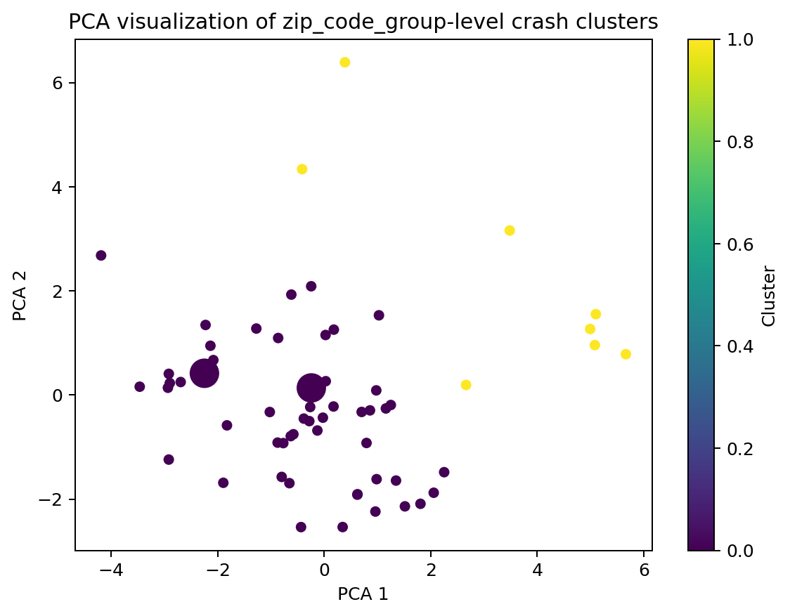
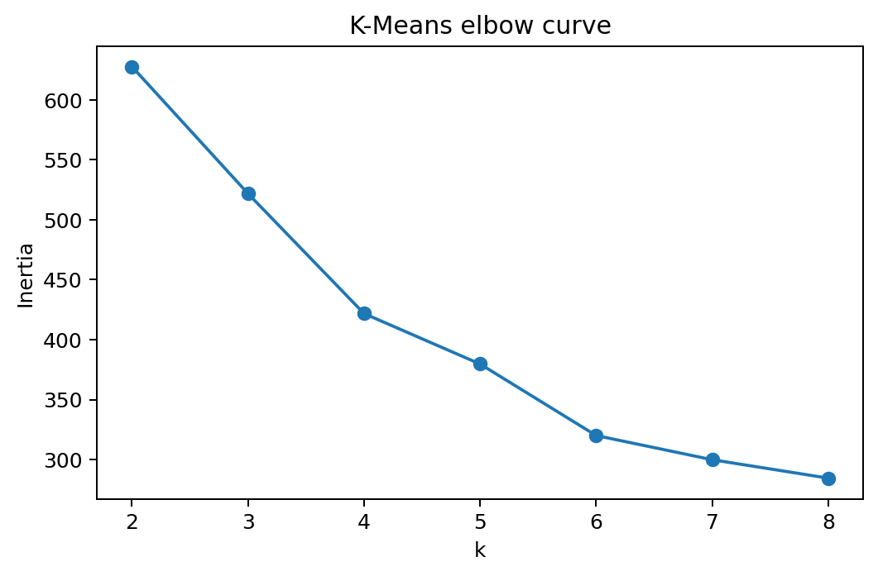
Unsupervised extension: crash archetypes
61
k = 2
ZIP-code groups clustered
selected by silhouette
Clusters separated more by involvement mix and timing than by raw injury rate.
Alan Nemkovsky • Section 05 • an1078
9
Notes:
I also added an unsupervised section to move beyond classification. Here, I aggregated crash characteristics by ZIP-code group and used PCA plus K-Means to look for crash archetypes. The silhouette score selected two clusters among 61 ZIP-code groups. The clusters were not simply high-injury versus low-injury areas. Instead, they were more about crash composition. One cluster had higher shares of pedestrian involvement, bicyclist involvement, taxi involvement, weekend crashes, and late-night crashes. So the clustering is exploratory: it helps describe different crash profiles across the city, even when the overall injury rates are similar.

Slide 10
Takeaways
What I found
Linked tables improved prediction
XGBoost performed best on 2025
I ♥ NYC
Results are associations, not causes
Limits
reported crashes only • no traffic exposure data • no causal claims
Alan Nemkovsky • Section 05 • an1078
10
Notes:
To close, the main finding is that injury-producing crashes are meaningfully predictable from linked NYC administrative records. XGBoost performed best overall, but the ablation study is the strongest evidence for the project’s main contribution: vehicle and person aggregates substantially improved prediction over a crash-only model. At the same time, the limitations are important. These are reported crashes, not every traffic interaction. The dataset does not include exposure denominators like traffic volume, pedestrian volume, road geometry, or weather in this version. So the results should be interpreted as predictive associations, not causal conclusions. My final takeaway is that a leakage-controlled multi-table workflow can turn large public safety records into useful insight, while still being honest about what the data can and cannot prove.

