Slide 1

XYZ GAMES
GRAPHIC PORTFOLIO

Slide 2

GRAPHIC 1 – BITMAP LOGO
Alan Robb
HND WEB DEVELOPMENT 06/11/24

Slide 3

GRAPHIC 2 – BITMAP BANNER
Alan Robb
HND WEB DEVELOPMENT 06/11/24

Slide 4

GRAPHIC 3 – BITMAP 3D TEXT
Alan Robb
HND WEB DEVELOPMENT 06/11/24

Slide 5
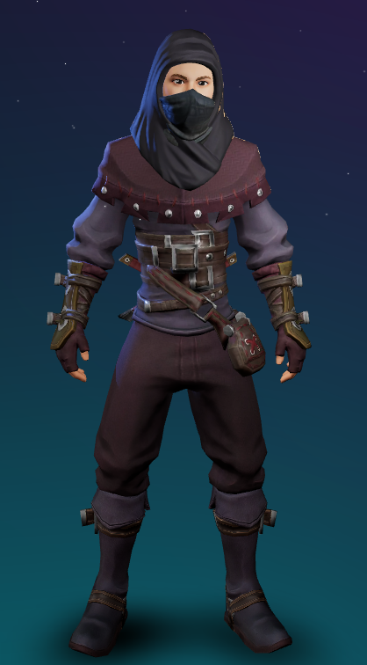
GRAPHIC 4 – BITMAP AVATAR
Alan Robb
HND WEB DEVELOPMENT 06/11/24

Slide 6
GRAPHIC 5 – BITMAP PHOTOMONTAGE
Alan Robb
HND WEB DEVELOPMENT 06/11/24

Slide 7
GRAPHIC SOFTWARE – URL LINKS
BITMAP LOGO
BITMAP BANNER
BITMAP 3D TEXT
BITMAP AVATAR
BITMAP PHOTOMONTAGE
Alan Robb
HND WEB DEVELOPMENT 06/11/24

