Slide 1
Course Introduction & History of Database Systems
CMPT 843, SPRING 2019
Jiannan Wang
https://sfu-db.github.io/dbsystems/
Notes:
Two parts

Slide 2
Introduce Yourself
What’s your name?
Where are you from?
M.Sc. or Ph.D.? Which year?
What do you want to get out of the course?

Slide 3
Course Introduction

Slide 4
Why this course?
Objective 1. Stand on the shoulders of giants!
A Half Century DB Research
VLDB = Very Large Data Base (founded in 1975)
Four Turing Awards
$50 billion Market Per Year
Objective 2. Master essential skills for being a researcher
Reading Papers
Giving Talks
Reviewing Papers
Asking Questions
Notes:
Why obj 1?
Reinvent wheel
Go to a wrong way
Why obj2?
Graduate course – prepare you to become a good phd
Go to a wrong way

Slide 5
Prerequisites
Undergraduate Database Systems Courses
Testing yourself: Relational Model, SQL, Query Optimization, Transaction, Concurrency Control, ACID, etc.
If not, you have to spend extra time on
Textbook: “Database Management Systems”
Online Courses: Stanford, Berkeley
Notes:
Assume you have taken an undergraduate db course
If not, two options
Quit
Spend extra time

Slide 6
39 papers
Part 1: Traditional Database Systems and Techniques (20 papers)
Part 2: Modern Database Systems and Techniques (18 papers)

Slide 7
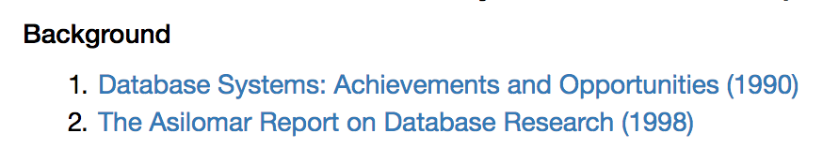
Part 1: Traditional Database Systems and Techniques (before 2000)

Slide 8
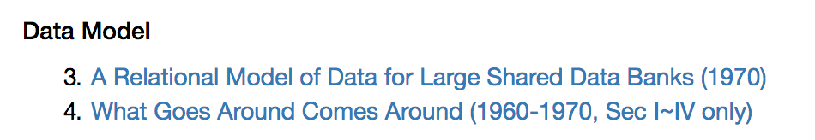
Part 1: Traditional Database Systems and Techniques (before 2000)

Slide 9
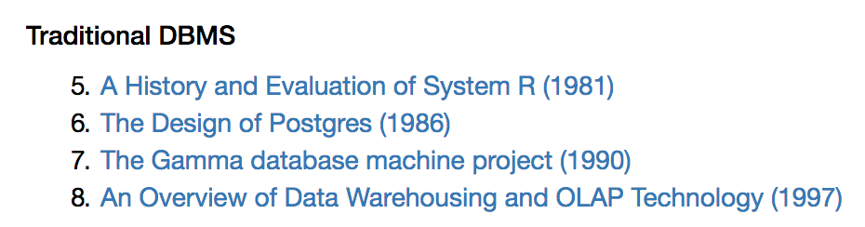
Part 1: Traditional Database Systems and Techniques (before 2000)

Slide 10
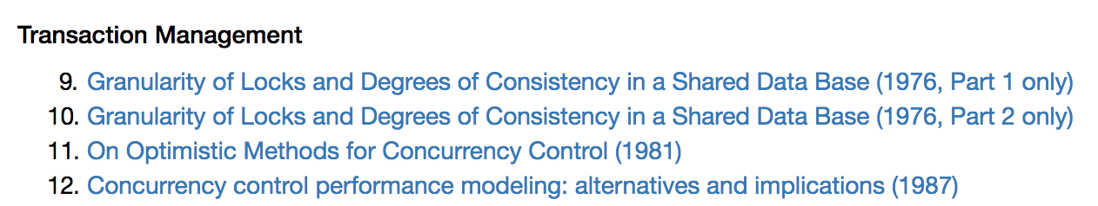
Part 1: Traditional Database Systems and Techniques (before 2000)

Slide 11
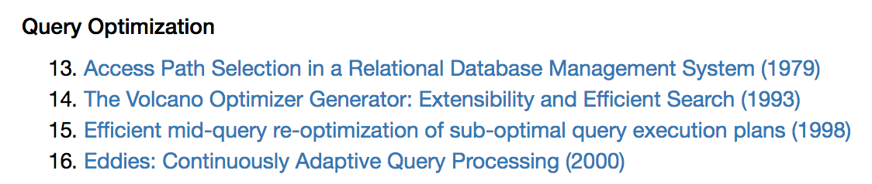
Part 1: Traditional Database Systems and Techniques (before 2000)

Slide 12
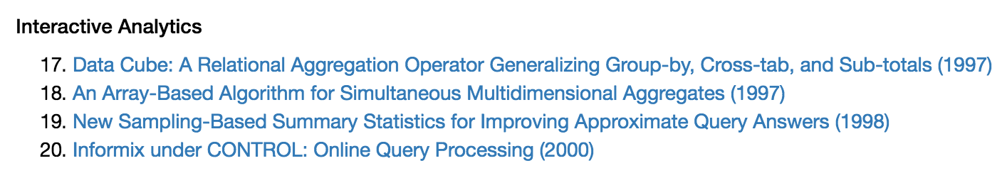
Part 1: Traditional Database Systems and Techniques (before 2000)

Slide 13
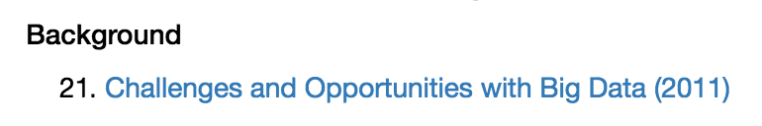
Part 2: Modern Database Systems and Techniques (after 2000)

Slide 14
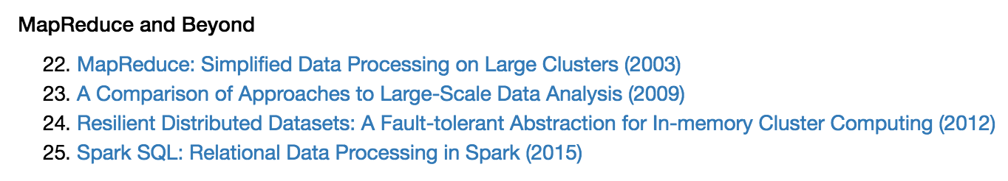
Part 2: Modern Database Systems and Techniques (after 2000)

Slide 15
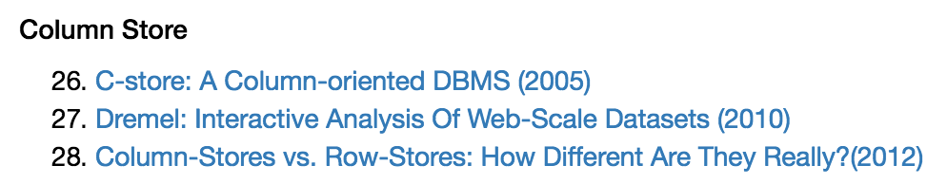
Part 2: Modern Database Systems and Techniques (after 2000)

Slide 16
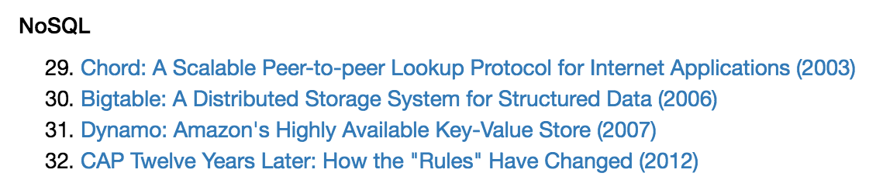
Part 2: Modern Database Systems and Techniques (after 2000)

Slide 17
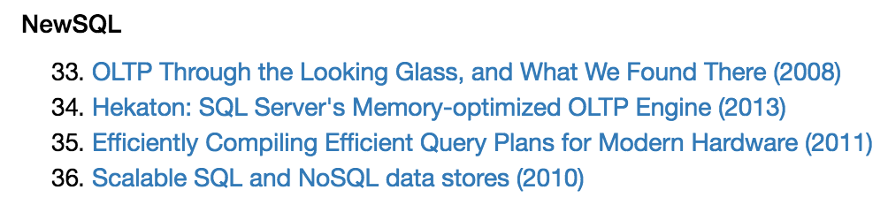
Part 2: Modern Database Systems and Techniques (after 2000)

Slide 18
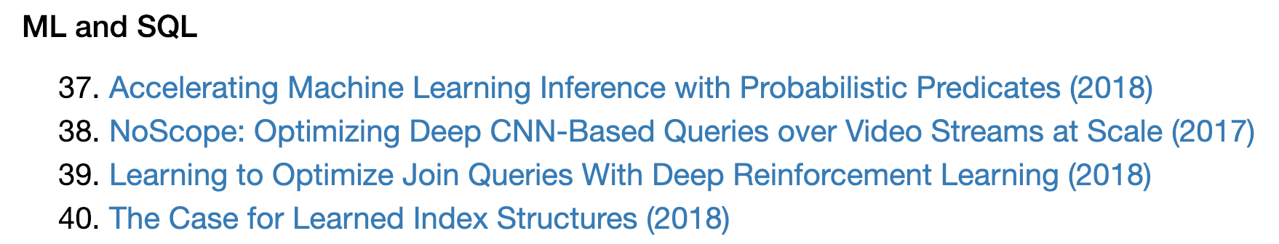
Part 2: Modern Database Systems and Techniques (after 2000)

Slide 19
References
Papers to read
Redbook - 5th Edition (Peter Bailis, Joseph M. Hellerstein, Michael Stonebraker)
Readings in Database (Reynold Xin)
Related Graduate Courses
CS286: Implementation of Database Systems (UC Berkeley, Fall 2014)
EECS 584: Advanced Database Management Systems (UMichgan, 2015 Fall)
Big Data Systems (Columbia, 2016 Spring)
15-799: Advanced Topics in Database Systems (CMU, 2013 Fall)

Slide 20
Skills
Reading Papers
Giving Talks
Reviewing Papers
Asking Questions

Slide 21
How you will be trained
Reading Papers
40 Papers
Giving Talks
2 Paper (20min+10 min Q&A)
Reviewing Papers
2 Papers
Asking Questions
Asking at least 10 questions in the Q&A sessions

Slide 22
Grading
Paper Presentation: 20%
Paper Review: 20%
Participation: 10%
Questions: 10%
Blog Post: 10%
Final Project: 30% (2% plan + 14% poster + 14% report)

Slide 23
What’s next
Fill in the form by the end of Monday 1/7
https://goo.gl/g3y735

Slide 24
History of Database Systems

Slide 25
Database Systems in a Half Century (1960s – 2010s)
When | What
Early 1960 – Early 1970 | The Navigational Database Empire
Mid 1970 – Mid 1980 | The Database World War I
Mid 1980 – Early 2000 | The Relational Database Empire
Mid 2000 – Now | The Database World War II
References.
https://en.wikipedia.org/wiki/Database#History
What Goes Around Comes Around (Michael Stonebraker, Joe Hellerstein)
40 Years VLDB Panel

Slide 26
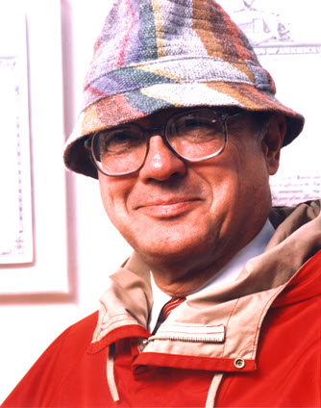
The Navigational Database Empire (Early1960 – Early 1970)
Data Model
How to organize data
How to access data
Navigational Data Model
Organize data into a multi-dimensional space (i.e., A space of records)
Access data by following pointers between records
Inventor: Charles Bachman
The 1973 ACM Turing Award
Turing Lecture: “The Programmer As Navigator”

Slide 27
The Navigational Database Empire (Early1960 – Early 1970)
Representative Navigational Database Systems
Integrated Data Store (IDS), 1964, GE
Information Management System (IMS), 1966, IBM
Integrated Database Management System (IDMS), 1973, Goodrich
CODASYL
Short for “Conference/Committee on Data Systems Languages”
Define navigational data model as standard database interface (1969)

Slide 28
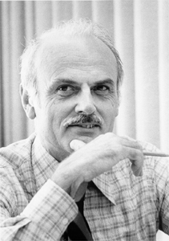
The Birth of Relational Model
Ted Codd
Born in 1923
PHD in 1965
“A Relational Model of Data for Large Shared Data Banks” in 1970
Relational Model
Organize data into a collection of relations
Access data by a declarative language (i.e., tell me what you want, not how to find it)
Data Independence

Slide 29
The Database World War I: Background
One Slide (Navigational Model)
Led by Charles Bachman (1973 ACM Turing Award)
Has built mature systems
Dominated the database market
The other Slide (Relational Model)
Led by Ted Codd (mathematical programmer, IBM)
A theoretical paper with no system built
Little support from IBM

Slide 30
The Database World War I: Three Big Campaigns
1. Which data model is better in theory?
(Mid 1970)
2. Which data model is better in practice?
(Late 1970 – Early 1980)
3. Which data model is better in business?
(Early 1980 – Mid 1980)

Slide 31
The “Theory” Campaign
A debate at ACM SIGFIDET (precursor of SIGMOD) 1974
Navigational model is bad
Data Organization: So complex
Data Access: No declarative language
Relational model is bad
Data Organization: A special case of navigational model
Data Access: No system proof that declarative language is viable

Slide 32


The “Practice” Campaign
The Big Question
Can a relational database system perform as good as a navigational system?
System prototypes
Ingres at UC Berkeley (early and pioneering)
System R at IBM (arguably got more stuff “right”)
The System R Team
Query Optimization (Patricia P. Griffiths et al.)
SQL ( Donald D. Chamberlin et al.)
Transaction (Jim Gray et al.)

Slide 33
The “Business” Campaign
Commercialization of Relational Database Systems
Not as easy as we thought
Three reasons (required) that led relational database systems to won
The minicomputer revolution (1977)
Competing products (e.g. IDMS) could not be ported to the minicomputer
Relational front end was not added to navigational database systems

Slide 34
What Can We Learn?
Lesson 1.
Lesson 2.
Lesson 3.
The winning of theory
The winning of practice
The winning of practice
The winning of business
Everyone can get a chance to win

Slide 35
The Relational Database Empire (Mid1980 – Early 2000)
Parallel and distributed DBs (1980 – 1990)
SystemR*, Distributed Ingres, Gamma, etc.
Objected-oriented DB (1980 – 1990)
Objects: Data/Code Integration
Extensibility: User-defined functions, User-defined data types
MySQL and PostgresSQL (1990s)
Widely used open-source relational DB systems

Slide 36
The Database World War II: Background
Internet Boom (Early 2000)
Larger data volume that cannot be fit in a single machine
Faster data updates that cannot be handled by a single machine
Commercial distributed database systems are expensive ☹
Open-source database systems do not support distributed computing well ☹

Slide 37
The Database World War II: Two Big Campaigns
Which is better for large-scale data analysis:
MapReduce vs. Traditional Database Systems?
Which is better for distributed transaction processing:
NoSQL vs. Traditional Database Systems?
Let’s find the answers through this course! ☺

