Slide 1
C-Store: A Column-oriented DBMS
Authors: Mike Stonebraker, Daniel J. Adabi, Adam Batkin, Xuedong Chen, etc.
Presenter: Ruijia Mao

Slide 2
Why Column Store?

Slide 3
Why Column Store?
Avoid bringing irrelevant attributes to the memory
Use CPU cycles to save disk bandwidth
Code data into a more compact form
Densepack value in storage
Other indexes can be applied
Bitmap index
Notes:
Row : pad data to byte or word

Slide 4
Agenda
C-Store Architecture
C-Store Data Model
Read-optimized Store (RS) & Writable Store (WS)
Updates & Transactions
Tuple Mover
Query Optimization
Conclusion & Comments

Slide 5
C-Store Architecture

Slide 6
C-Store Architecture
Writable Store (WS)
Insert/Update
Tuple Mover
Read-optimized Store (RS)
Read

Slide 7
C-Store: K-safety
A system tolerates K failures is called K-safe
Allocating segments of projections and corresponding join indices into various sites

Slide 8
C-Store Data Model

Slide 9
C-Store Data Model
C-Store supports relational logical data model
Physically, C-Store implements projections
Notes:
A database consists of several tables and each table has several columns

Slide 10
C-Store Data Model: Projections
Projection: a group of columns sorted on the same attributes
A projection is anchored on a logical table and has the same number of rows as the table

Slide 11
C-Store Data Model: Projection example
Name | Age | Dept. | Salary
Bob | 25 | Math | 10k
Bill | 27 | EECS | 50k
Jill | 24 | Biology | 80k

Slide 12
C-Store Data Model: Projection example
Name | Age | Dept. | Salary
Bob | 25 | Math | 10k
Bill | 27 | EECS | 50k
Jill | 24 | Biology | 80k
EMP1 ( name, age )
EMP2 ( dept, age, DEPT.floor )
EMP3 ( name, salary )
DEPT1 ( dname, floor )
Notes:
EMP(name, age, salary, dept)
DEPT(dname, floor)
Column-wise
if there are K attributes in a projection, there will be K data structures, each storing a single column, each of which is sorted on the same sort key.

Slide 13
C-Store Data Model:
Sort Key
Name | Age | Dept. | Salary
Bob | 25 | Math | 10k
Bill | 27 | EECS | 50k
Jill | 24 | Biology | 80k
EMP1 ( name, age | age )
EMP2 ( dept, age, DEPT.floor | DEPT.floor )
EMP3 ( name, salary | salary )
DEPT1 ( dname, floor | floor )
Notes:
The sort key can be any column or columns in the projection.

Slide 14
C-Store Data Model: Projection segments
Every projection is horizontally partitioned into 1 or more segments, which are given a segment identifier
C-Store only supports value-based partitioning on the sort key of a projection
Each segment is associated with a ket range

Slide 15
C-Store Data Model: Projection segment example
1 - 100
1 - 25
1
26 - 50
2
51 - 100
3
Projection
Key range
Segment
sid

Slide 16
C-Store Data Model: reconstruct complete row
Storage key (SK)
Join indices

Slide 17
C-Store Data Model: reconstruct complete row
Storage key (SK)
Each segment associates every data value of every column with a storage key
In RS, storage keys are inferred from a tuple’s physical position. In WS, storage keys are physically stored
Join indices

Slide 18
C-Store Data Model: reconstruct complete row
Storage key (SK)
Join indices
If T1 and T2 are two projections that cover a table T, a join index from M segments in T1 to N segments in T2 is logically a collection of M tables.

Slide 19
C-Store Data Model: reconstruct complete row
Storage key (SK)
Join indices
For every segment S in T1, the table contains rows of the form:
( t: SID in T2, k: Storage Key in Segment t )

Slide 20
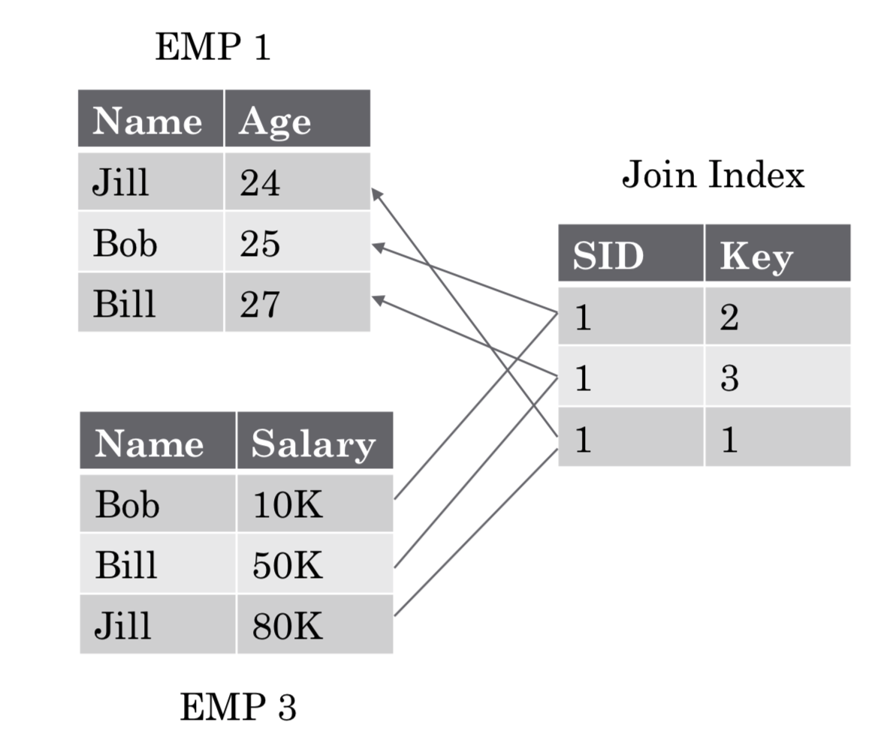
C-Store Data Model:
join indices example
Notes:
Serves as a pointer to corresponding row in another projection
Join index is expensive to maintain. Every update need to update all join indices

Slide 21
Read-optimized Store (RS) & Writable Store (WS)

Slide 22
RS
Columns in RS are compressed using one of four encodings according to their ordering
Notes:
As we mentioned earlier

Slide 23
RS: encoding schemes
Type 1: Self-order, few distinct values
A sequence of tuples (v, f, n)
Example: A group of 4’s appears in positions 12-18, represented by (4, 12, 7)
B-tree index over v.
Can Densepack because no online updates
Notes:
v value
F position v first appear
N number of times v appears

Slide 24
RS: encoding schemes
Type 2: foreign-order, few distinct values
A sequence of tuples (v, b)
Example: A column of integers ( 0, 0, 1, 1, 2, 1, 0, 2, 1 ) can be represented as 3 tuples: (0, 110000100), (1, 001101001), (2, 000010010)
Notes:
v value
B Bitmap indicating position

Slide 25
RS: encoding schemes
Type 3: self-order, many distinct values
Represent every value in the column as a delta from previous value
Example: A column of integers ( 1, 4, 7, 7, 8, 12 ) is represented by ( 1, 3, 3, 0, 1, 4 )

Slide 26
RS: encoding schemes
Type 4: foreign-order, many distance values
Currently left unencoded

Slide 27
WS
WS is also a column store and implements the identical DBMS design as RS
Storage is drastically different in order to support fast updating

Slide 28
WS: Data Storage
Storage key, SK, is explicitly stored in each WS segment
Data don’t get compressed because the size of WS is small
B-tree index on (v, sk) is used to maintain a logical sort-key order
Notes:
In RS inferred by the position in segment
This SK is an integer, larger than the number of records in the largest segment in the database.
v is the value in the column and sk is its corresponding storage key

Slide 29
Updates & Transactions

Slide 30
Updates
Updates in C-Store are represented as an insert followed by a delete
An insert is represented as a collection of new objects in WS, one per column per projection, plus the sorted key data structure.
Notes:
All inserts corresponding to a single logical record have the same storage key

Slide 31
Updates
Utilize a very large main memory buffer pool to avoid poor update performance.
Expect “hot” WS data structures to be largely main memory resident.

Slide 32
Update & transaction: Snapshot Isolation
C-Store isolates read-only transactions using snapshot isolation
Snapshot isolation works by allowing read-only transactions to access database as of some time in the recent past.
No lock needed for the past.
Notes:
When talking C-store expects large read queries followed by a small number of update query

Slide 33
Update & transaction: Snapshot Isolation
High Water Mark (HWM ): the most recent time in the past
Low Water Mark (LWM): the earliest effective time
Epoch: several seconds, unit of timestamps

Slide 34
Update & transaction: Snapshot Isolation
No records in RS were inserted after the LWM
All transactions that start before HWM are complete

Slide 35
Update & transaction: Snapshot Isolation
LWM(E)
HWM (E+1)
Now
E
E+1
E+2
E+3
Notes:
White two inserts

Slide 36
Updates & Transactions:
Locking-based Concurrency Control
Read-write transactions use strict two-phase locking
Write-ahead logging for recovery
Resolve deadlock via timeouts

Slide 37
Update & transaction: Recovery
Three types of crashes:
Failed site suffers no data loss - execute queued updates
Both RS and WS are failed - restore from other sites
Only WS fails - most common

Slide 38
Update & transaction: Recovery
Only WS fails:
Find the timestamp for the most recent insertion in RS. If there is no insertion in remote sites, we can simply restore WS with the help of remote sites
Otherwise, force the tuple mover to keep log.

Slide 39
Tuple Mover

Slide 40
Tuple Mover
Move blocks of tuples in a WS segment to the corresponding RS segment, and update join indices

Slide 41
Tuple Mover: MOP
Tuple mover perform merge-out process on (RS, WS) segment pair
Locate all records in WS segment with an insertion time <= LWM
Those deleted before LWM - Discard them
Not deleted or deleted after LWM - Move to RS

Slide 42
Query Optimization

Slide 43
Query Optimization
Use a Selinger-style optimizer that uses cost-based estimation for plan construction
Two differences with respect to traditional optimization
The need to consider compressed representations of data
The decisions about when to mask a projection using a bitstring
Notes:
The ability to process compressed data improves the performance of C-Store a lot. But some compressed data, like Type 2, require much larger memory buffer space than other three types of compression.
A bitstring is a list of zeros and ones indicating whether the associated values are desired.

Slide 44
Conclusion & Comments

Slide 45
Conclusion & Comments
Column-based storage for efficient read and other smart designs
WS was not fully implemented at that time

Slide 46
Q&A
Thanks

