Slide 1
Essential Skills Needed for a PhD Student
Jiannan Wang
Simon Fraser University

Slide 2

What is a PhD?
5 more years of learning new knowledge

Slide 3

What is a PhD?
Imagine a circle that contains
all of human knowledge
From http://matt.might.net/articles/phd-school-in-pictures/

Slide 4
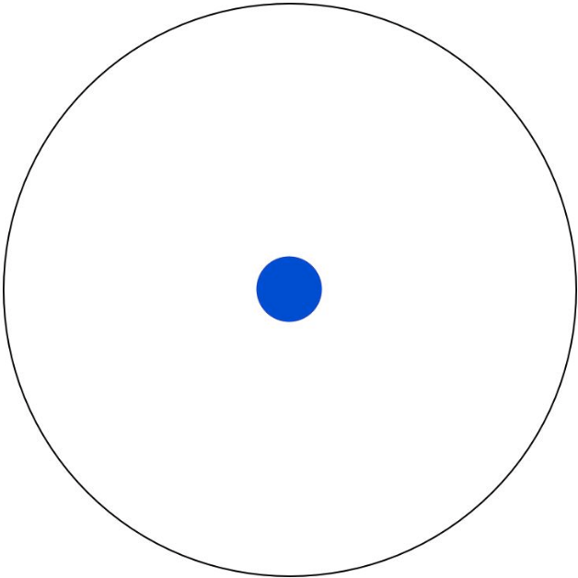
What is a PhD?
By the time you finish
elementary school,
you know a little.
From http://matt.might.net/articles/phd-school-in-pictures/

Slide 5
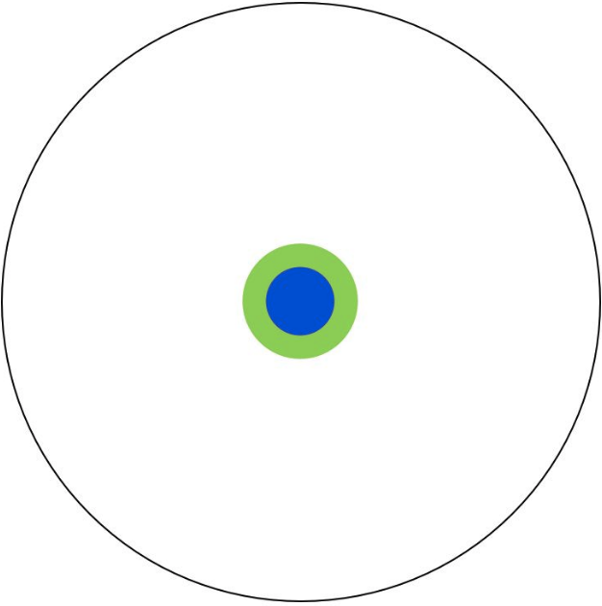
What is a PhD?
By the time you finish
high school,
you know a bit more
From http://matt.might.net/articles/phd-school-in-pictures/

Slide 6
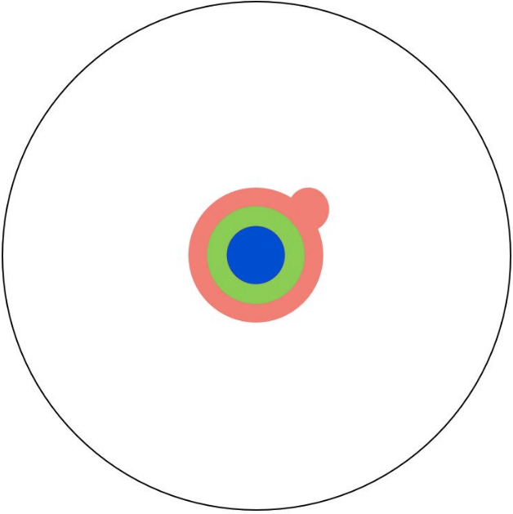
What is a PhD?
With a bachelor’s degree, you gain a specialty.
From http://matt.might.net/articles/phd-school-in-pictures/

Slide 7
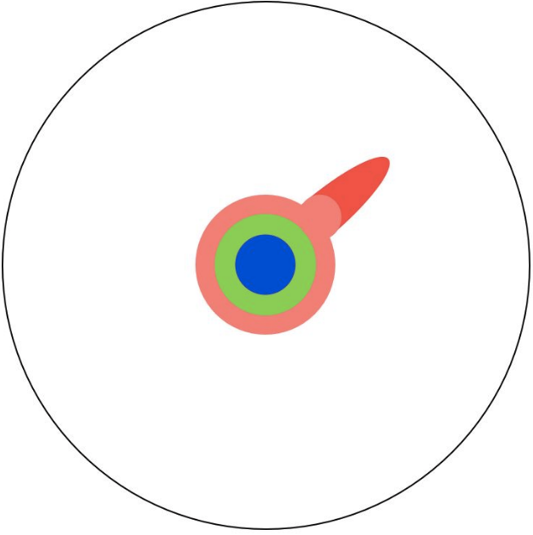
What is a PhD?
A master’s degree deepens that specialty.
From http://matt.might.net/articles/phd-school-in-pictures/

Slide 8
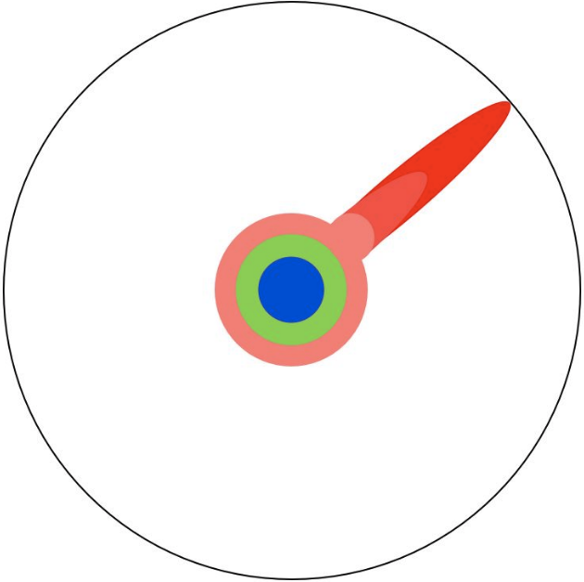
What is a PhD?
Reading papers takes you to the edge of human knowledge.
From http://matt.might.net/articles/phd-school-in-pictures/

Slide 9
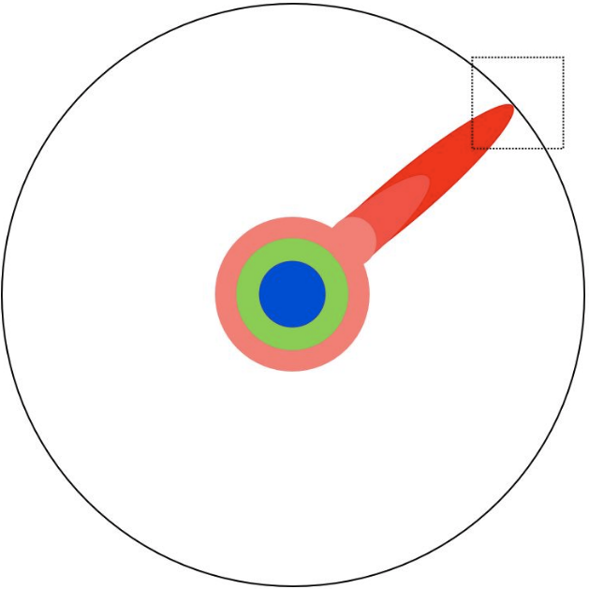
What is a PhD?
Once you’re at the boundary, you focus.
From http://matt.might.net/articles/phd-school-in-pictures/

Slide 10

What is a PhD?
You push at the boundary for a few years.
From http://matt.might.net/articles/phd-school-in-pictures/

Slide 11

What is a PhD?
Until one day, the boundary gives way.
From http://matt.might.net/articles/phd-school-in-pictures/

Slide 12
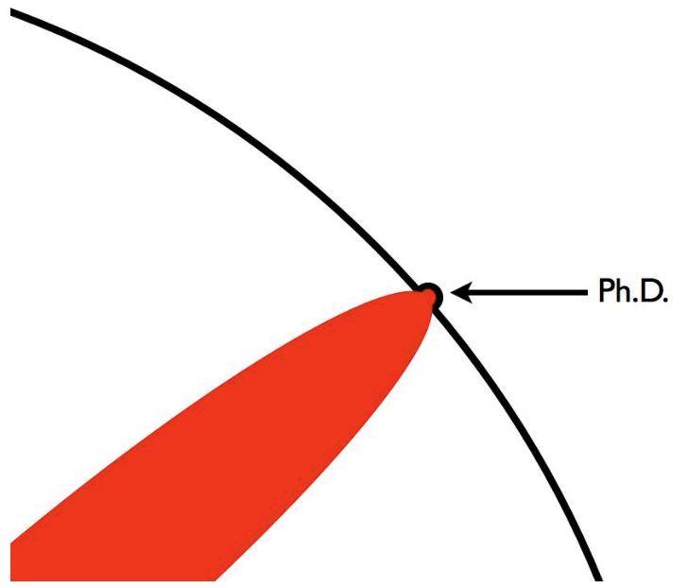
What is a PhD?
And, that dent you've made is called a Ph.D.
From http://matt.might.net/articles/phd-school-in-pictures/

Slide 13
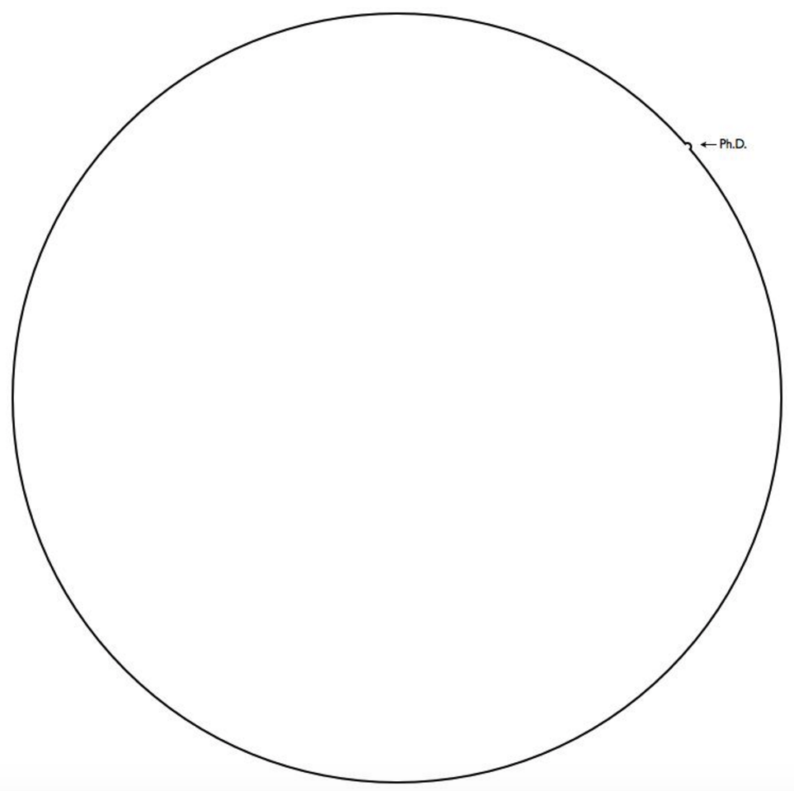
What is a PhD?
Thanks to your contribution!

Slide 14
Essential Skills
Reading Papers
Critical Thinking
Reviewing Papers
Asking Questions
…
Presentation
Giving Talks
…

Slide 15
Reading Papers
Top conferences/journals
E.g., Database: SIGMOD, VLDB, TODS, …
E.g., Machine Learning: NIPS, ICML, JMLR, ...
The three-pass approach*
A quick scan
With greater care, but ignore details
Virtually re-implement the paper
* S. Keshav. How to read a paper? http://blizzard.cs.uwaterloo.ca/keshav/home/Papers/data/07/paper-reading.pdf

Slide 16
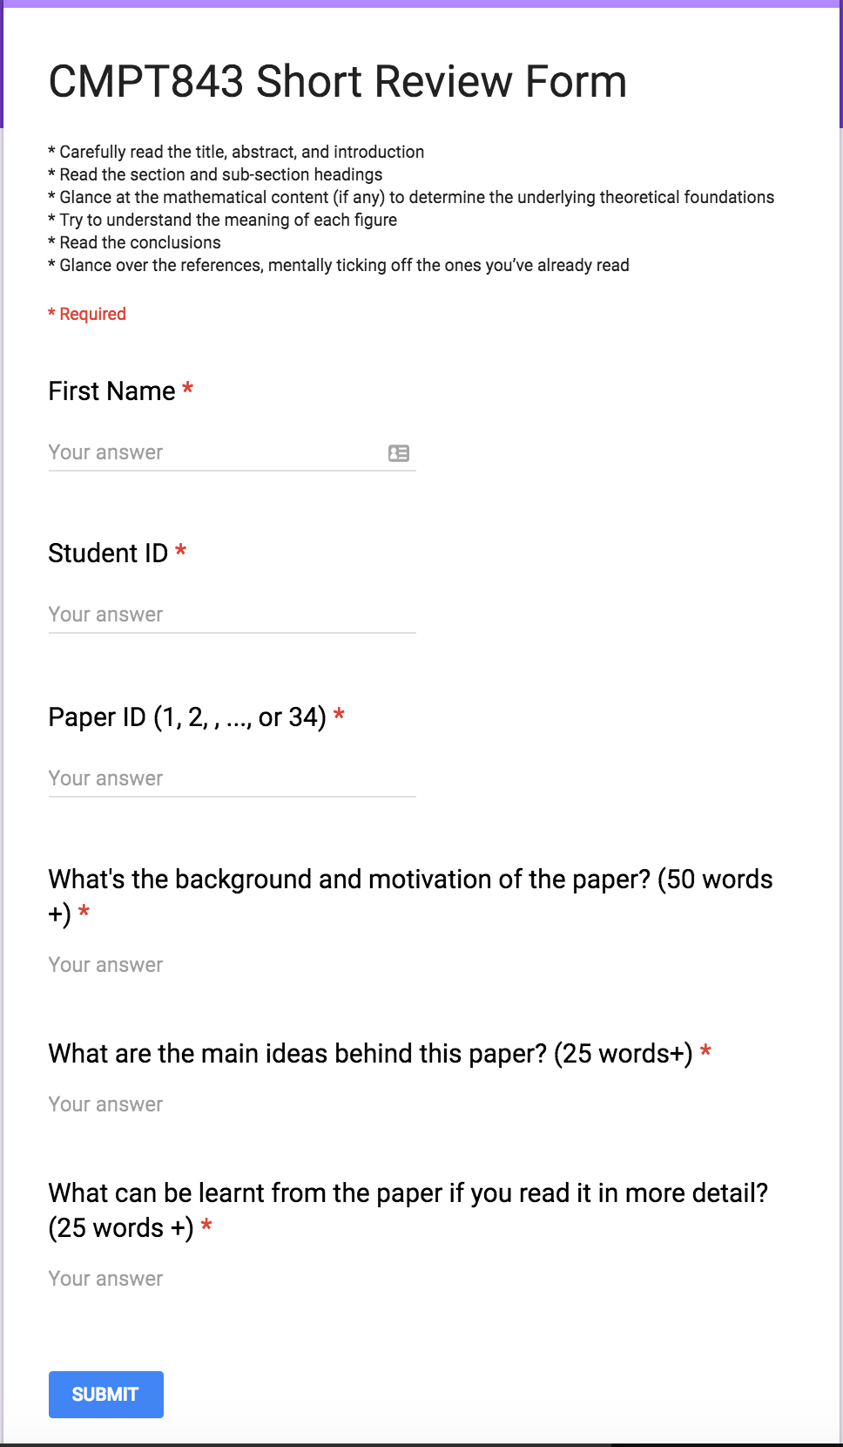
The First Pass
“
”
A quick scan means that:
Carefully read the Title, Abstract, Introduction, Section headings, Conclusion
Glance over the mathematical content (if any) and the references
You should be able to answer:
What’s the motivation of the paper?
What’s the key idea of the paper?
What can be learnt from the paper?
https://goo.gl/forms/ValSvKdrHd9CAa032

Slide 17
The Second Pass
“
”
With greater care, but ignore details means that:
Look carefully at the figures, diagrams and examples
Mark relevant unread references for further reading
Ignore proofs, extensions, and appendix
You should be able to
Summarize the content of the paper
Explain the main objective of the paper, with supporting evidence, to somebody else

Slide 18
The Third Pass
“
”
Virtually re-implement the paper means that
Challenge every assumption
Think about how you yourself would present a particular idea
Compare this re-creation with the actual paper
You should be able to
Identify hidden failings and assumptions
Derive new ideas for future work

Slide 19
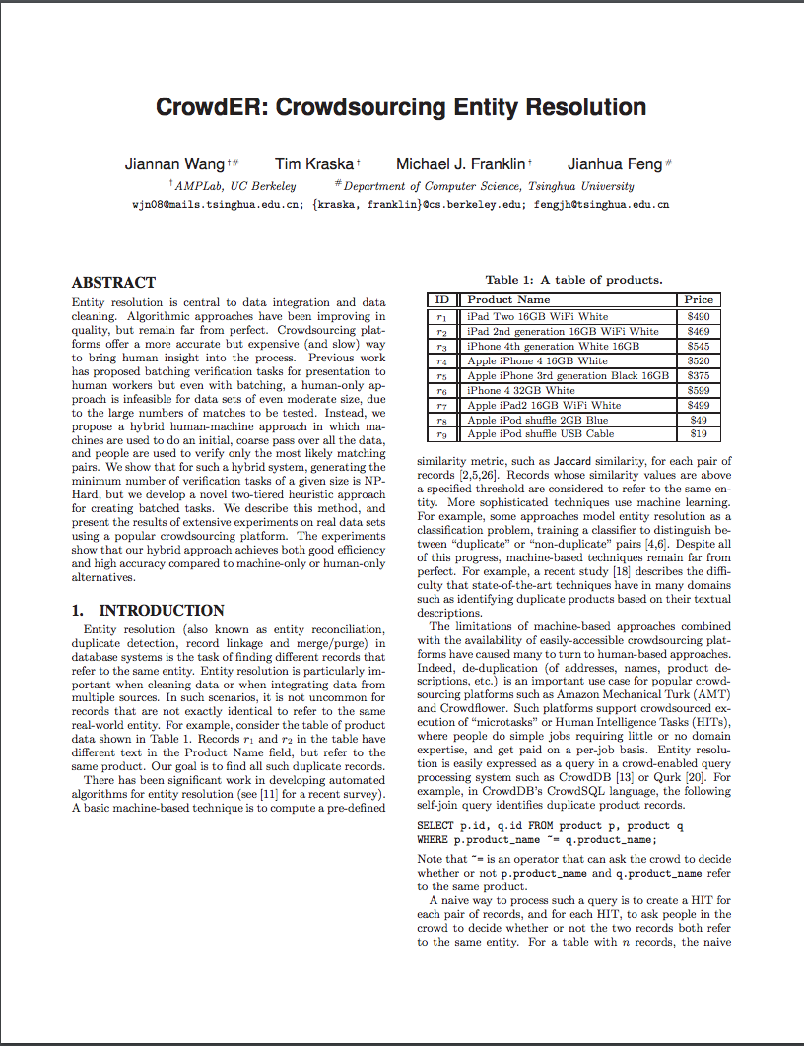
When to use which
The 1st Pass
Stop here if
not interesting

Slide 20
When to use which
The 2nd Pass
Stop here if not useful to your work

Slide 21
When to use which
The 3rd Pass
Fully understand the paper

Slide 22
Essential Skills
Reading Papers
Critical Thinking
Reviewing Papers
Asking Questions
…
Presentation
Giving Talks
…

Slide 23

Why Paper Review
The Peer Review Process
What’s a review for?
Quality Control: Publish or not?
Constructive Criticism: How to improve?

Slide 24
Structure of a Review
Long Review
Summarize the paper (1-2 paras)
State the contributions (1 para)
Strong/Weak Points (in bullet form, 3+ for each)
Detailed Comments (as long as necessary)
Novelty, Presentation, Significance, Technical Depth, Related Work
Technical flaws? Unaddressed issues? Appropriate for the venue?
Timothy Roscoe. Writing reviews for systems conferences. March 2007

Slide 25
Advice on writing reviews
Take notes while reading the paper
Make the review constructive
The system doesn’t deal with … → The paper would be much stronger if ...
Criticize the paper, not the authors or the work itself
You should cite [1] → The paper reminded me of [1], which seems quite similar
Avoid flat assertions
The algorithm breaks when n=1 → The description in the paper left me worried that the algorithm breaks when n=1. For example, suppose …

Slide 26
Asking Questions at Talks
Why to ask?
Force you to listen to a talk more carefully
A great opportunity to talk directly with a big guy
Train your public speaking skills
You will be remembered if asking a great question
Show respect to a speaker

Slide 27
Guidance
What to ask?
Asking Questions ≈ Online Paper Review
Critical Thinking*
How to ask?
Be clear about what you want to know
Provide context if necessary
Challenge the speaker in a constructive way
* M. Neil Browne and Stuart M. Keeley. Asking the Right Questions

Slide 28
Essential Skills
Reading Papers
Critical Thinking
Reviewing Papers
Asking Questions
…
Presentation
Giving Talks
…

Slide 29
Plenty of Opportunities
Give a talk in a conference
Give a talk in class
Give a talk in a meeting with your advisor
Give a talk in a group meeting
Give a talk in PhD Depth Exam
Give a talk in PhD Thesis Defense
Notes:
1. Presentation is not equal to whether you can speak English well.

Slide 30
Why giving a talk?
Communication
Convey complex information in a simple way
Excite and motivate the audience

Slide 31
How to prepare a talk?
Step 1: Come up with a message objective
Step 2: Come up with no more than 3 points in support of your message objective
Step 3: Determine the evidence to support each point
Step 4: Determine your hook
Step 5: Determine your wrap-up
Joey Asher. Even a Geek Can Speak: Low-tech Presentation Skills for High-tech People. 2006

Slide 32
Steps in Preparing a Talk - 1
Step 1: Come up with a Message Objective
Why? Never hear again: “I’m not sure what your point is”
How? Bring together what you want with what the audience wants
Example: By mastering the essential skills, students will have a higher chance to become a successful PhD

Slide 33
Steps in Preparing a Talk - 2
Step 2: Come up with no more than 3 points in support of your message objective
Why? People cannot remember more than 3 points. Fewer points have more impact
How? Keep the most important points
Example: (Point 1) What is a PhD?
(Point 2) What are essential skills for a PhD?
(Point 3) How to master the skills

Slide 34
Steps in Preparing a Talk - 3
Step 3: Determine the evidence to support each point
This step is the key to make your presentation exciting
How? Examples, Analogies, Stories, Personal experiences, Quotes, Statistics
Example: Using to explain what a PhD is

Slide 35

Steps in Preparing a Talk - 4
Step 4: Determine your hook
The Hook: Make a first impression with impact
A great hook should
Grab the audience's attention
Focus the audience immediately on the key issues
Be short and fast
Example: PHD is just 5 more years of learning new knowledge?

Slide 36
Steps in Preparing a Talk - 5
Step 5: Determine your wrap-up
Why? Make absolutely sure that the audience has gotten your key message
How?
Restate your message objective and your key points
Call to action: what you want the audience to do next
Example. See Slide 38.

Slide 37
Fill in the Form for Your Talk
Hook:
Message Objective:
Key Points Along With Their Evidence
Point 1:
Evidence:
Point 2:
…
Recap and Wrap:

Slide 38
Summary
Objective: By mastering the essential skills, students will have a higher chance to become a successful PhD
1. What is a PHD? Creating new knowledge
2. What are essential skills? How to read/review papers, ask questions, and give talks?
3. How to master the skills? The three pass approach; Structure of a review; Guidance for asking questions; Five steps in preparing a talk
Action: Please follow these approaches throughout the entire course to read/review papers, ask questions, and give talks

Slide 39
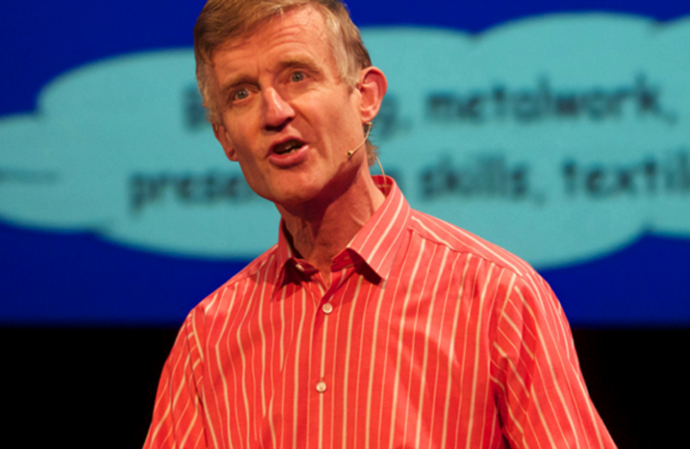
How to give a great research talk by Simon Peyton Jones

