Slide 1
An Array-Based Algorithm for Simultaneous Multidimensional Aggregates
Pushkar Sinha

Slide 2
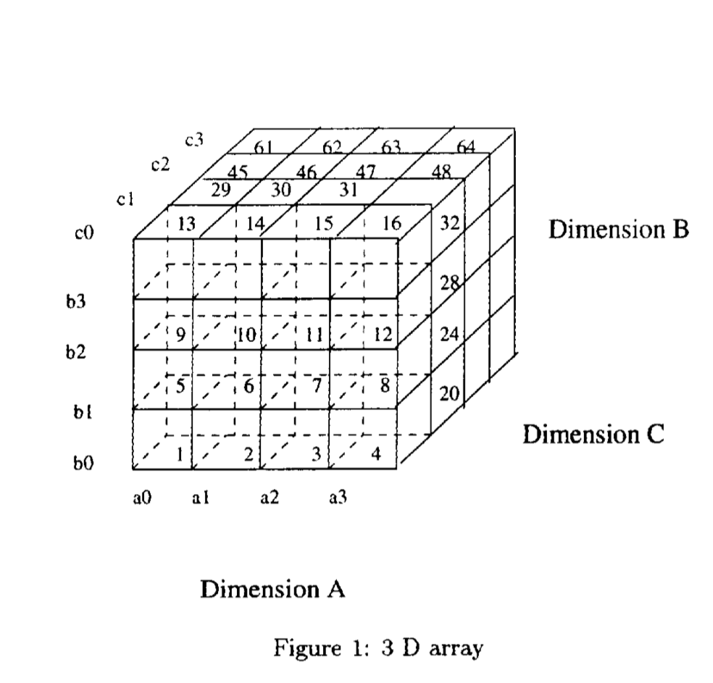
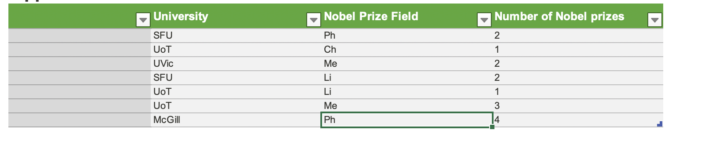
Cube Operator and Multidimensional Array
No of relational rows = 8, No of DQ rows = 4X4X4

Slide 3
Different Group-by and their Independence
A chunk is 1 of the small 64 cubes in the pic. Total cube is 16X16X16 while a chuck is 4X4X4
For group by AB we aggregates each cell of the front face for the whole C dimension and store it in the disk.
Since these AB cells are independent we need to store on one AB chunk at a time.

Slide 4
Reading order and the Key concept
We want to read as many less times as possible ( if enough memory, we read only once).
Reading in dimensional order (A,B,C) mean reading the chunks linearly 1-64. You see that its group by BC (aggregating BC cells towards dimension A). For which we need only one chunk i.e. a0 b0 + a1b0 + a2b0 + a3b0 each time to calculate each cell of BC.
But to group by BC we need 4 chunks and similarly for group by AB we need 16 chunks.

Slide 5
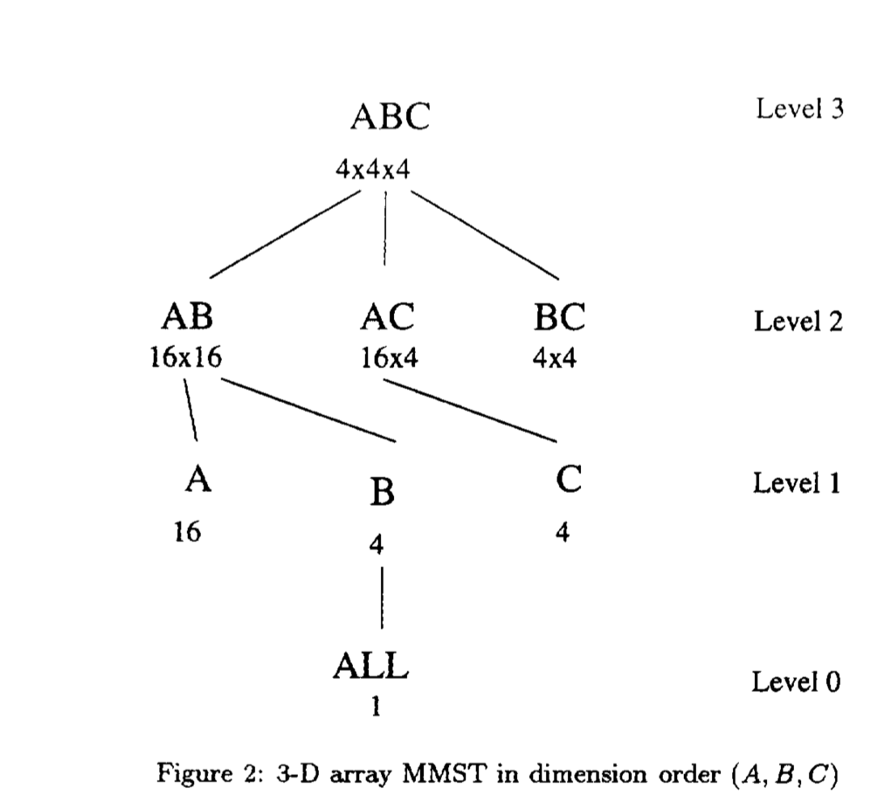
MMST
We have this tree as well as the required data structure so as we read and we can have the possible subtrees calculated, they will be such.

Slide 6
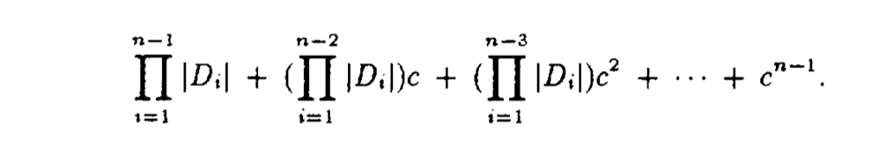
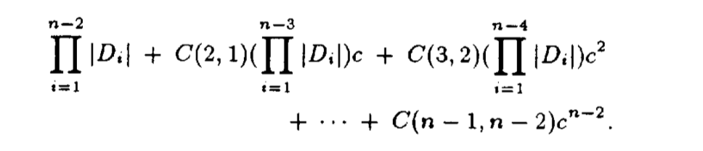
Generalizing the memory requirement for n dimension
We see that as the group bys get more sqewed corresponding to how we read the chunks in the first place the memory requirement increases (Right-to-left).

Slide 7
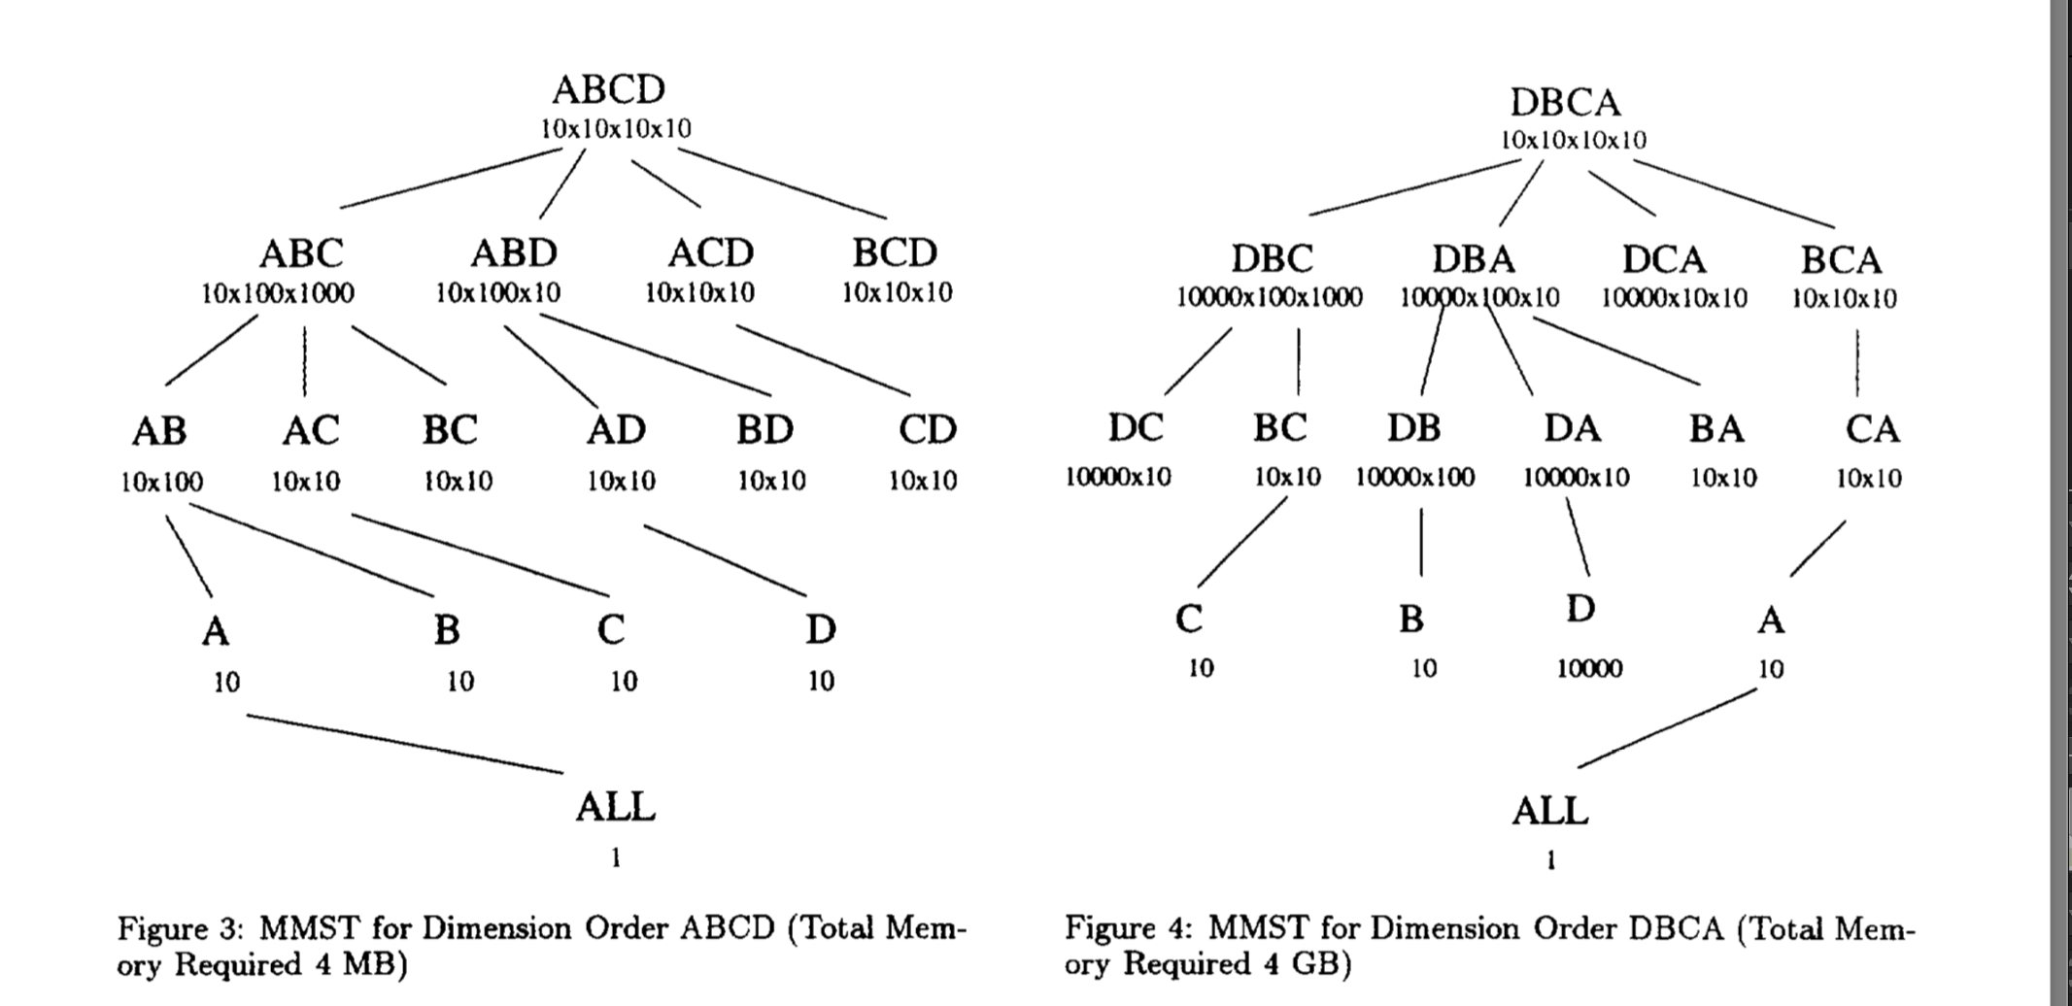
Reading order comparison

Slide 8
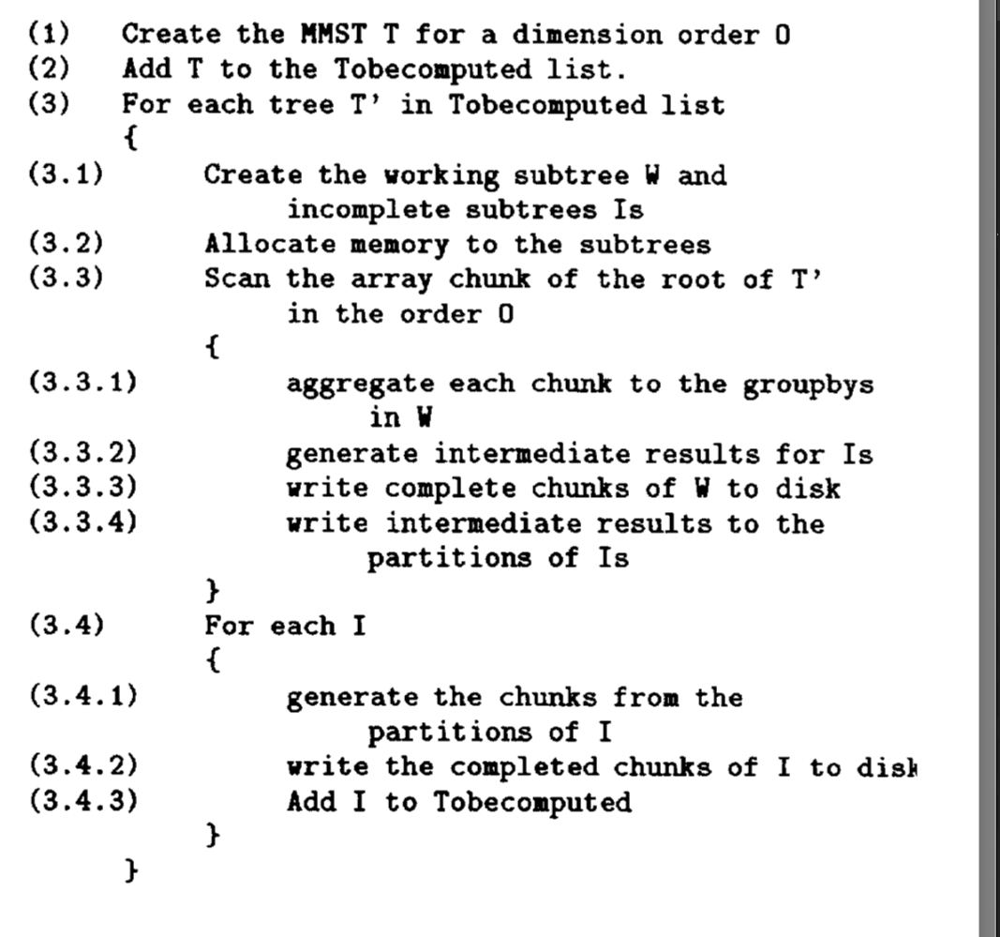
When we don’t have enough memory for the whole MMST

