Slide 1
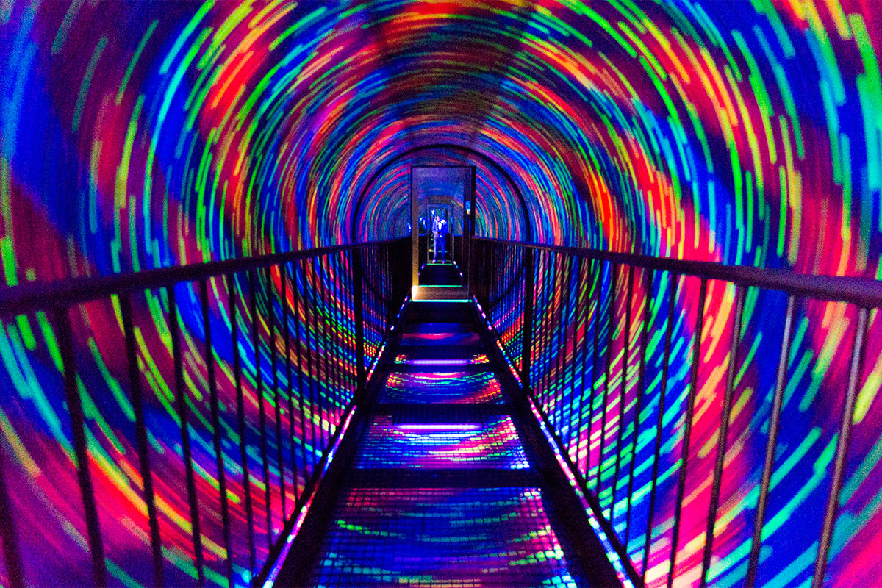
Camera Clara
Alan Savio Paul
Efe Hoplamaz
Dimitris Christodoulou

Slide 2
The problem
Map customer journey in Camera Obscura
How long people spend at the attraction
In what order they do things
How long they spend at each floor/exhibit

Slide 3
What we did
Using a camera located near an exhibit we can:
Keep track of the number of people looking at it
Know for how long they spend interacting with it
Using a Bluetooth receiver we can estimate the number of people in a room/floor

Slide 4
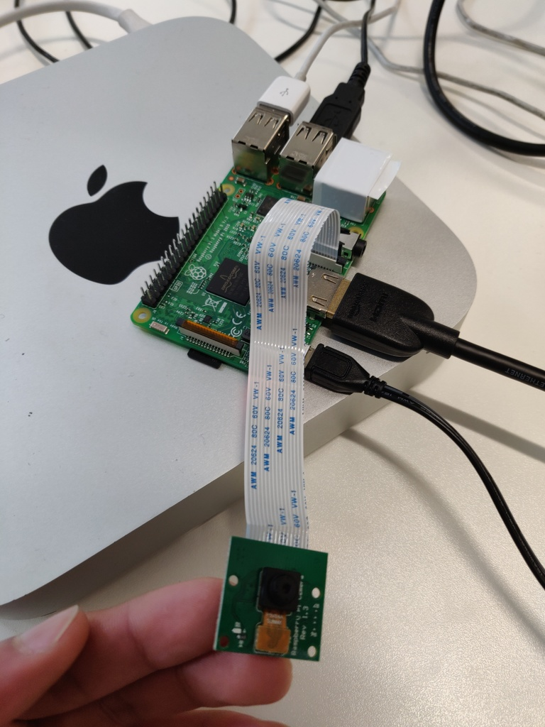
What is Camera Clara?
Using a camera placed near an exhibit, we can detect the number of faces looking at the exhibit and determine the popularity of an exhibit.
People who are too far away are ignored.

Slide 5
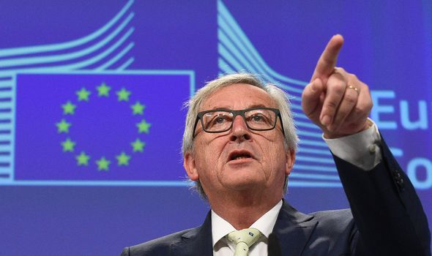
But what about GDPR?
We are not storing footage from the camera.
The data we keep does not contain personal information.

Slide 6
Demo

Slide 7
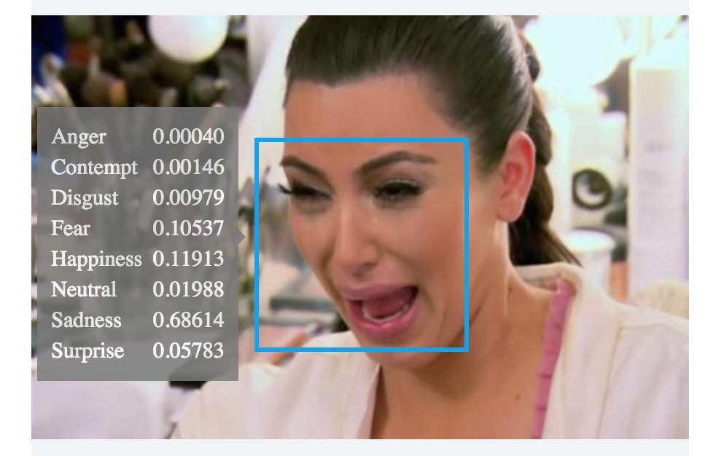
What’s next for Camera Clara?
Improve real time emotion detection to distinguish between visitors who are having fun and those who are not so amused.
We can extrapolate the data to deduce what emotions each exhibit makes the visitors feel.
Improve accuracy

Slide 8
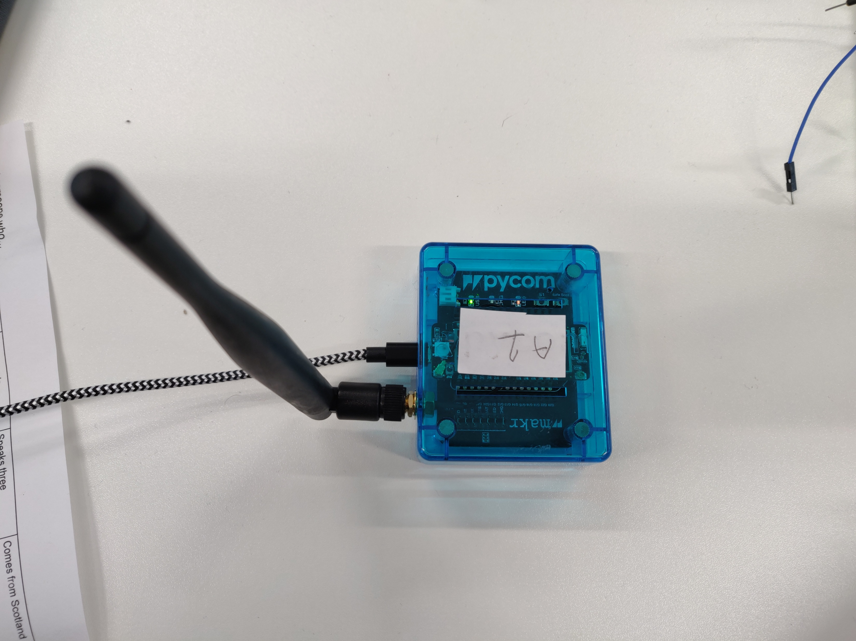
Using Bluetooth
We used the Bluetooth receiver on LoPy to estimate the number of people around
However, not everyone has Bluetooth turned on in their devices
An incentive can be provided for people to turn the Bluetooth on their devices on
For example, creating a mobile app that provides location-specific information about the museum/exhibits
Bluetooth beacons can track the location of visitors in the museum and push information about exhibits on their devices

Slide 9
Any questions?

