Slide 1
AUTONOMOUS GROUND ROVER FOR OUTDOOR SURFACE LEVEL TRASH COLLECTION
RIYA ELIZABETH RAJU
MAC20CS050
ARUN JOSEPH
MAC20CS021
ANAGHA ASHOKAN
MAC20CS013
S8 R
DEPT OF COMPUTER SCIENCE AND ENGINEERING, MACE KOTHAMANGALAM

Slide 2
Introduction
Problem statement
Objectives
Literature Survey 1
Literature Survey 2
Literature Survey 3
Literature Survey 4
Literature Survey 5
Proposed methodology
System Architecture
Block Diagram
Hardware Components
Design and Model
Competitions and Awards
Results
Conclusion
References
INTRODUCTION
Outdoor cleaning used to be a laborious task, requiring daily manual effort, and the lack of innovation in this field significantly impacted people's daily lives. However, an autonomous rover equipped with advanced sensor capabilities presents an opportunity to effectively automate this process.
Dept of Computer Science and Engineering, MACE Kothamangalam

Slide 3
Introduction
Problem statement
Objectives
Literature Survey 1
Literature Survey 2
Literature Survey 3
Literature Survey 4
Literature Survey 5
Proposed methodology
System Architecture
Block Diagram
Hardware Components
Design and Model
Competitions and Awards
Results
Conclusion
References
PROBLEM STATEMENT
To design and implement an autonomous rover capable of handling uneven ground level surfaces and to implement a vison enabled path planning model for effective trash collection. The design should be compact, effective and efficient for use.
Dept of Computer Science and Engineering, MACE Kothamangalam

Slide 4
Introduction
Problem statement
Objectives
Literature Survey 1
Literature Survey 2
Literature Survey 3
Literature Survey 4
Literature Survey 5
Proposed methodology
System Architecture
Block Diagram
Hardware Components
Design and Model
Competitions and Awards
Results
Conclusion
References
OBJECTIVES
Model and manufacture the frame of the rover
Assemble and test the required hardware components
Prepare the autonomous algorithms and programs
Test and make improvements to path planning and trash detection
Enable the rover to operate autonomously.
Dept of Computer Science and Engineering, MACE Kothamangalam
Dept of Computer Science and Engineering, MACE Kothamangalam
8 May, 2024
4

Slide 5
LITERATURE SURVEY
Introduction
Problem statement
Objectives
Literature Survey 1
Literature Survey 2
Literature Survey 3
Literature Survey 4
Literature Survey 5
Proposed methodology
System Architecture
Block Diagram
Hardware Components
Design and Model
Competitions and Awards
Results
Conclusion
References
[1] R. J. Ong and K. N. F. Ku Azir, "Low Cost Autonomous Robot Cleaner using Mapping Algorithm based on Internet of Things (IoT)," IOP Conf. Ser.: Mater. Sci. Eng., vol. 767, p. 012071, 2020.
Detects any obstacles with the help of sensor and send its output to microcontroller that will control the autonomous vacuum cleaner movement.
Based on Arduino uno and node mcu ,obstacle avoidance
Dept of Computer Science and Engineering, MACE Kothamangalam
Dept of Computer Science and Engineering, MACE Kothamangalam
8 May, 2024
5

Slide 6
LITERATURE SURVEY
Introduction
Problem statement
Objectives
Literature Survey 1
Literature Survey 2
Literature Survey 3
Literature Survey 4
Literature Survey 5
Proposed methodology
System Architecture
Block Diagram
Hardware Components
Design and Model
Competitions and Awards
Results
Conclusion
References
[2] M. Kulshreshtha, S. S. Chandra, P. Randhawa, G. Tsaramirsis, A. Khadidos, and A. O. Khadidos, "OATCR: Outdoor Autonomous Trash-Collecting Robot Design Using YOLOv4-Tiny," Electronics, vol. 10, no. 18, p. 2292, Sep. 2021
This paper proposed a Rocker-bogie based mechanism for autonomous Trash-Collecting Robots.
Mask-RCNN, YOLOV4, and YOLOv4-tiny were experimented on and analysed for trash detection
This system uses pick and place method to collect the trash thus no sweeping action or a trajectory to cover the entire region is not taken.
Dept of Computer Science and Engineering, MACE Kothamangalam
Dept of Computer Science and Engineering, MACE Kothamangalam
8 May, 2024
6

Slide 7
LITERATURE SURVEY
Introduction
Problem statement
Objectives
Literature Survey 1
Literature Survey 2
Literature Survey 3
Literature Survey 4
Literature Survey 5
Proposed methodology
System Architecture
Block Diagram
Hardware Components
Design and Model
Competitions and Awards
Results
Conclusion
References
[3] Jinjun Rao, Haoran Bian, Xiaoqiang Xu and Jinbo Chen, "Autonomous Visual Navigation System Based on a Single Camera for Floor-Sweeping Robot," Appl. Sci. 2023, vol 13(3), 1562
This technology is mostly used in indoor areas and its cleaning
Not ideal for outdoor use also no detection for elevation change
localization is difficult in this case but not limited to any other means
Dept of Computer Science and Engineering, MACE Kothamangalam
Dept of Computer Science and Engineering, MACE Kothamangalam
8 May, 2024
7

Slide 8
LITERATURE SURVEY
Introduction
Problem statement
Objectives
Literature Survey 1
Literature Survey 2
Literature Survey 3
Literature Survey 4
Literature Survey 5
Proposed methodology
System Architecture
Block Diagram
Hardware Components
Design and Model
Competitions and Awards
Results
Conclusion
References
[4] Latifinavid, M.; Azizi, A. Development of a Vision-Based Unmanned Ground Vehicle for Mapping and Tennis Ball Collection: A Fuzzy Logic Approach. Future Internet 2023.
Difficult to incorporate with robot operating system as raspberry pi is not ideal for such high end processing
Yolo and slam techniques are successfully incorporated in this model also the outdoor usage is successfully demonstrated
Dept of Computer Science and Engineering, MACE Kothamangalam
Dept of Computer Science and Engineering, MACE Kothamangalam
8 May, 2024
8

Slide 9
LITERATURE SURVEY
Introduction
Problem statement
Objectives
Literature Survey 1
Literature Survey 2
Literature Survey 3
Literature Survey 4
Literature Survey 5
Proposed methodology
System Architecture
Block Diagram
Hardware Components
Design and Model
Competitions and Awards
Results
Conclusion
References
[5] Zhang, Y.; Wu, Y.; Tong, K.; Chen, H.; Yuan, Y. Review of Visual Simultaneous Localization and Mapping Based on Deep Learning. Remote Sens. 2023.
Slam implementation, classification and design is obtained
Future scope and the applicability of slam and v-slam is retained from this survey
Dept of Computer Science and Engineering, MACE Kothamangalam
Dept of Computer Science and Engineering, MACE Kothamangalam
8 May, 2024
9

Slide 10
Introduction
Problem statement
Objectives
Literature Survey 1
Literature Survey 2
Literature Survey 3
Literature Survey 4
Literature Survey 5
Proposed methodology
System Architecture
Block Diagram
Hardware Components
Design and Model
Competitions and Awards
Results
Conclusion
References
PROPOSED METHODOLOGY
Image detection and processing:
YOLO: YOLO (You Only Look Once) is a real-time object detection algorithm that is very fast and accurate.
• used in detecting and classifying trash in the environment
• predicts bounding boxes and class probabilities for multiple objects in a single pass.
Dept of Computer Science and Engineering, MACE Kothamangalam
Dept of Computer Science and Engineering, MACE Kothamangalam
8 May, 2024
10

Slide 11
Introduction
Problem statement
Objectives
Literature Survey 1
Literature Survey 2
Literature Survey 3
Literature Survey 4
Literature Survey 5
Proposed methodology
System Architecture
Block Diagram
Hardware Components
Design and Model
Competitions and Awards
Results
Conclusion
References
PROPOSED METHODOLOGY
Mapping and localization:
SLAM: SLAM is a technique that allows a robot to build a map of its environment while simultaneously localizing itself within the map. It uses infrared and imu sensors.
vSLAM algorithms are employed to create the map with the help of lidar and depth camera, which in term is used for localization of the rover.
Odometry: Odometry is a technique that uses the wheel encoders to estimate the position of the robot.
Slam as well as other processing is primarily performed on the microprocessor running ROS
Dept of Computer Science and Engineering, MACE Kothamangalam
Dept of Computer Science and Engineering, MACE Kothamangalam
8 May, 2024
11

Slide 12
Introduction
Problem statement
Objectives
Literature Survey 1
Literature Survey 2
Literature Survey 3
Literature Survey 4
Literature Survey 5
Proposed methodology
System Architecture
Block Diagram
Hardware Components
Design and Model
Competitions and Awards
Results
Conclusion
References
PROPOSED METHODOLOGY
Motion of the rover:
Once the robotic vehicle has a map of the environment and is localized within the map, motion commands can be generated to navigate to the desired location and clean the desired area.
Path planning: Path planning algorithms can be used to generate a path from the current location of the robot to the desired location.
A* search is the proposed path planning algorithm.
It's an extension of Dijkstra's algorithm with heuristic enhancements, allowing it to
find the shortest path efficiently.
Behavior-based control: Behavior-based control is a technique that uses a set of rules to control the behavior of the robot.
Dept of Computer Science and Engineering, MACE Kothamangalam
Dept of Computer Science and Engineering, MACE Kothamangalam
8 May, 2024
12

Slide 13
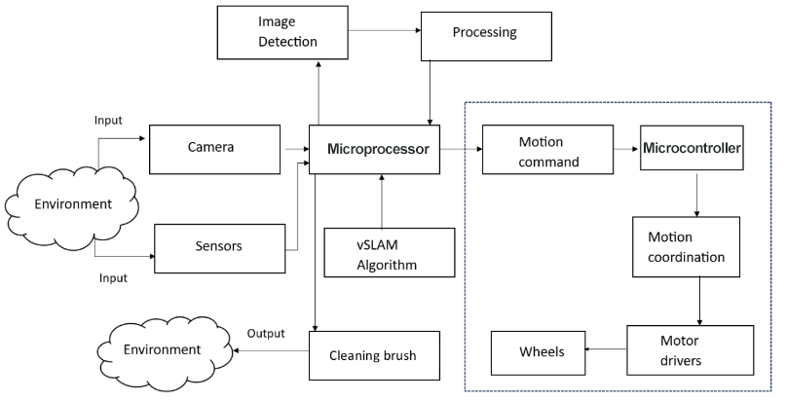
Introduction
Problem statement
Objectives
Literature Survey 1
Literature Survey 2
Literature Survey 3
Literature Survey 4
Literature Survey 5
Proposed methodology
System Architecture
Block Diagram
Hardware Components
Design and Model
Competitions and Awards
Results
Conclusion
References
System Architecture
Dept of Computer Science and Engineering, MACE Kothamangalam
Dept of Computer Science and Engineering, MACE Kothamangalam
8 May, 2024
13

Slide 14
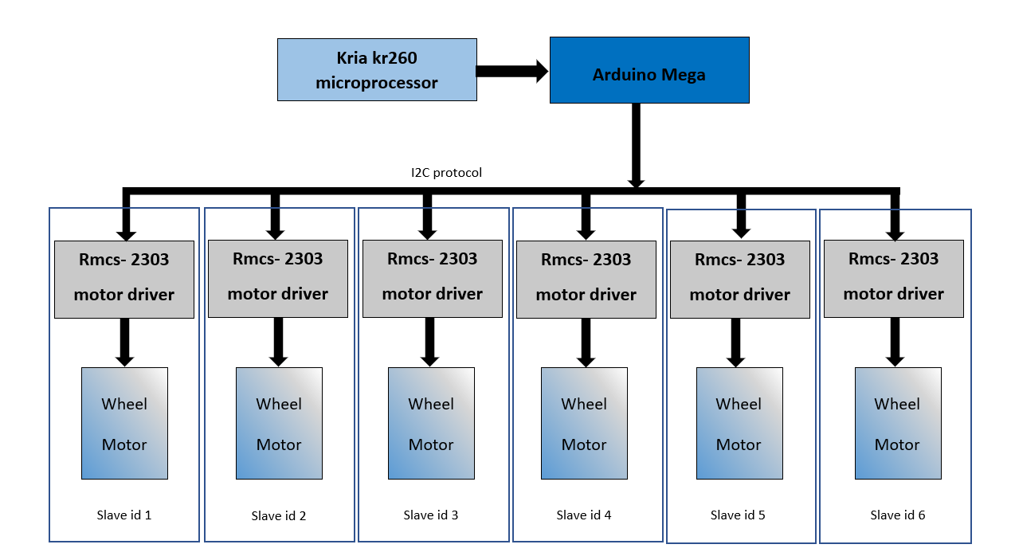
Introduction
Problem statement
Objectives
Literature Survey 1
Literature Survey 2
Literature Survey 3
Literature Survey 4
Literature Survey 5
Proposed methodology
System Architecture
Block Diagram
Hardware Components
Design and Model
Competitions and Awards
Results
Conclusion
References
Hardware Communication block diagram
Dept of Computer Science and Engineering, MACE Kothamangalam
Dept of Computer Science and Engineering, MACE Kothamangalam
8 May, 2024
14

Slide 15
Introduction
Problem statement
Objectives
Literature Survey 1
Literature Survey 2
Literature Survey 3
Literature Survey 4
Literature Survey 5
Proposed methodology
System Architecture
Block Diagram
Hardware Components
Design and Model
Competitions and Awards
Results
Conclusion
References
Hardware components used
Xilinx Kria kr260 /Raspberrypi
IMU mpu6050
Arduino Mega
RMCS-2303 motor driver
A1M8 Lidar sensor
Intel 435i rgbd camera
Dept of Computer Science and Engineering, MACE Kothamangalam
Dept of Computer Science and Engineering, MACE Kothamangalam
8 May, 2024
15

Slide 16
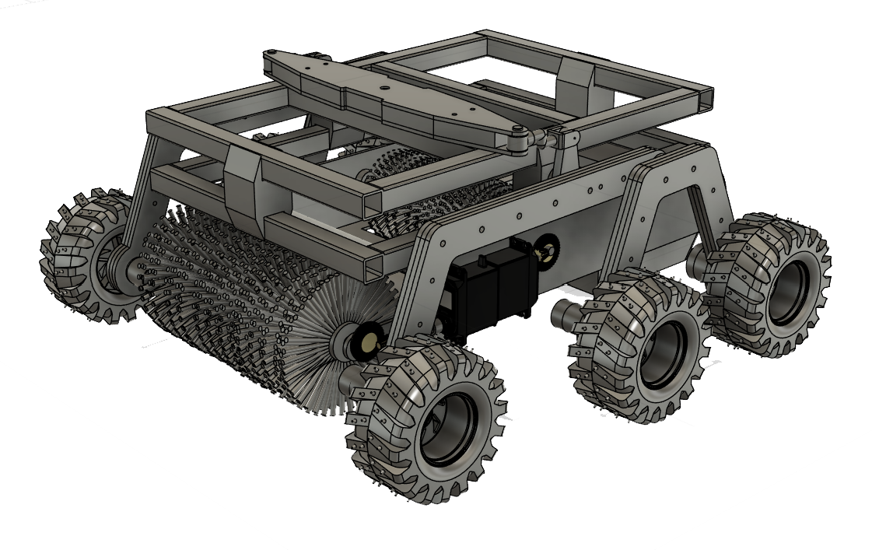
Introduction
Problem statement
Objectives
Literature Survey 1
Literature Survey 2
Literature Survey 3
Literature Survey 4
Literature Survey 5
Proposed methodology
System Architecture
Block Diagram
Hardware Components
Design and Model
Competitions and Awards
Results
Conclusion
References
Design and Model
Dept of Computer Science and Engineering, MACE Kothamangalam
Dept of Computer Science and Engineering, MACE Kothamangalam
8 May, 2024
16

Slide 17
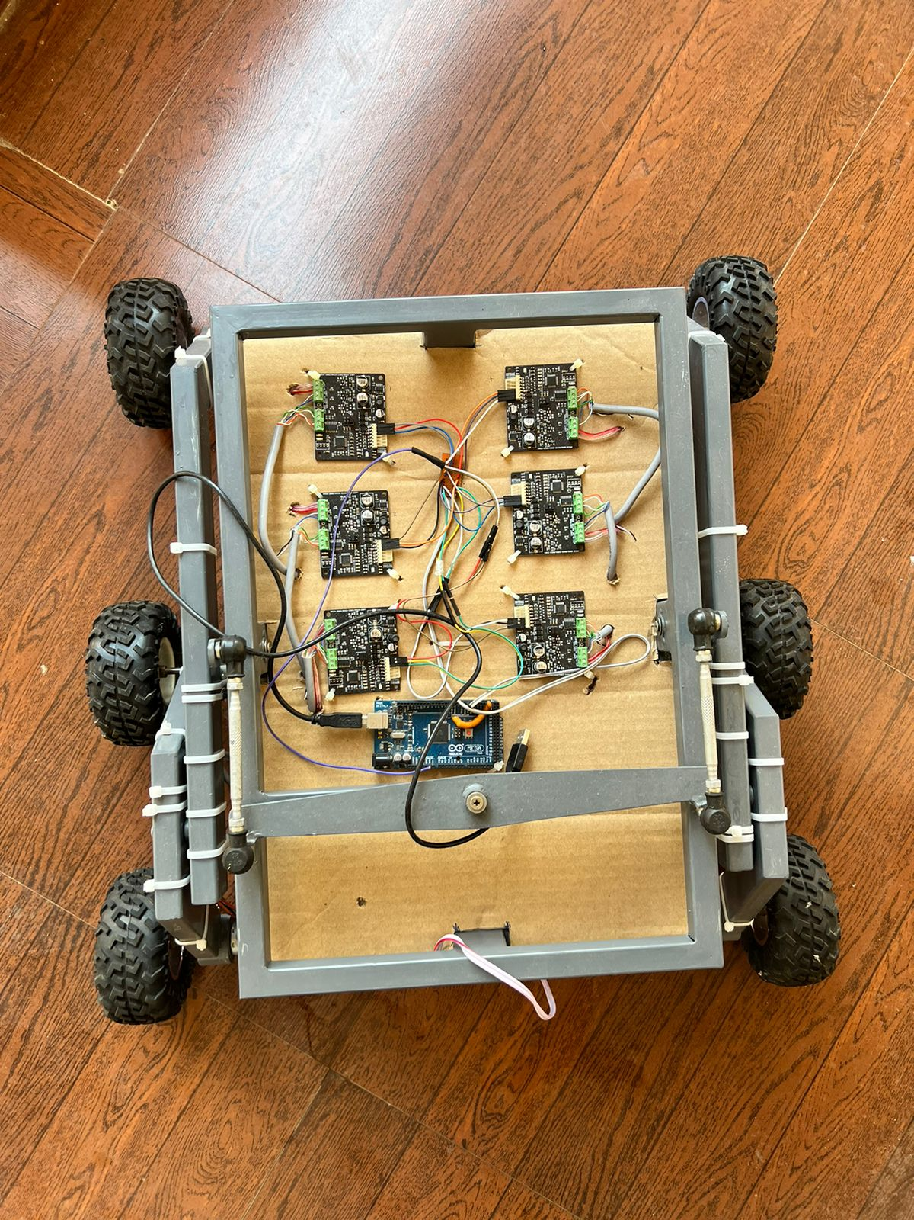
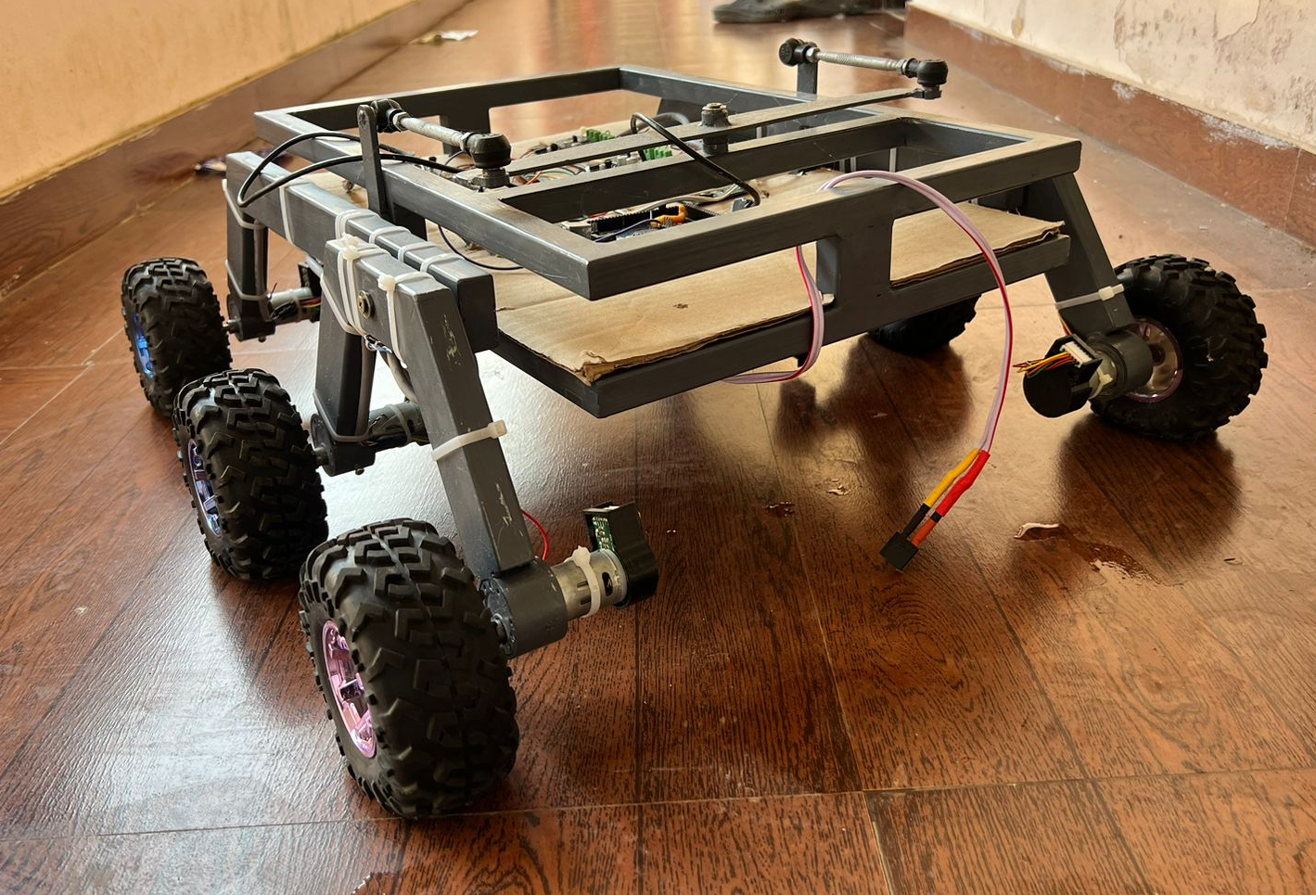
Introduction
Problem statement
Objectives
Literature Survey 1
Literature Survey 2
Literature Survey 3
Literature Survey 4
Literature Survey 5
Proposed methodology
System Architecture
Block Diagram
Hardware Components
Design and Model
Competitions and Awards
Results
Conclusion
References
Design and Model
Dept of Computer Science and Engineering, MACE Kothamangalam
Dept of Computer Science and Engineering, MACE Kothamangalam
8 May, 2024
17

Slide 18
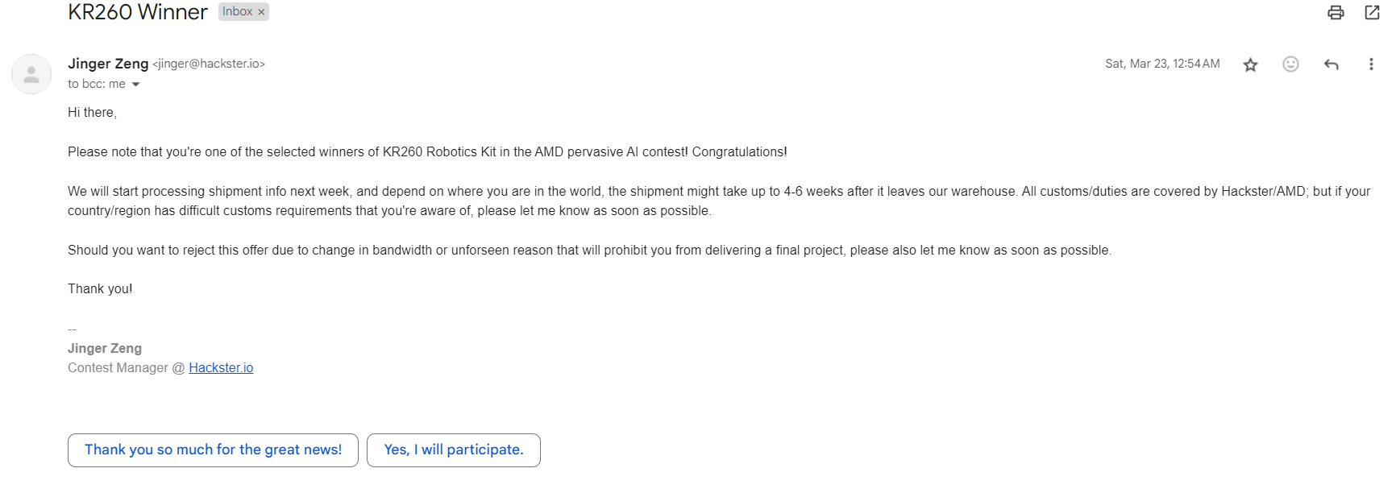
Introduction
Problem statement
Objectives
Literature Survey 1
Literature Survey 2
Literature Survey 3
Literature Survey 4
Literature Survey 5
Proposed methodology
System Architecture
Block Diagram
Hardware Components
Design and Model
Competitions and Awards
Results
Conclusion
References
Competitions and Awards
The project was awarded with kria kr269 robotics starter kit so as to develop the project and submit it to the hackster community. The hardware was provided by AMD Xilinx robotics.
Dept of Computer Science and Engineering, MACE Kothamangalam
Dept of Computer Science and Engineering, MACE Kothamangalam
8 May, 2024
18

Slide 19
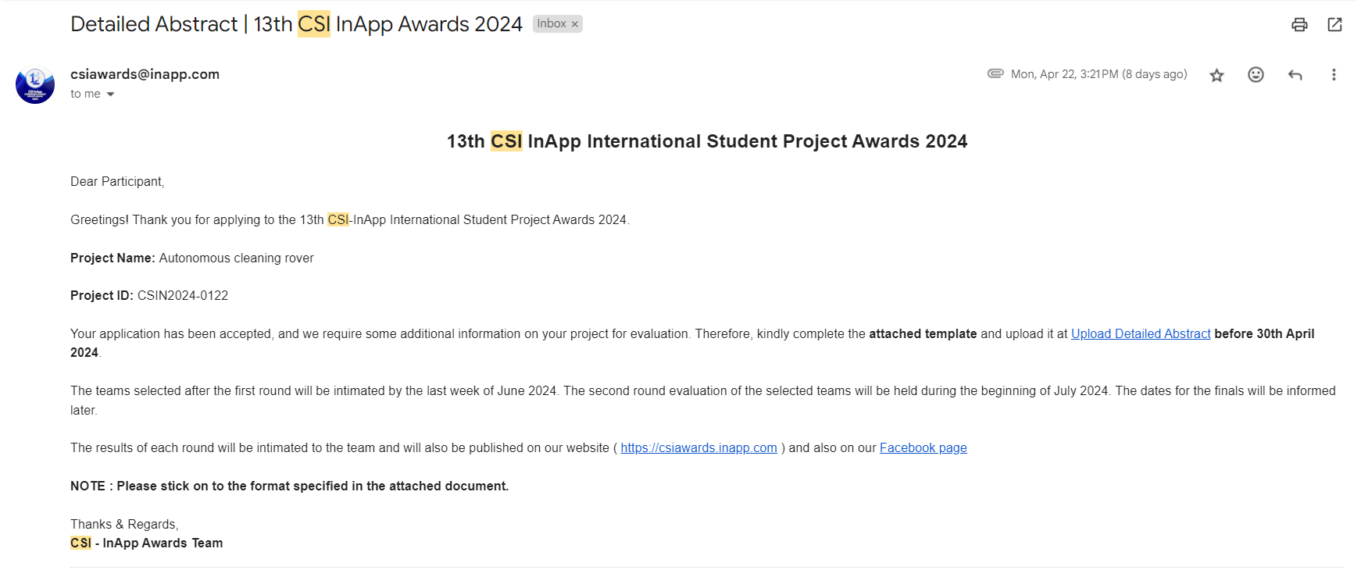
Introduction
Problem statement
Objectives
Literature Survey 1
Literature Survey 2
Literature Survey 3
Literature Survey 4
Literature Survey 5
Proposed methodology
System Architecture
Block Diagram
Hardware Components
Design and Model
Competitions and Awards
Results
Conclusion
References
Competitions and Awards
Dept of Computer Science and Engineering, MACE Kothamangalam
Dept of Computer Science and Engineering, MACE Kothamangalam
8 May, 2024
19

Slide 20
Introduction
Problem statement
Objectives
Literature Survey 1
Literature Survey 2
Literature Survey 3
Literature Survey 4
Literature Survey 5
Proposed methodology
System Architecture
Block Diagram
Hardware Components
Design and Model
Competitions and Awards
Results
Conclusion
References
Competitions and Awards
Our project was awarded as the best project from Computer Science department . It was awarded by the PTA of MACE with a cash prize of 5000.
Dept of Computer Science and Engineering, MACE Kothamangalam
Dept of Computer Science and Engineering, MACE Kothamangalam
8 May, 2024
20

Slide 21
Introduction
Problem statement
Objectives
Literature Survey 1
Literature Survey 2
Literature Survey 3
Literature Survey 4
Literature Survey 5
Proposed methodology
System Architecture
Block Diagram
Hardware Components
Design and Model
Competitions and Awards
Results
Conclusion
References
RESULTS
The rover is near finish, excluding the cleaning module part that is based on theoretical basis for now but can be developed into a working unit as the next step of the project, since there has been significant changes in microprocessor and design, the adaptation is ongoing and is expected to be completed in short time
Dept of Computer Science and Engineering, MACE Kothamangalam
Dept of Computer Science and Engineering, MACE Kothamangalam
8 May, 2024
21

Slide 22
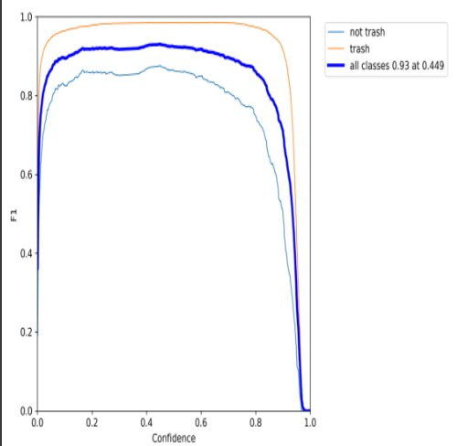
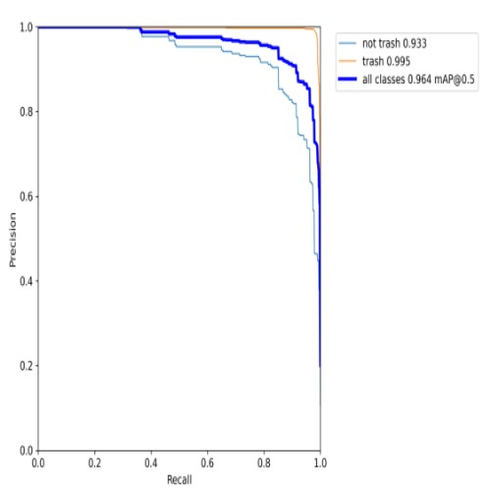
Introduction
Problem statement
Objectives
Literature Survey 1
Literature Survey 2
Literature Survey 3
Literature Survey 4
Literature Survey 5
Proposed methodology
System Architecture
Block Diagram
Hardware Components
Design and Model
Competitions and Awards
Results
Conclusion
References
RESULTS
Fig 1. F1 Curve
Fig.2 PR Curve
Dept of Computer Science and Engineering, MACE Kothamangalam
Dept of Computer Science and Engineering, MACE Kothamangalam
8 May, 2024
22

Slide 23
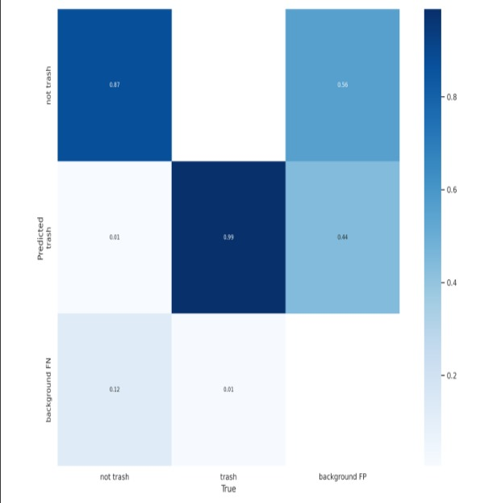
Introduction
Problem statement
Objectives
Literature Survey 1
Literature Survey 2
Literature Survey 3
Literature Survey 4
Literature Survey 5
Proposed methodology
System Architecture
Block Diagram
Hardware Components
Design and Model
Competitions and Awards
Results
Conclusion
References
RESULTS
Fig 3. Confusion Matrix
Dept of Computer Science and Engineering, MACE Kothamangalam
Dept of Computer Science and Engineering, MACE Kothamangalam
8 May, 2024
23

Slide 24
Introduction
Problem statement
Objectives
Literature Survey 1
Literature Survey 2
Literature Survey 3
Literature Survey 4
Literature Survey 5
Proposed methodology
System Architecture
Block Diagram
Hardware Components
Design and Model
Competitions and Awards
Results
Conclusion
References
CONCLUSION
In conclusion, this project represents a significant stride in the realm of autonomous cleaning technology for outdoor environments. The dedicated efforts in crafting an autonomous cleaning rover tailored for diverse terrains underscore a commitment to addressing real-world challenges in outdoor maintenance.
Dept of Computer Science and Engineering, MACE Kothamangalam
Dept of Computer Science and Engineering, MACE Kothamangalam
8 May, 2024
24

Slide 25
Introduction
Problem statement
Objectives
Literature Survey 1
Literature Survey 2
Literature Survey 3
Literature Survey 4
Literature Survey 5
Proposed methodology
System Architecture
Block Diagram
Hardware Components
Design and Model
Competitions and Awards
Results
Conclusion
References
REFERENCES
[1] R. J. Ong and K. N. F. Ku Azir, "Low Cost Autonomous Robot Cleaner using Mapping Algorithm based on Internet of Things (IoT)," IOP Conf. Ser.: Mater. Sci. Eng., vol. 767, p. 012071, 2020.
[2] M. Kulshreshtha, S. S. Chandra, P. Randhawa, G. Tsaramirsis, A. Khadidos, and A. O. Khadidos, "OATCR: Outdoor Autonomous Trash-Collecting Robot Design Using YOLOv4-Tiny," Electronics, vol. 10, no. 18, p. 2292, Sep. 2021
[3] Jinjun Rao, Haoran Bian, Xiaoqiang Xu and Jinbo Chen, "Autonomous Visual Navigation System Based on a Single Camera for Floor-Sweeping Robot," Appl. Sci. 2023, vol 13(3), 1562
[4] Latifinavid, M.; Azizi, A. Development of a Vision-Based Unmanned Ground Vehicle for Mapping and Tennis Ball Collection: A Fuzzy Logic Approach. Future Internet 2023, 15, 84.
[5] Zhang, Y.; Wu, Y.; Tong, K.; Chen, H.; Yuan, Y. Review of Visual Simultaneous Localization and Mapping Based on Deep Learning. Remote Sens. 2023, 15, 2740.
Dept of Computer Science and Engineering, MACE Kothamangalam
Dept of Computer Science and Engineering, MACE Kothamangalam
8 May, 2024
25

Slide 26
THANK YOU
Dept of Computer Science and Engineering, MACE Kothamangalam
Dept of Computer Science and Engineering, MACE Kothamangalam
8 May, 2024
26

