Slide 1
AlgoVisualizer
By Alan Shami

Slide 2
AlgoVisualizer is an educational tool that Visualize different algorithm techniques to better understand it.

Slide 3
Motivation
As we all know, humans are visual beings, and most of us understand way better when we see than listen.
For me personally, I have always understood something way better when seeing it than reading about it.
When it comes to complicated thing, such as algorithms, watching the progress and what happens under the hood, makes it way easier to comprehend.

Slide 4
What is included
2 Sorting Algorithms
2 Searching Algorithms
3 Graph Algorithms
Different Algorithmic Techniques

Slide 5
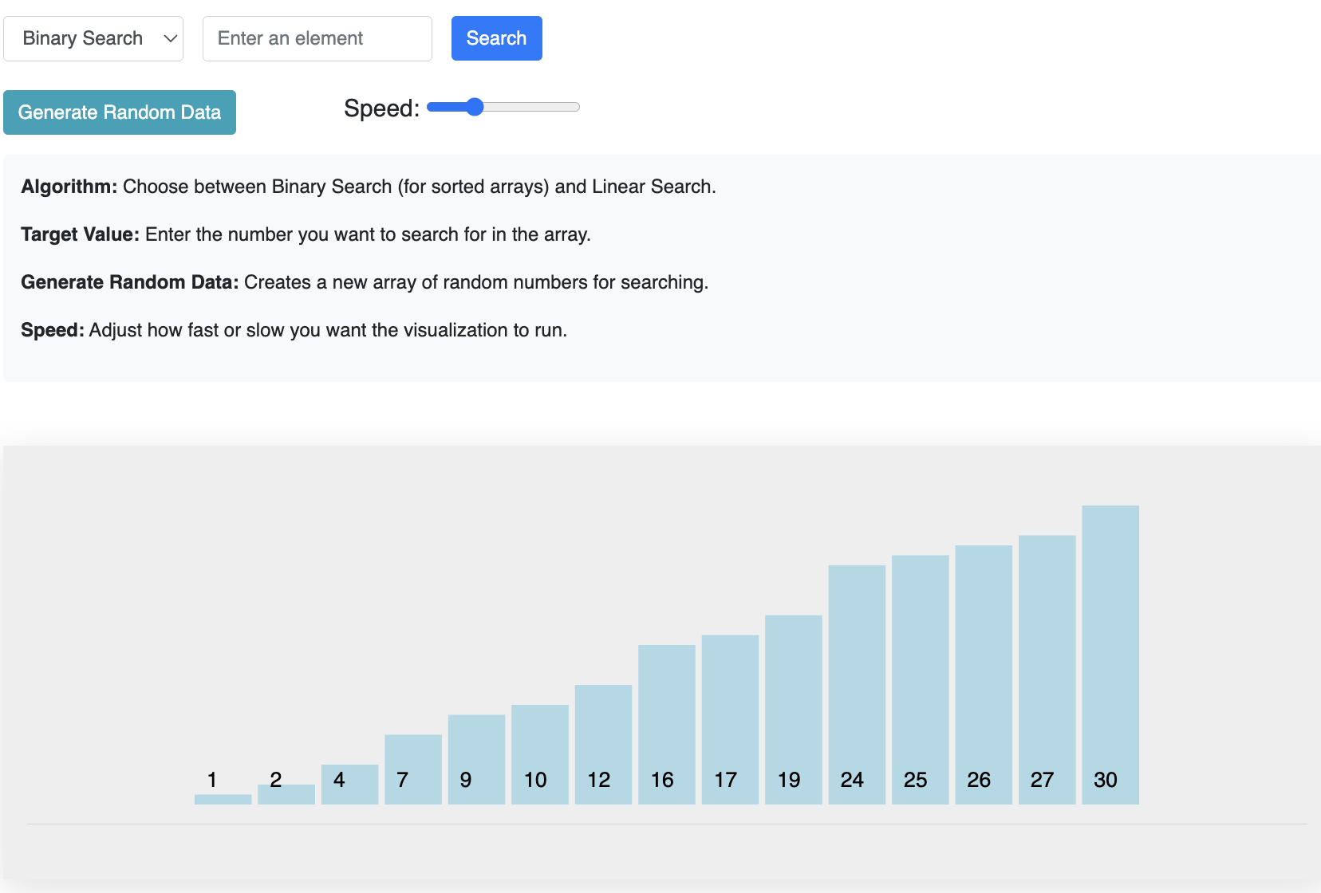
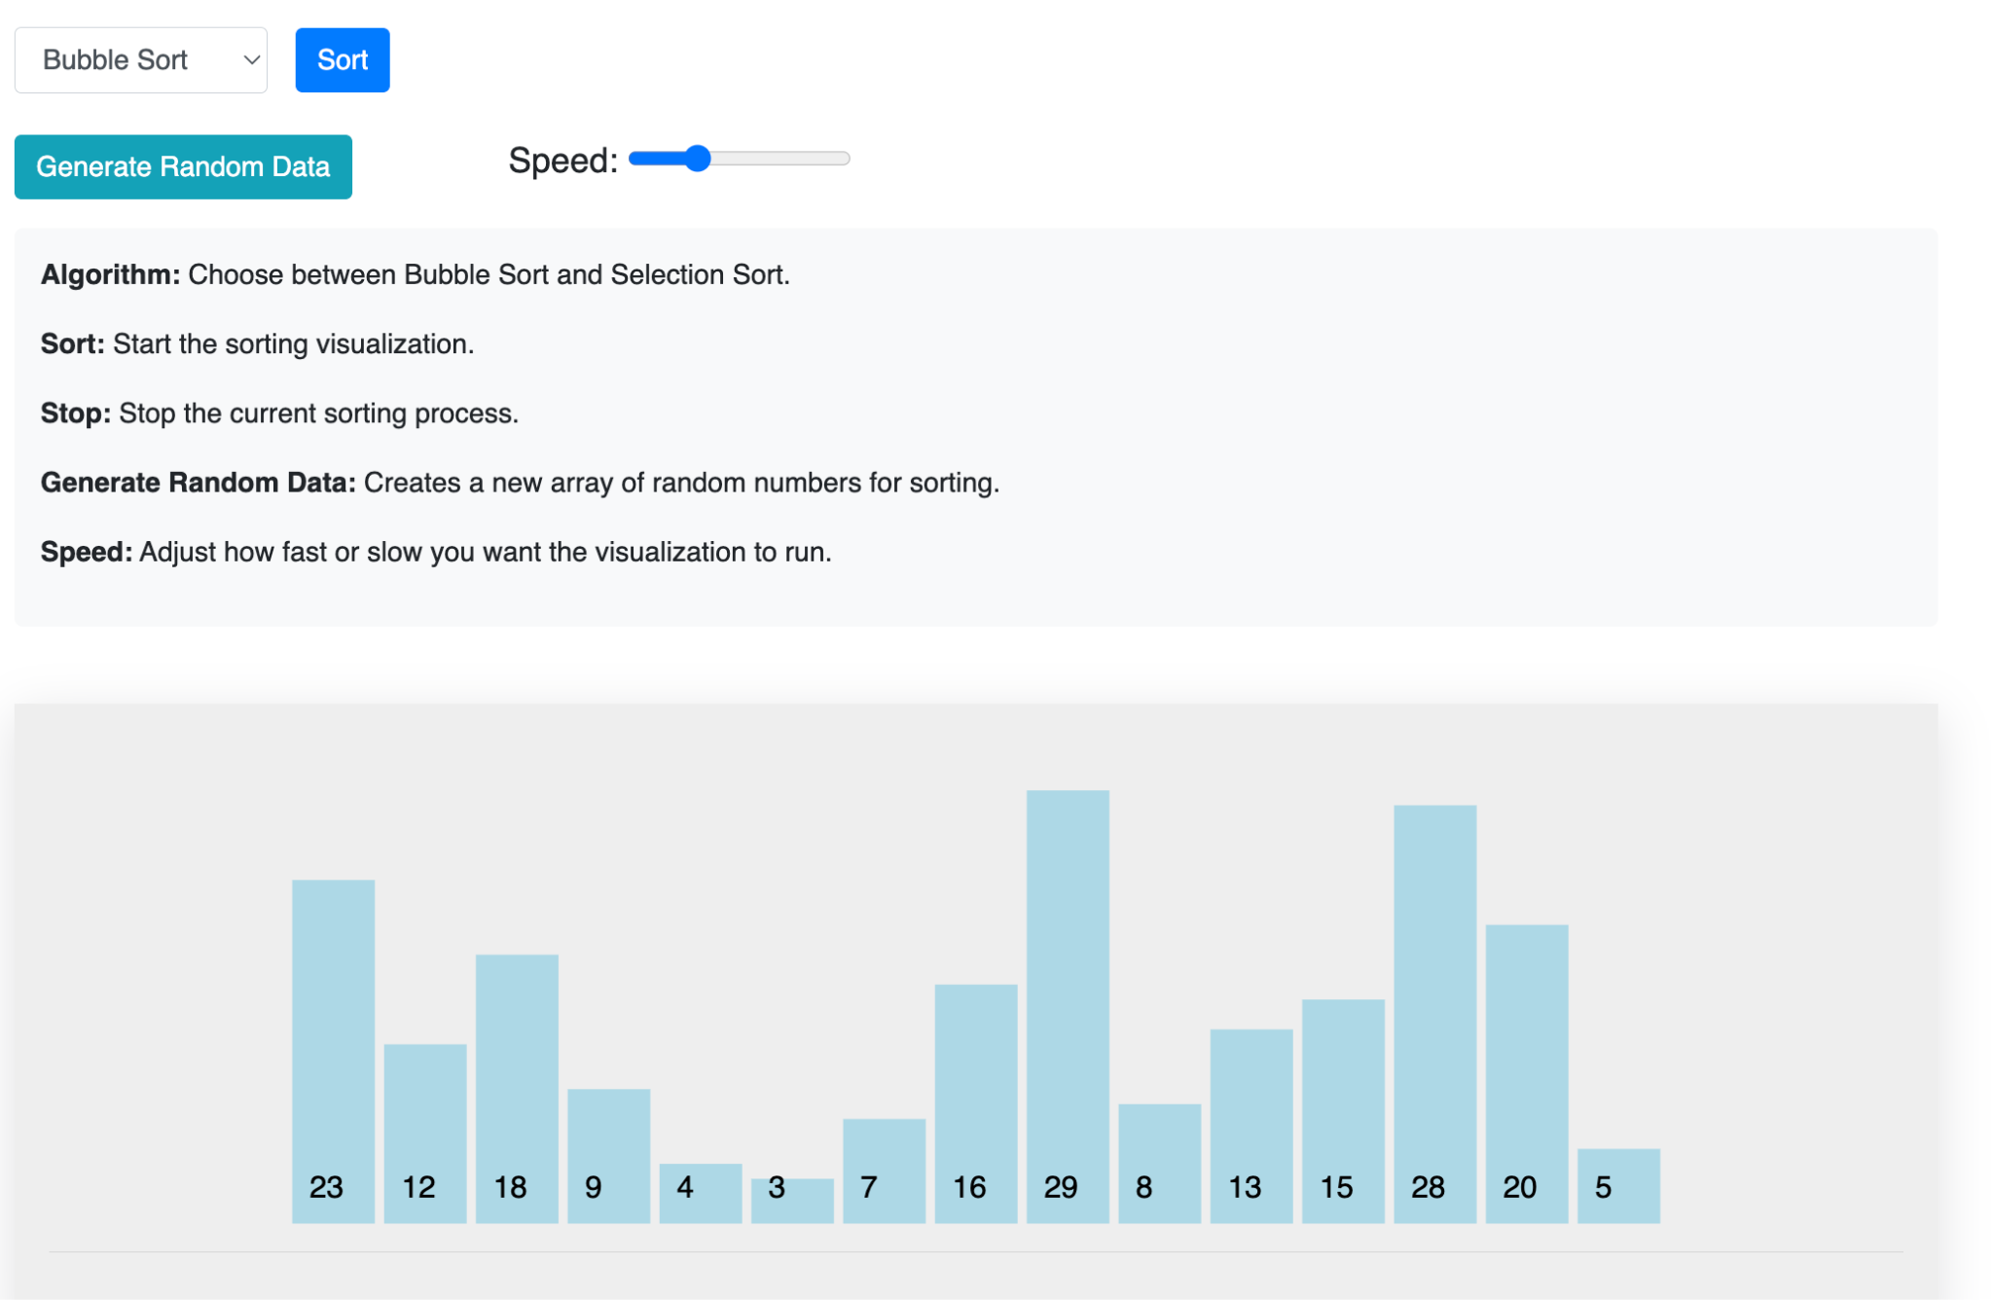
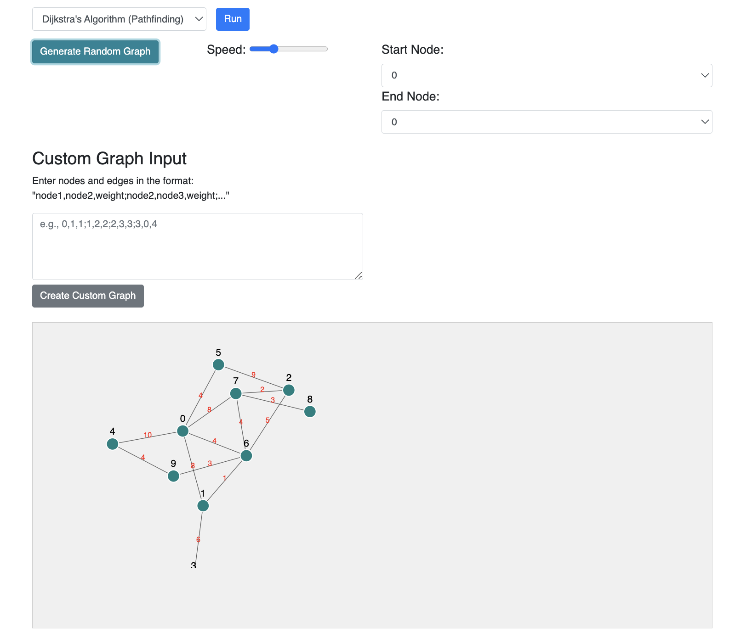
Details
The project consists of 7 different algorithms.
Each one is explained in detail.
Visual representation for each one.
Sound effects.

Slide 6
Conclusion
Although this project is still under development and the lack of time to deliver the product, it can be improved to do much more and more algorithms can be added.
Hopefully, I will be able to maintain it and enhance it in the future.
For anyone is willing to customized it and make it their own, please feel free to do so.

