Slide 1
SQL commands from C# and ASP.net

Slide 2
SQL commands
Microsoft’s database system is called “SQL Server”
The most popular open source database is called “MySQL”
SQL : Structured Query Language
Select * From PlantData Where Collection = ‘Ivy‘
Select * From PlantData Where Location = ‘House10’
Lists all the database records that satisfy that criteria
Select COUNT (DISTINCT ScientificName) FROM PlantData
Counts the number of unique plant names
therefore = number of plant types
Returns a useful statistic

Slide 3
Question 1: How do you issue an SQL command from C#?
It’s all about the connection string:
string CONNECTION_STRING = "Data Source=MBUCKLEY16; Initial Catalog=BotanicalApp; Integrated Security=True";
string CONNECTION_STRING_LOCATIONS ="Data Source=MBUCKLEY16; Initial Catalog=Locations; Integrated Security=True";
string CONNECTION_STRING_COLLECTIONS ="Data Source=MBUCKLEY16; Initial Catalog=Collections; Integrated Security=True";
note: SERVER DATABASE

Slide 4
Issuing an SQL command with no reply
string connectionString = GlobalVariables.CONNECTION_STRING;
SqlConnection sqlConnection1 = new SqlConnection(connectionString);
sqlConnection1.Open();
// SQL output
SqlCommand cmd = new SqlCommand();
cmd.CommandText = "INSERT INTO PlantData( [ID], [CommonName]) VALUES (‘1258’, ‘Daisy’) " ;
cmd.Connection = sqlConnection1;
cmd.ExecuteNonQuery(); // executes the Command, expects no reply

Slide 5
Question 2: How do you get a reply?
string connectionString = GlobalVariables.CONNECTION_STRING;
String replyString = " ";
SqlConnection sqlConnection1 = new SqlConnection(connectionString);
sqlConnection1.Open();
// SQL output (query)
SqlCommand cmd = new SqlCommand();
// SQL input (reader)
SqlDataReader reader;
IDataRecord readRecord = null;
cmd.CommandText = "SELECT COUNT(DISTINCT ID) FROM PlantData";
cmd.Connection = sqlConnection1;
reader = cmd.ExecuteReader(); // executes the command reads the reply
readRecord = (IDataRecord)(reader); // places reply into a Data Record
reader.Read(); // reads the Data Record
replyString = String.Format("{0}", readRecord[0]); // convert ints to strings, nulls to ""
if (String.Compare(replyString, "") != 0) // if not null
{
sqlConnection1.Close();
} // end if not blank
else
{
sqlConnection1.Close();
replyString = ("SQL Query Error");
} // end if

Slide 6
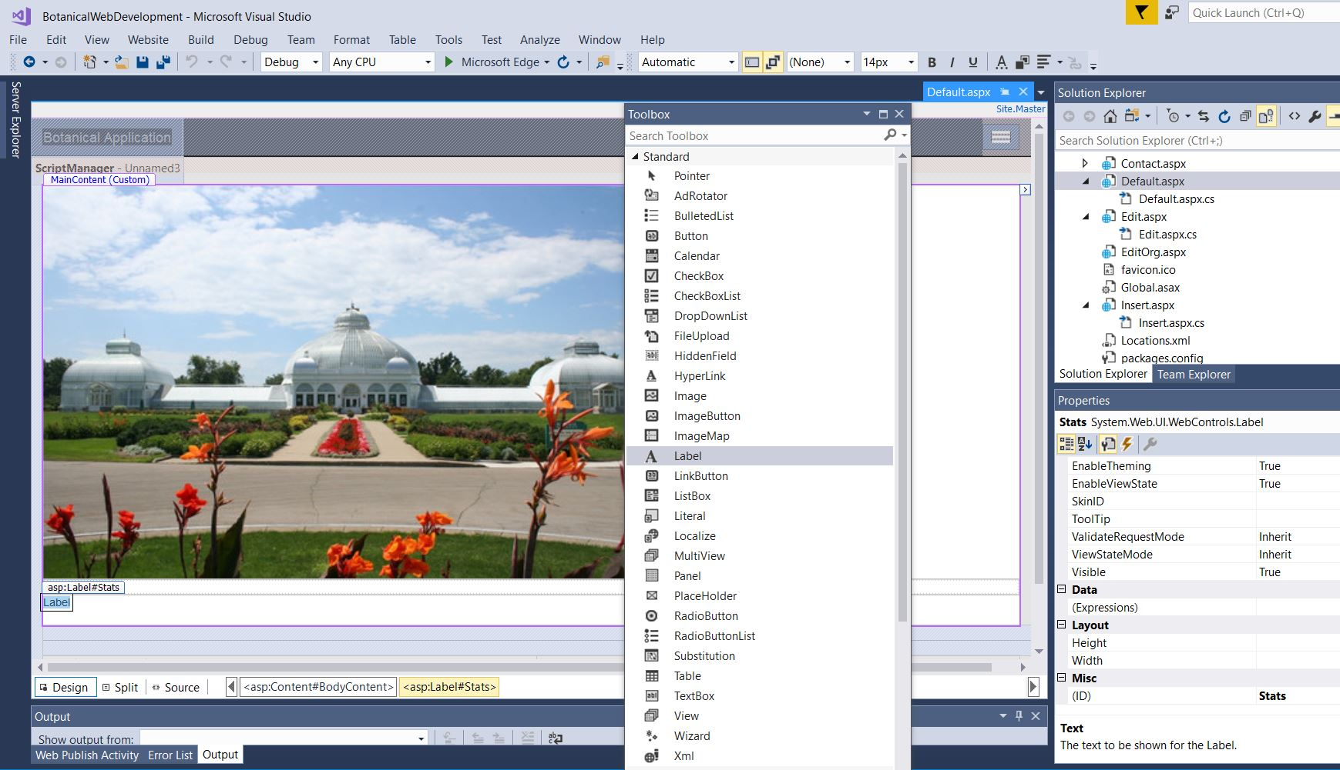
3. What to do with replyString?
e.g. Stats.Text = replyString;

Slide 8
In Default.aspx.cs
protected void Page_Load(object sender, EventArgs e)
{
UsefulFunctions SQLQuery = new UsefulFunctions();
Stats.Text = SQLQuery.SQLCommand("SELECT COUNT(DISTINCT ScientificName) FROM PlantData");
}
}

