Slide 1

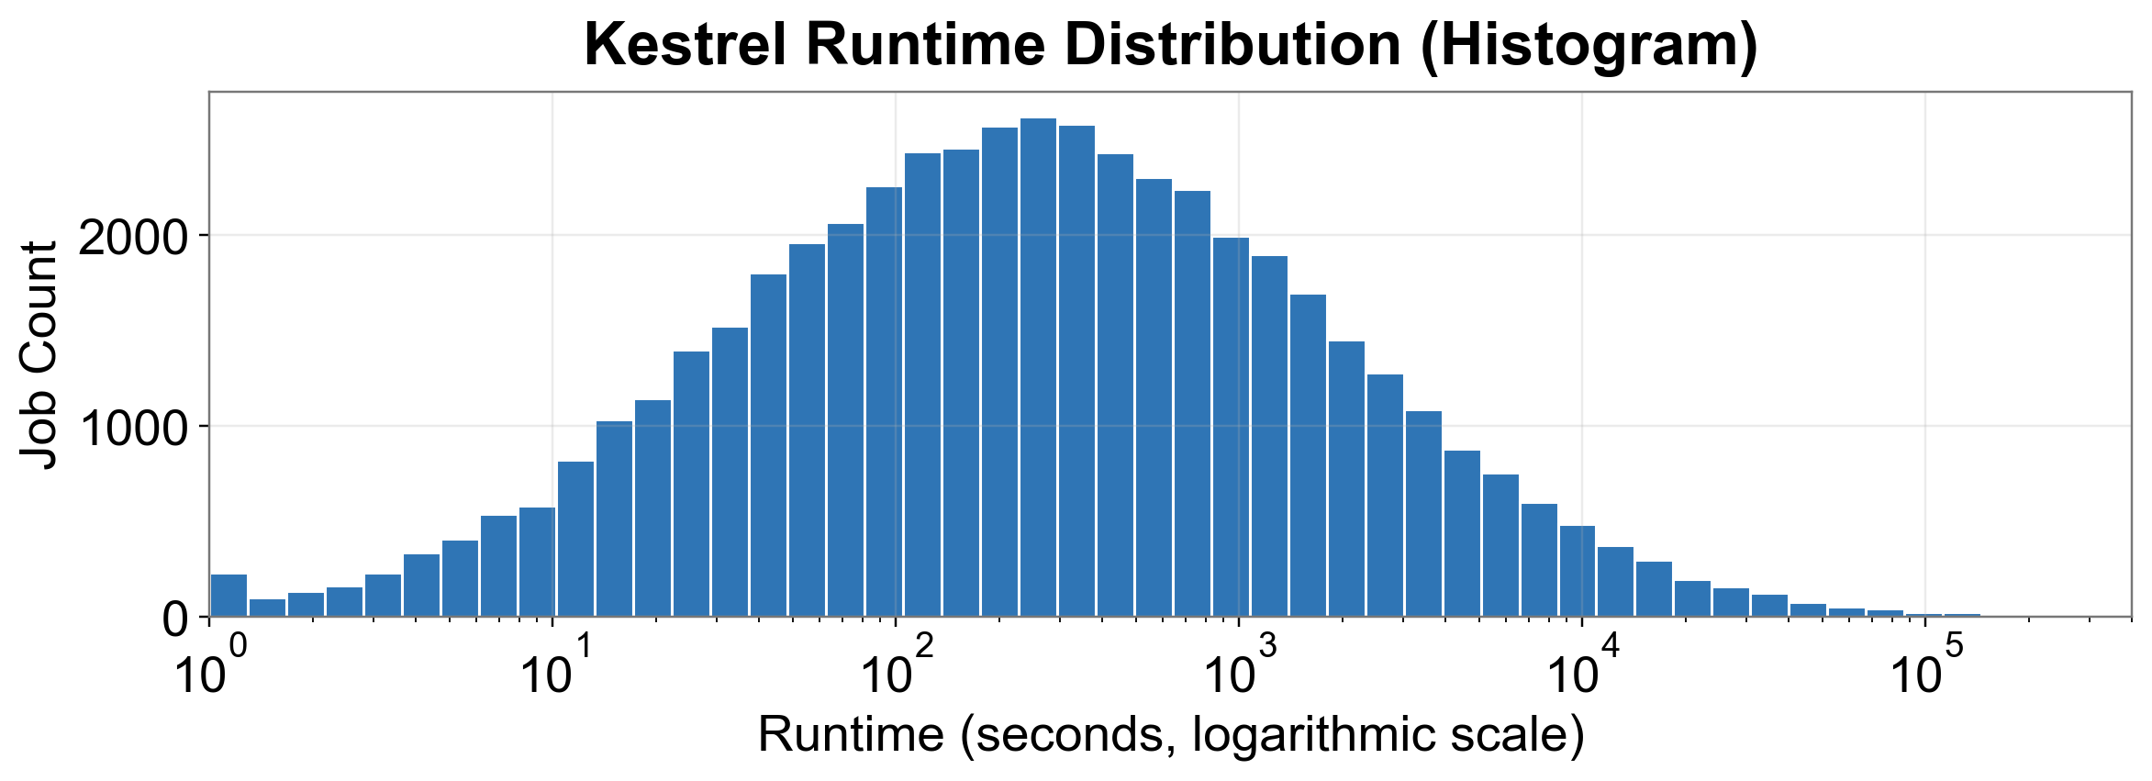
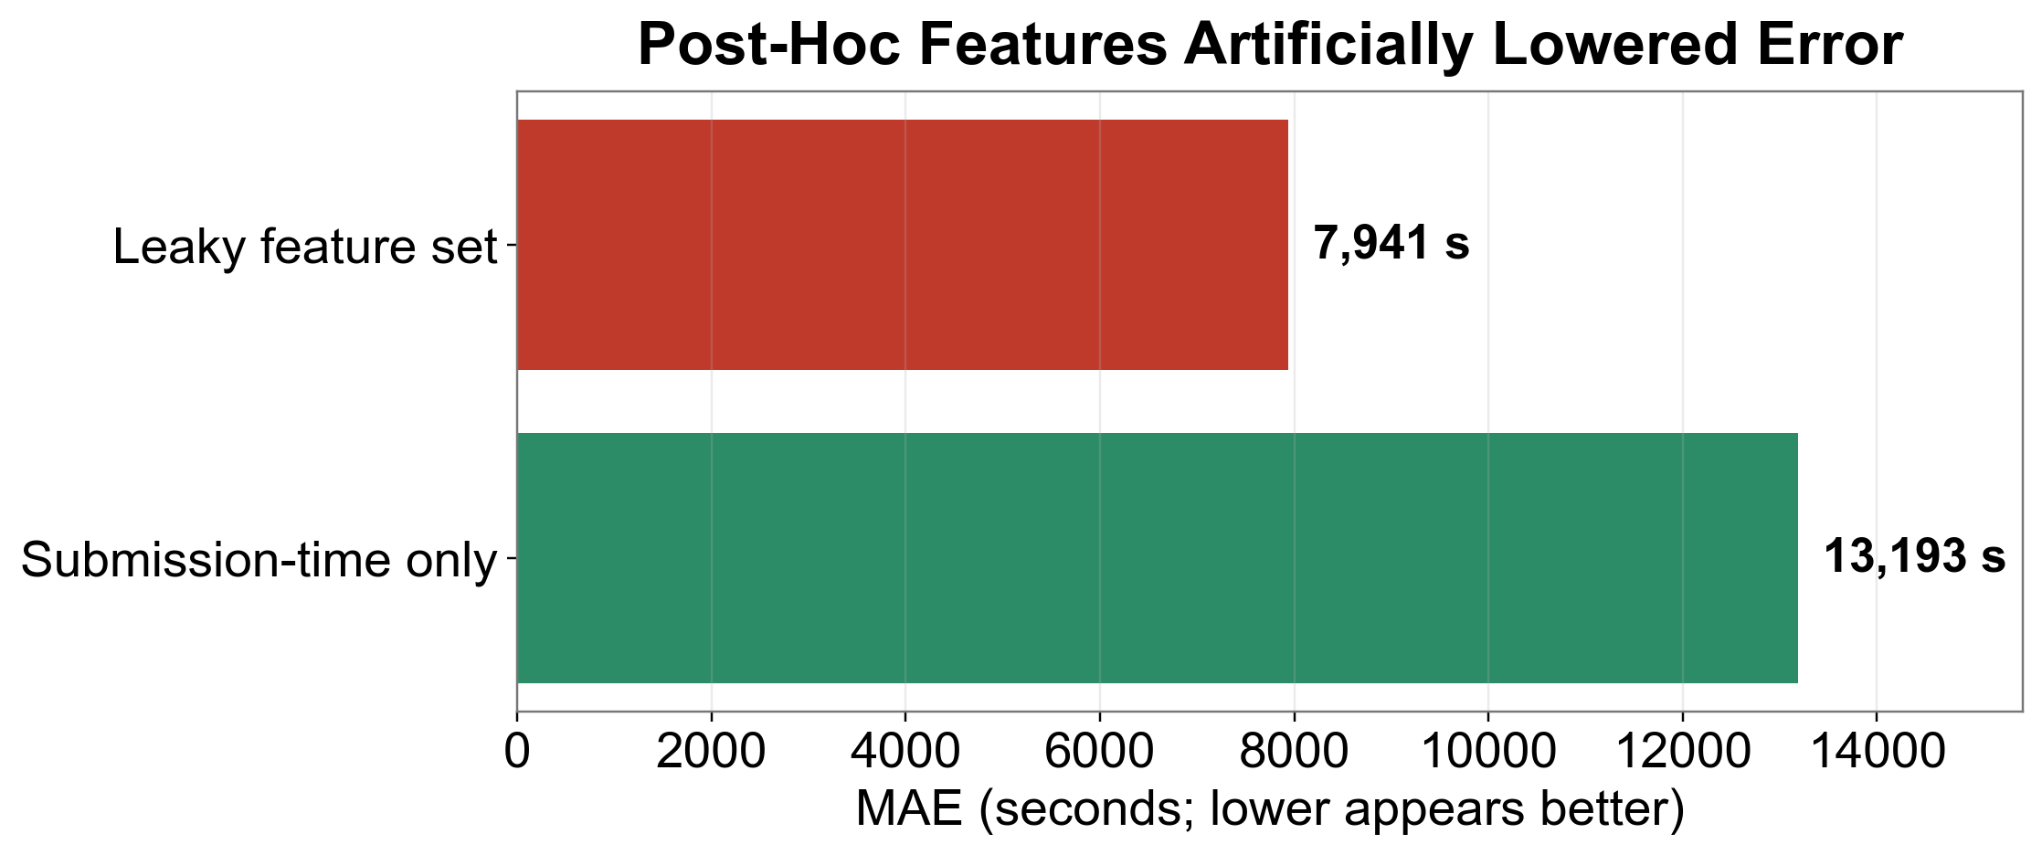
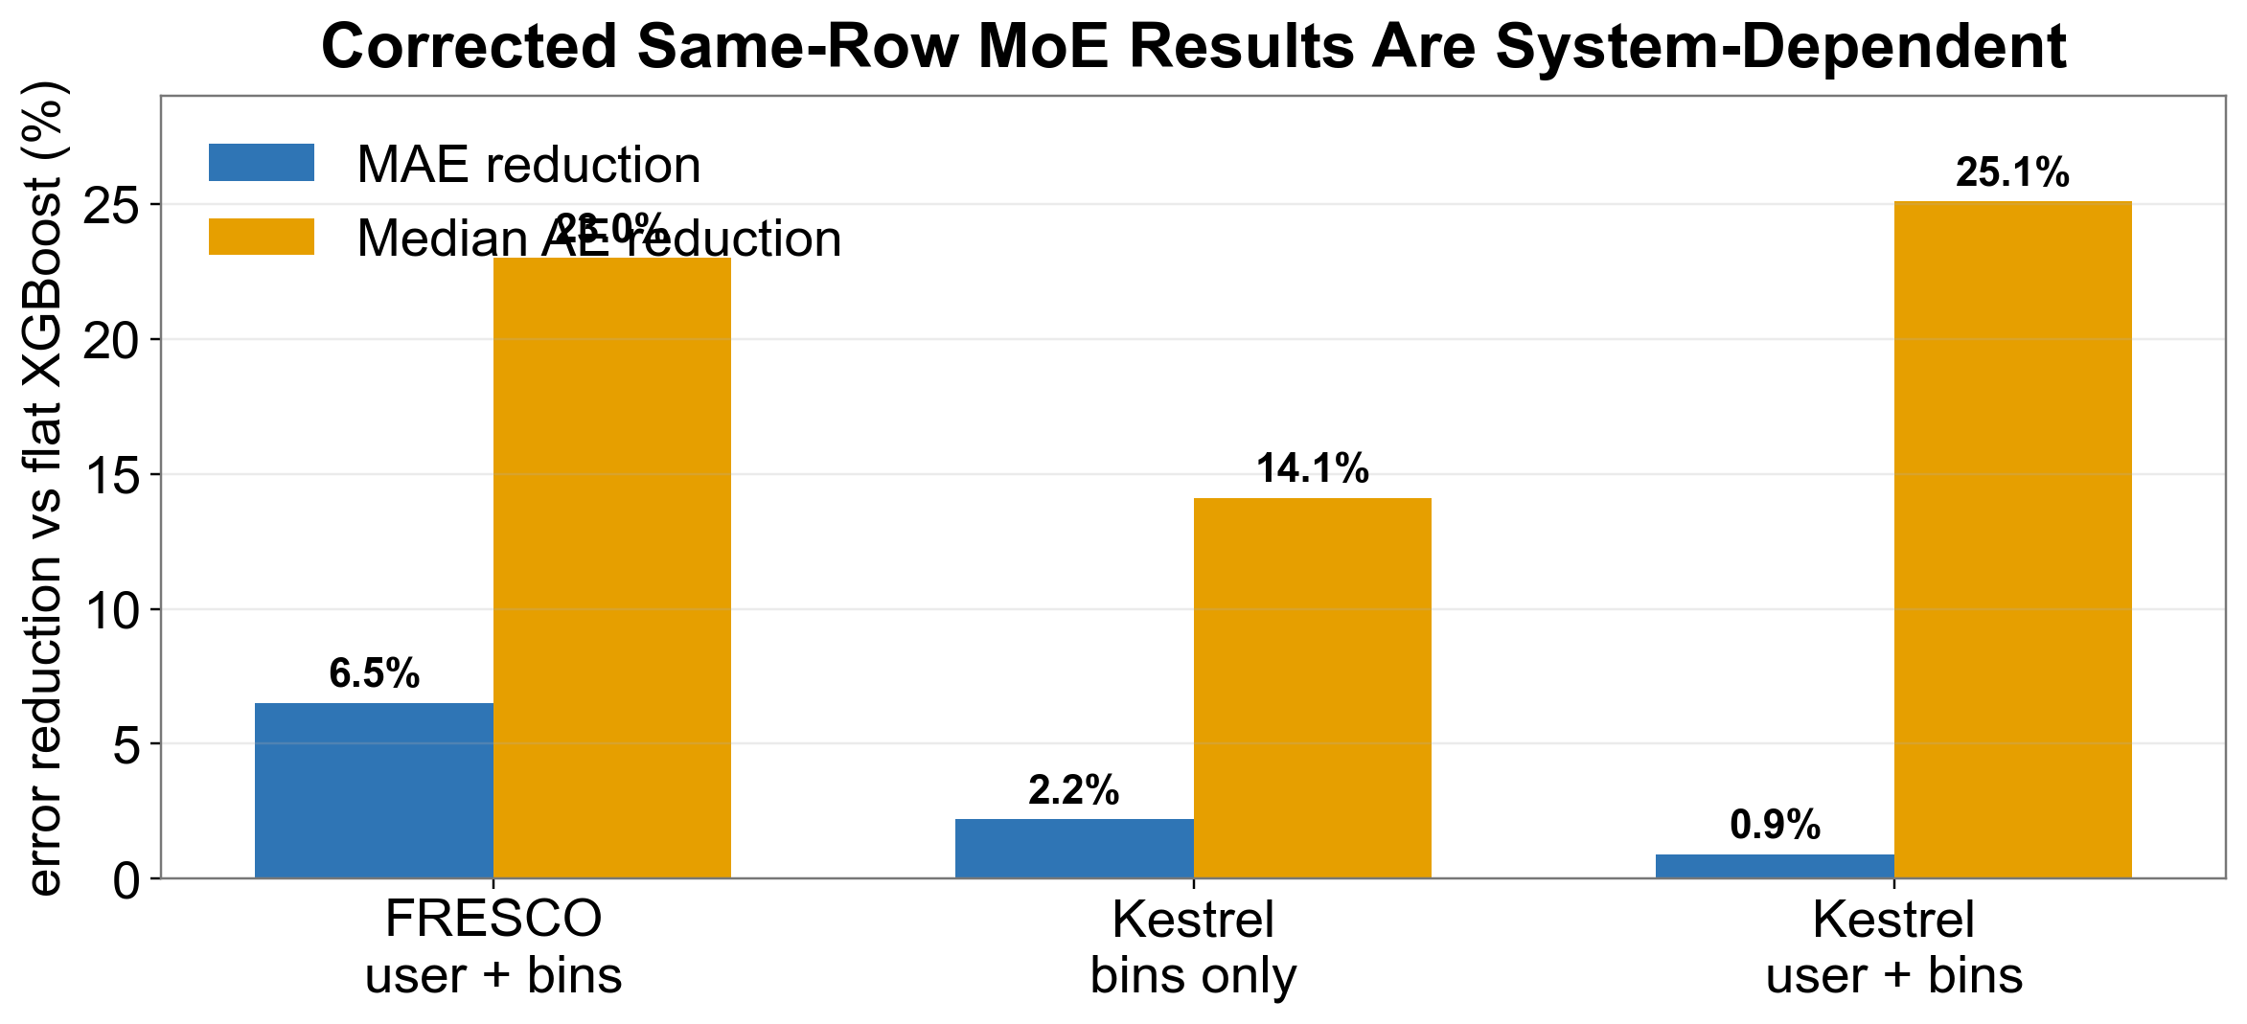



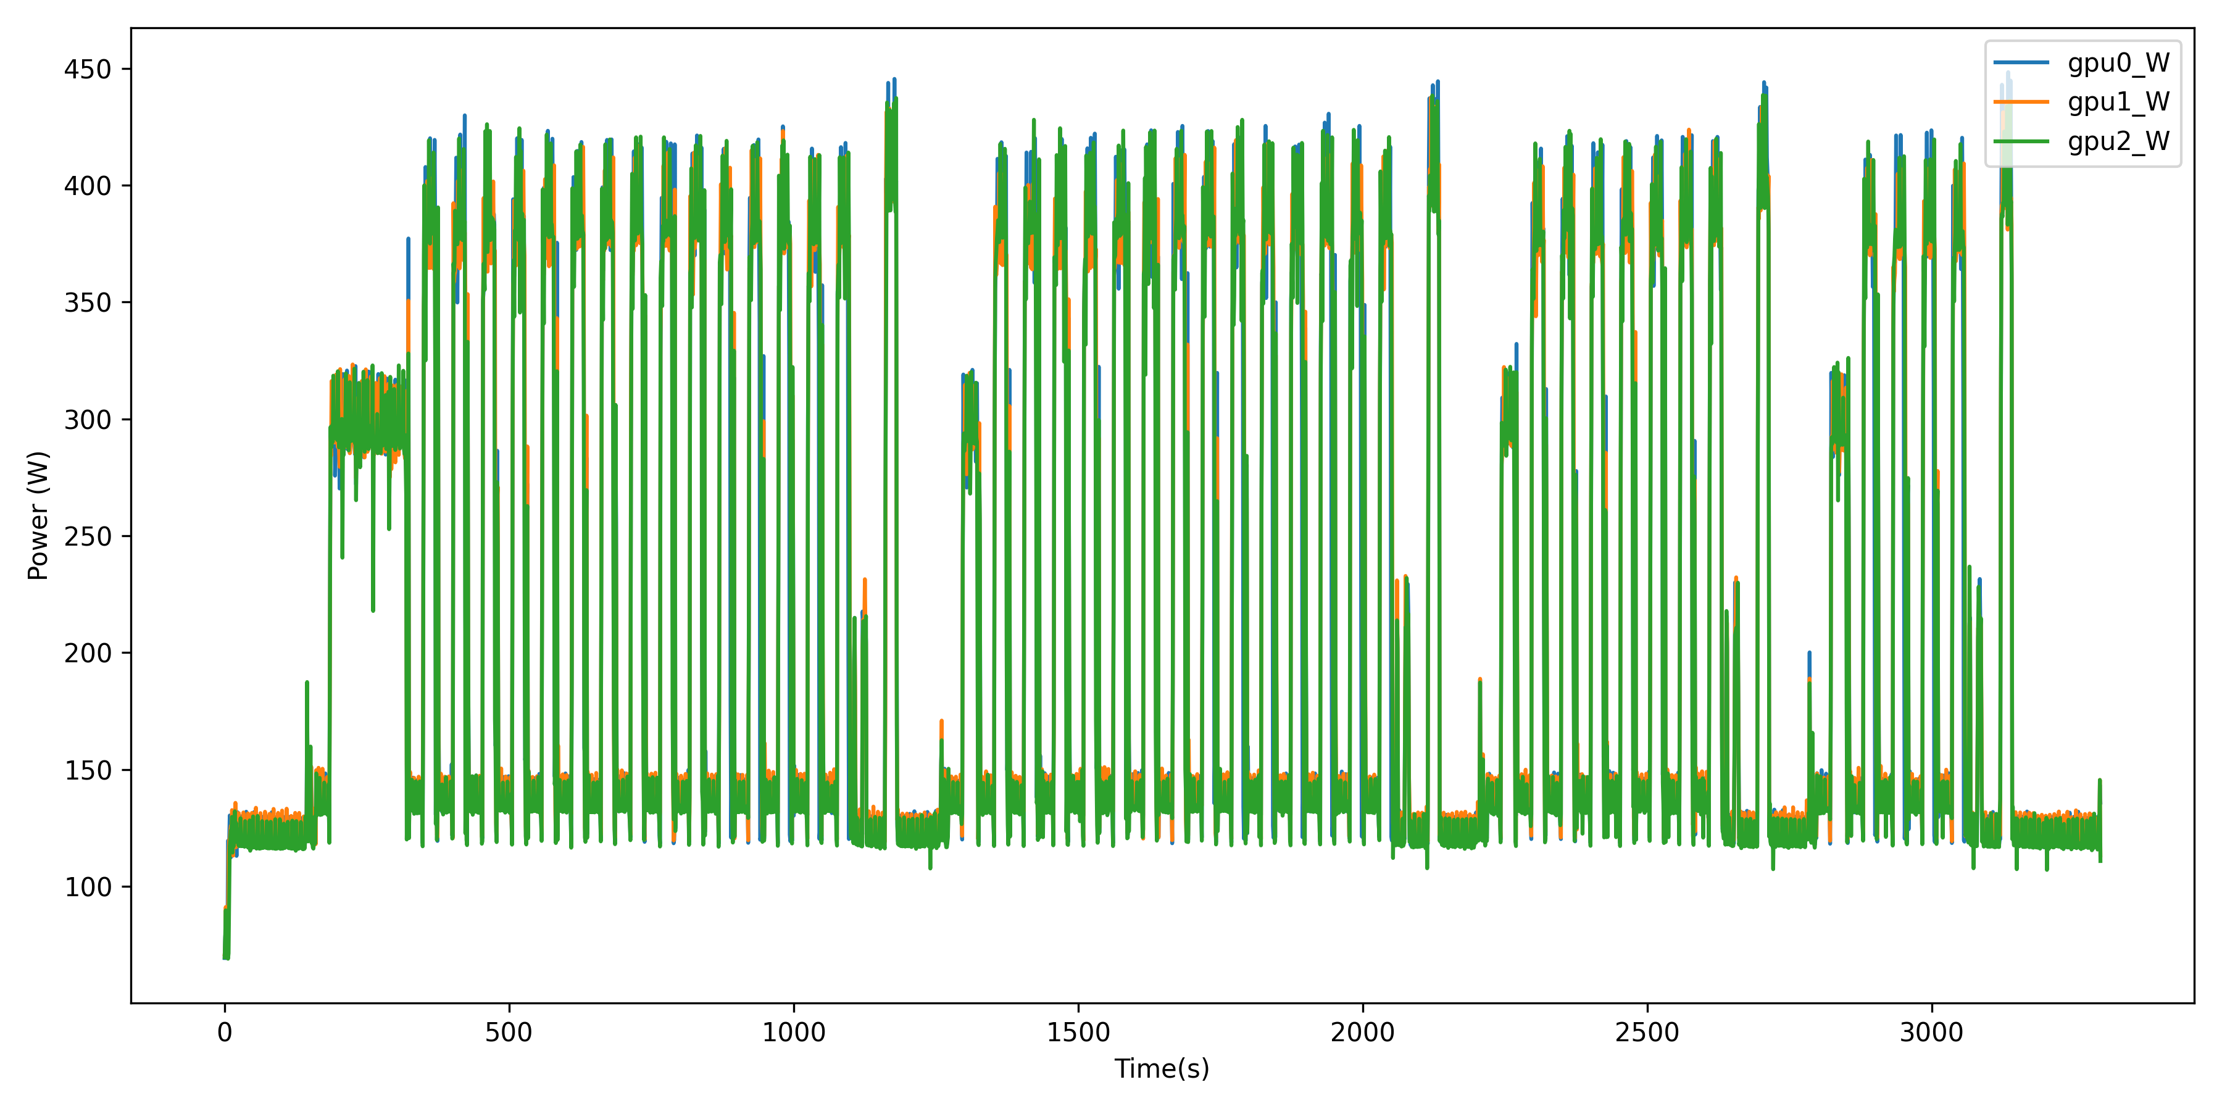
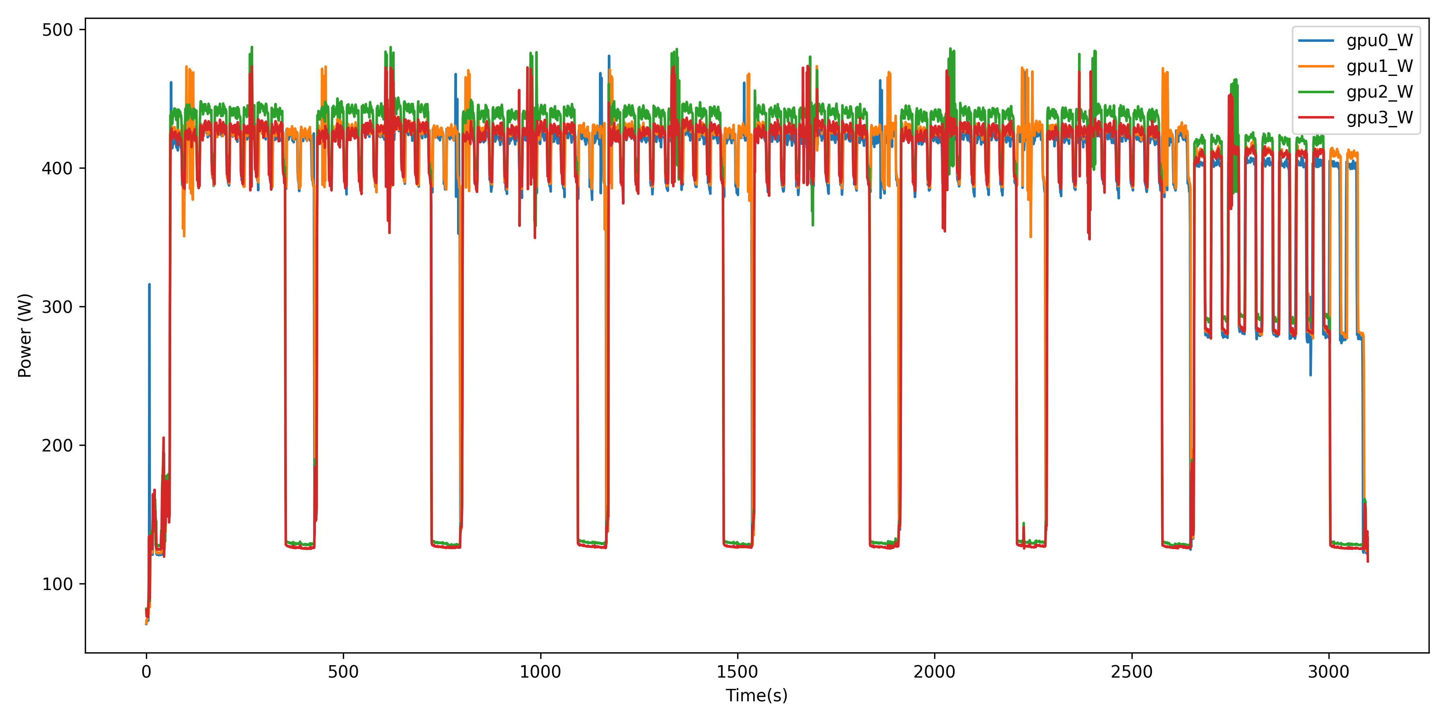
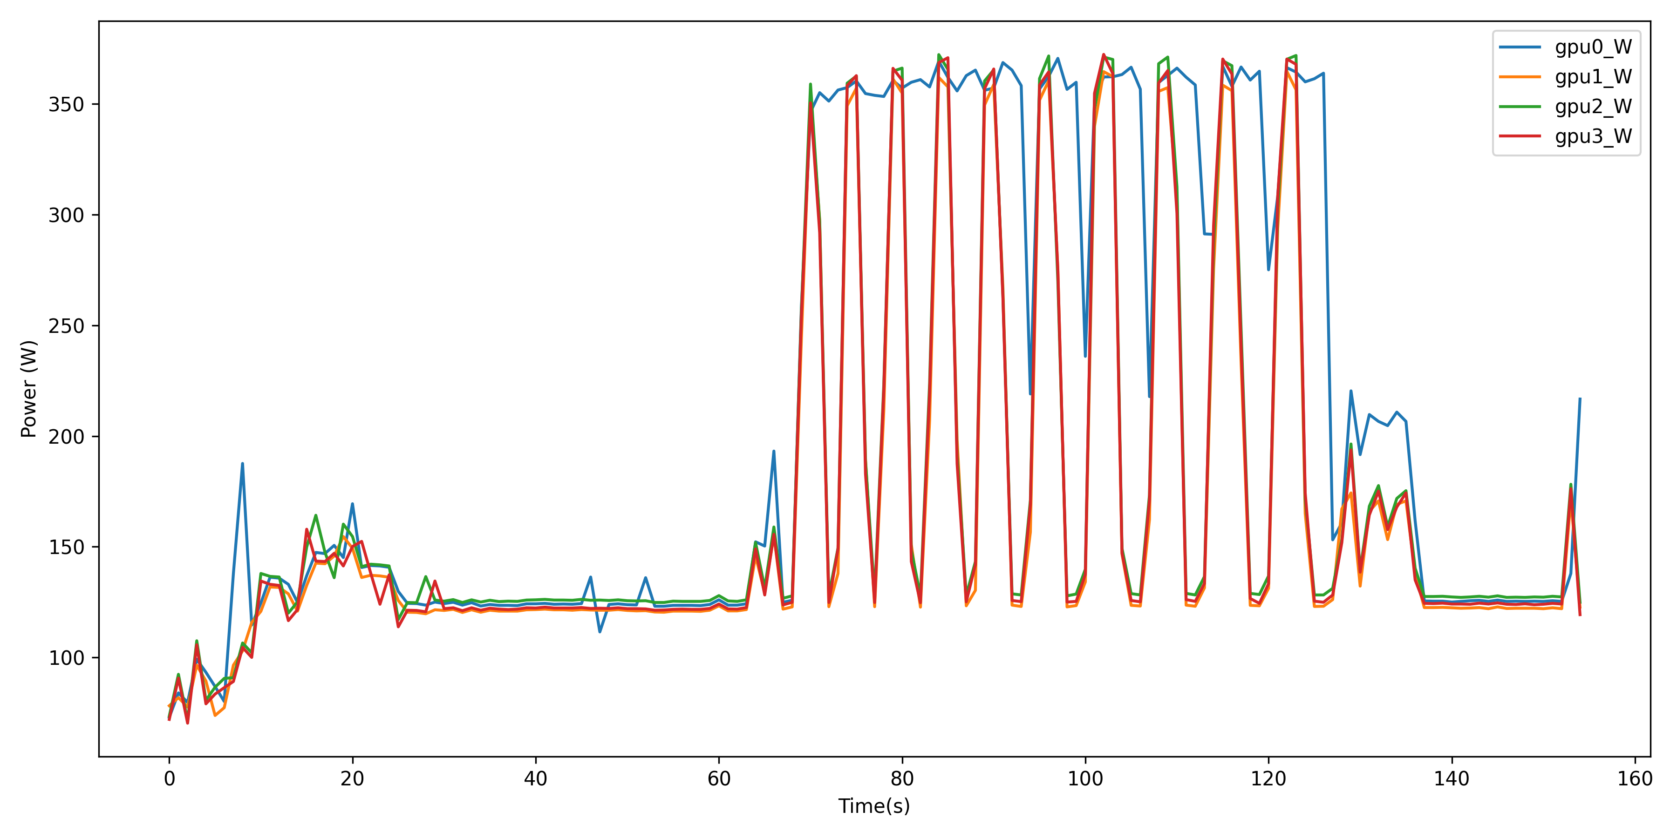
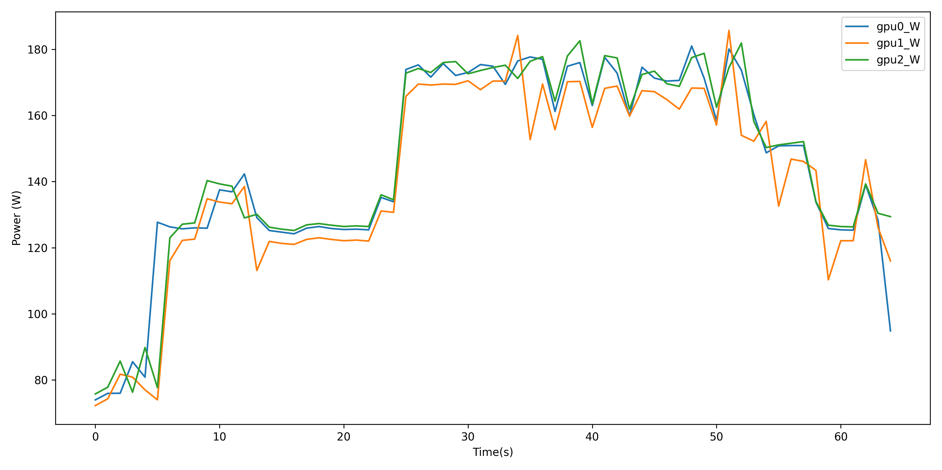
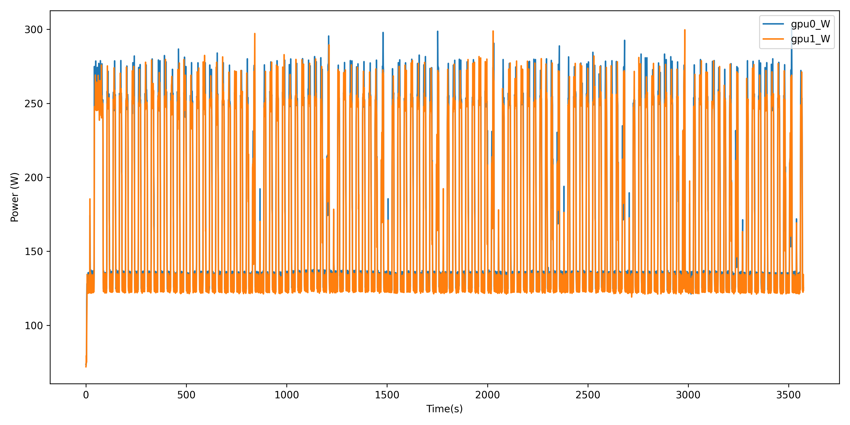
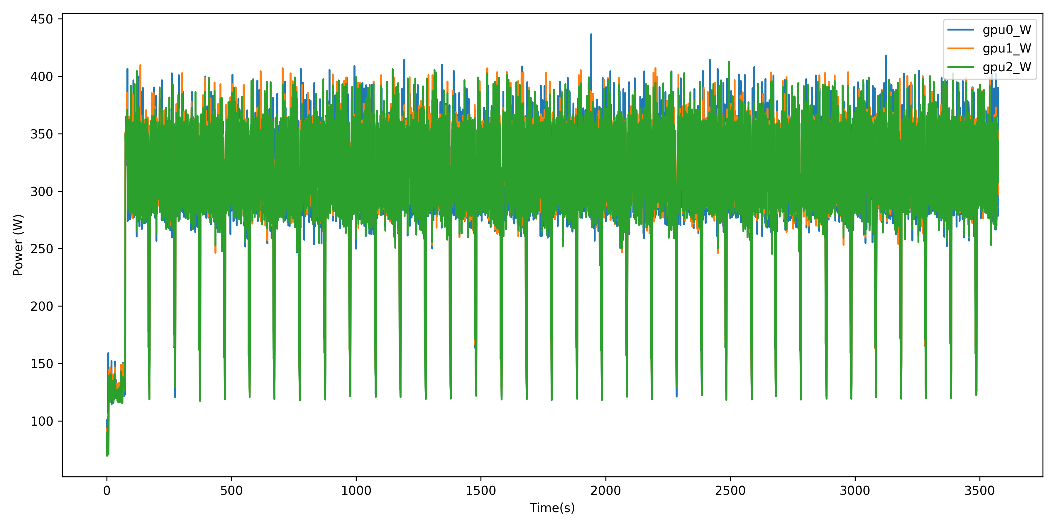
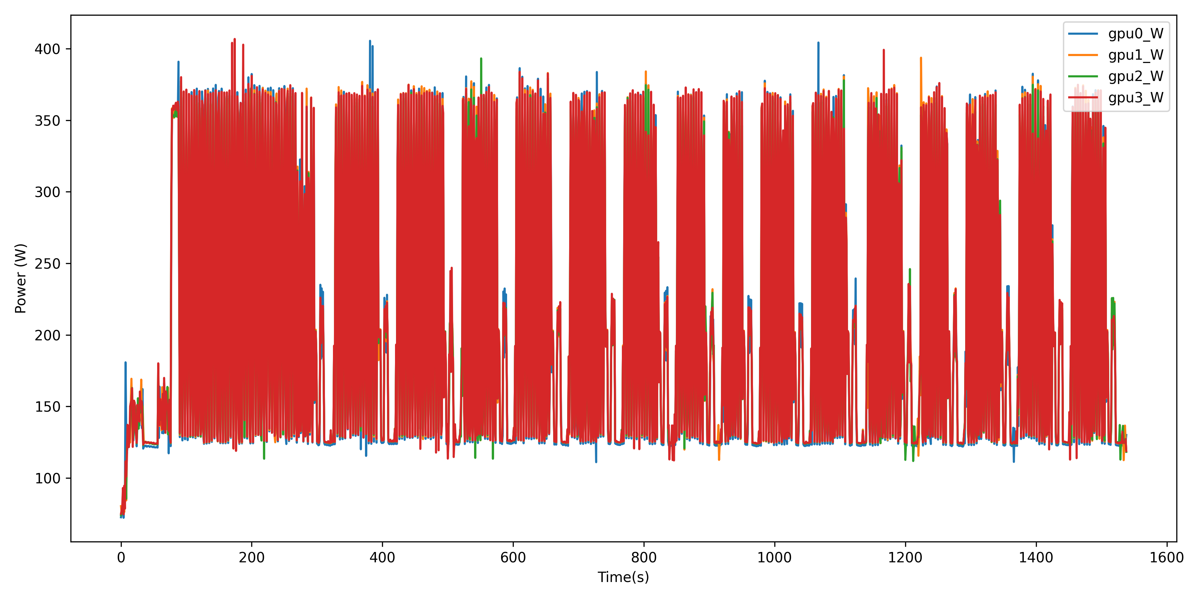
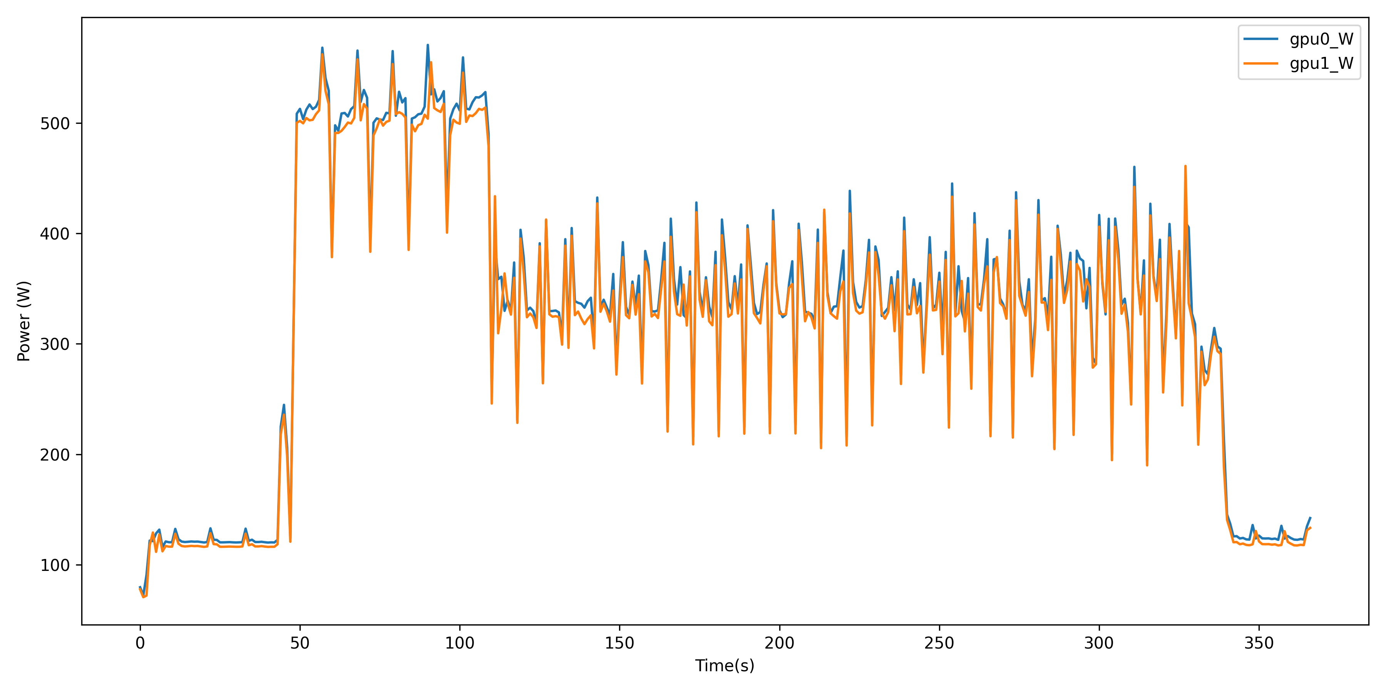
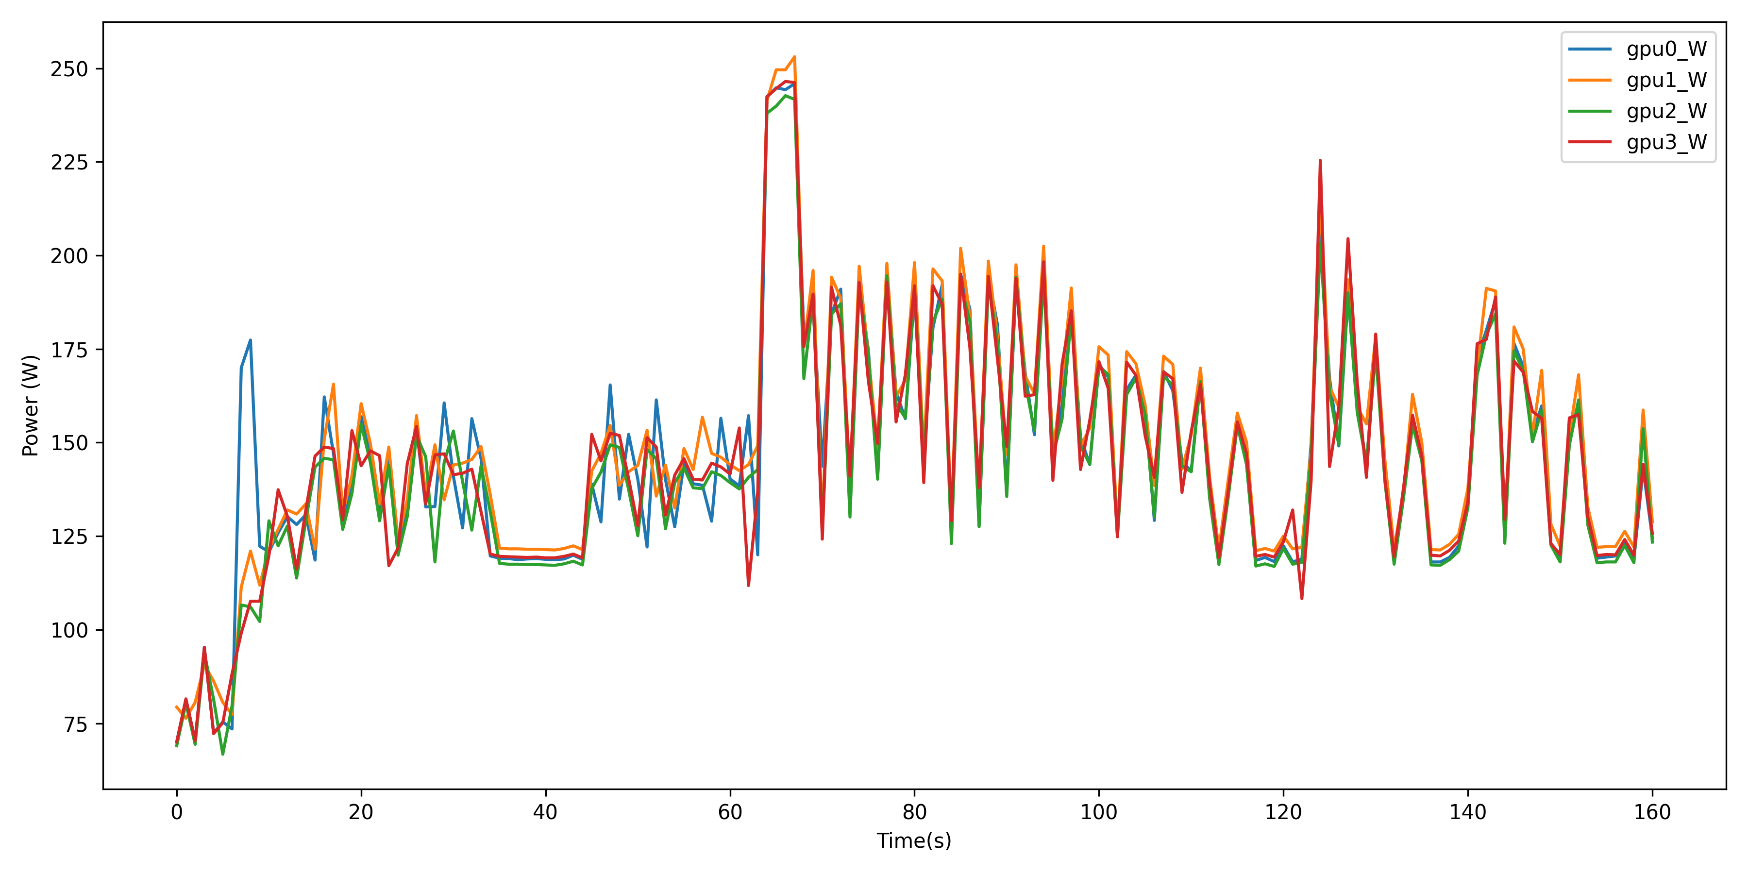
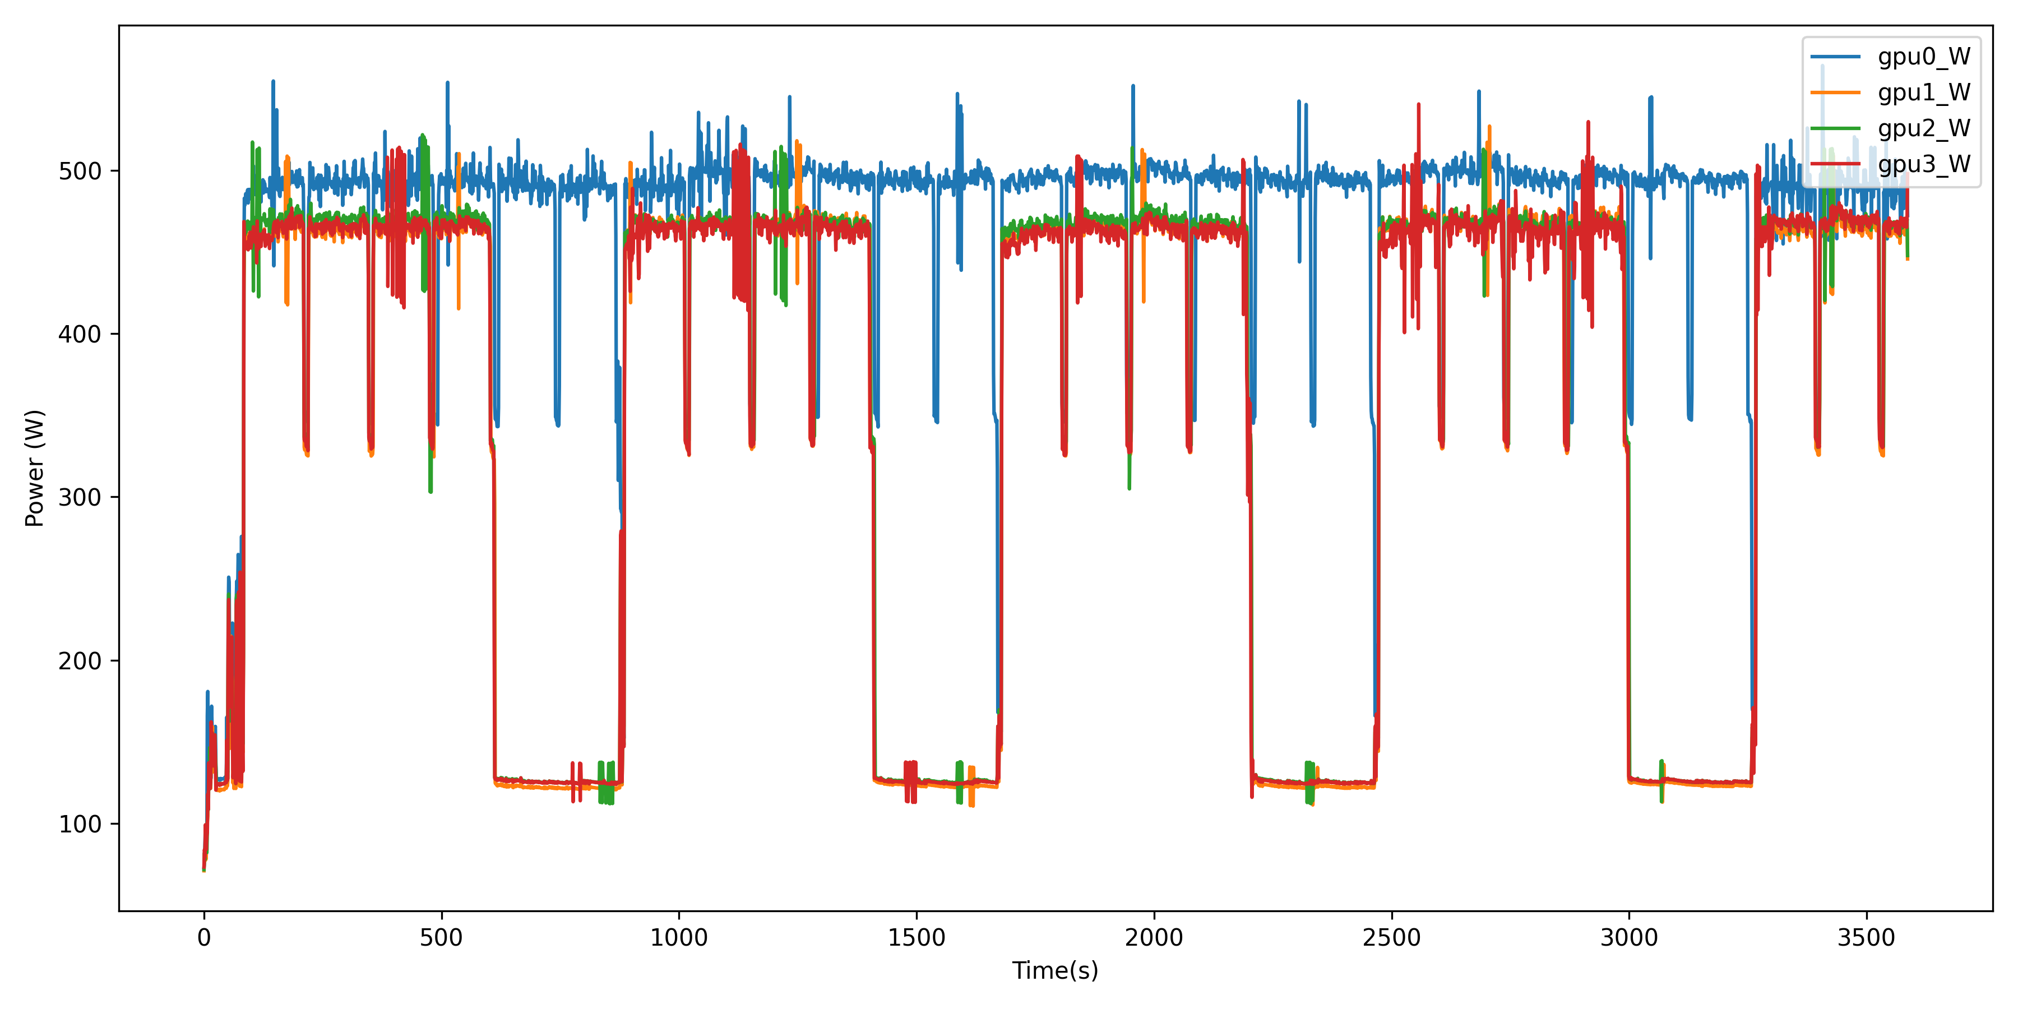
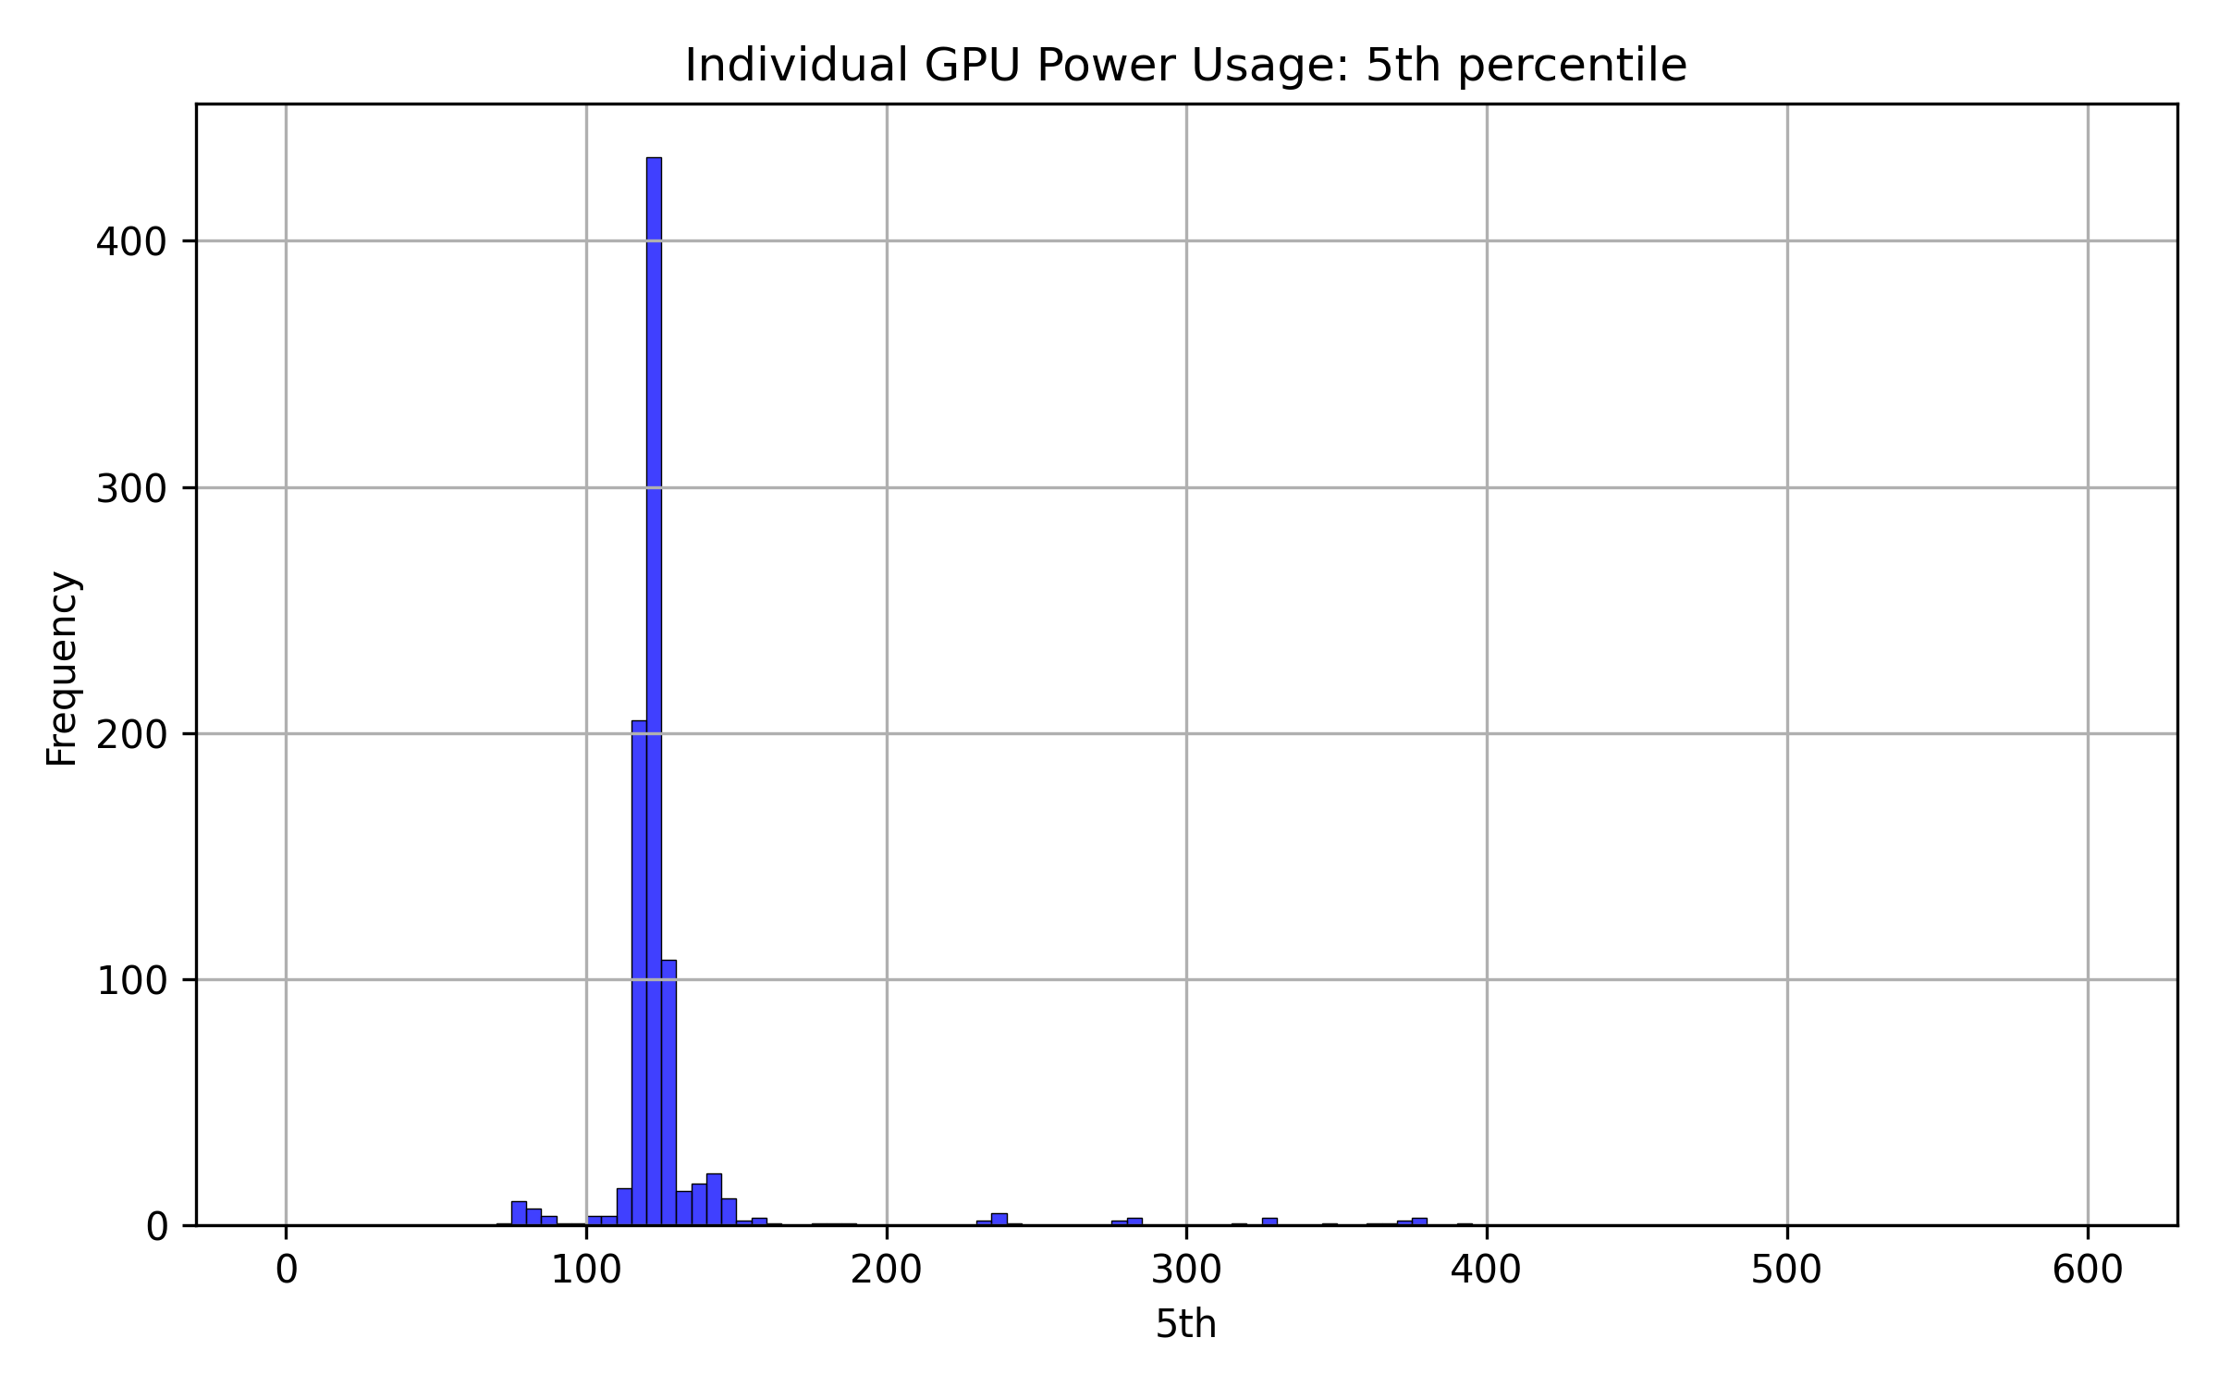
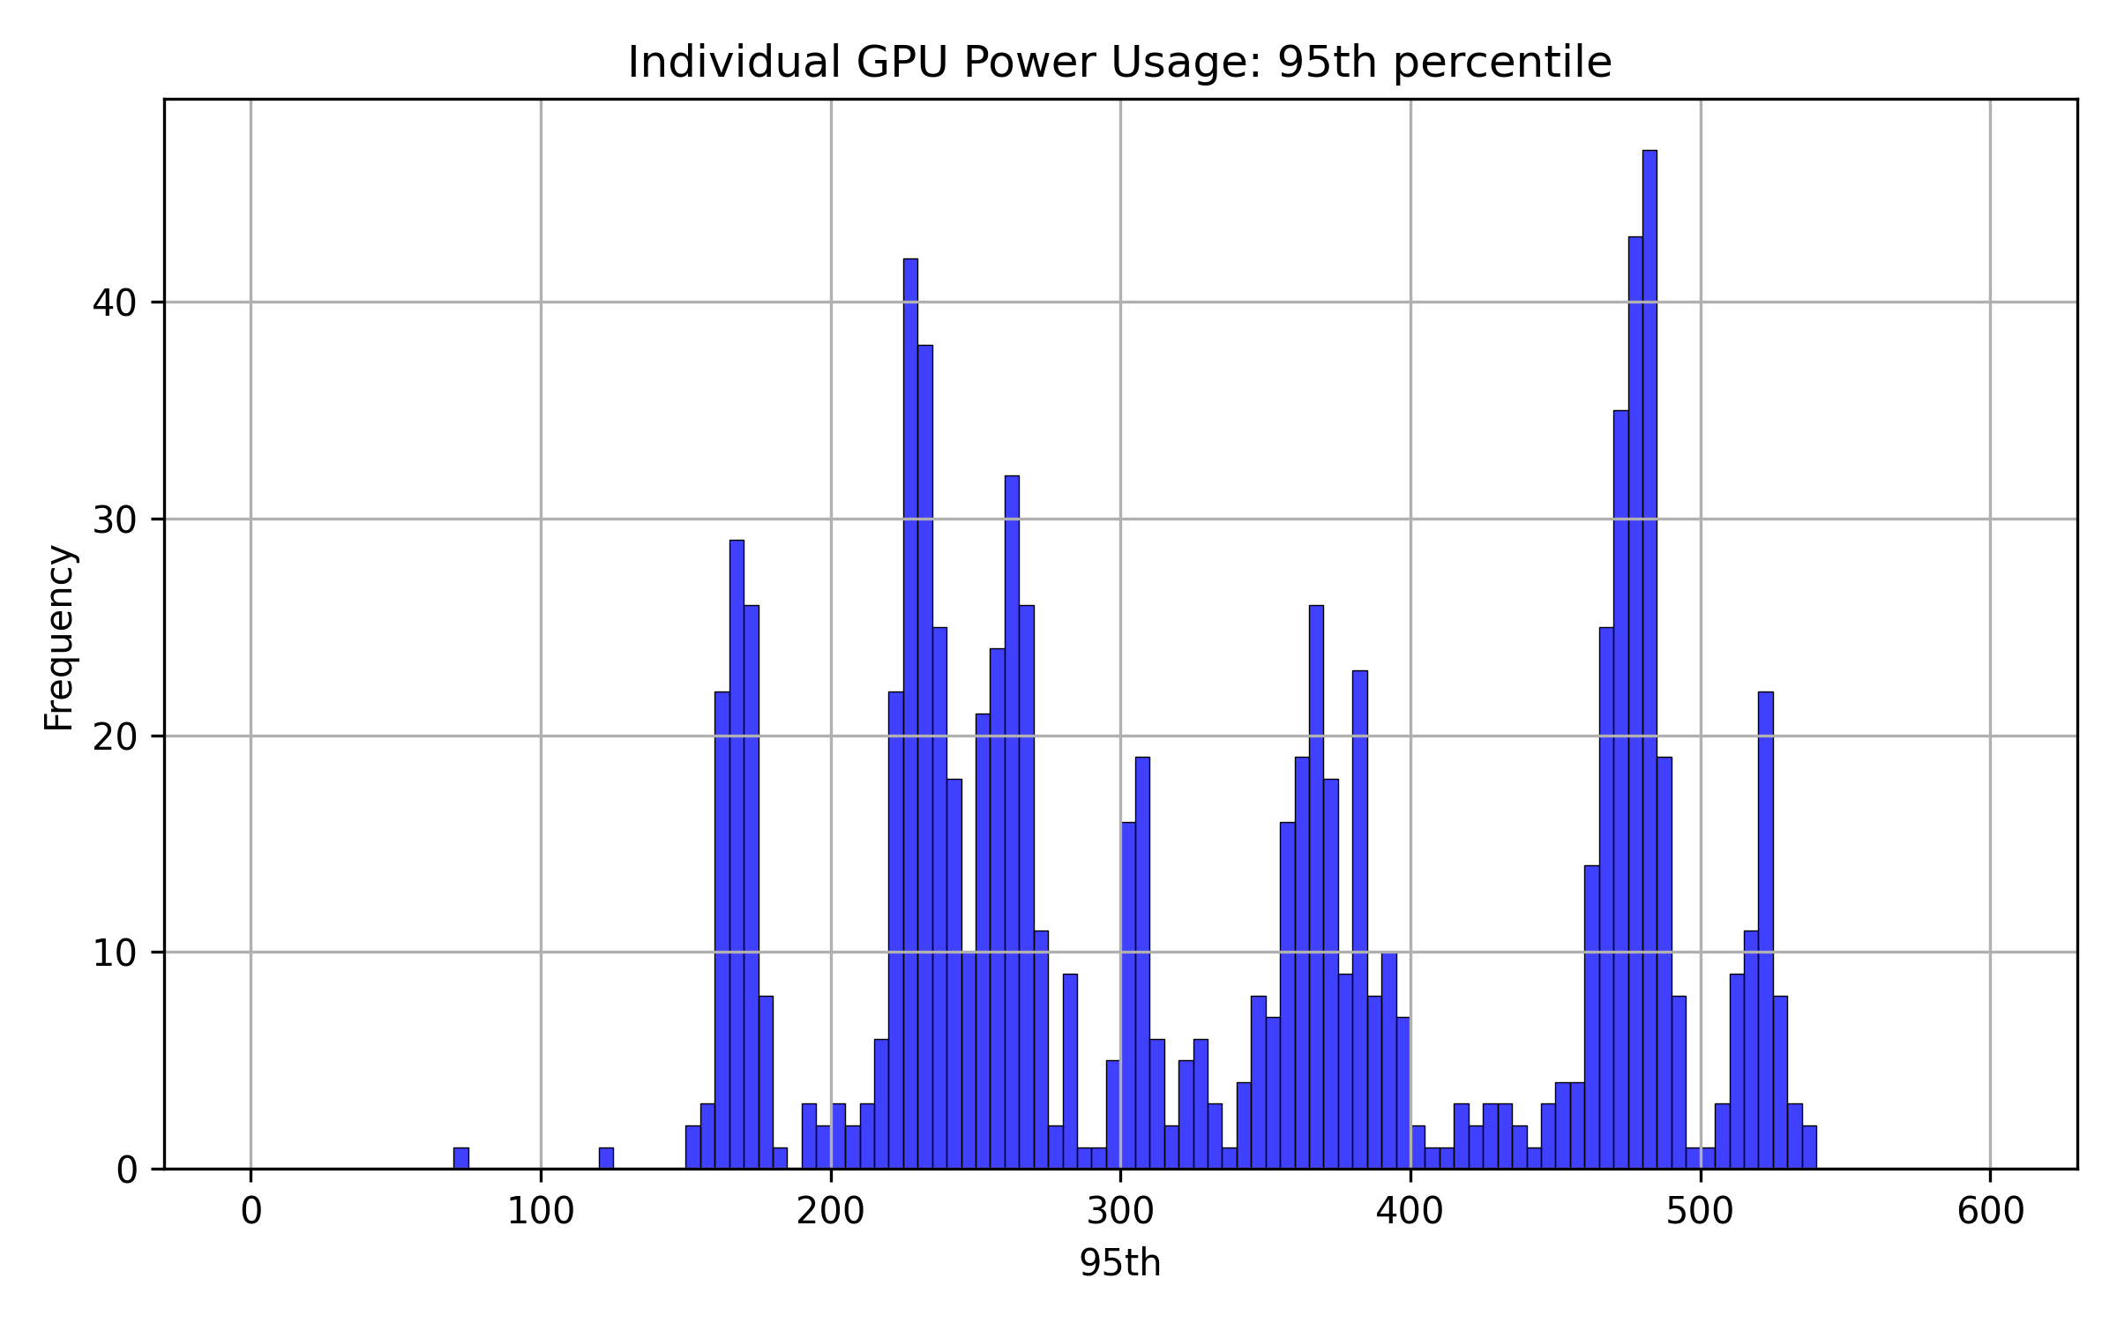
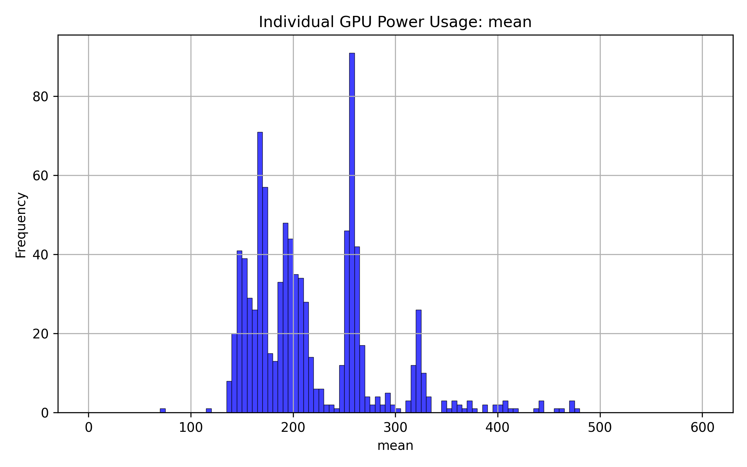
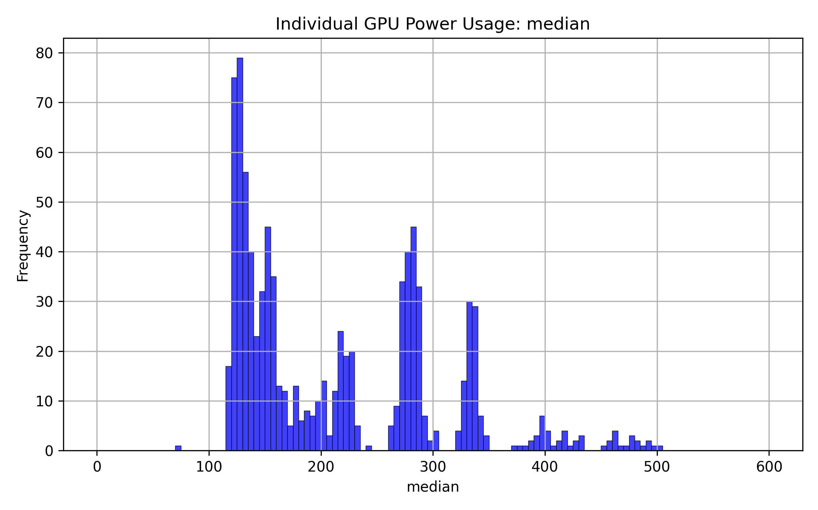
Reproducible Runtime Prediction for Heterogeneous HPC Workloads
HPC ODA COMMONS
Alan Ma¹, Kevin Menear¹ | ¹National Laboratory of the Rockies (NLR) | DOE SULI Program
open • local • reproducible
Introduction
Results
Discussion and Conclusions
• HPC schedulers need reliable runtime estimates to reduce idle resources and improve queue planning.
• Workloads are highly heterogeneous: on Kestrel, runtimes form a heavy-tailed distribution (see right histogram).
• Published results are hard to compare because sites use different data, feature sets, and temporal splits.
• Benchmark integrity was the largest finding. Feature leakage and inconsistent test populations changed conclusions more than small hyperparameter differences.
• Wallclock requests encode workload class. Partition-limit clusters identify distinct populations, but XGBoost already captures some of this signal.
• User routing is not universally beneficial. It can reduce typical-job error while worsening overall MAE or RMSE.
• No single model wins everywhere. Site workload structure determines whether extra routing complexity pays off.
HPC ODA Commons Toolkit
HPC ODA Commons is an open-source, artifact-driven standard toolkit designed for High Performance Computing Operational Data Analytics. It provides a local-first approach to normalizing SLURM logs, enforcing submission-time feature policies to avoid data leakage, and enabling reproducible benchmark grids.
Contributions
• Dataset audit: characterized 11 public HPC traces for quality, coverage, and benchmark readiness.
• Toolkit fixes: identified parser, sentinel, and post-hoc feature leakage issues; three fixes merged.
• Model development: evaluated four distinct models and contributed time-decay weighting and production MoE XGBoost.
• Evaluation safeguards: shared rolling grids, data-derived bins, fallback coverage, and exact same-row checks.
Methodology & Models
Leakage made the old absolute MAEs look much better than a deployable model.
• 1. Normalize job records to the `oda.job.v0.2.0` schema.
• 2. Restrict features to information known when the job is submitted.
• 3. Route inside each window to data-derived wallclock/user experts.
Four Models Evaluated:
Future Work
• Flat XGBoost: Baseline gradient boosting over all data.
• MoE XGBoost: Mixture of Experts routing by user & wallclock.
• LightGBM: High-efficiency, fast alternative for comparison.
• Random Forest: Traditional ensemble, stable but often slower.
Corrected 8-Configuration Ablation
• Energy and power prediction: compare direct energy, average power, and runtime–power cascades on Fugaku and Kestrel.
• Cross-system validation: run the benchmark matrix to identify when routing, decay, or log targets help.
A checkpointed experiment now isolates user routing, wallclock routing, and time decay on the exact same Kestrel jobs using the current feature allowlist. The script hashes split rows and true targets and refuses to compare mismatched populations.
Acknowledgements
Special thanks to Kevin Menear, the HPC ODA Commons contributors, and the NLR Computational Science Center. This research was supported by the U.S. Department of Energy Office of Science Science Undergraduate Laboratory Internships (SULI) program.
This research was supported by the U.S. Department of Energy Office of Science, Office of Workforce Development for Teachers and Scientists (WDTS) under the Science Undergraduate Laboratory Internships (SULI) program. The views expressed do not necessarily represent the views of the DOE or the U.S. Government.

