Slide 1



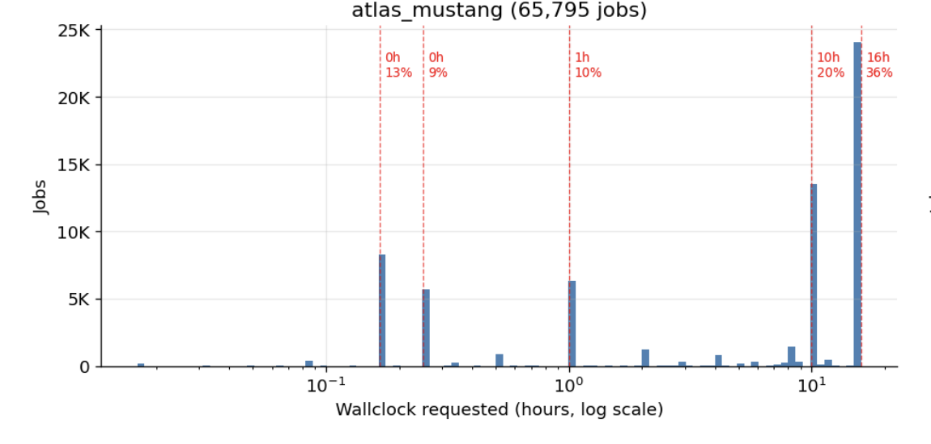
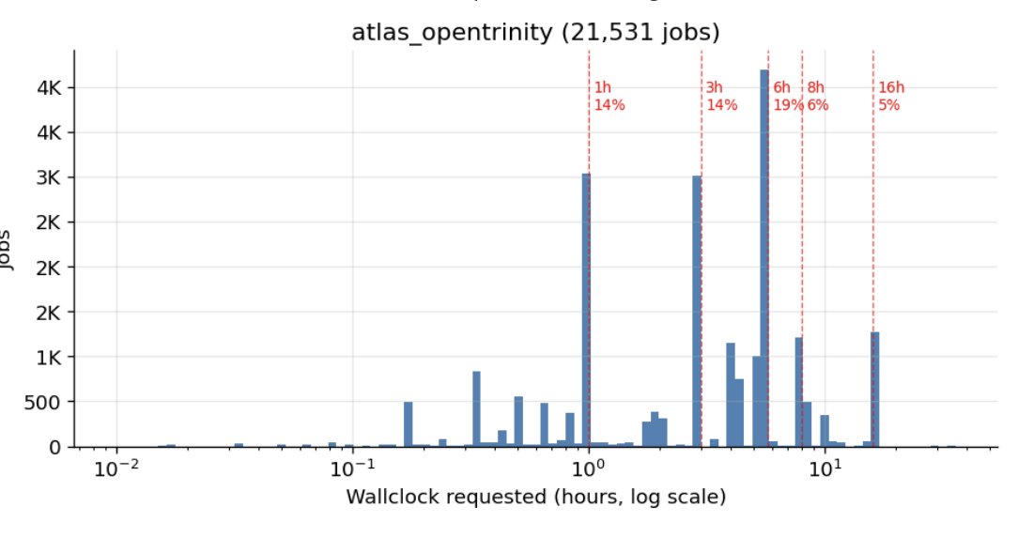
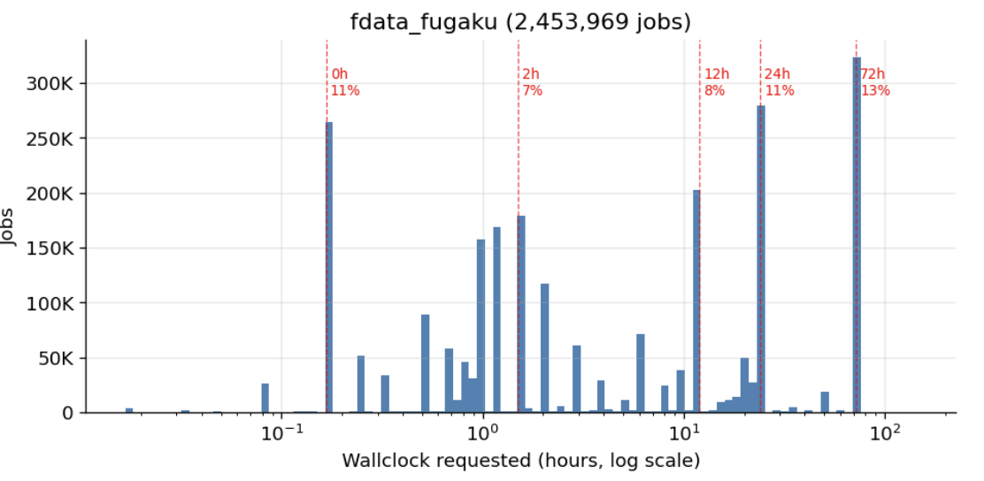
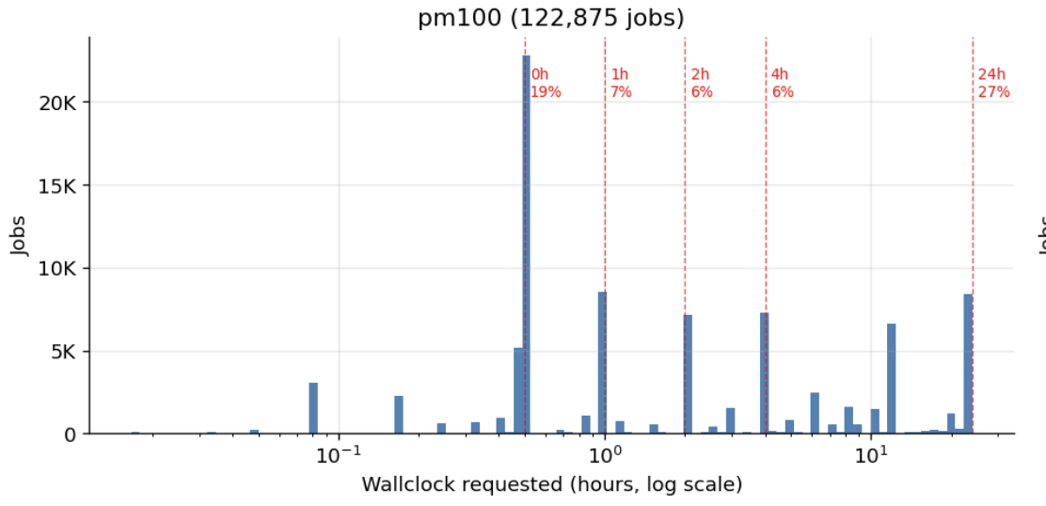
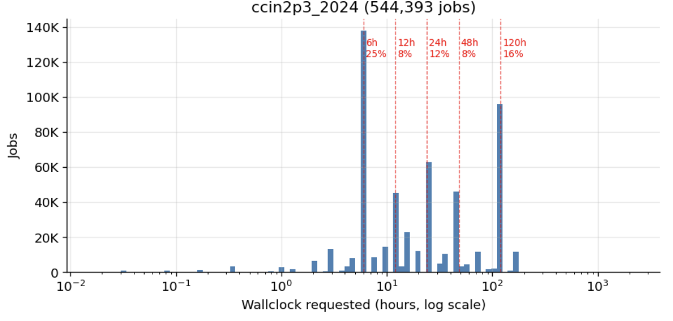
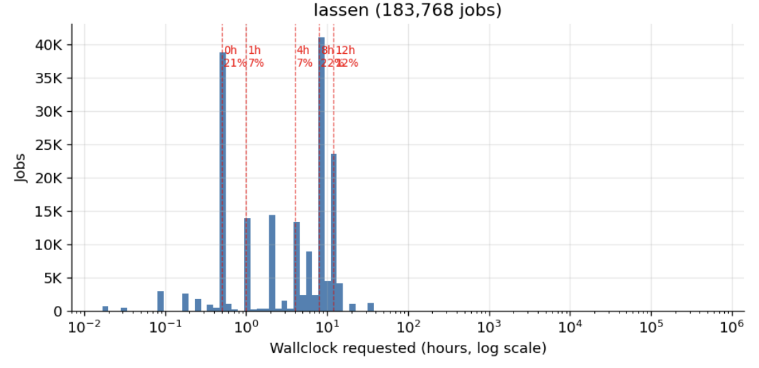
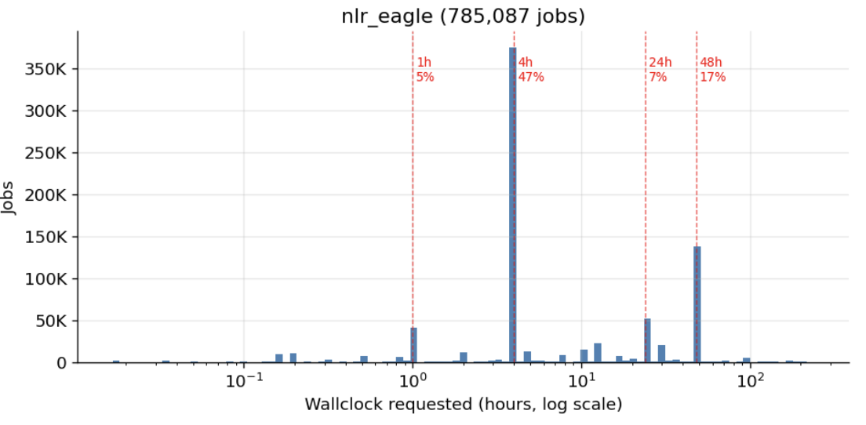
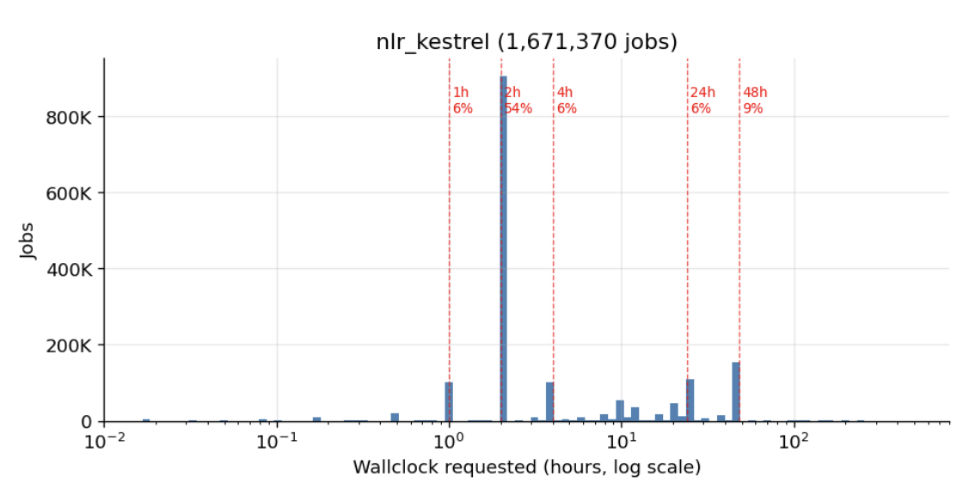
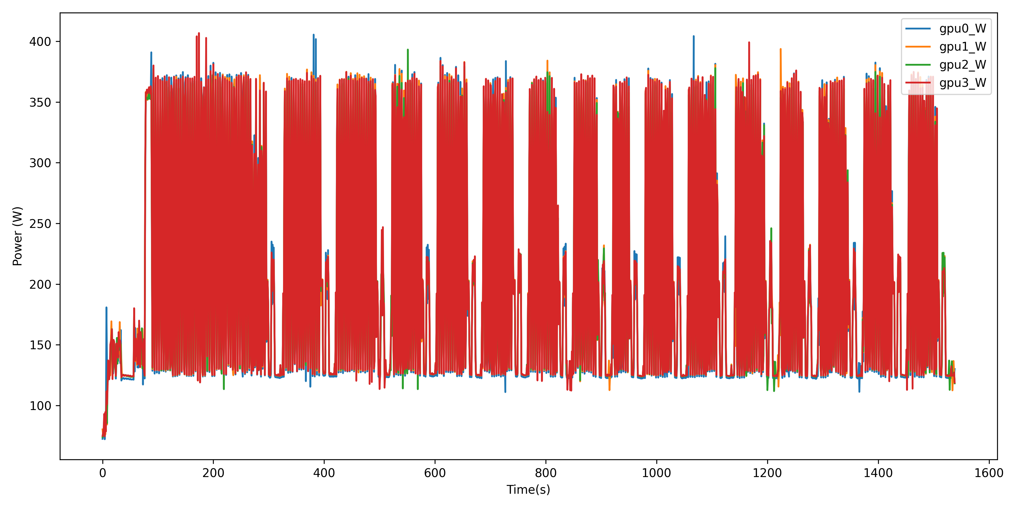
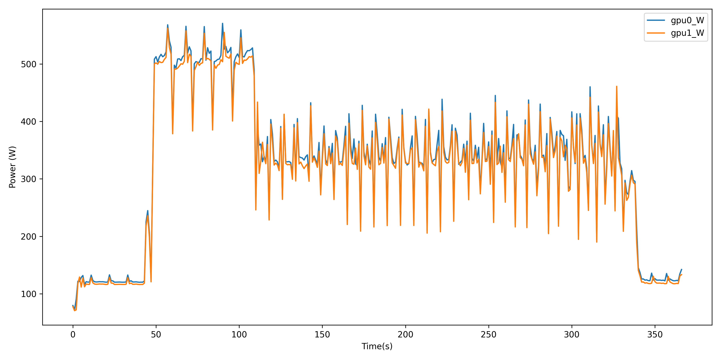
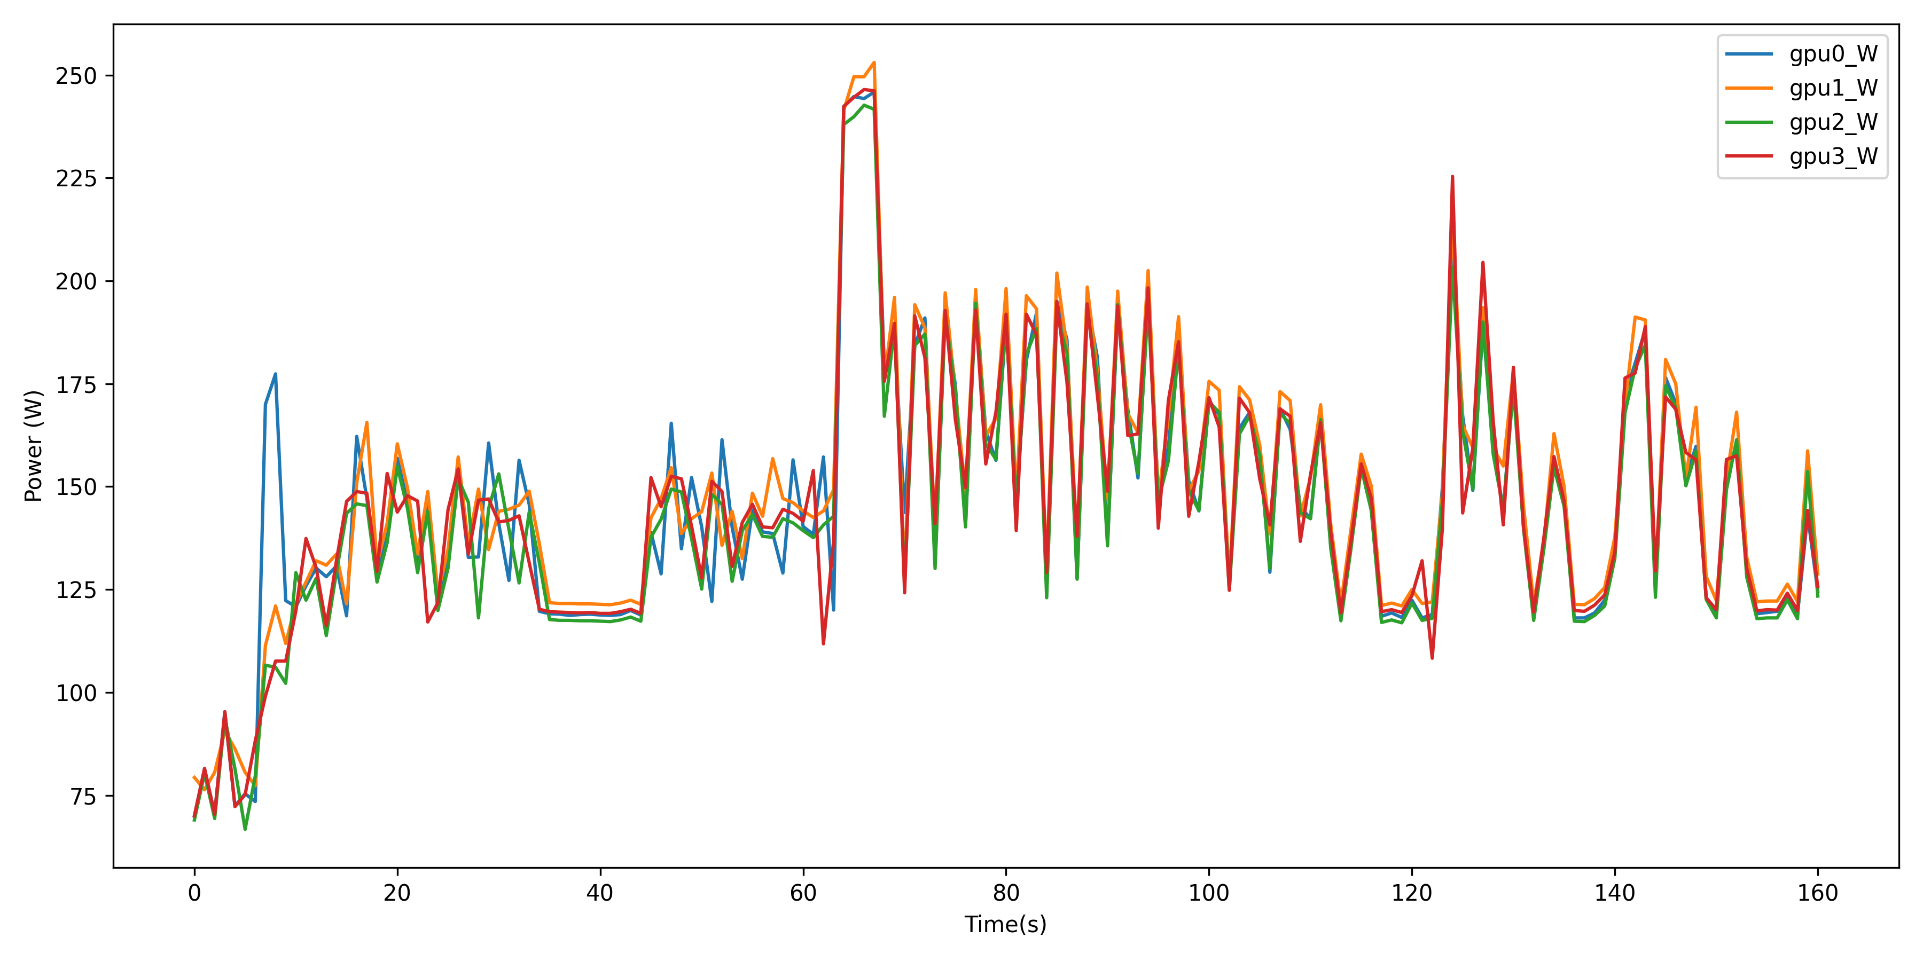
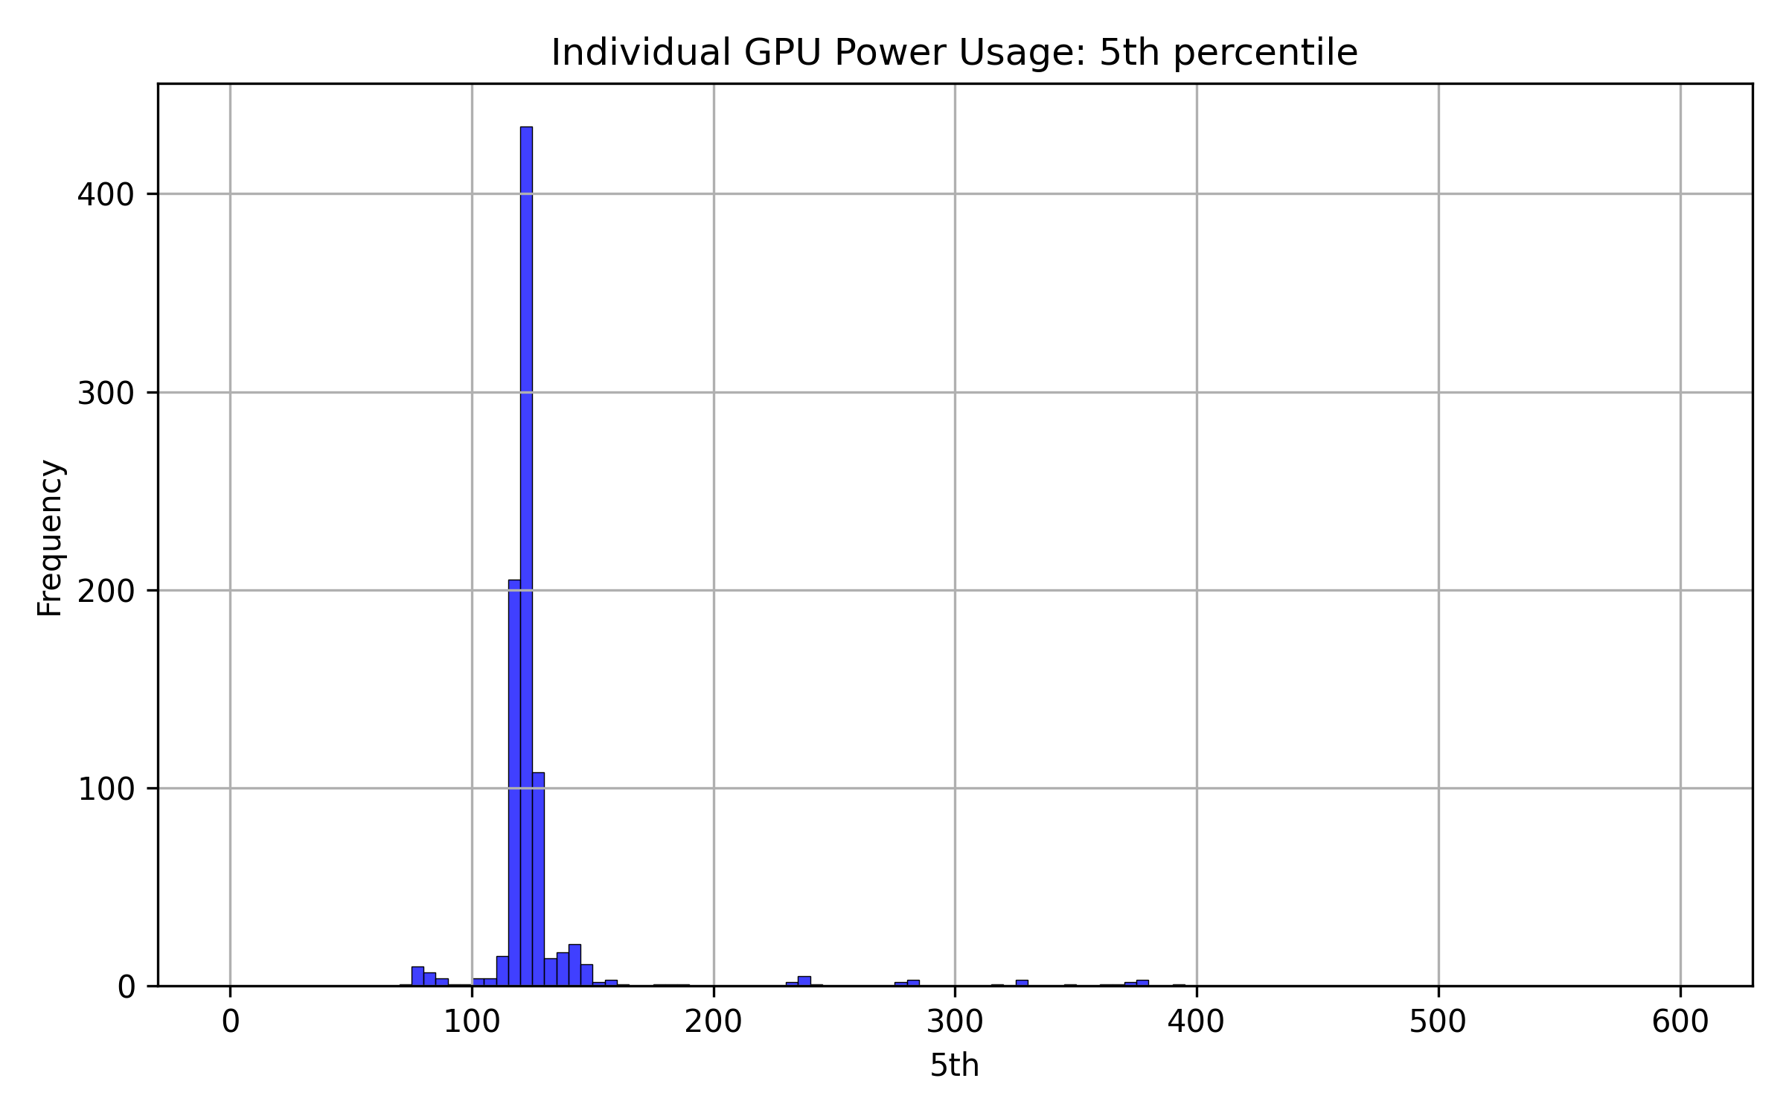
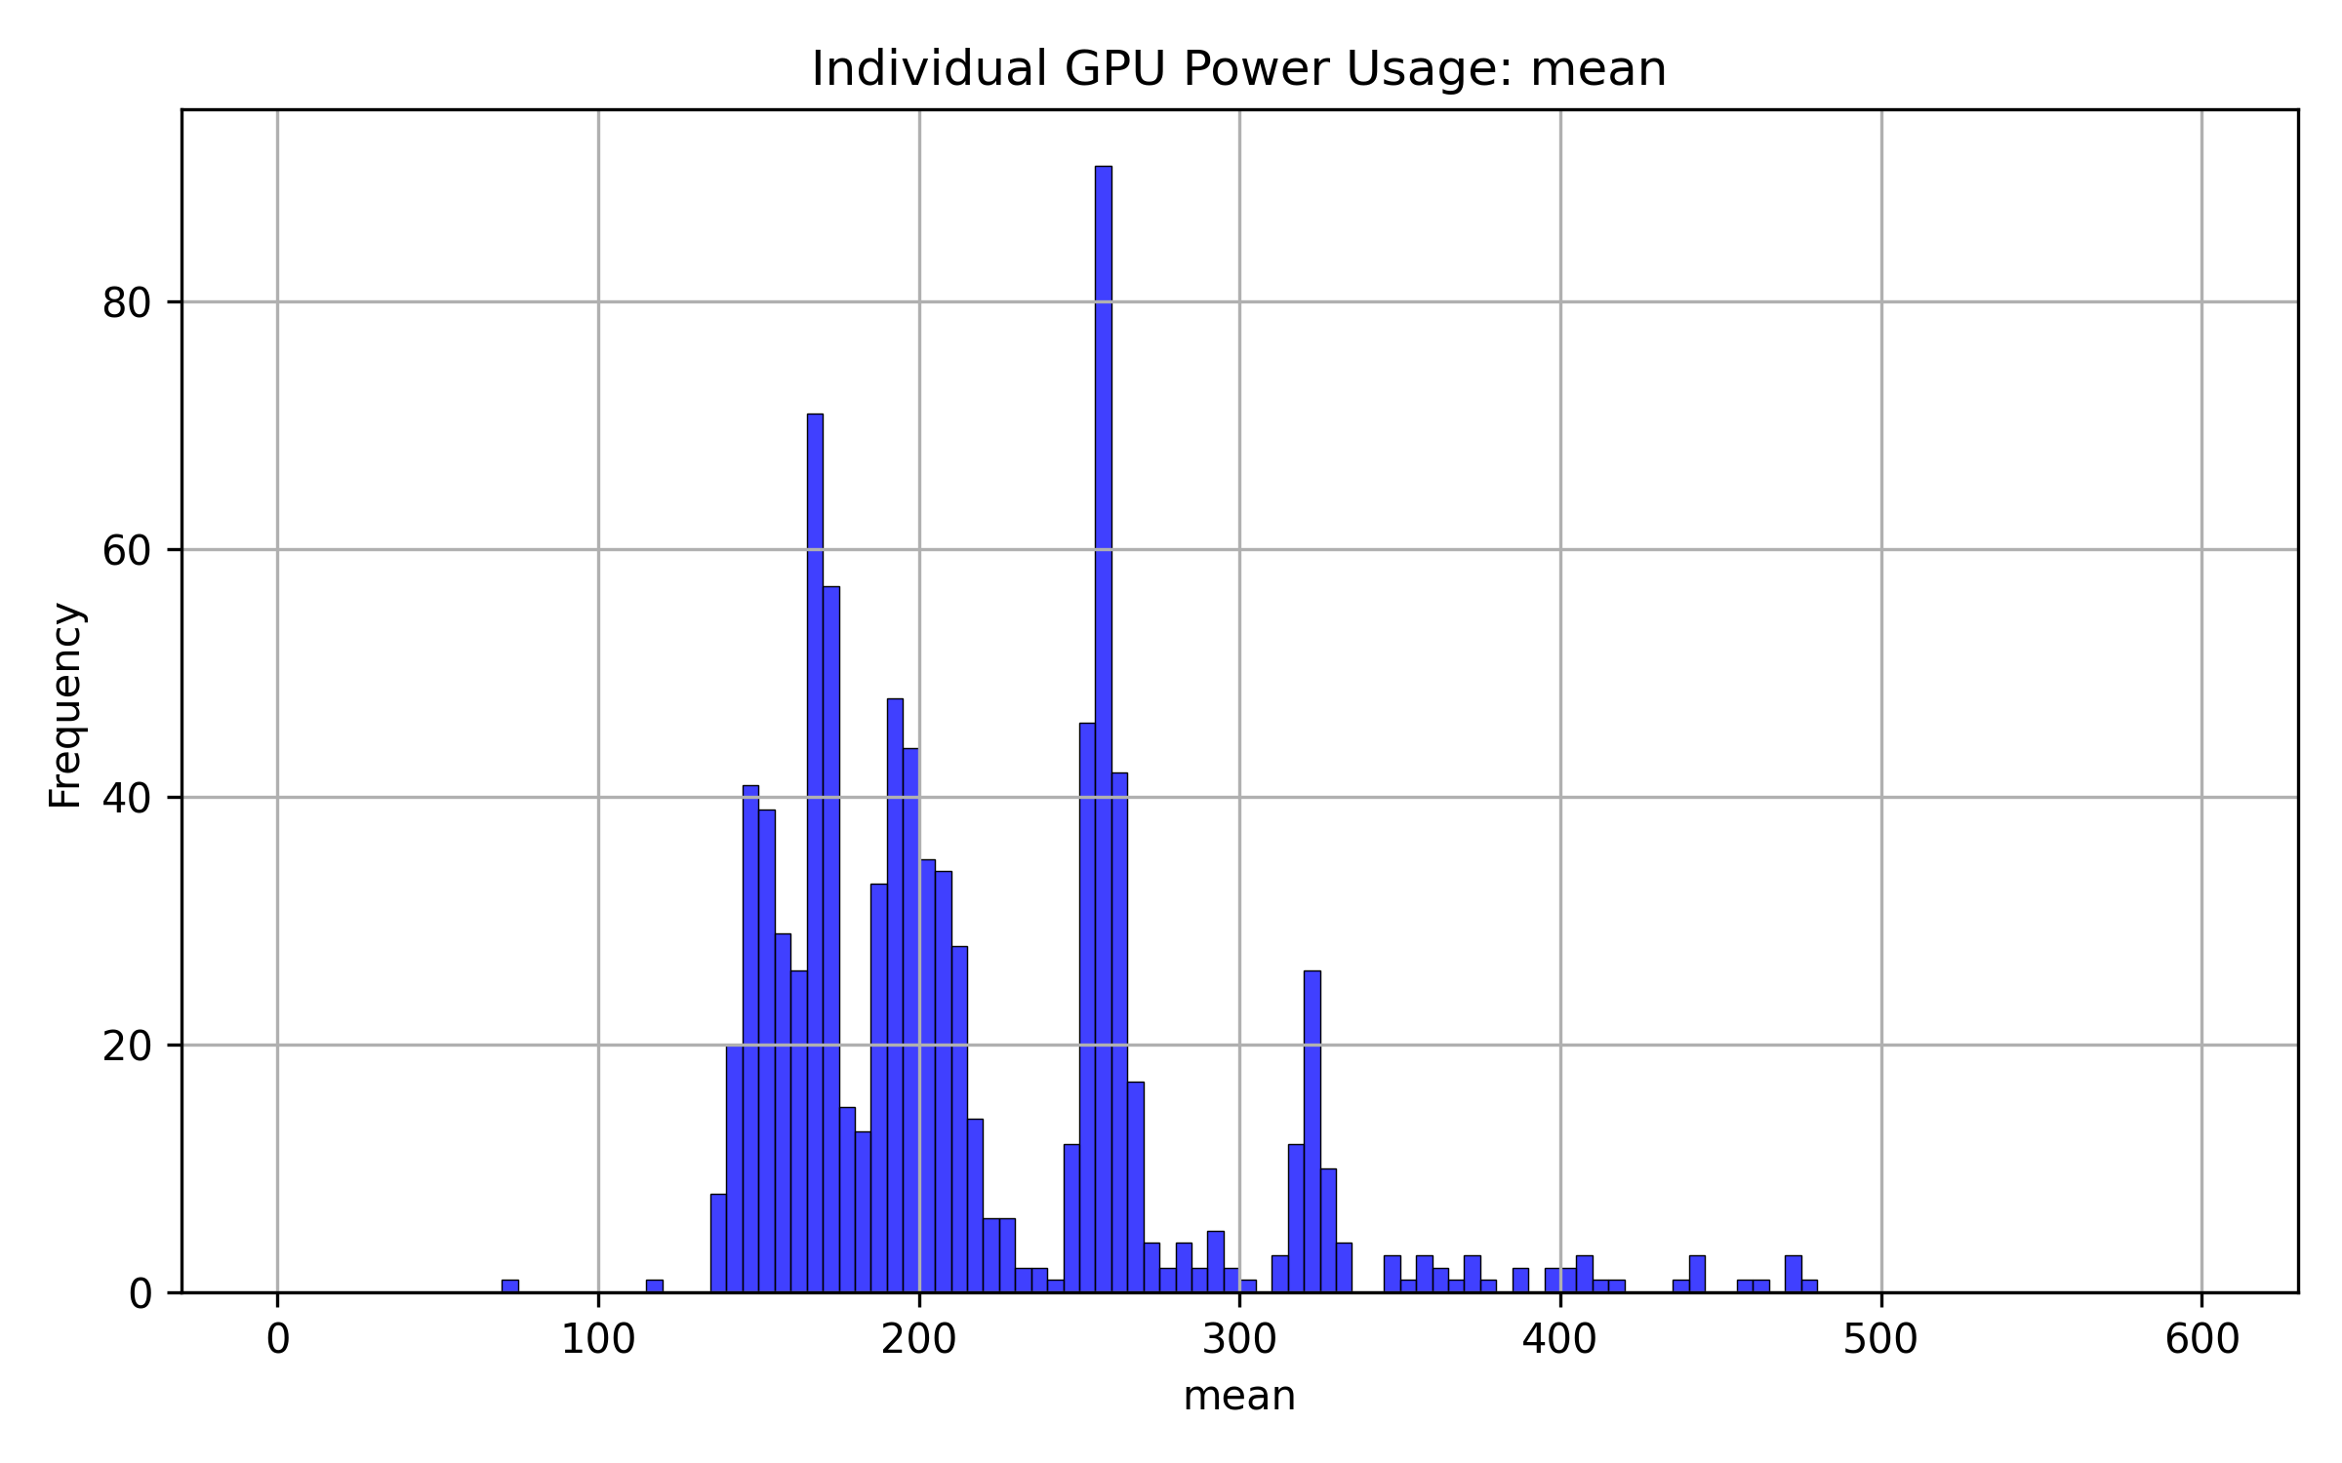
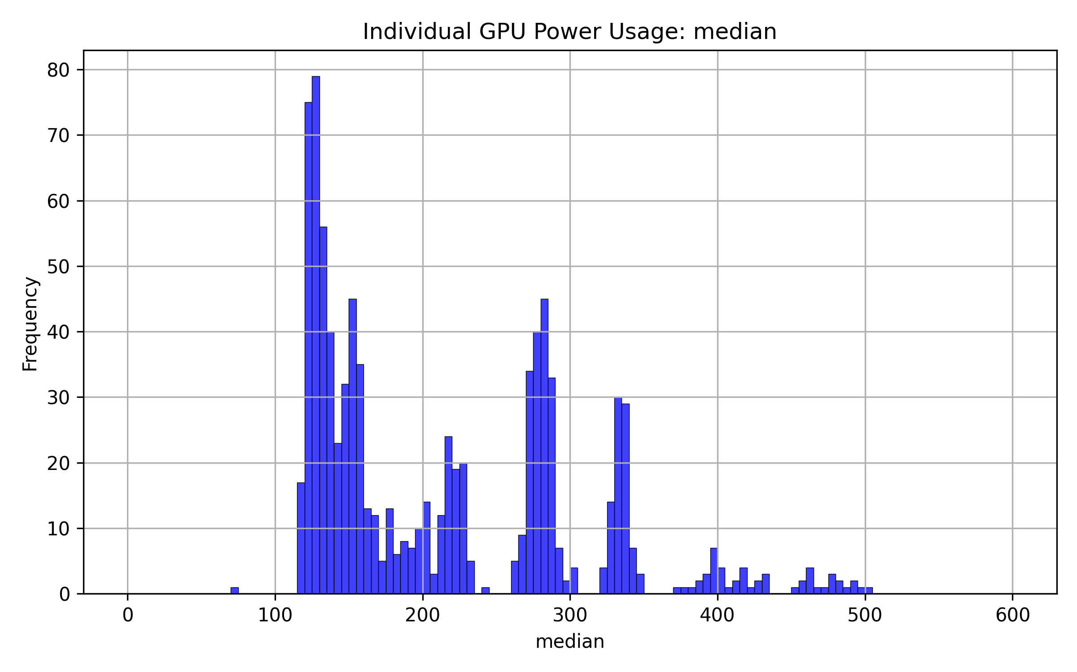
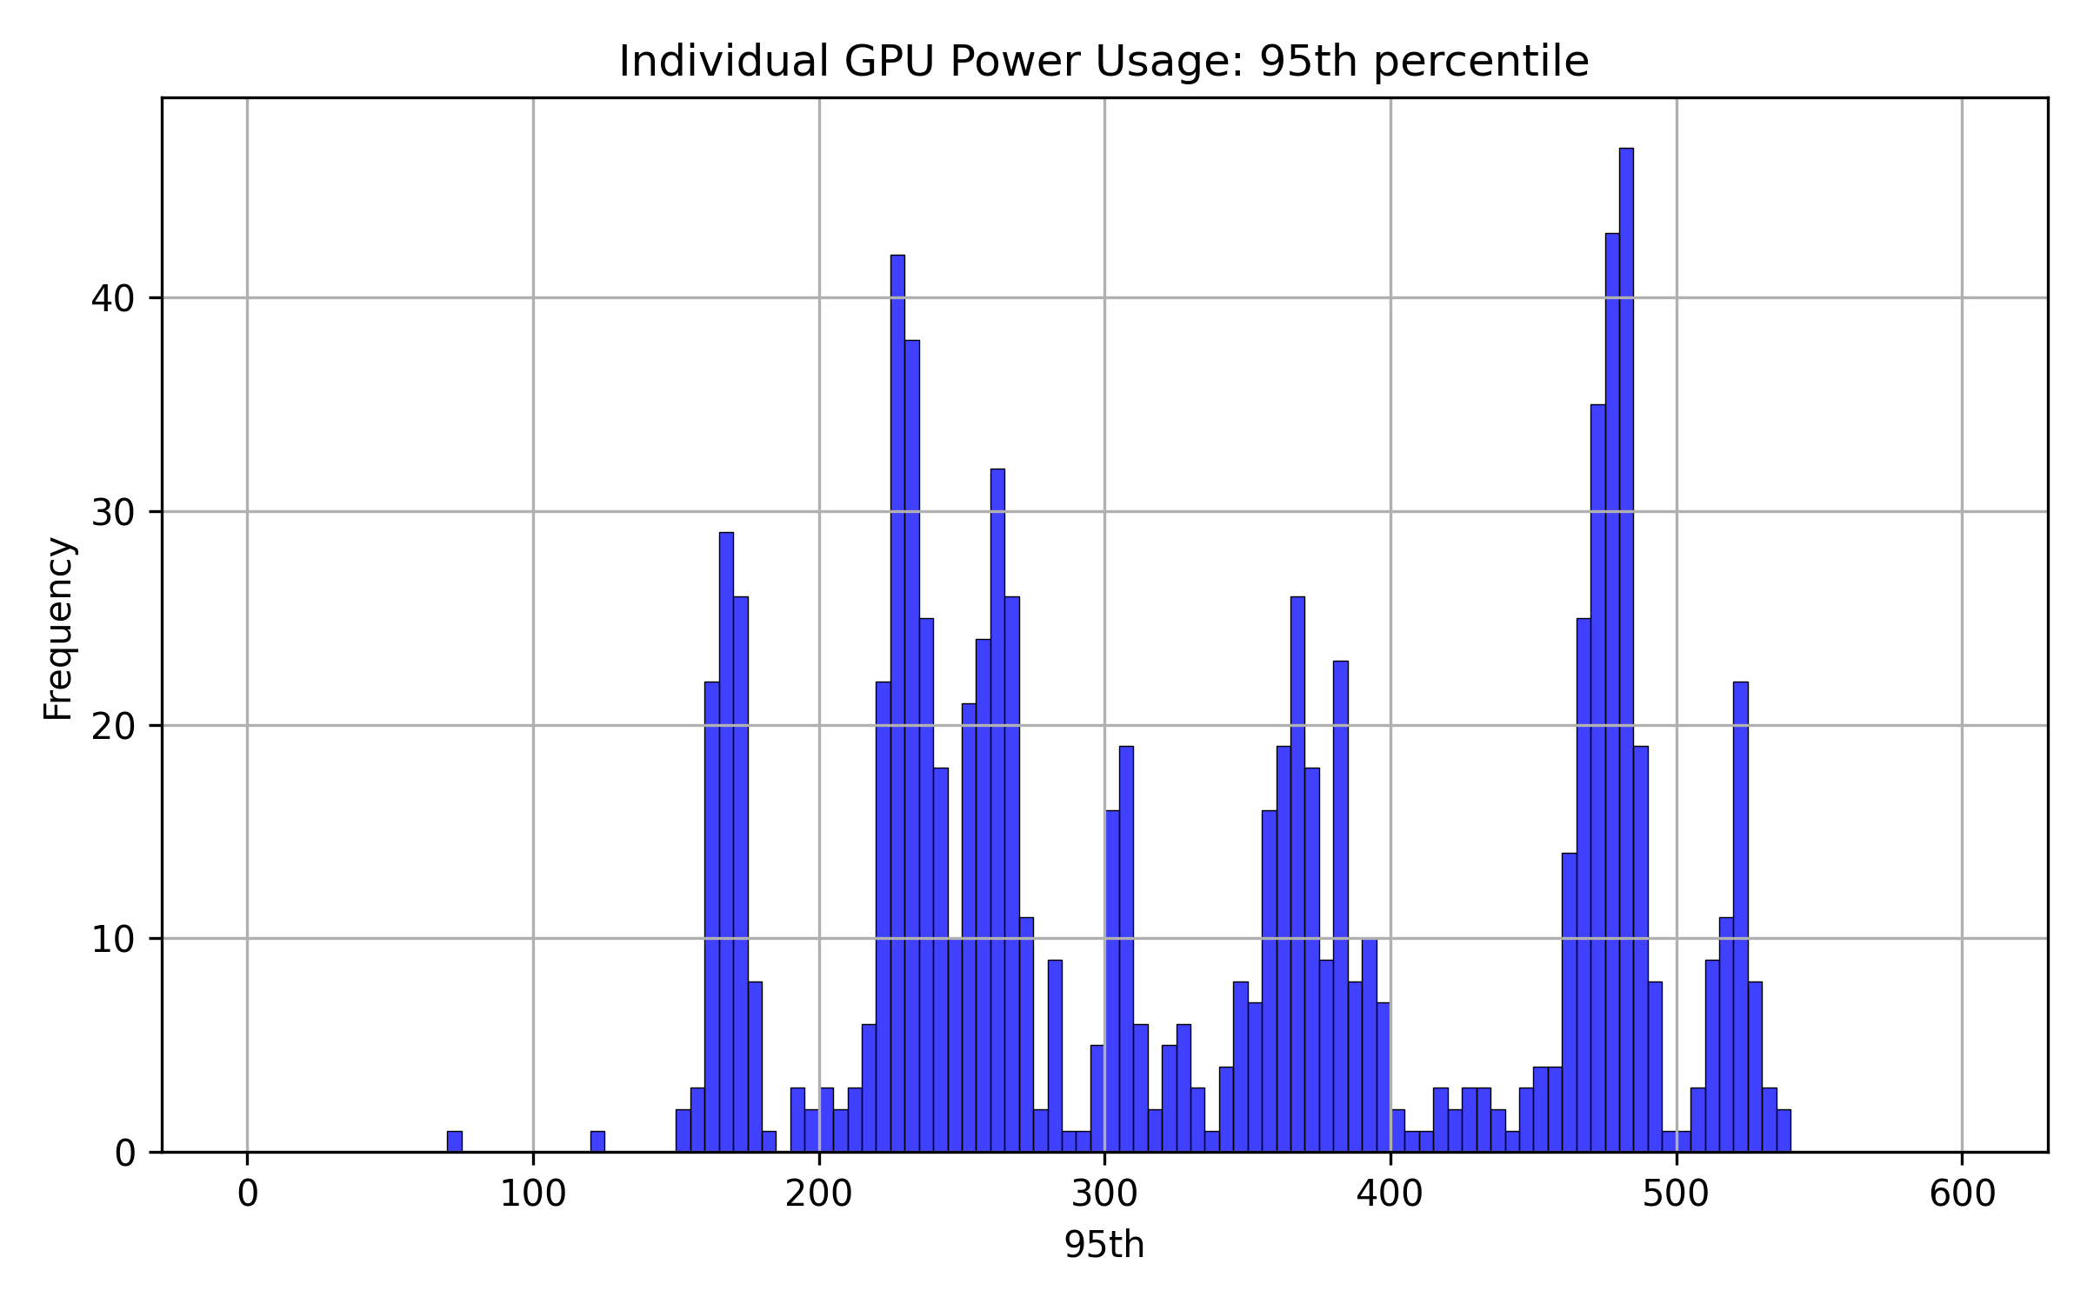
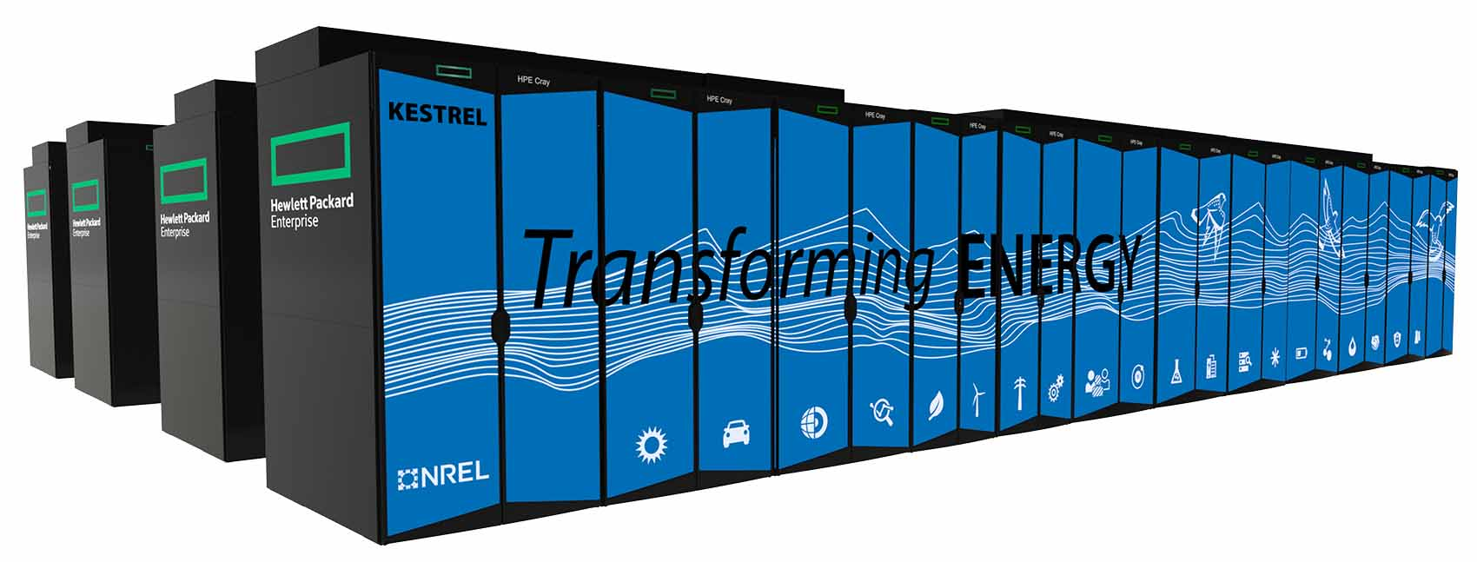
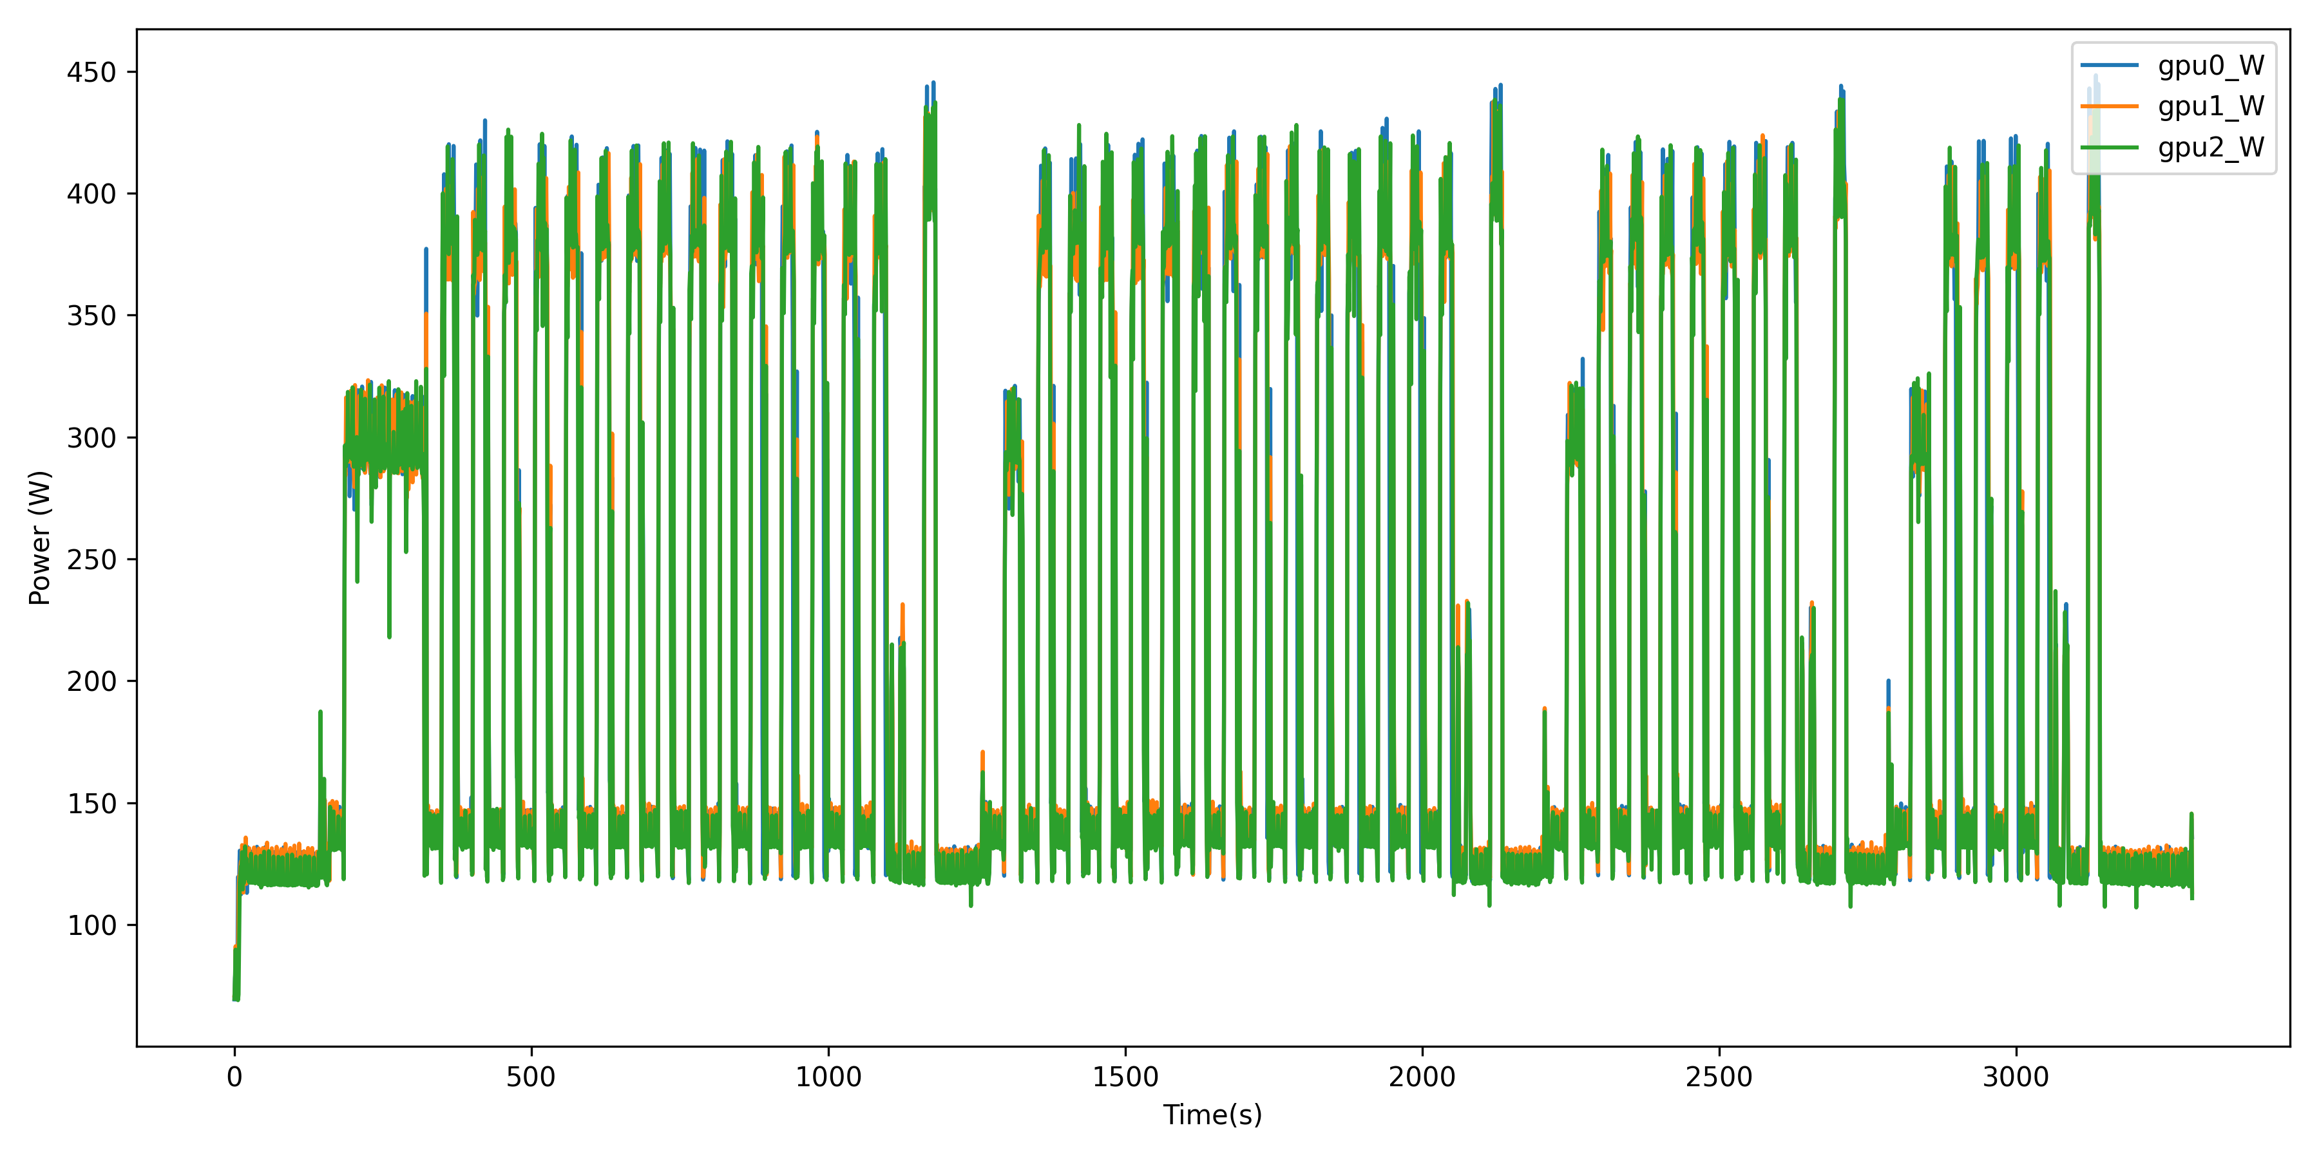
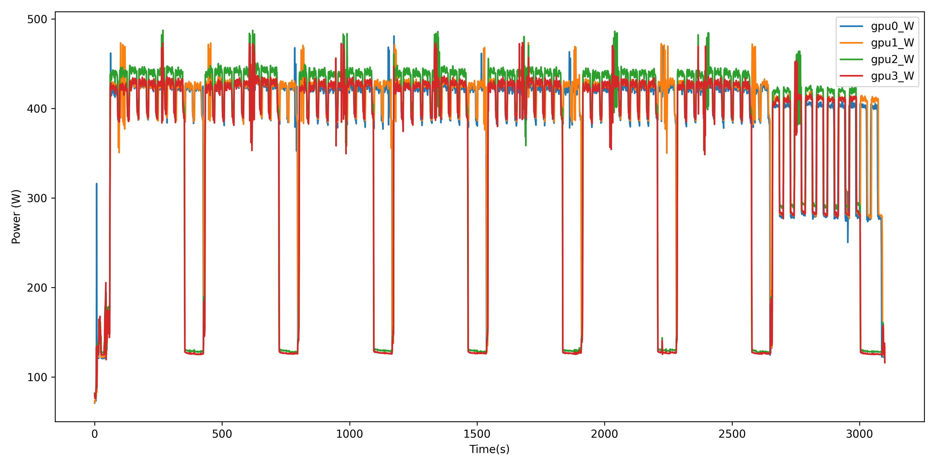
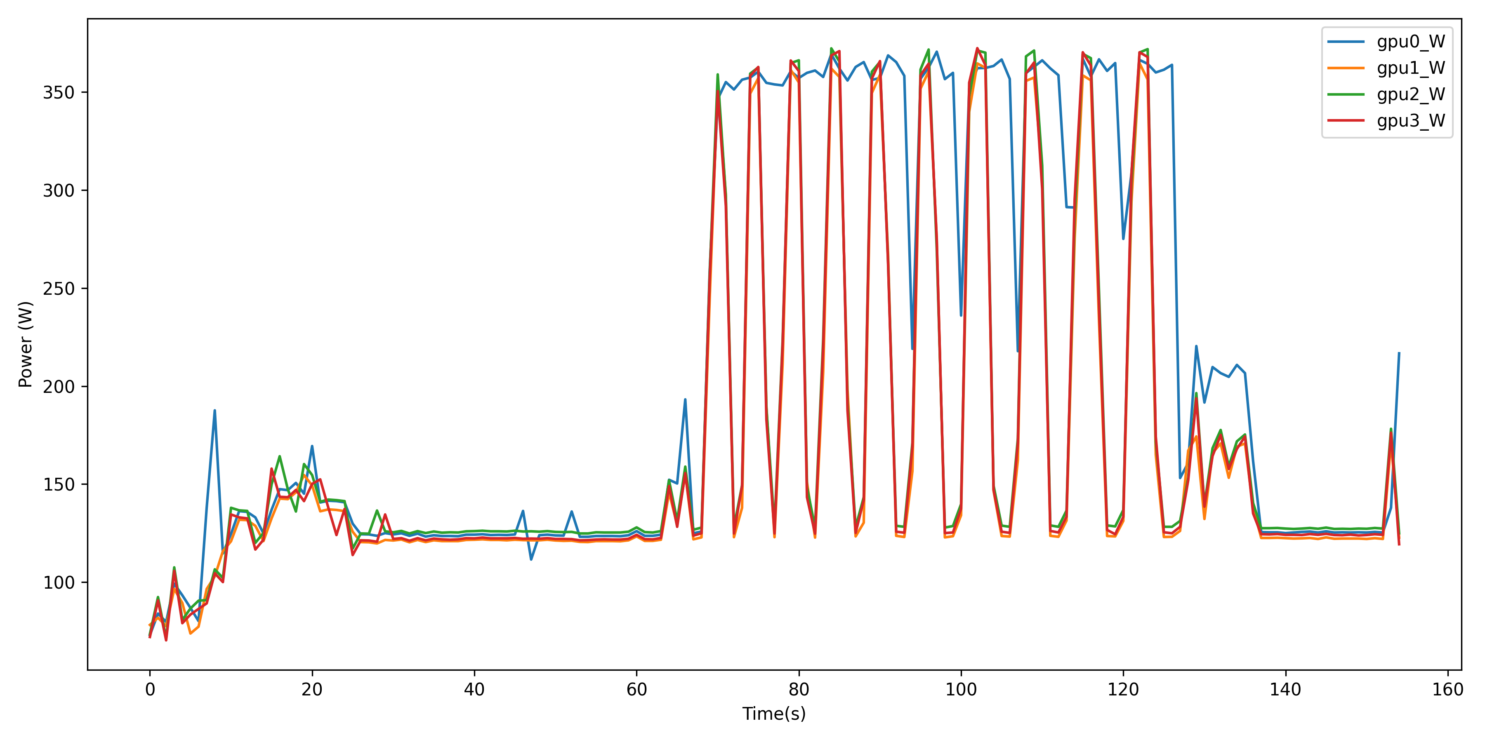
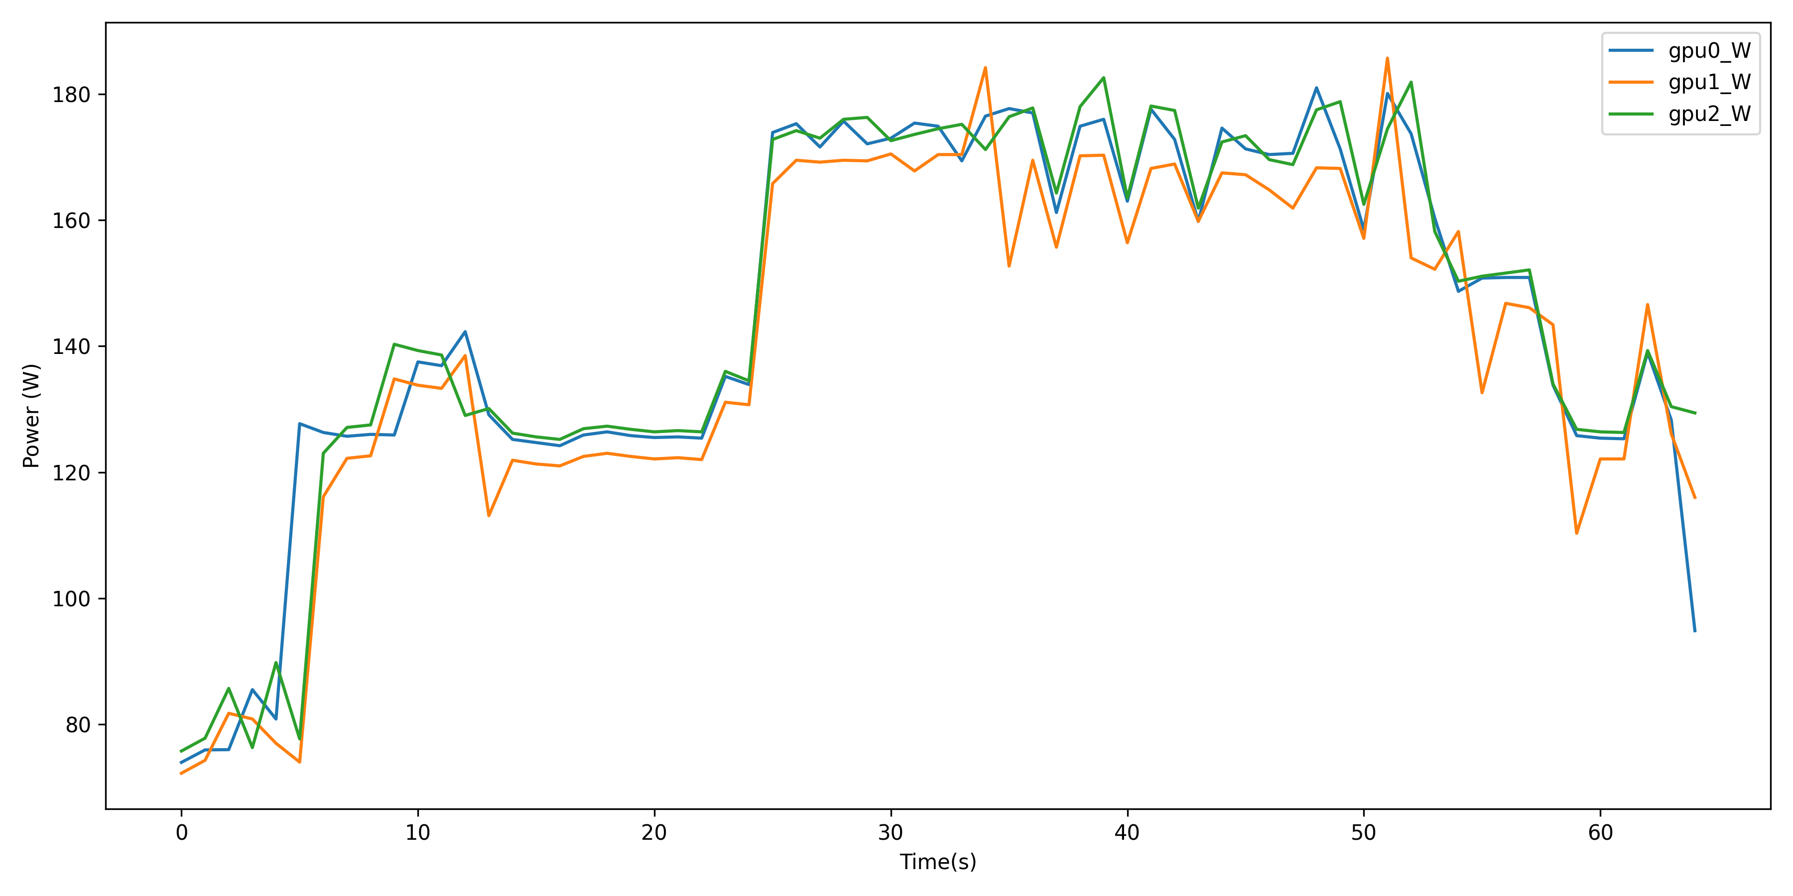
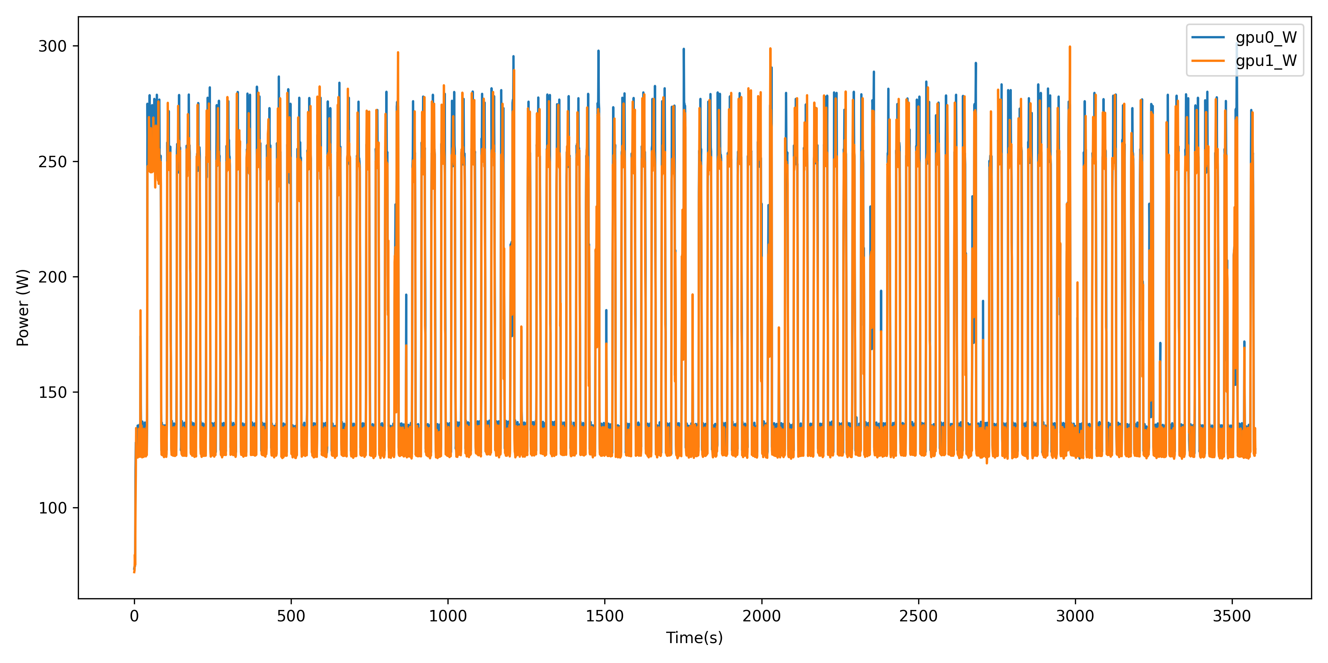
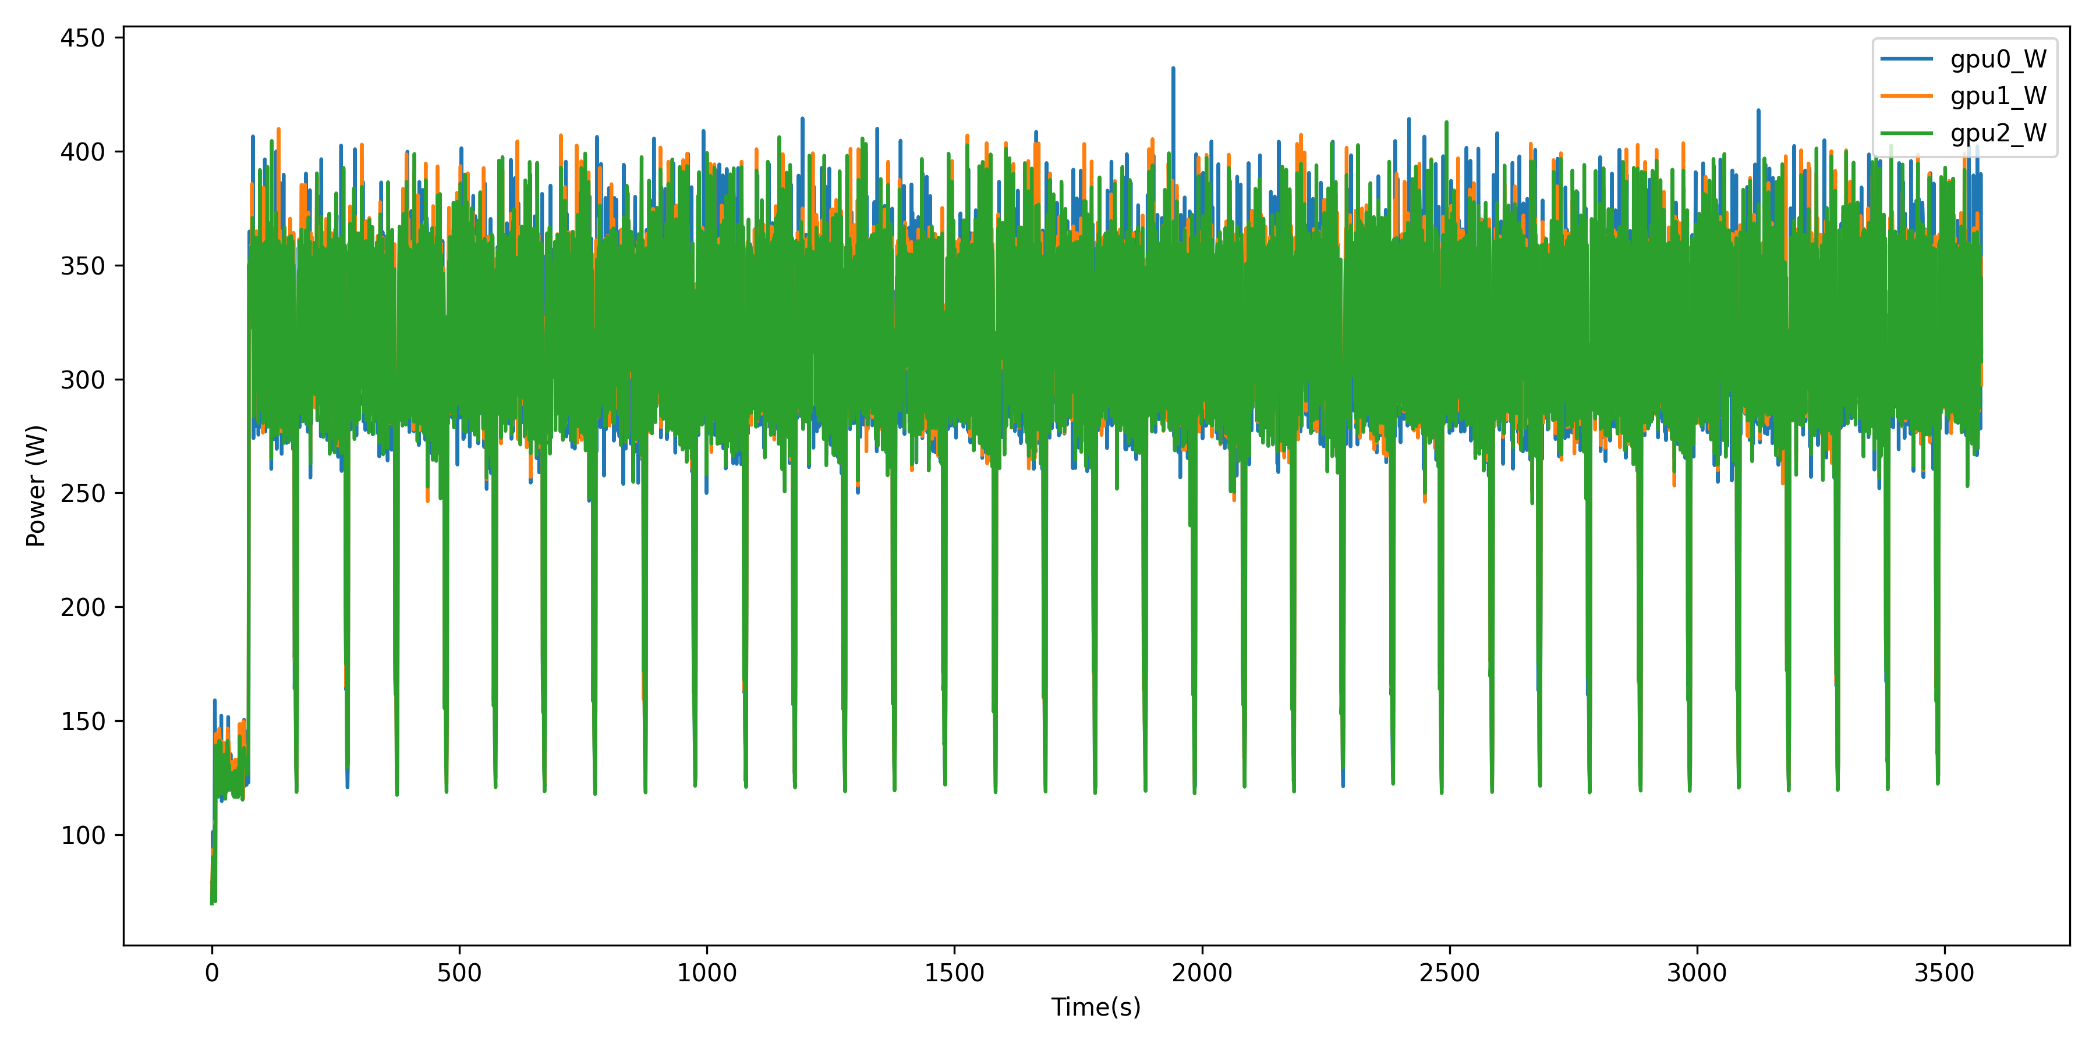
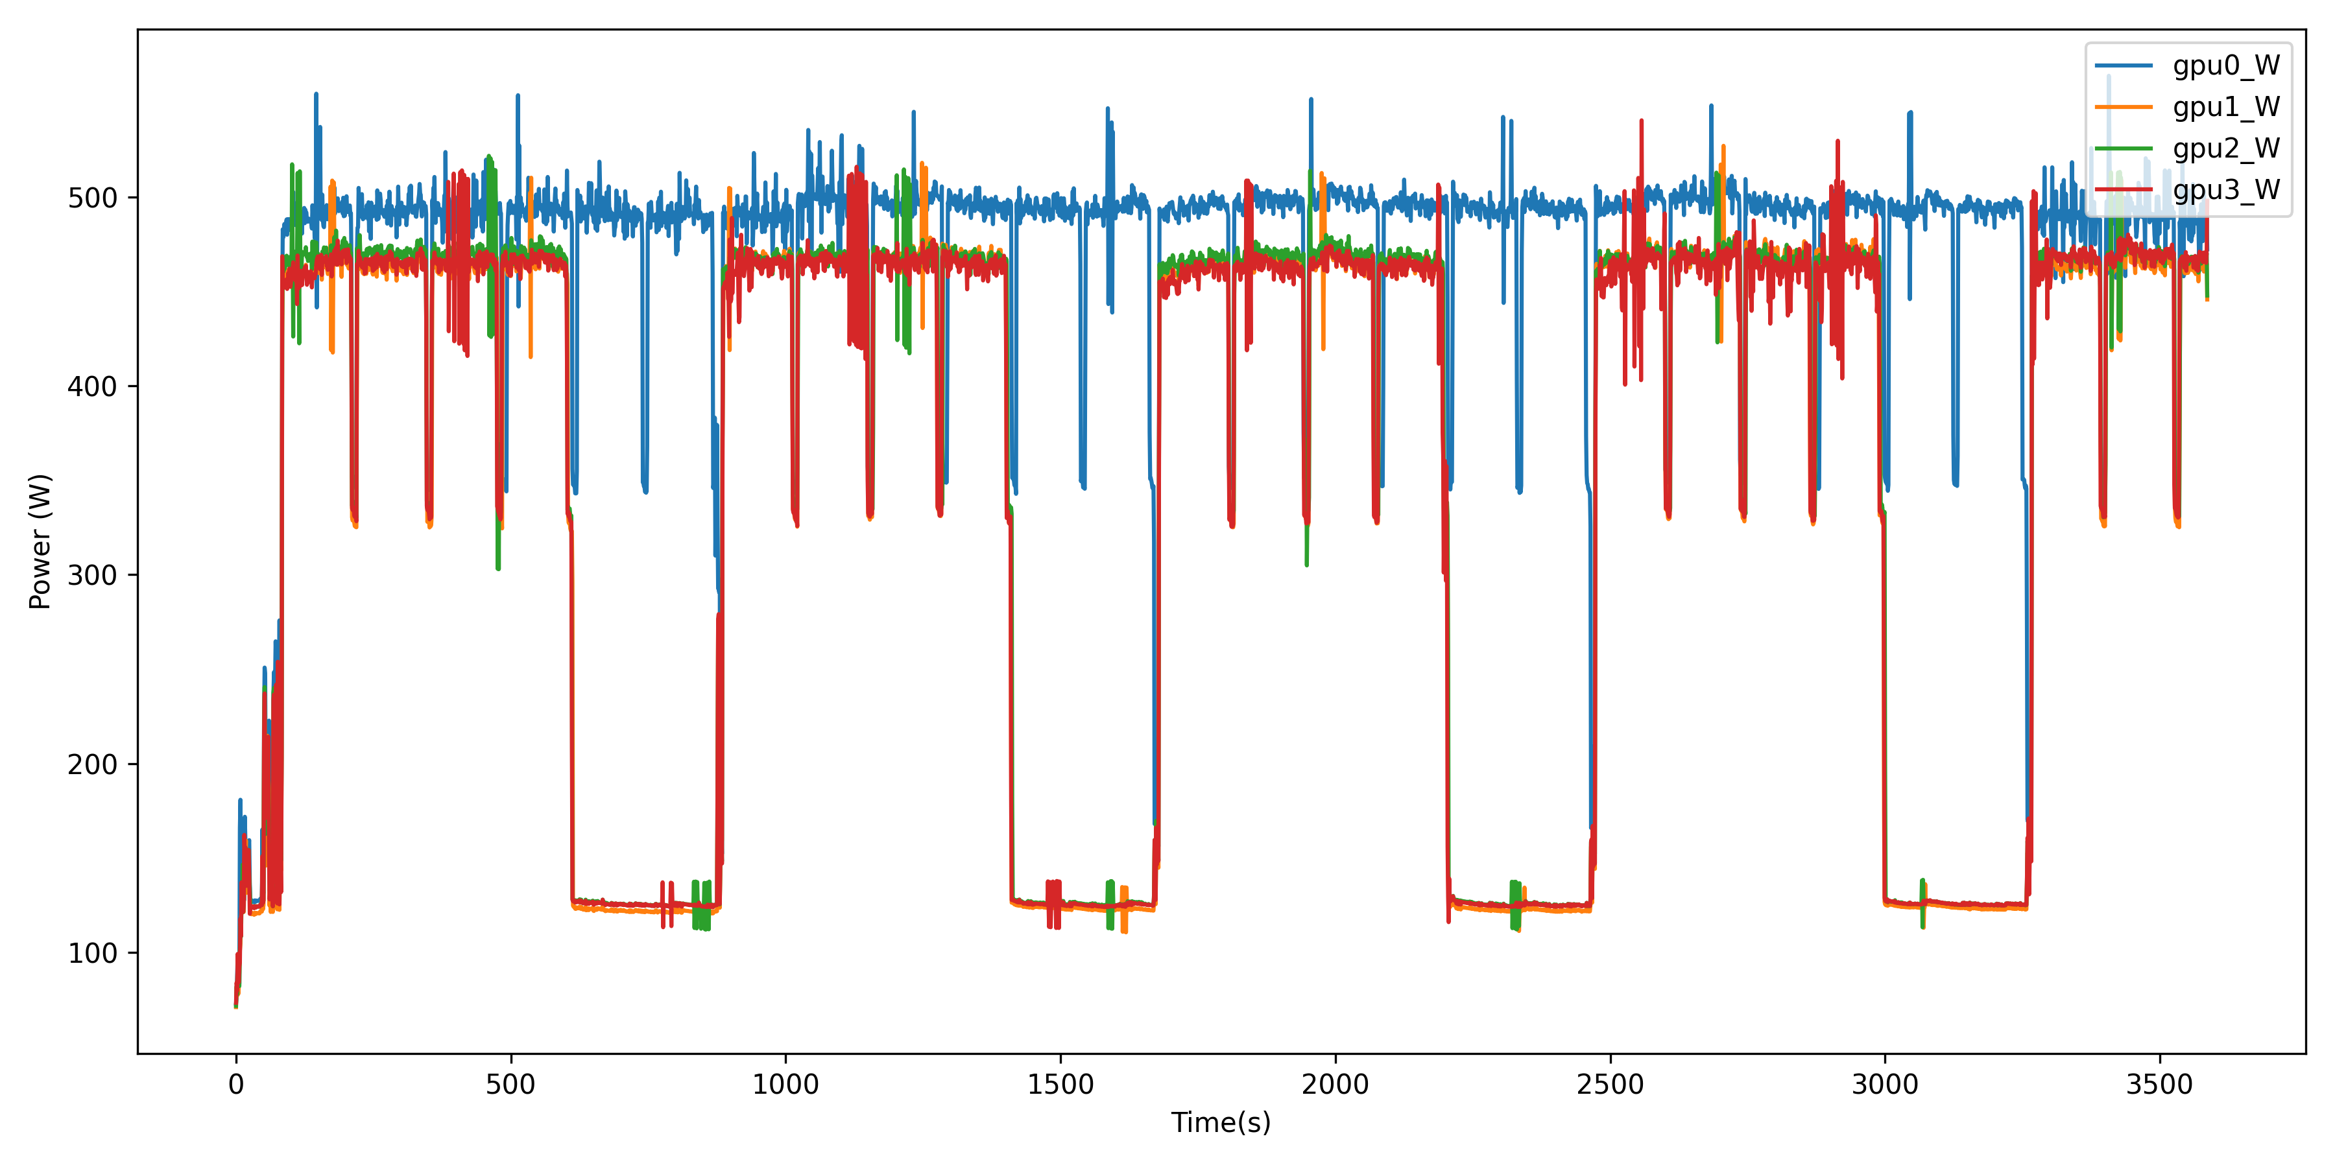
MoE Wallclock Routing & Time Decay for Job Runtime Prediction
Alan Ma¹, Kevin Menear¹, Dmitry Duplyakin¹
¹National Renewable Energy Laboratory & NatLabRockies
Introduction
Results
Discussion and Conclusion
• Runtime prediction critical for scheduling
• Long-tail distributions hurt global models
• Goal: Route workloads to specialized experts
• Users massively over-request wallclock
• Request limit encodes job type/intent
• MoE isolates workload patterns effectively
• Time-decay adapts to rolling behavior
Future Work
• Scale to full hpc-oda-commons benchmark
• Automate per-bin decay optimization
• Integrate log_target per expert
Methodology
• Analyzed Kestrel/Eagle wallclock requests
• Built Mixture-of-Experts (MoE) classifier
• Routed by requested partition limits
• Applied 0.05 time-decay (2-week half-life)
• 54% Kestrel jobs request exactly 2h
• 47x actual runtime difference across bins
• ~40% Coefficient of Variation reduction
• MoE + decay yields ~6% MAE improvement
Acknowledgements
References
Statistical Distributions of GPU Power Consumption in VASP Jobs
This work was authored [in part] by the National Renewable Energy Laboratory, operated by Alliance for Sustainable Energy, LLC, for the U.S. Department of Energy (DOE) under Contract No. DE-AC36-08GO28308. Funding provided by [applicable Department of Energy office and program office, e.g., U.S. Department of Energy Office of Energy Efficiency and Renewable Energy Solar Energy Technologies Office (spell out full office names; do not use initialisms/acronyms)]. The views expressed in the article do not necessarily represent the views of the DOE or the U.S. Government. The U.S. Government retains and the publisher, by accepting the article for publication, acknowledges that the U.S. Government retains a nonexclusive, paid-up, irrevocable, worldwide license to publish or reproduce the published form of this work, or allow others to do so, for U.S. Government purposes.

