Slide 1
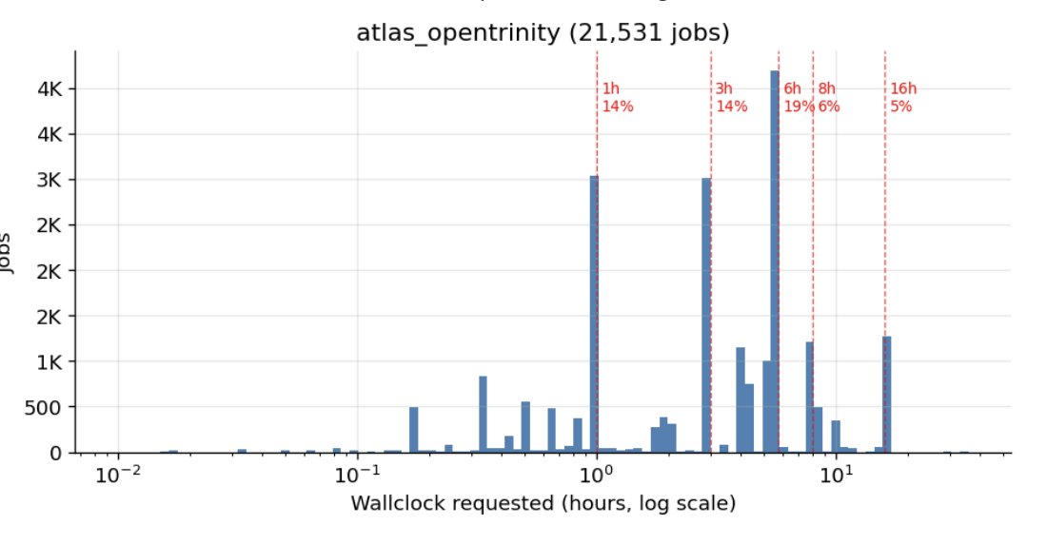
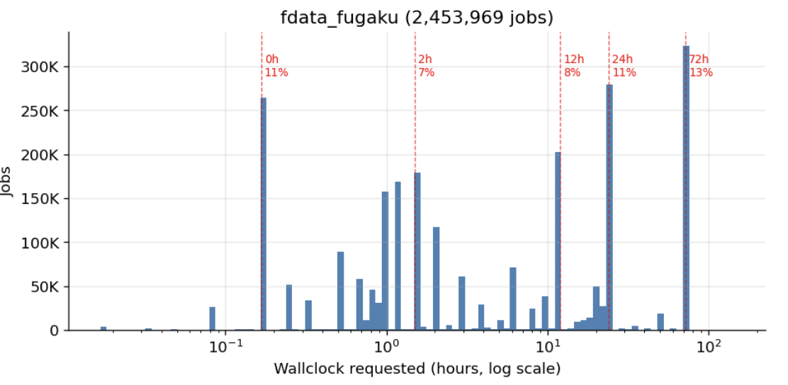
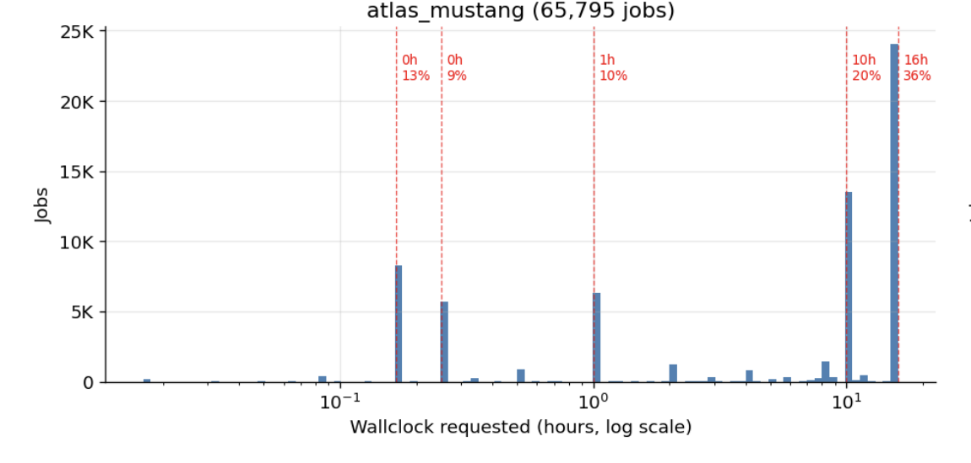
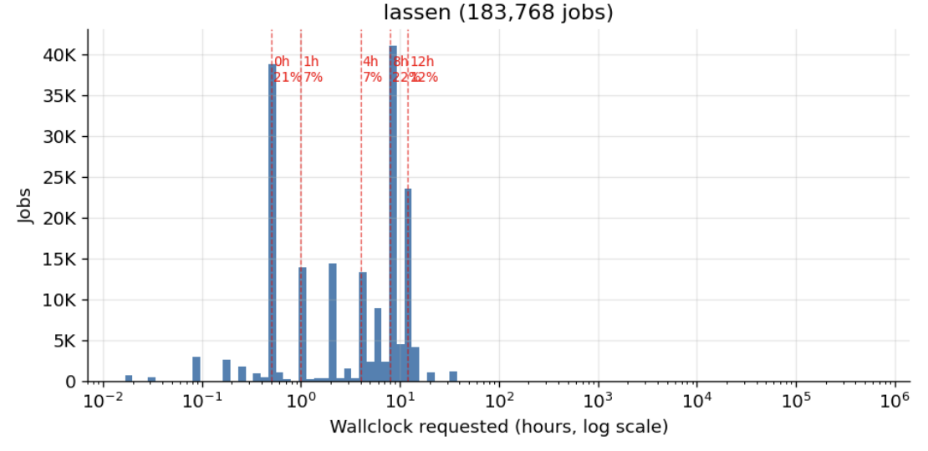
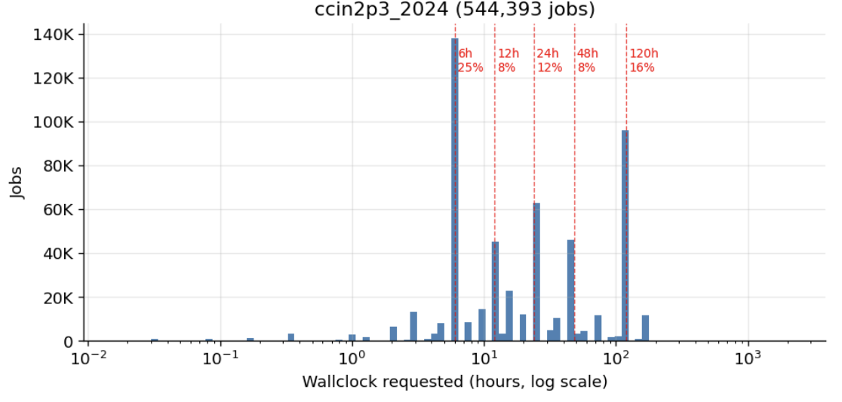
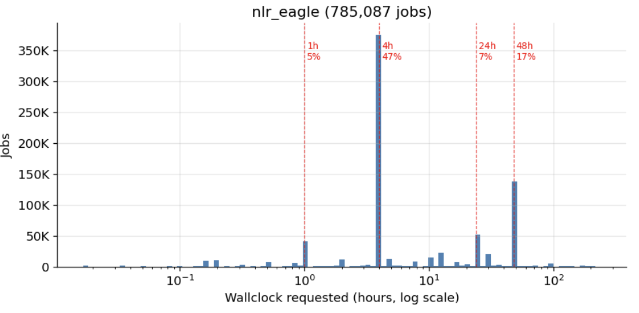
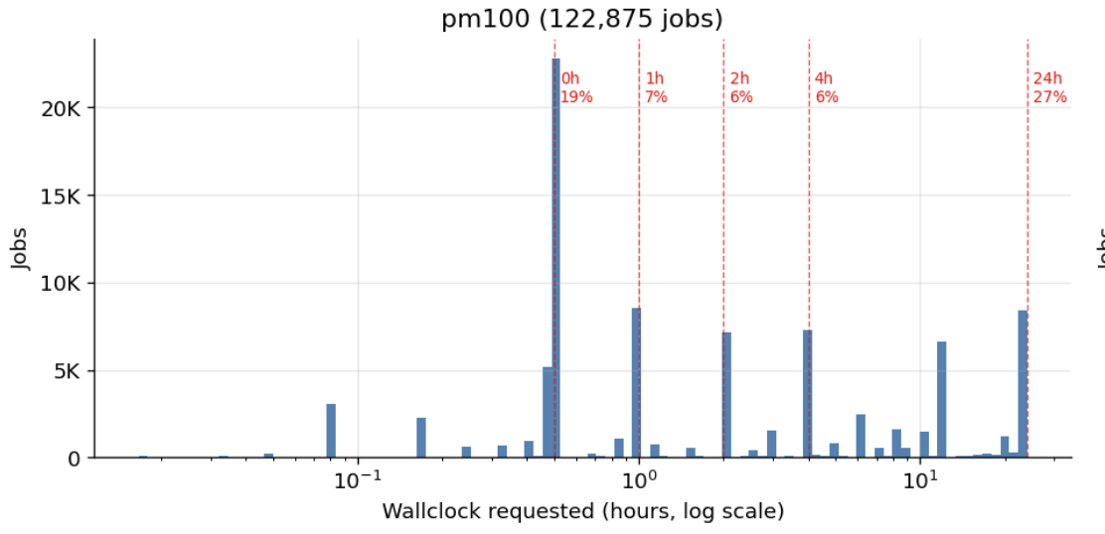
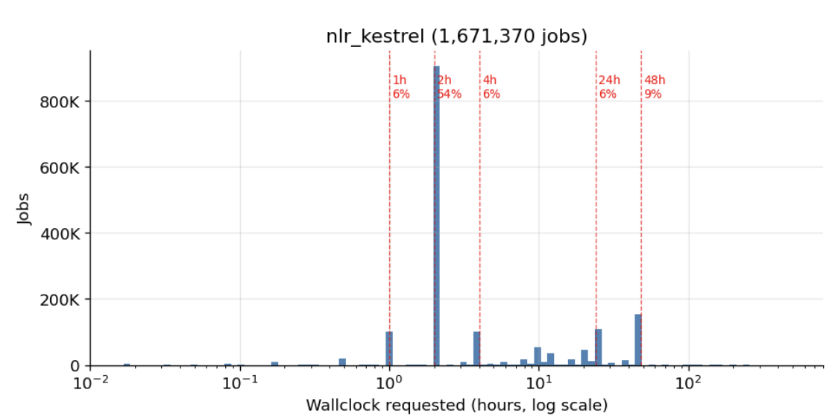
Wallclock Distribution Analysis for Mixture-of-Experts
Key Findings from the Analysis 1. STRONG CLUSTERING EXISTS 54-71% of jobs cluster at just 3 wallclock values per system. These are real partition limits, not arbitrary numbers. 2. CLUSTERS ARE DIFFERENT POPULATIONS 47x difference in median runtime between Kestrel's 2h and 48h clusters. Different users, different workloads, different patterns. 3. USERS OVER-REQUEST BY 20-100x Wallclock encodes job type/intent more than expected duration. 4. CLUSTERING REDUCES VARIANCE BY ~40% But per-cluster variance is still high — not a silver bullet. 5. MIXTURE-OF-EXPERTS (MoE) ROUTING & TIME DECAY A new MoE XGBoost model routing solely by requested wallclock, combined with a 0.05 time-decay rate (giving recent jobs more weight), achieved a ~6% MAE improvement over the baseline. 6. INTEGRATION WITH HPC ODA COMMONS The ultimate goal is running this model on the official HPC ODA Commons benchmark. A reproducible recipe (`kestrel_moe_best_rolling.yml`) has been merged to standardise these MoE parameters and validate them via `hpc-oda benchmark`.

