Slide 1
MACHINE LEARNING
Milestone 3 Presentation
Team #5:
Harin Avvari, Kevin Grewal, Tino Jimenez,
Jonathan Nguyen, Alan Viollier, Angela Yang

Slide 2
INTRODUCTION
Machine Learning Website
Features
Introduction to ML
ML Coding Exercises
Interview Preparation
News and Trends

Slide 3
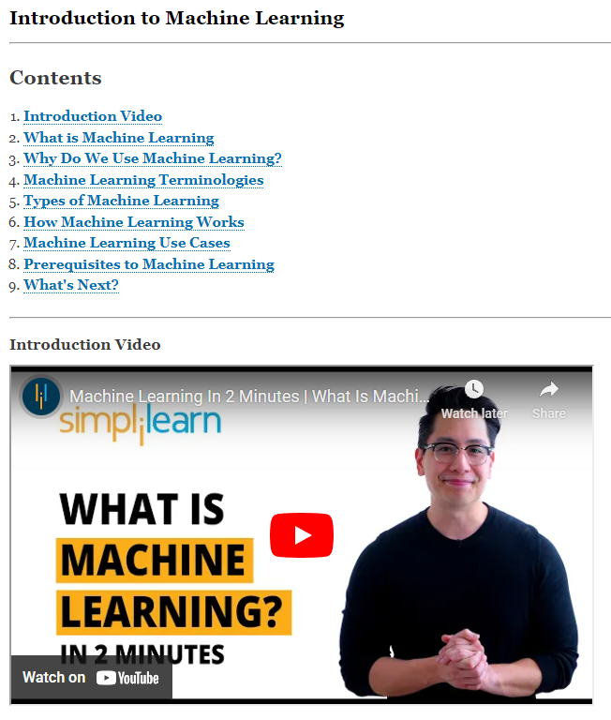
Feature #1:
Intro to ML
Short description:
Introduction to all things Machine Learning. What, Why, Basic Types of ML, Applications, and Prerequisites.
No change since last time.
Image here maybe?

Slide 4
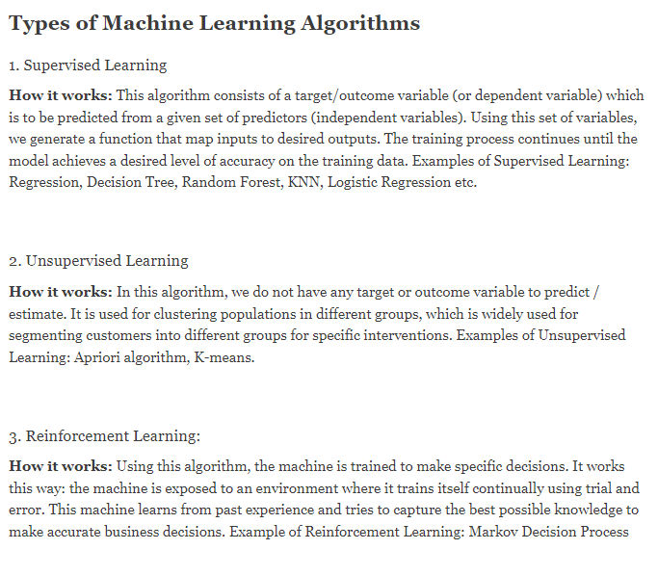
Feature #2:
ML Coding Exercises
Short description:
Types of algorithms with links to each specific algorithm with coding walkthrough
Implementation of child pages in progress.

Slide 5
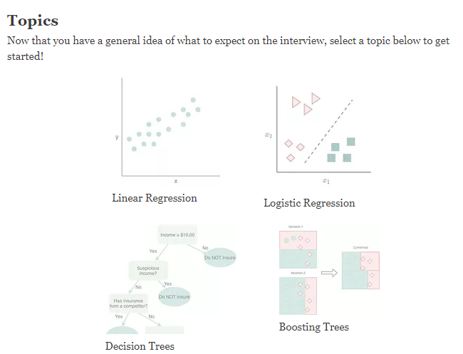
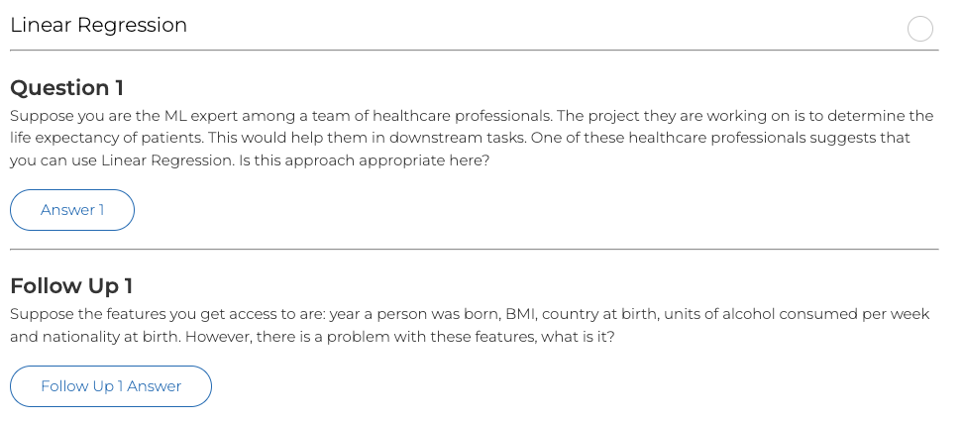

Feature #3:
Interview Prep
-The user can learn specific interview topics:
i) Linear Regression
ii) Logistic Regression
iii) Decision Trees
iv) Boosting Trees
v) KNN
vi) Naive Bayes
vii) Clustering
viii) Dimensionality Reduction
-Furthermore, the user is provided with an additional outside resource for interview preparation

Slide 6
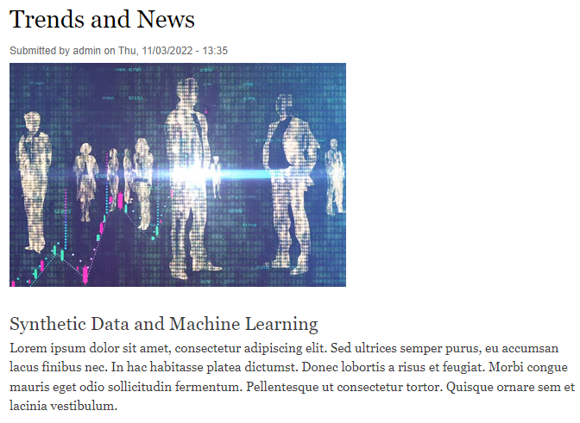
Feature #4:
News and Trends
Short description:
The user can look up current news and trends regarding machine learning.
Users can post comments on news articles.

Slide 7
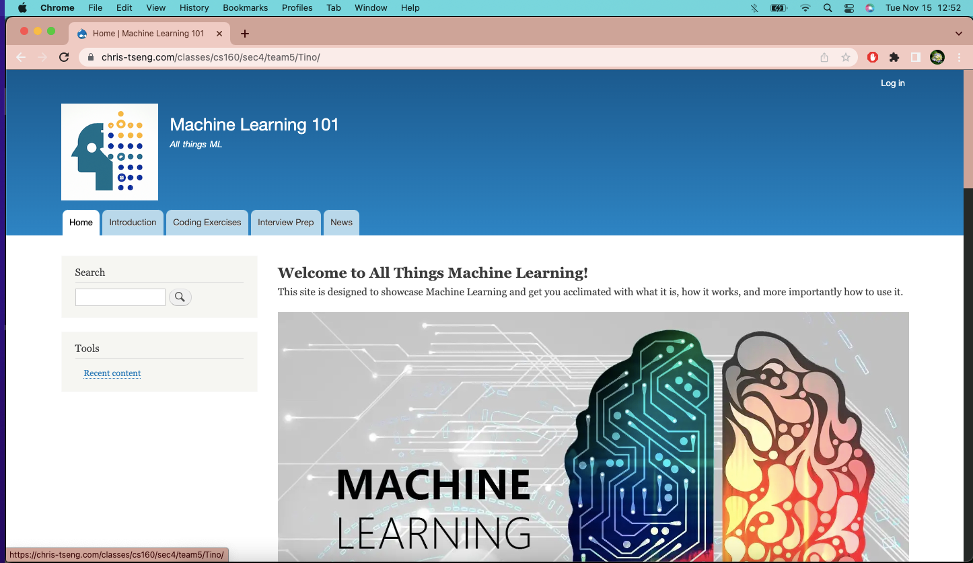
DEMO
Login Info:
Username: Angela Password: @ng3l@
Username: Kevin Password: K3v1n
Link to website: https://chris-tseng.com/classes/cs160/sec4/team5/Tino/

Slide 8
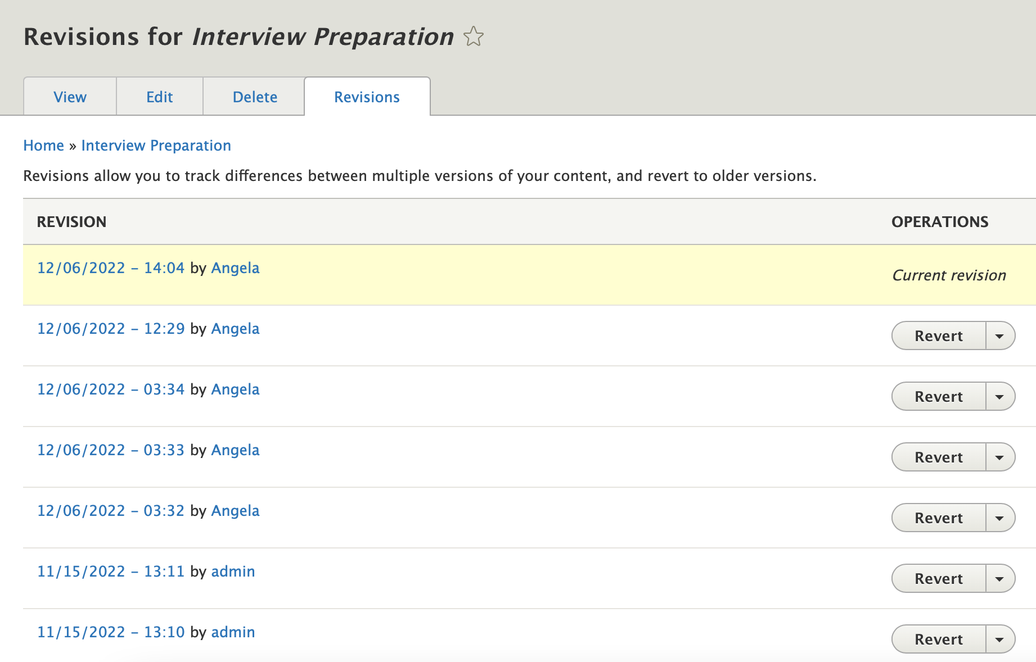
Version Control
Drupal built-in
Multiple accounts using ‘Content Editor’ settings
1 Administrator

Slide 9
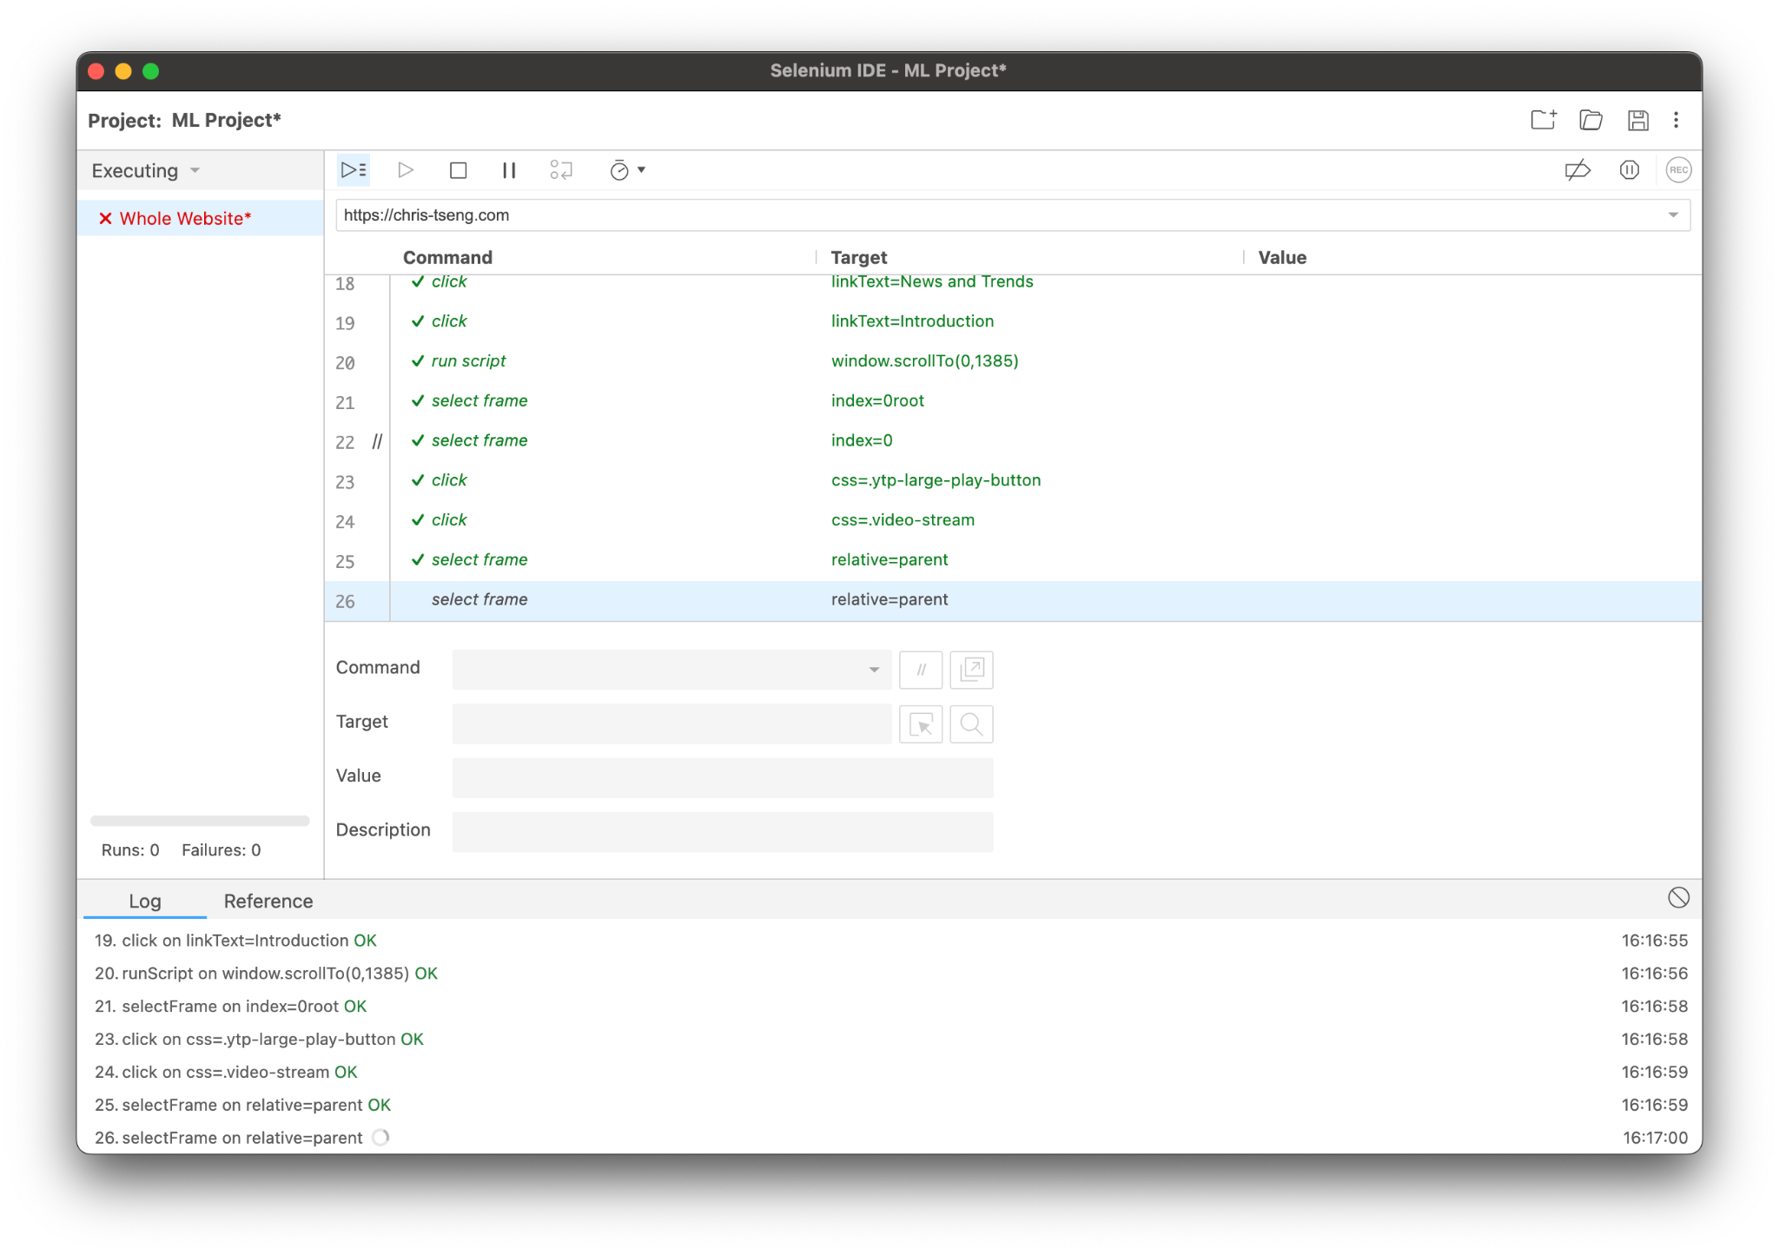
Website Testing
Selenium
Testing is currently in progress as we finalize the project.

Slide 10
THANKS
FOR LISTENING!
Any questions?
MACHINE LEARNING
Team #5:
Harin Avvari, Kevin Grewal, Tino Jimenez,
Jonathan Nguyen, Alan Viollier, Angela Yang

