Slide 1
Connecting to SQL/noSQL databases in NodeJS
Meetup.com Peoria JavaScript Meetup
Monday, December 10th, 2018
Alan Wilson

Slide 2
What we are going to cover tonight:
Simple NodeJS setup
MongoDB in Mongoose
SQL in SQLite3
SQL in Sequelize
Tips and Tricks
Q&A (WELCOME AT ANY TIME!)
??
Follow Along at: https://github.com/NannerFox/Javascript-Talk

Slide 3

Data bases

Slide 4
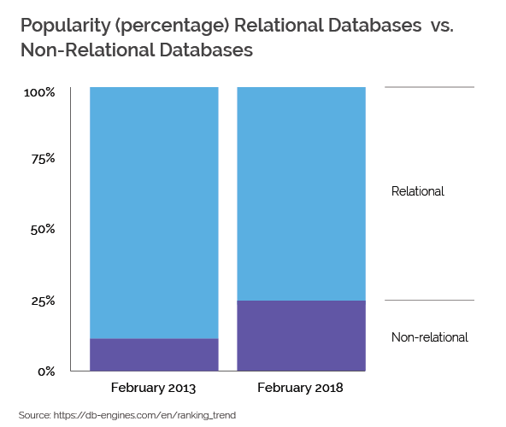
Databases Types and Popularity Trends

Slide 5
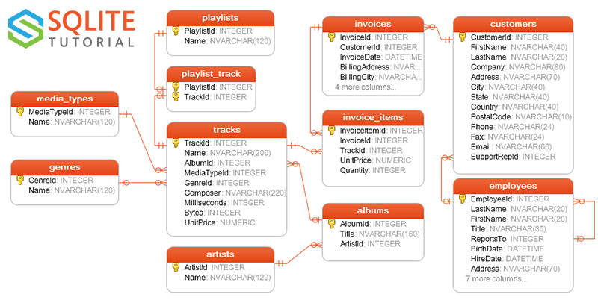
Sample SQLite Database

Slide 6
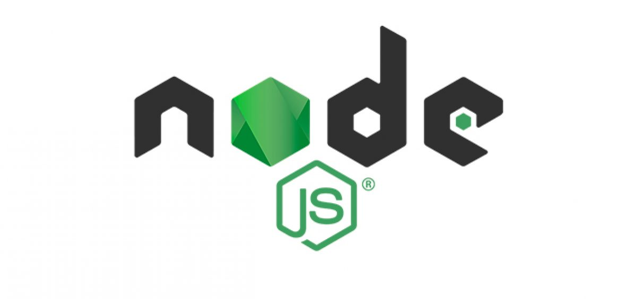
Creating a Simple Node.js server
https://nodejs.org/

Slide 7

Mongoose
https://mongoosejs.com/

Slide 8

SQLite3
https://github.com/mapbox/node-sqlite3

Slide 9

Sequelize
http://docs.sequelizejs.com/

Slide 10

With Great Power, Comes Great Responsibility

Slide 11

</END>
About Me:
Alan Wilson
alanwilson020@gmail.com
309-241-7990
http://nannerfox.github.io

