Slide 1
Thesis B Demo
Alan Yi
z3492986

Slide 2
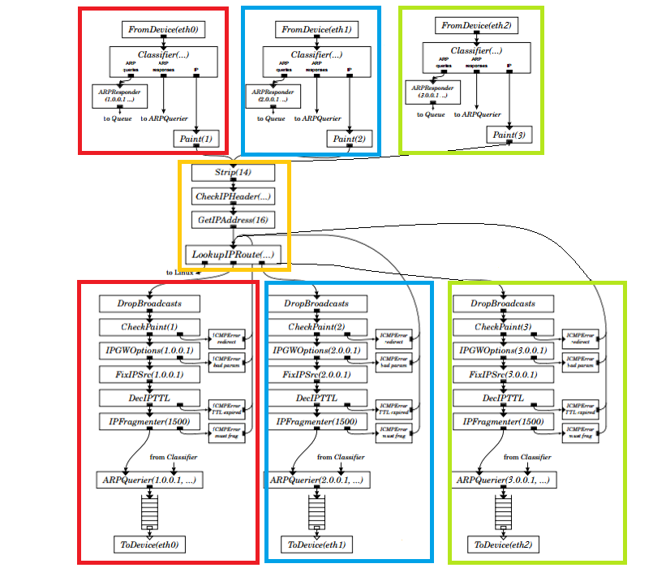
A basic coarse grain configuration

Slide 3
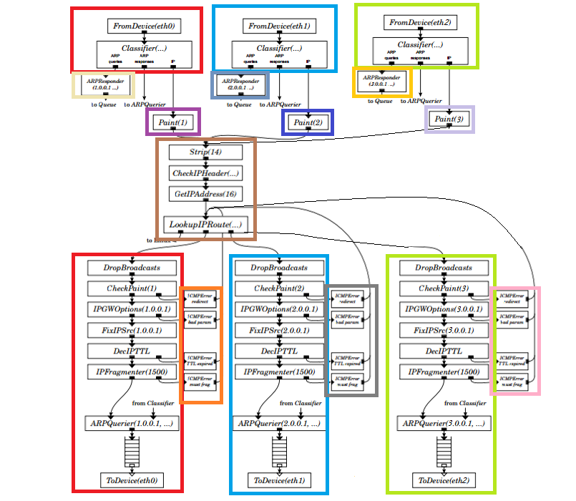
A fine-grain configuration

Slide 4
Push proxy
Each component has an event loop
Wait for any incoming packet (which is pushed from others)
Notification and a dataport is used when a packet is ready to pull
Pullee notifies the element that requires to pull a packet from upstream with CamKES notification
Puller pull packet upon notification via dataport.

Slide 5
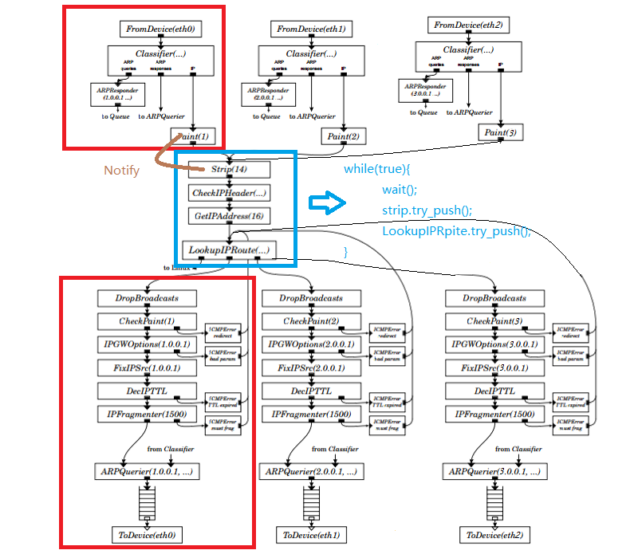
Push proxy

Slide 6
Pull proxy
Each component has an event loop
Wait for any incoming packet (which is pushed from others)
Pusher uses notification and a dataport to push a packet to other component
This requires modification of each element at the boundary
Pushee must be scheduled inside the event loop to check if there is incoming packet.

Slide 7
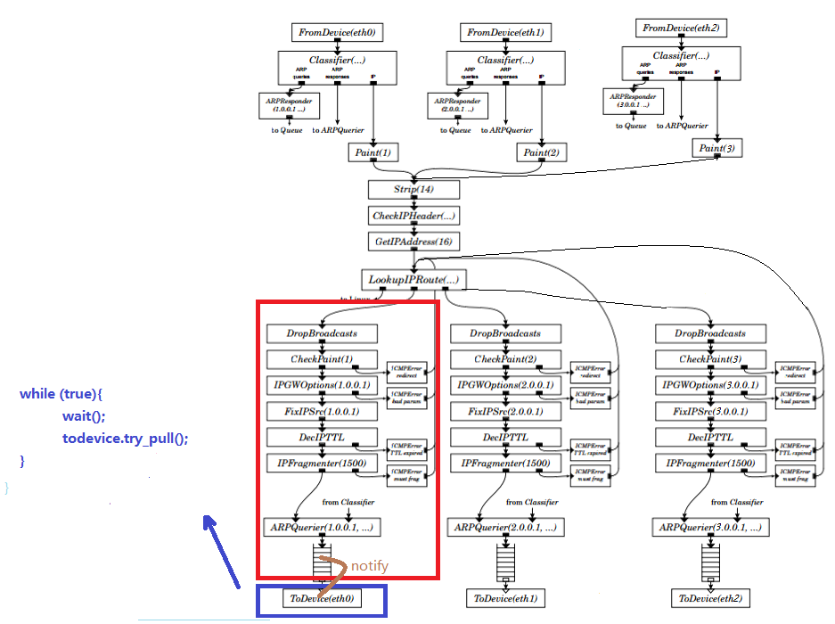
Pull proxy

