Slide 1
Build a Python Chatbot using Keras & NLTK
Deep Learning Project
Intelligent Systems Technologies Gpo 1
Juan Arturo Cruz Cardona
A01701804

Slide 2
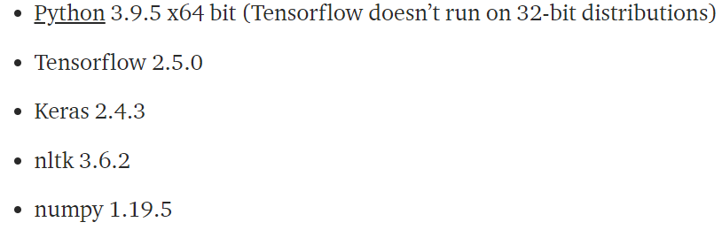
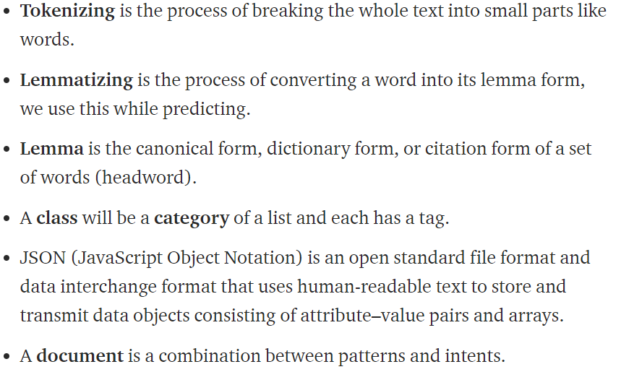
Problem Statement
Datasets
A Chatbot capable of responding messages after learning certain patterns the user can introduce and the answer for these. It doesn’t create its own answer, but it chooses randomly.
Medical Support
COVID-19
Link: https://meta-guide.com/software/100-best-github-chatbot-dataset
System Requirements
Link to medium tutorial: https://a01701804.medium.com/build-a-python-chatbot-using-keras-nltk-db19eea77f74
Terminology

Slide 3

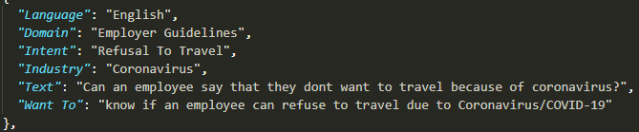
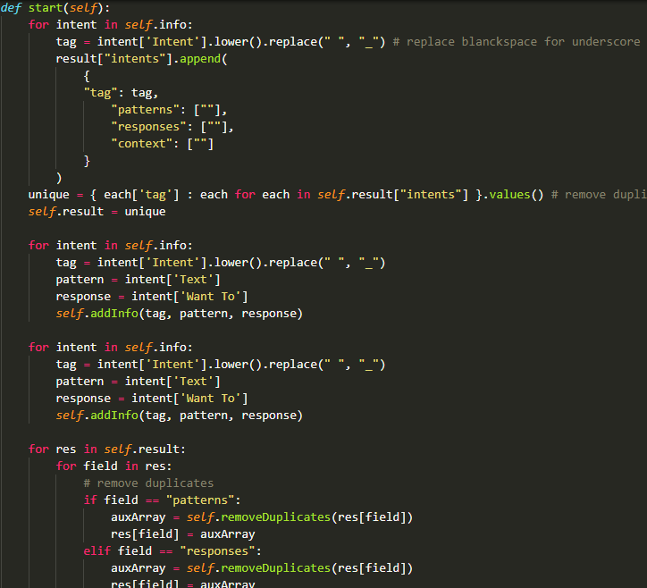
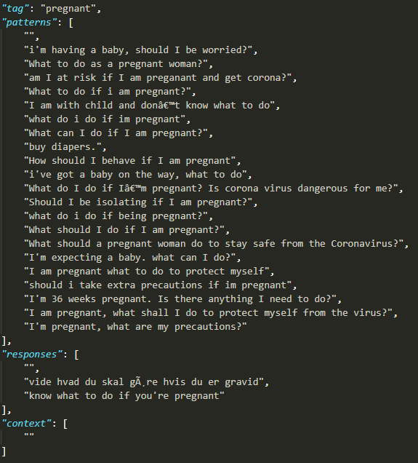

Intents, Patterns and Responses Structure
Medical Support
COVID-19
Tag: Identifier
Patterns: User queries
Responses: Chatbot answers
Context (not used): Used for connect intents
Parser

Slide 4
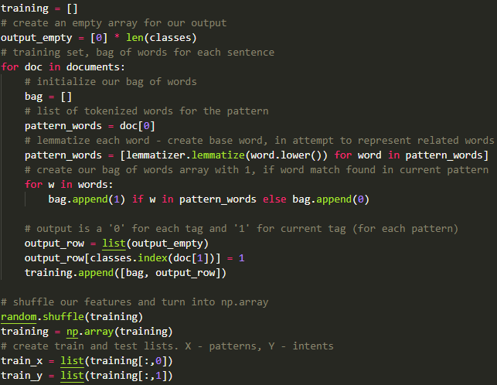
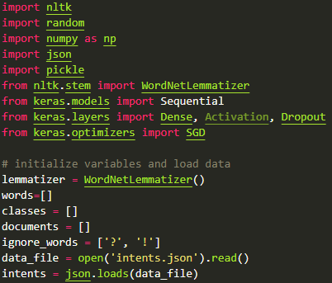
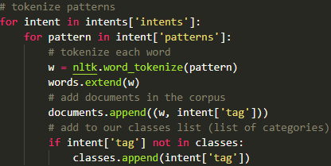
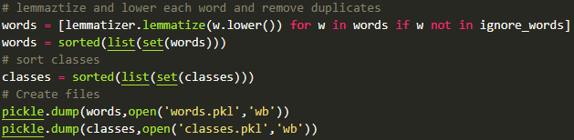
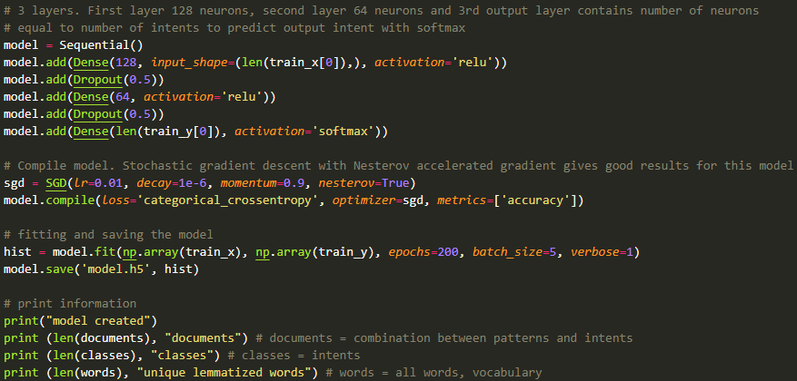
About training
3. Create training and testing data
1. Import and load the data file
2. Preprocess data
X for patterns
Y for intents
3-layer neural network
128 neurons – activation ReLU
64 neurons – activation ReLU
Length of Y neurons – activation softmax
4. Build the model

Slide 5
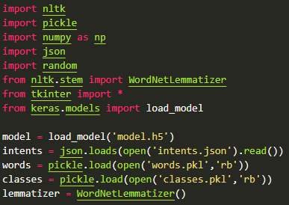
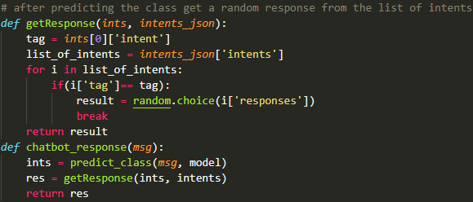
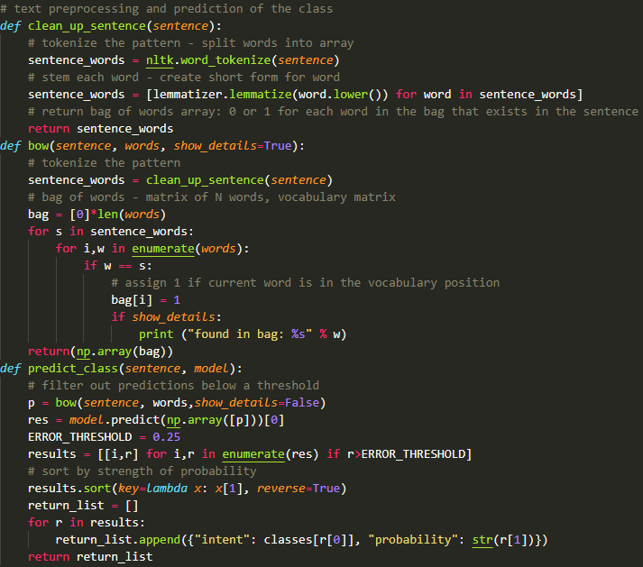
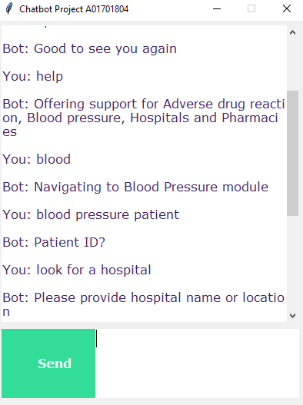
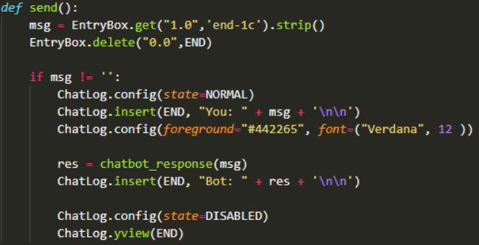
1. Load necessary packages
Running the chatbot
3. Get a random response
2. Predict class functions
4. Tkinter GUI

Slide 6
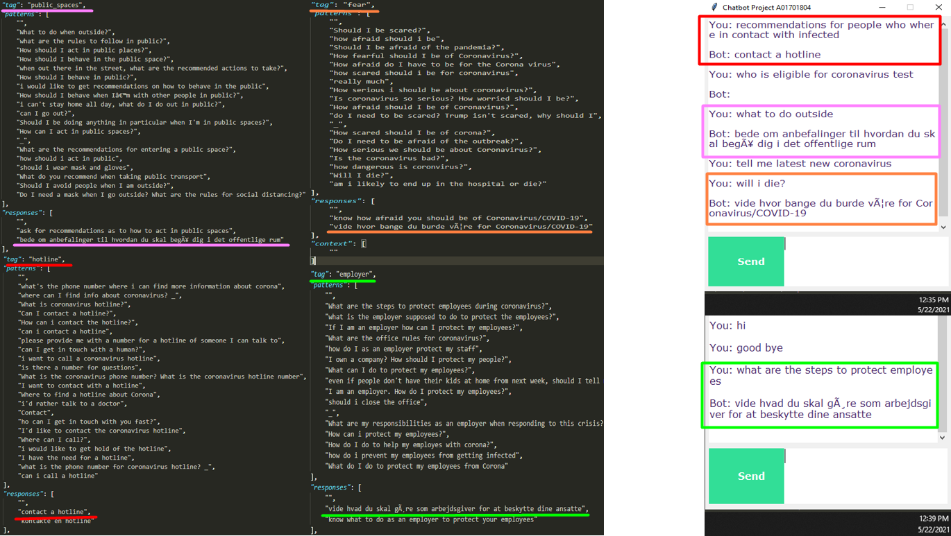

Slide 7
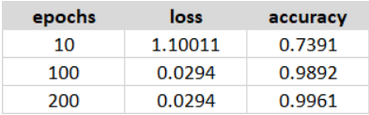
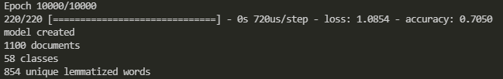
Results and Conclusions
Medical Support
COVID-19
Project

