Slide 1
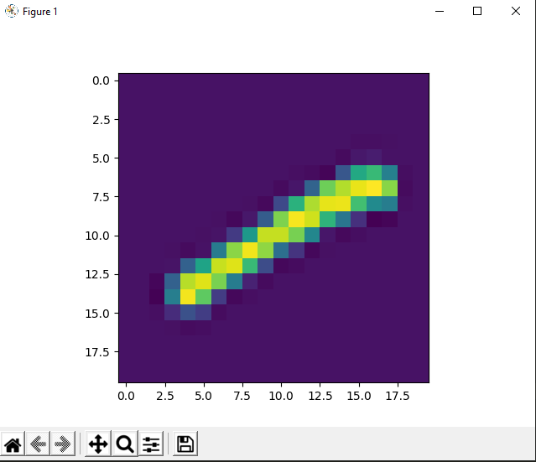
Problem Statement
The idea of this project is to develop and train a model that is able to take the pixel values of a digit and identify if it is an image of the digit one or not.

Slide 2
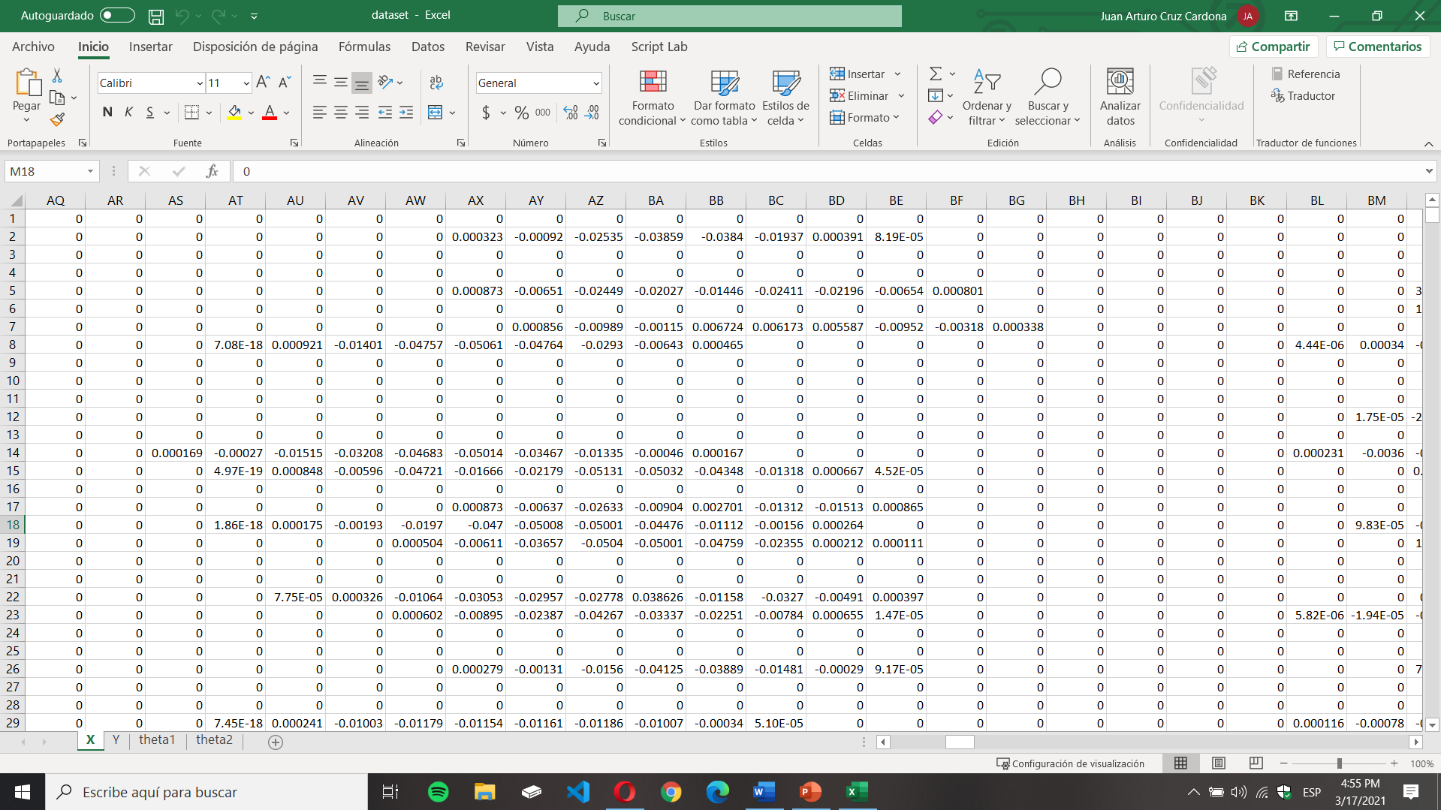

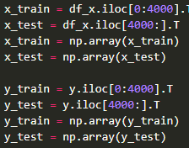

Dataset

Slide 3
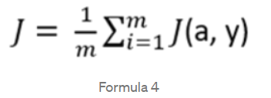


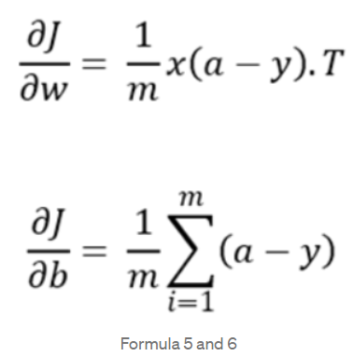
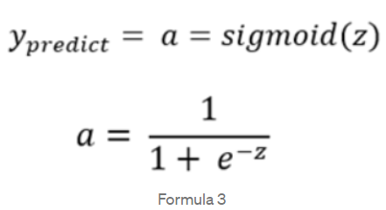
Formulas
Cost Function
Basic Linear Regression Formula but also in logistic regression
Gradients
Sigmoid

Slide 4
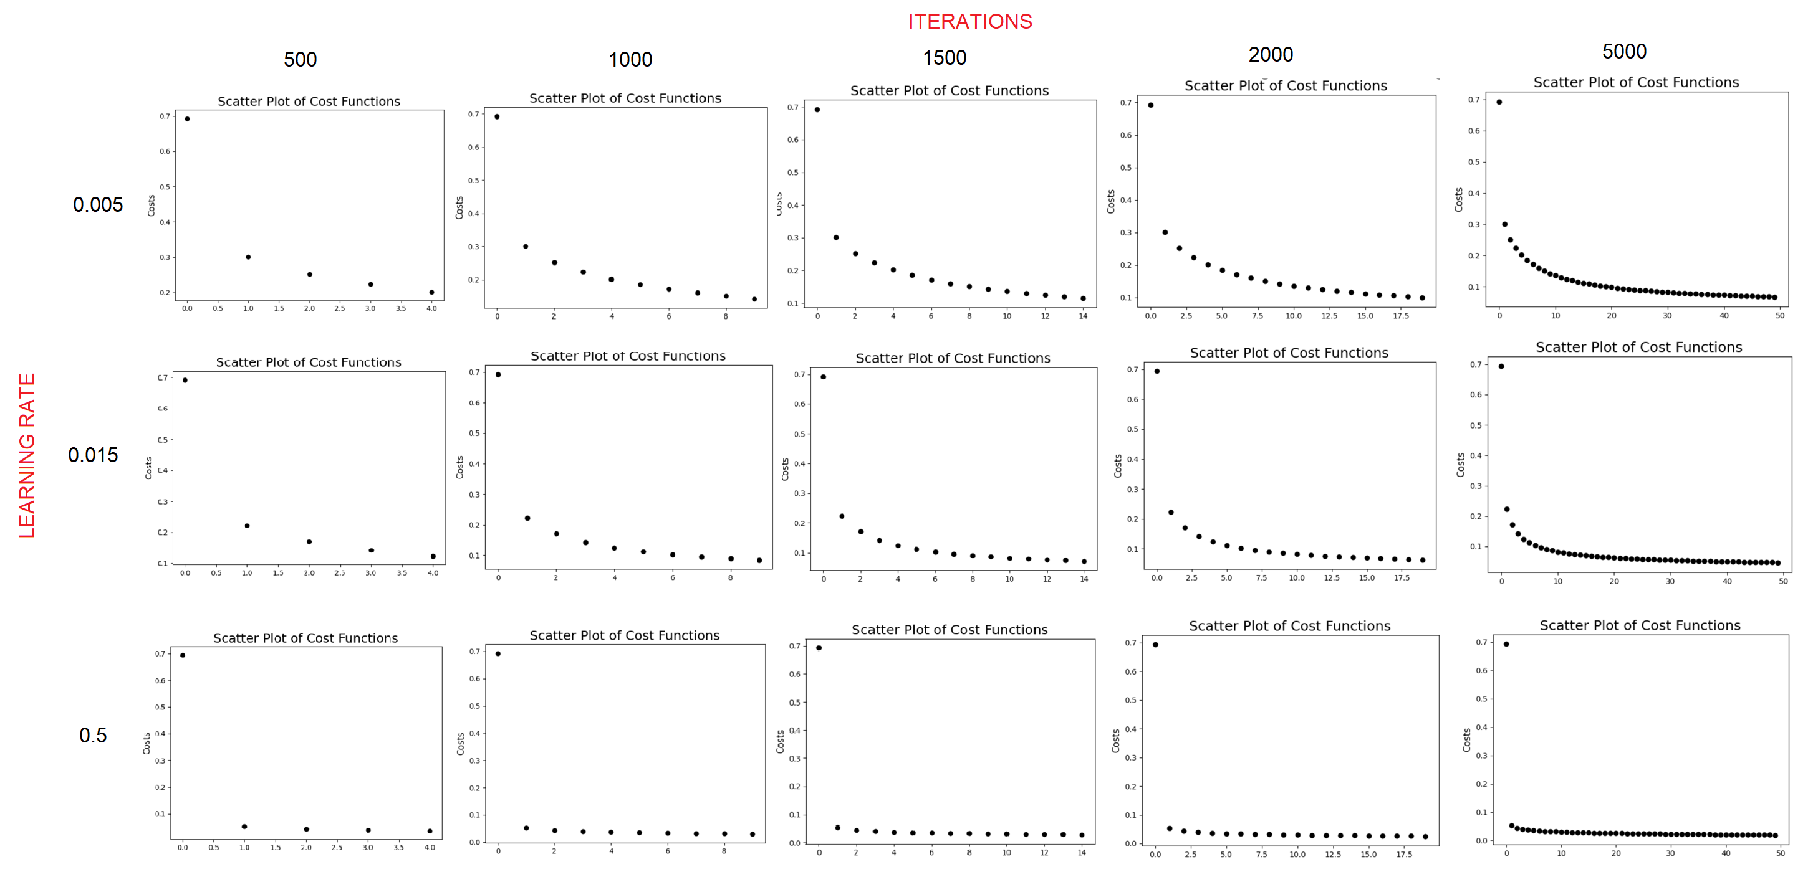
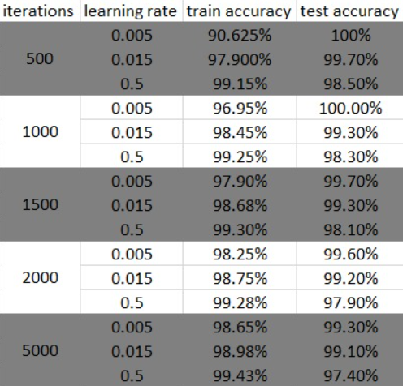
Conclusions

