Slide 1
REDUX AND APOLLO

Slide 2
The User Tools Team
Members: Alan Fernandez, Charles Fulnecky, Craeg Strong, Clark Jones, Praveen Kuthari, Directed by Scott Howie
Front End Technology
ES6
React for View
Redux for State Management
RxJS for Enhancing Redux
Webpack for build tool and dev server
Enzyme for Unit Test
Apollo for GraphQL Client

Slide 3
Key points in Presentation
React
Redux
Apollo + GraphQL
You can get some code we prepared at the following git repo https://github.com/Alanf718/Apollo-GraphQL-Demo - I recommend that anyone who wants to follow along later pull the repo down and do an NPM install

Slide 4
What is React?
React is a view framework that has had wide community support
React supports Single Page Apps, Server Side Rendering, Mobile Development, and Even VR!

Slide 5
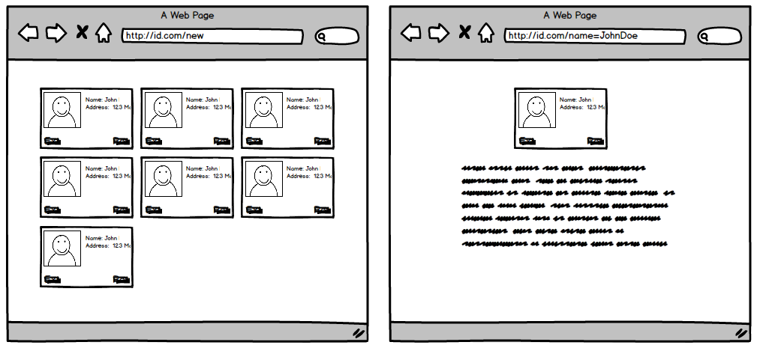
Why React?
Widely supported
Modularity can fix the following

Slide 6
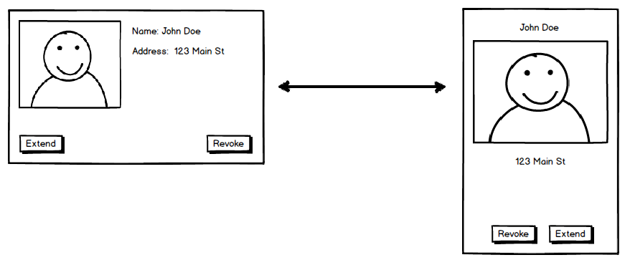
Design Changed

Slide 7
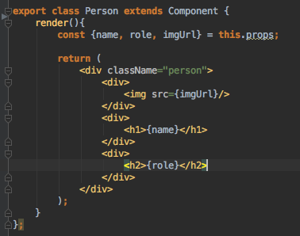

Example:

Slide 8
Redux
Redux is a state container, it helps us manage our application state
Our application state is basically the data our front end would need in order to render the user interface.
Enforces good functional programming practices.

Slide 9
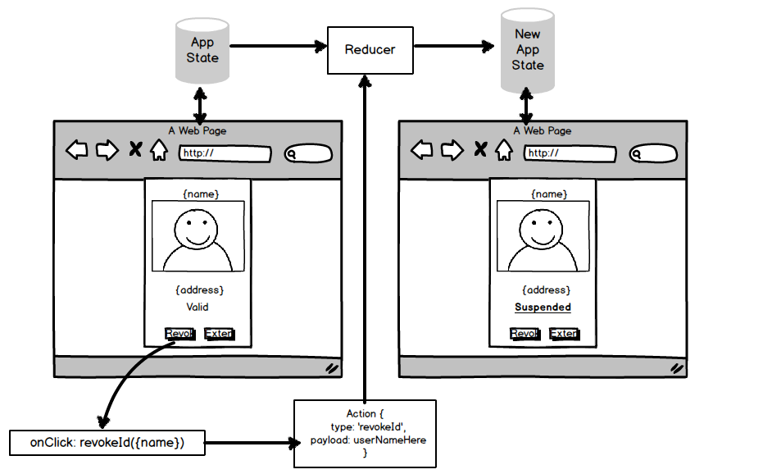
How does Redux Work?

Slide 10
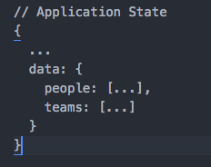
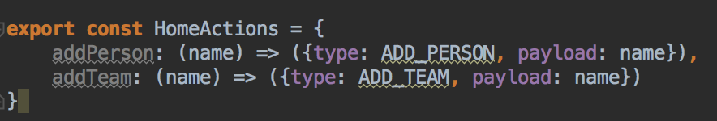
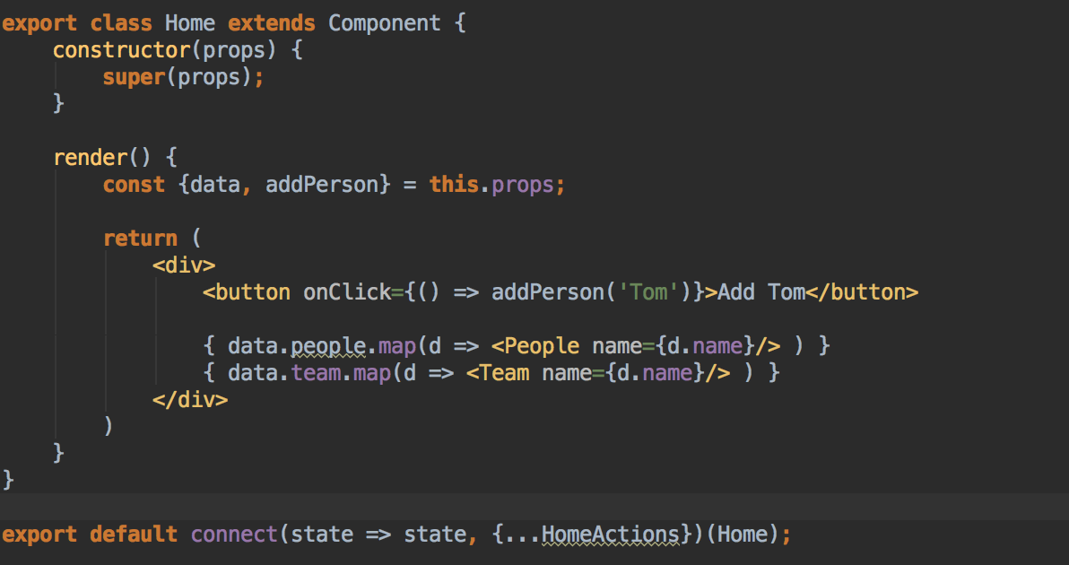

Slide 11
Redux Recap
Action Creators create an action
A Reducer modifies your application state
An action is responsible for triggering a reducer
You should be able to represent your entire view with your application state

Slide 12
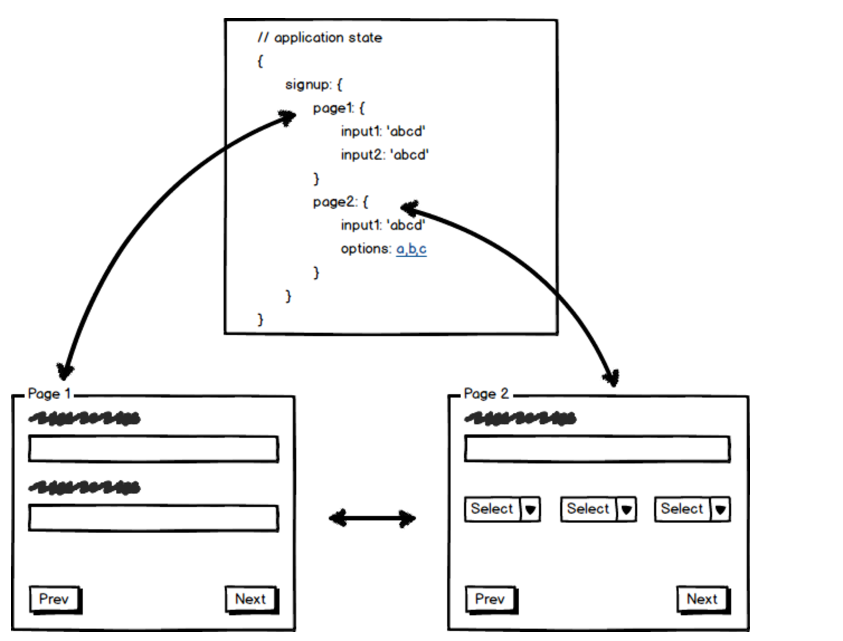
Benefits of Stateless

Slide 13
Why Redux
Middleware
Simple?
Great Dev-Tools and community support
Code is easier to maintain

Slide 14
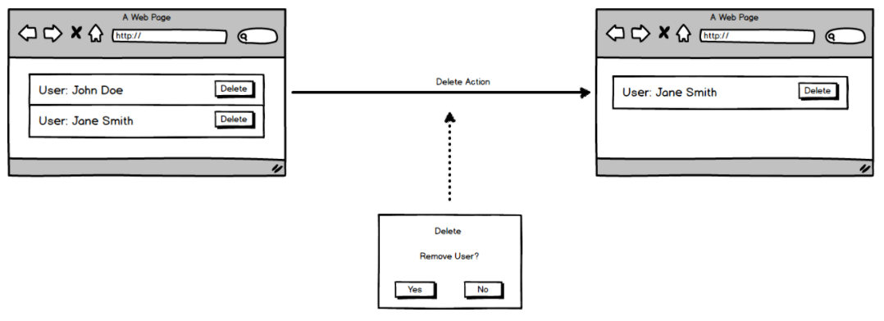
Confirm Dialog Problem

Slide 15
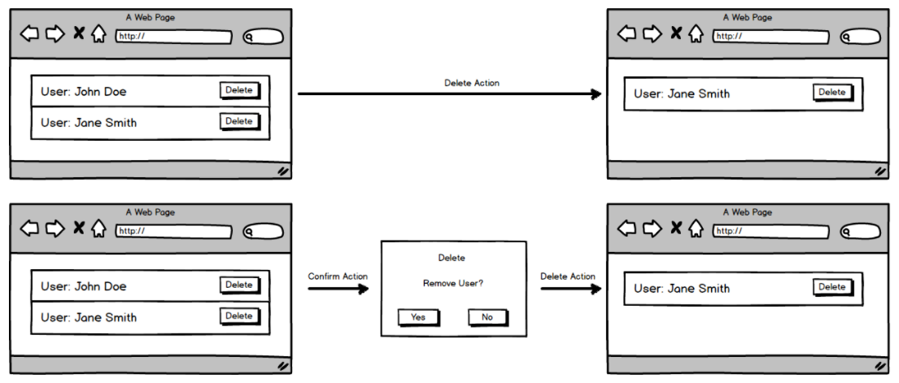
Confirm Dialog Solution

Slide 16
Other Potential Redux Solving Problems
Replaying User State
Analytics made simpler

Slide 17
Apollo & GraphQL
GraphQL is a query language
Popular GraphQL Clients are Relay, Apollo, and Lokka
Reduce the amount of times the client has to ping the server

Slide 18
Apollo Capabilities
Batching
Batching based on time-interval defined
Caching
Queries cached by default
Cache can be updated via polling, forced fetch, updateQuery param on Mutations
Push Notifications via Subscriptions

Slide 19
Apollo & Interactive Portion
Anyone who hasn’t done so and wants to follow along, please download the repo at https://github.com/Alanf718/Apollo-GraphQL-Demo and run npm install
Open up two terminal windows and run “npm run graphql” and “npm run client”

Slide 20
Apollo
No Schema imports needed
Regular GraphQL
Mobile Performance?
Multiple Frameworks
Easier to Learn?
Relay
Schema has to be imported into client
Superset of GraphQL
Mobile Performance++
Bound to React
Harder to Learn?

