Slide 1
WARP3D:
Solution for an Inclined Penny Crack in Infinite Body
Robert H. Dodds, Jr.
Department of Civil & Environmental Engineering
June 8, 2017
College of Engineering, University of Illinois

Slide 2
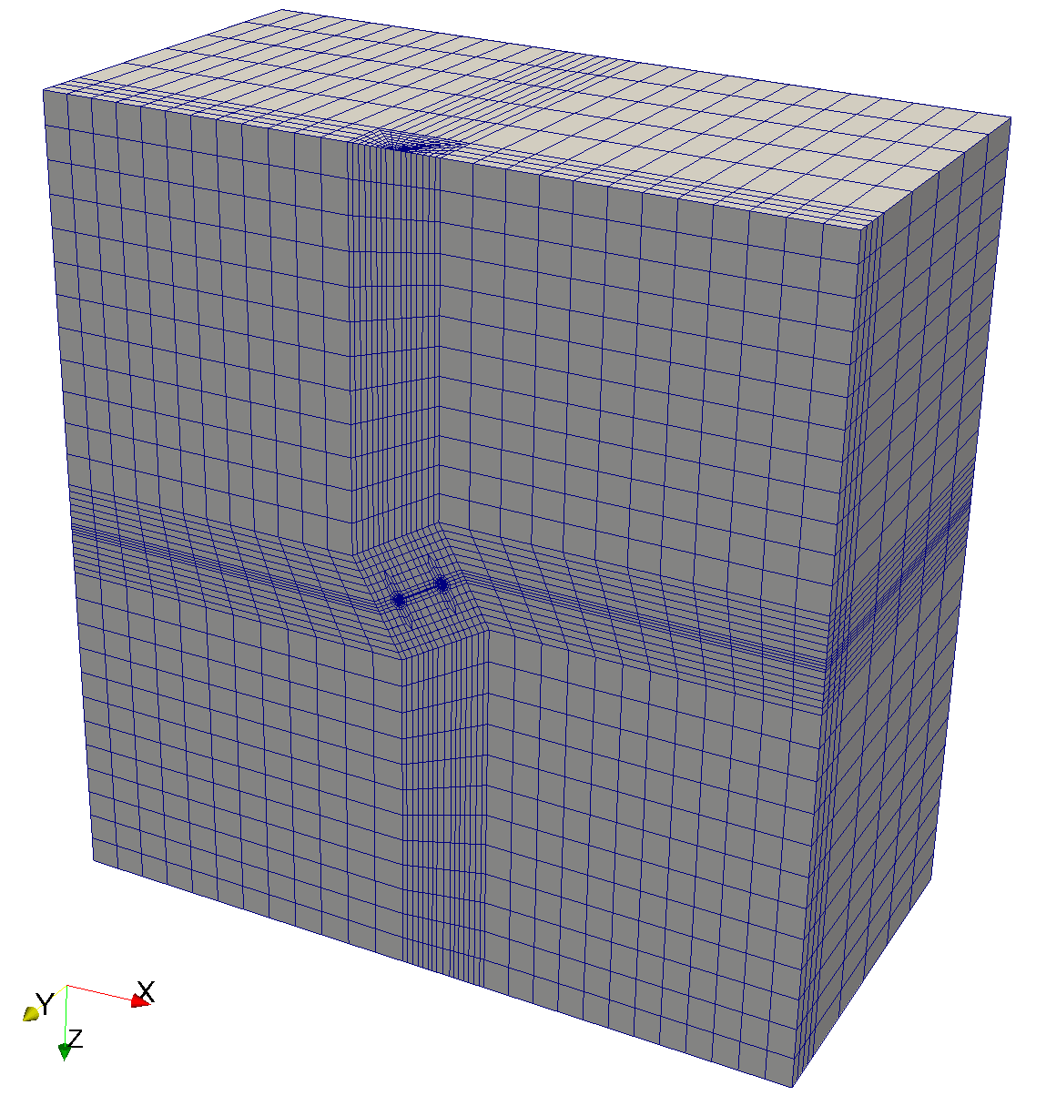

Problem setup
Test domain interaction integrals to compute Mode I-II-III stress intensity factors for a case with an analytical solution
Inclined penny crack embedded in an infinite body
Half-symmetric model
Units: kips, inches
Crack radius: 1.0 in
Remote tensile stress T_{z} = 1.0 ksi
Exact solution*
15 in.
30 in.
w = 0
$$θ$$
A
A
30º
30 in.
B
B
Symmetry Plane
Y
X
Symmetry Plane
Z
Nodes: 91,885
Elements: 21,168
20-node isoparametrics
2x2x2 integration
½ point nodes at front
Zero radius
T_{Z} =1.0
Mesh created using FEACrackTM
http://www.questintegrity.com/software-products/feacrack
Assistance from Dr. Greg Thorwald, Quest Integrity
*G.P. Cherapanov. Mechanics of Brittle Fracture. McGraw-Hill, 1979

Slide 3

Mesh details
71800
(-15, -15, -15)
17123
(-15, 0, -15)
71960
(15, -15, -15)
49
(15, 0, -15)
$$θ$$
A, Node 51
B, Node 17125
A
B
65360
(15, -15, 15)
49701
(-15, 0, 15)
Y
X
Z
33473
(15, 0, 15)

Slide 4
Global ZZ-stress
Y
X
Z

Slide 5

Stress-intensity factors
$$θ$$
A
B
K_{I}
(Exact: 0.85)
K_{I} for exact solution is constant along front
K_{II} is anti-symmetric
K_{III} should vanish at 0, 180
Model only approximates an infinite body.
Mode III results on the symmetry plane show an
anomalous spike - cause unknown at present.
Results are clearly headed ➝ 0 on approaching the symmetry planes.
Elements incident on Y = 0 symmetry plane are source of behavior
K_{III}
(Exact: 0.49)
K_{II}
(Exact: 0.49)
Stress-intensity, ksi√in
180
144
108
72
36
0
θ (degrees)
Other references:
Nikishkov, G. and Atluri, N. Calculation of Fracture Mechanics Parameters for an Arbitrary 3D Crack by Equivalent Domain Integral Method. International Journal for Numerical Methods in Engineering, Vol. 24, 1801-1921, 1987.
Shivakumar, K.N., and Raju, I.S., An Equivalent Domain Integral Method for 3D Mixed-Mode Fracture Problems. Engineering Fracture Mechanics, Vol. 42, No. 6, 935-959, 1992.

Slide 6

T-stress
T-stress, ksi
$$θ$$
A
B
180
144
108
72
36
0
θ (degrees)

