Slide 1
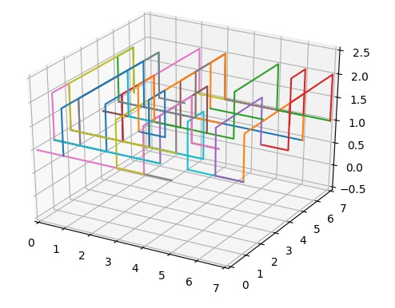
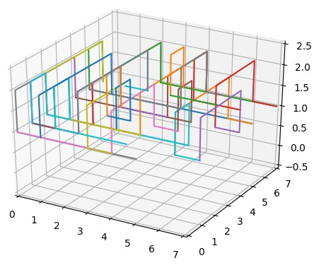
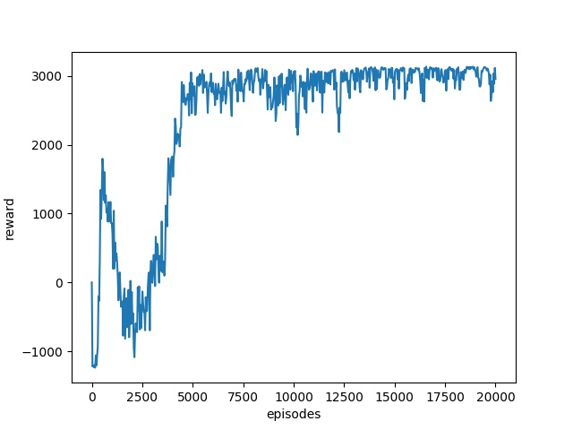
DRL:
OF 2
WL 193
A*Search:
OF 2
WL 199
8by8
test_benchmark_18
Net 15, MaxPin 5, Cap 6

Slide 2
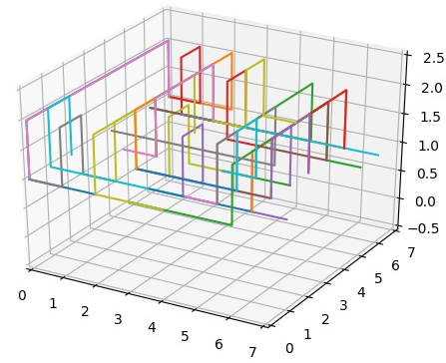
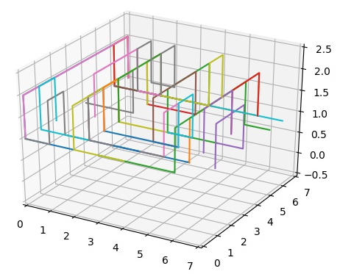
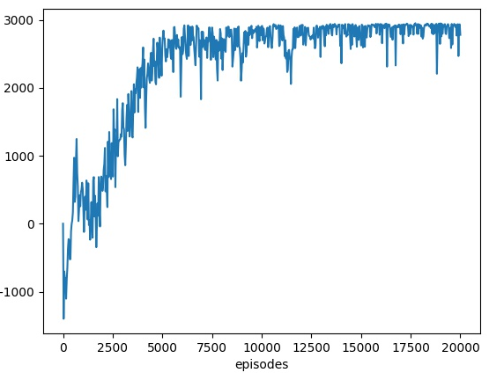
DRL:
OF 0
WL 177
A*Search:
OF 1
WL 179
8by8
test_benchmark_8
Net 15, MaxPin 5, Cap 6

