Slide 1


Mobile phone price prediction
Model insights and feature recommendations

Slide 2
Data exploration
Input Variables – Memory, RAM, Battery, Camera, AI Lens, Mobile Height, Colour and Processor.
Output Variable- Price.
Memory- Average memory of th mobile phones is 111GB with minimum memory 16GB and maximum memory 256GB.
RAM- Average RAM of the phones is 5.4GB with minimum RAM 2GB and Maximum RAM 8GB.
Battery- Average battery capacity is 4873 mAh with minimum battery capacity 800 mAh and maximum battery capacity 7000 mAh.
Mobile Height- Average height of the mobile phones is 16.44mm with minimum height 4.5mm and maximum height 41.9mm.
Price- Average price of mobile phones is Rs 16341.6 with minimum price Rs 920 and maximum price Rs 80999.

Slide 3
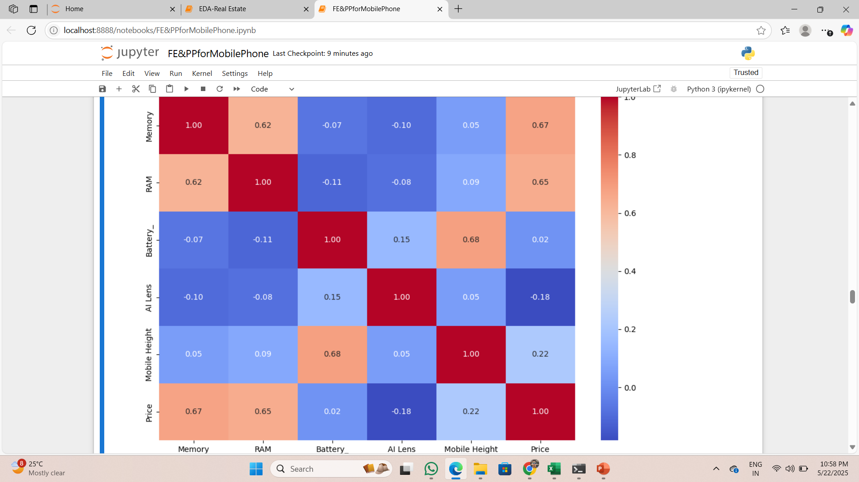
Correlation
Memory and RAM have the most importance in affecting Price(0.67 and 0.65 respectively). As the values of Memory and RAM increases, Price also increases.

Slide 4
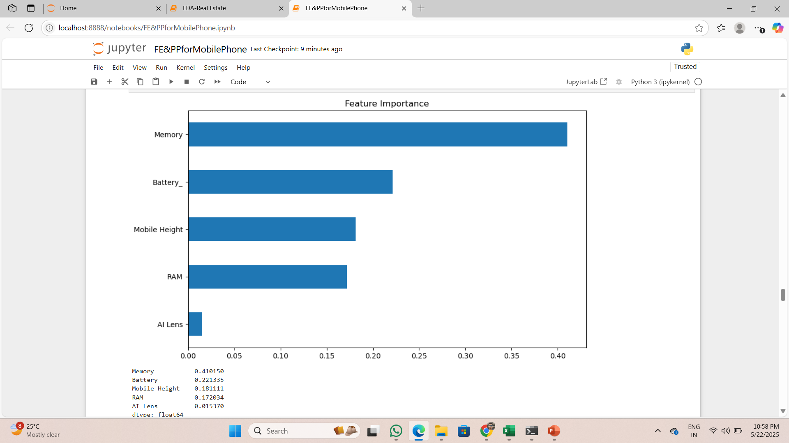
Feature importance- random forest
Memory has highest influence in prediction.
Battery, Mobile height and RAM have little low influence in predicting.
AI lens has no influence in prediction.

Slide 5
Model results
Linear Regression- MAE is 3050, which means on average the difference between actual price and predicted price is Rs 3050.20.
RMSE is 5028, which means larger errors are higher.
R2 score is 0.60, which means model is giving 60% correct predictions.
Decision Tree- MAE = Rs 1579.25, RMSE = Rs 3952.83, Rsquare Score = 0.758
Random Forest- MAE = Rs 1684.32, RMSE = Rs 3400.95, Rsquare Score = 0.821
XG Boost(Final)- MAE = Rs 1408.85, RMSE = Rs 2464.98, Rsquare Score = 0.906

Slide 6
Model performance(XG BOOST)
R^2 Score – 0.906
Mean Absolute Error(MAE) – Rs 1408.85
Root Mean Squared Error(RMSE) – Rs 2464.98
The model explains a significant portion of price variance.

Slide 7
Top influential features
Battery- Strongest influence on price.
Memory & Mobile Height- Strong internal and physical feature impact.
RAM- Moderate impact.
AI Lens & Camera Specs- Very low impact.

Slide 8
Recommendations for strategy
Focus marketing around battery performance and memory capacity.
Use camera and AI features to justify premium pricing.
Position products with optimal dimensions (Height) for perceived quality.

Slide 9
Thank you
By-
Alankar Saxena

