Slide 1
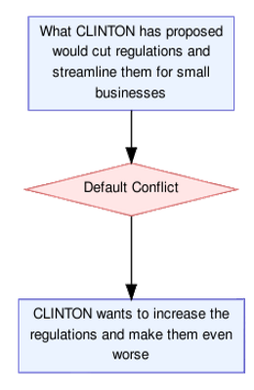
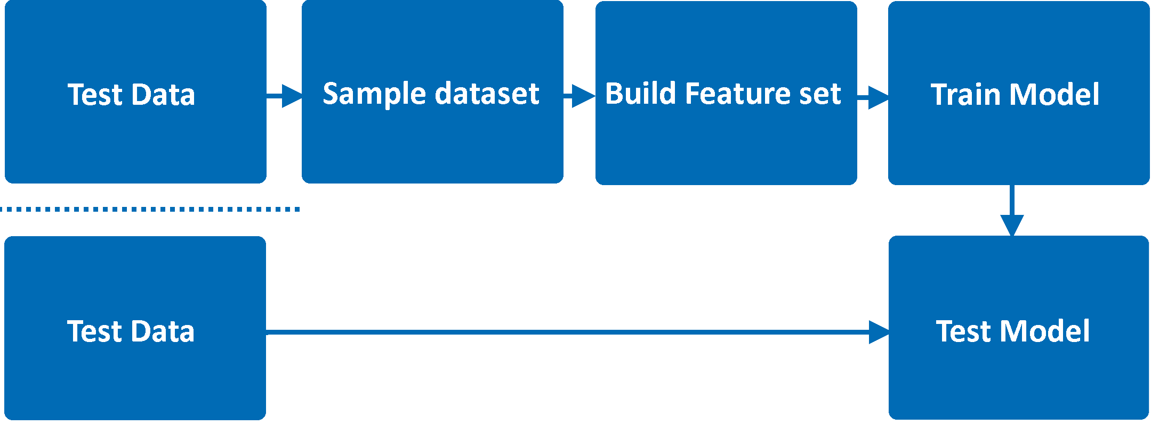


Classifying Argumentative Relations in Political Debates
Alan MacEachen
Supervised by Dr. Katarzyna Budzynska
AIM
Using a combination of natural language processing techniques and machine learning classifiers a pipeline can be built to classify argumentative units and the relations between them. This pipeline takes in two argumentative nodes and determines:
1. Are the two nodes related or unrelated
2. Is the relation between related nodes a conflict or not.
METHODOLOGY
This model was trained on a previously annotated corpus of arguments from the 2016 US presidential election debates (produced by ARG-Tech). A combination of different feature sets, machine learning classifiers, and sampling methods were used with 10-Fold Cross Validation to find the best model.
RESULTS
The top F₁-Score for each task
Task | Best Features | Best sampling method | Best Classifier | F₁-Score
Related/ Unrelated | All without structural | Random Undersampled | Logistic Regression | 89.44%
Conflicts | All features | Random Over-sampled + TLink | Logistic Regression | 67.61%
CONCLUSIONS AND FUTURE WORK
Argument mining is a young research area, and there is still a significant amount to be explored, this project focuses on the unexplored area of conflicts in political debates with the aim of outputting argument graphs as shown above. In future, this could be used to automatically, and in real-time, check the most contentious issues in a debate or the topics where two candidates disagree the most.
Do not allow any text, image or shadow to go below this level
Do not allow any text, image or shadow to go below this level

