Slide 1
Secure data hiding in images using steganography
CAPSTONE PROJECT
Presented By: Alan Merwin D
Student Name : Alan Merwin D
College Name & Department : Loyola-ICAM College of Engineering and Technology / Information Technology

Slide 2
OUTLINE
Problem Statement
Technology used
Wow factor
End users
Result
Conclusion
Git-hub Link
Future scope

Slide 3
Problem Statement
Sensitive information sent over digital channels is always at risk of being intercepted or accessed without permission. Encryption helps protect data, but it also makes hidden information obvious, which can attract hackers. This visibility increases the chances of targeted attacks, where attackers try to break the encryption or alter the data. Therefore, there is a strong need for a method that not only keeps data secure through encryption but also hides the fact that any hidden data exists. This would add another layer of security, making it much harder for attackers to find, steal, or tamper with sensitive information.

Slide 4
Technology used
Platform: Python IDLE
Libraries Used:
OpenCV: For image processing and manipulation.
NumPy: For handling and manipulating image arrays.
PIL (Pillow): For image handling and operations.
Cryptography: For encrypting and securing hidden messages.

Slide 5
Wow factors
Layered Security: Combines encryption with hidden messages for stronger protection.
Historical Significance: Used since ancient times, including in wartime espionage.
Modern Applications: Utilized in digital forensics, copyright protection, and more.
Stealth Communication: Messages can be embedded in images without visible changes.
Open-Source Advantage: Tools like OpenCV enable efficient image processing.

Slide 6
End users
Individuals: Protecting privacy in personal communications.
Journalists & Whistleblowers: Safely sharing sensitive information.
Corporations: Securing confidential data and intellectual property.
Government Agencies: Ensuring secure communication for national security.
Digital Forensics Experts: Investigating cybercrimes and preserving evidence.

Slide 7
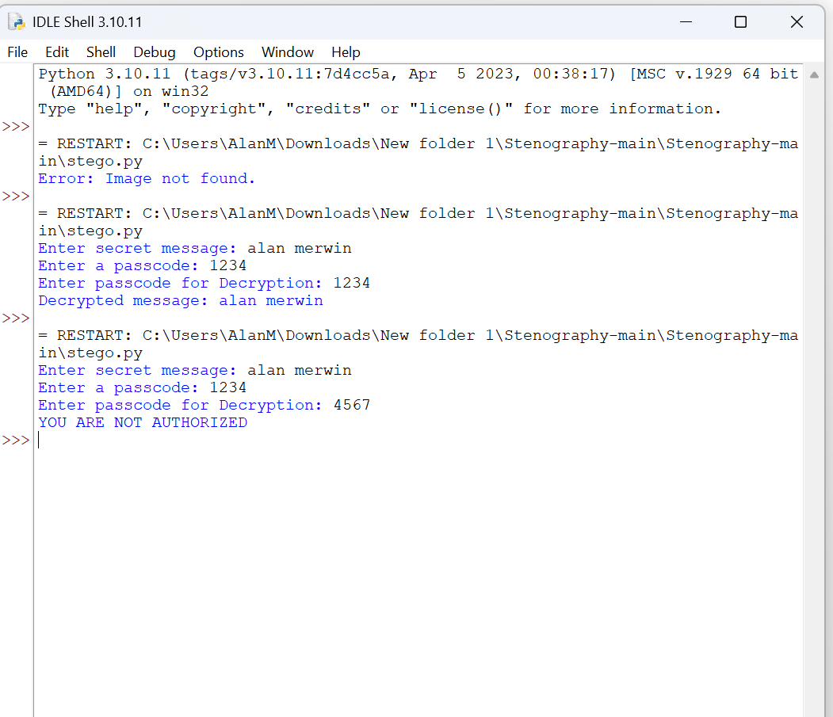
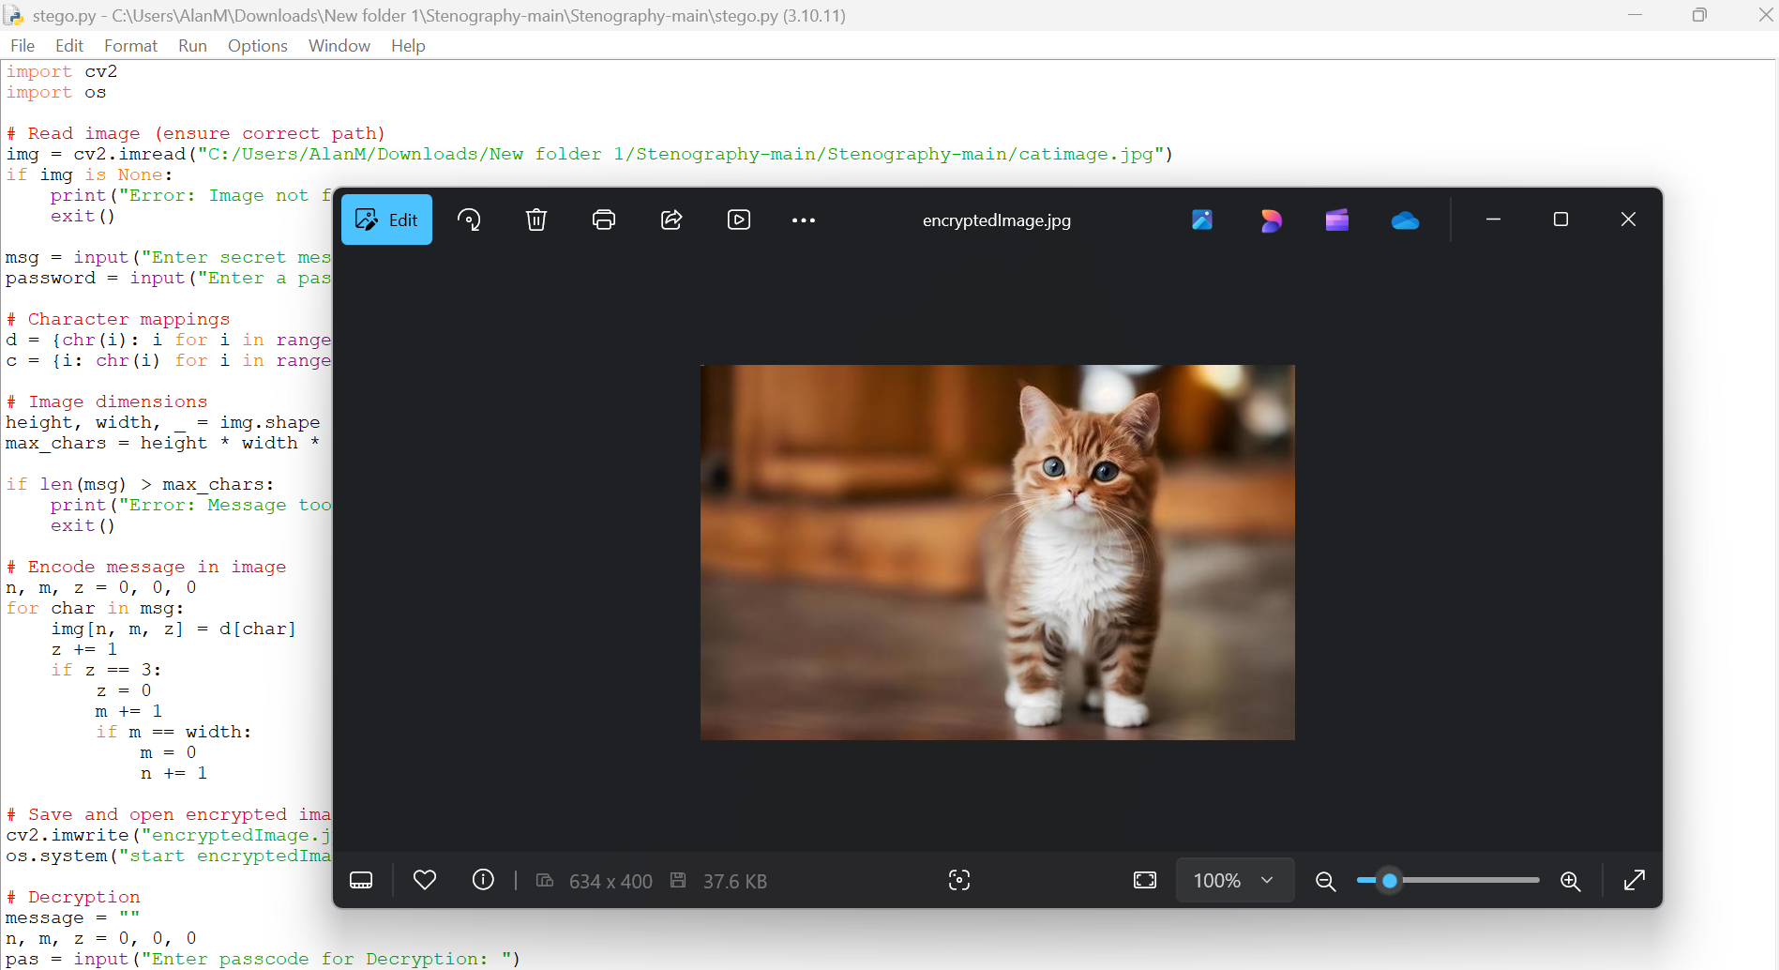

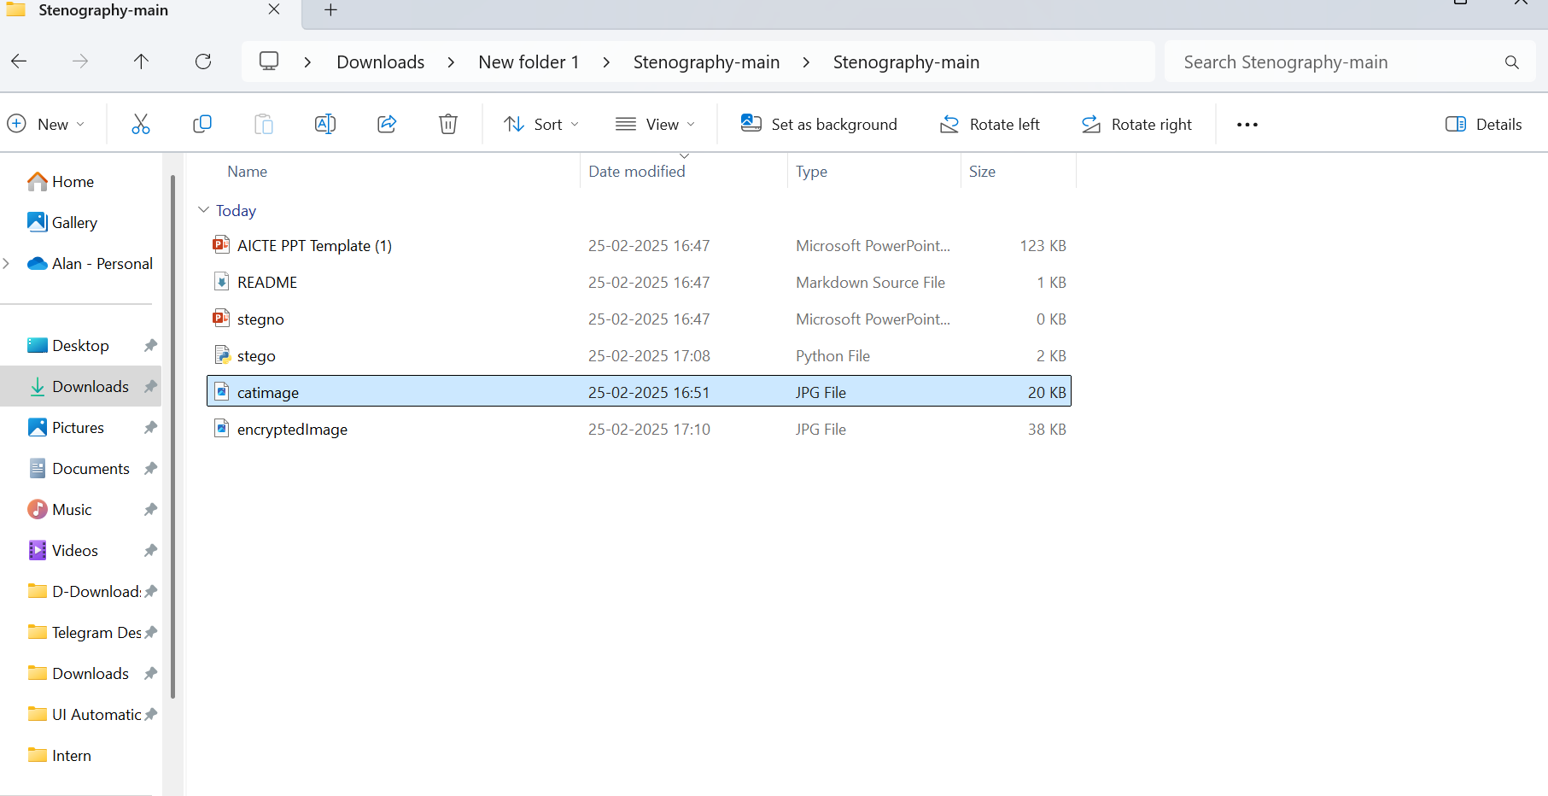
Results

Slide 8
Conclusion
This project explores the powerful application of steganography for securely embedding and retrieving hidden messages within digital images. By leveraging Python and advanced image-processing libraries such as OpenCV, NumPy, and PIL, we enable seamless concealment of confidential information without visibly altering the image.
Steganography plays a crucial role in covert communication, ensuring that sensitive data remains undetectable to unintended recipients. This approach enhances data privacy and security, making it invaluable for personal privacy protection, corporate data security, digital forensics, and governmental intelligence operations. It is widely used in fields such as whistleblowing, secure journalism, cybercrime investigation, and copyright protection.
Furthermore, by integrating encryption with steganography, this method fortifies the confidentiality and resilience of digital communication. It provides a layered security approach, making it significantly harder for cyber threats and unauthorized entities to detect, intercept, or manipulate sensitive information. With the power of open-source tools like OpenCV, implementing such security measures becomes both efficient and accessible.

Slide 9
GitHub Link
https://github.com/Alanmax16/steganography.git

Slide 10
Future scope(optional)
Advanced Cybersecurity – AI-driven anti-detection methods and blockchain integration for tamper-proof security.
AI-Powered Steganography – Deep learning techniques for undetectable data hiding and real-time encoding.
Defense & Intelligence – Covert communication for military operations and espionage.
Digital Watermarking – Protecting copyrights and detecting tampering in media and documents.
Cloud & IoT Security – Ensuring secure cloud storage and hidden data transmission in smart devices.
Quantum Steganography – Quantum-resistant methods for unbreakable encryption and secure key distribution.

Slide 11
THANK YOU

