Slide 1
WebSharper F# MVC API
10th April 2015

Slide 2
WebSharper
Allows the creation of JavaScript and html5 front end web applications in f#
Intellifactory (2008) (Adam Granicz)
Open source with commercial support
written in f#
operates on all major OS (windows, mac, android, iOS)
Install via websharper.com (runs on visual studio)

Slide 3
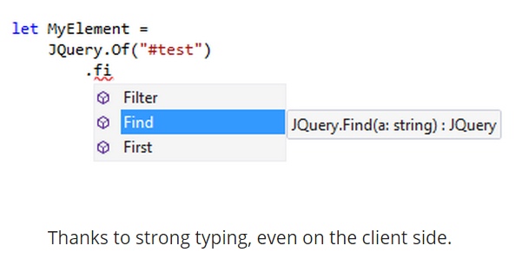
Why WebSharper?
More robust
More productive
More maintainable
More interoperable
More readable
More compatible

Slide 4
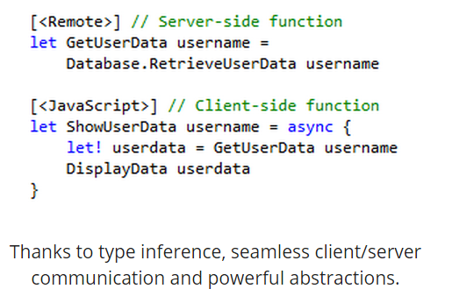
Why WebSharper?
More robust
More productive
More maintainable
More interoperable
More readable
More compatible

Slide 5
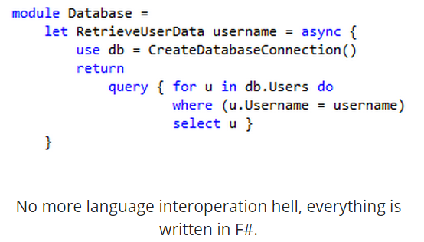
Why WebSharper?
More robust
More productive
More maintainable
More interoperable
More readable
More compatible

Slide 6
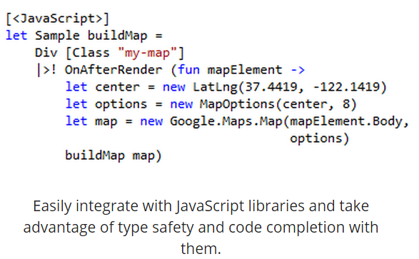
Why WebSharper?
More robust
More productive
More maintainable
More interoperable
More readable
More compatible
Notes:
Bing Maps, Google Maps, D3, JQuery Mobile

Slide 7
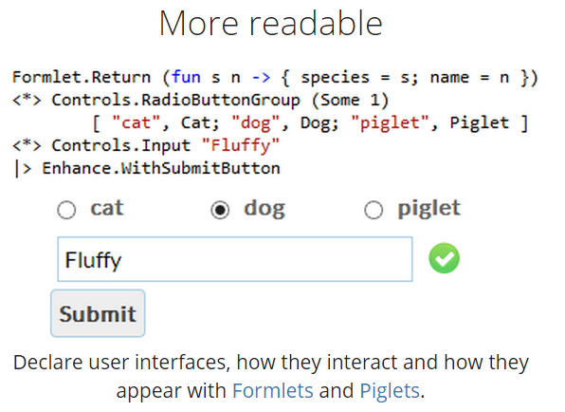
Why WebSharper?
More robust
More productive
More maintainable
More interoperable
More readable
More compatible

Slide 8
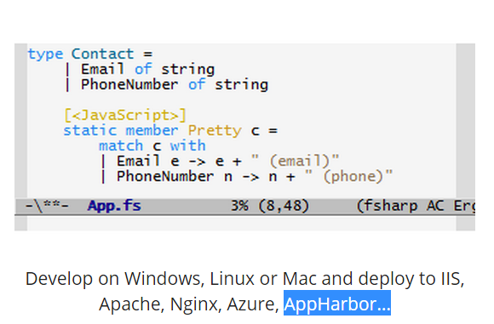
Why WebSharper?
More robust
More productive
More maintainable
More interoperable
More readable
More compatible

Slide 9
Client server web application
Main Module
Client Module
Remoting Module
Main Template (html page)
Examples + Hosting
Notes:
Client.Fs
Any code annotated with JavaScript gets cross compiled to JavaScript and run in the browser
Remote.Fs
Remote marks a server-side function to be called from a client remotely
Execution happens by serializing arguments and return value and passing them over HTTP. Not all types are supported, WebSharper will warn you about potential problems at compile time.
http://t0yv0.blogspot.com/2011/01/websharper-sitelets-building-two-page.html

Slide 10
Problems with WebSharper
Requires updates to nuget package manager & installation of the latest vs update (4)
Lack of a sizable community
Changes to code no immediately seen on browser (requires clearing of cache)
Referencing problems

Slide 11
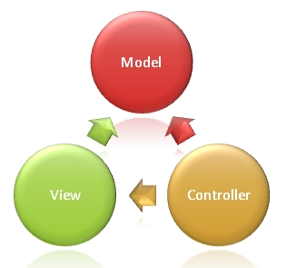
F# web api
F# template downloadable from visual studio solutions (mvc 4)
Notes:
The Model is the part of the application that handles the logic for the application data. Often model objects retrieve data (and store data) from a database.
The View is the parts of the application that handles the display of the data. Most often the views are created from the model data.
The Controller is the part of the application that handles user interaction. Typically controllers read data from a view, control user input, and send input data to the model.
The MVC separation helps you manage complex applications, because you can focus on one aspect a time. For example, you can focus on the view without depending on the business logic. It also makes it easier to test an application.

Slide 12
F# web api
Adding controllers
Returning record as json
Notes:
Controllers must end in Controller
CLIMutable or record type will always return null
Add reference to newtonsoft 6.0.0 or greater

Slide 13
Application demo
WebSharper web application
F# web service
Web service selects, inserts and deletes data to a posturesql database

