Slide 1
PostgreSQL
13th march 2015

Slide 2
History
Designed by Michael Stonebraker ( Andrew Yu, Jolly Chen) at ucla (1999)
15 years active development
Community developed
Open source (Forever)
Runs on all major operating systems
Designed for high volume environments
Sponsors (google, redhat, hp, skype)

Slide 3
Who uses PostgreSQL
McAfee
Last FM
Faa
Skype
Hi5 (6th in the all time most visited website list)

Slide 4
What's PostgreSQL
object-relational database
Document-orientated database
Key/value store

Slide 5
common sql features
Fully sql compliant
Data integrity
Indexing (more later)
Stored procedures (with a difference)

Slide 6
Why PostgreSQL over MS sql sever
Stored procedures (in your language c, java, Perl, python, ruby, JavaScript, php)
Read in Csv files
Ergonomics
Inheritance
Types (Arrays, hstore, Range types, numeric & decimal precision)
json

Slide 7
Json PostgreSQL 9.4
json is stored in its plain text format 9.2
Jsonb introduced in latest version 9.4
Jsonb lives within PostgreSQL (Stored like key value pairs)
Max 1gb per field
New jsonb query operators in 9.4 (@>, <@, ?, ?|, ?&)
Use json if only storing and retrieving records
Use jsonb when performing lots of operations (gin indexing)

Slide 8
Jsonb indexing (GIn index)
Gin (galvanised inverted index)
Index is modelled on a b-tree
Heavily optimised for storing duplicate values
Duplicates stored in a paging file or tree
Re-indexing may be required
B-tree for unique indexing

Slide 9
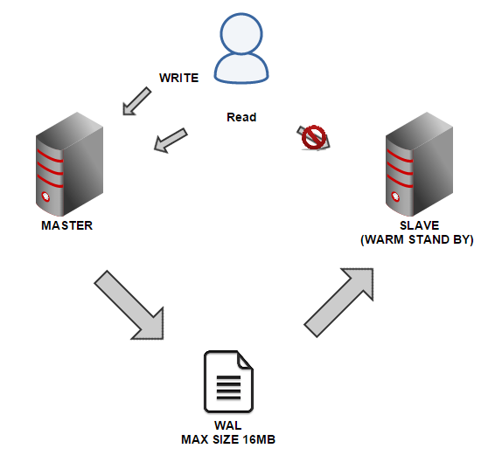
Scalability, AVAILABILITY & REPLICATION warm stand by
ALL TRANSACTIONS WRITTEN TO WAL FILE (CAN’T SPECIFY specific TABLES)
periodical shipping of WAL files to the secondary server (OR WHEN WAL IS FULL)
Async by default
NO SCHEMA REPLICATION, LOAD BALANCING, QUERY ON SLAVE
IDENTICAL MACHINES AND VERSIONS OF POSTGRESQL
MAX LOSS 1 WHOLE WAL (16MB)
Uses (pitr)

Slide 10
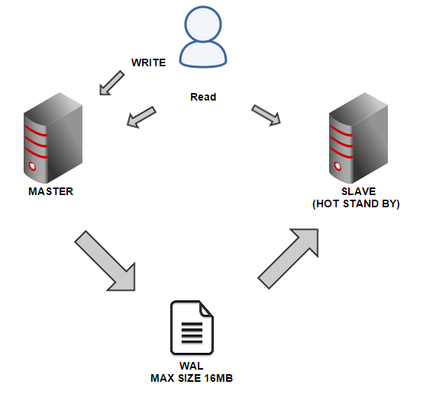
Scalability, AVAILABILITY & REPLICATION HOT stand by
capability to run queries on a database that is currently performing archive recovery
Standby nodes can then be used for read-only query access
USES (Point-in-Time Recovery, scalability, AVAILABILITY)
Failover (slave promoted)

Slide 11
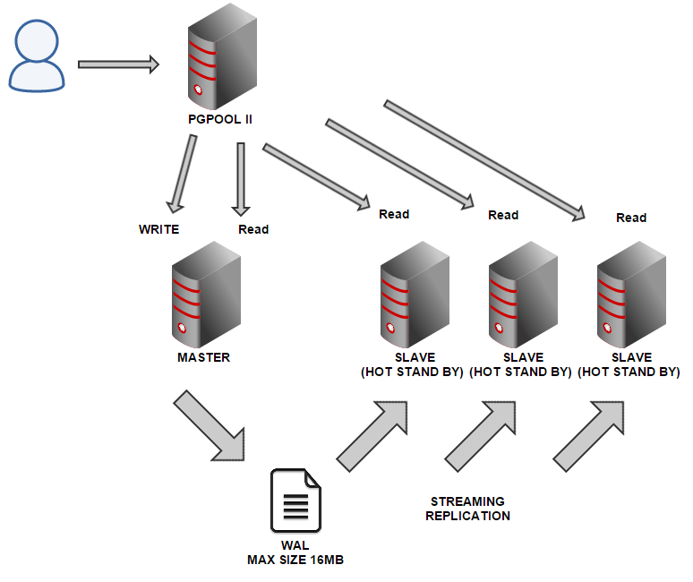
Scalability, AVAILABILITY & REPLICATION STREAMING REPLICATION/PgPooling II with multiple slaves
Wal files sent to asap
Pgpool ii performs failover and load balancing
USES (Point-in-Time Recovery, LOAD BALANCING, high availability)

Slide 12
Limitations
Replication can be difficult (recent advances)
read-heavy operations, PostgreSQL can be an over-kill and might appear less performant
Dose not work well with windows
Difficult to find hosting

Slide 13
Example queries
Queries using JSON, JSONB, Arrays, inheritance
https://github.com/Alanmugz/PostGreSQL/blob/master/Code%20snippets.sql

