Slide 1
WP5: Exploiting Large Datasets to Understand the Genetics and Clinical Heterogeneity of PID
Chris Wallace, Ken Smith Tom Willis

Slide 2
Aims of WP5
Task 5.1 Coheritability of IMD and other molecular phenotypes with PID
Task 5.2: Identify common PID-associated variants
Task 5.3: Leverage common disease genetics to aid rare variant analysis
Task 5.4: Genetic regulation of immunophenotypes generated in WP2, WP3
Task 5.5: Reverse genetics: phenotype of carriers of PID variants in EPIC, UK Biobank

Slide 3
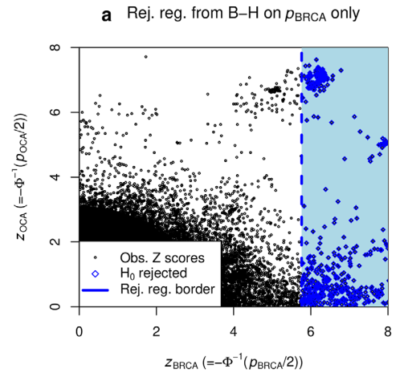
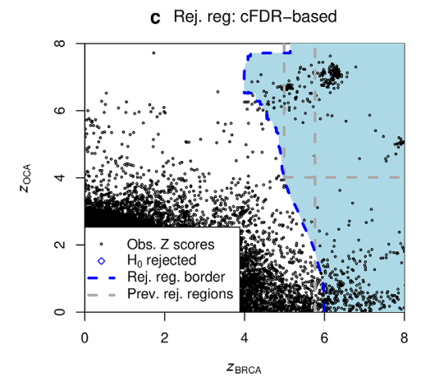
Integration of PID GWAS with other IMD (Task 5.2)
With conditional FDR we can adapt our rejection region to reject slightly larger p values when a related trait has smaller p values
Breast cancer only
Breast cancer | ovarian cancer
Ovarian cancer
Ovarian cancer
Breast cancer
Breast cancer
Liley, Wallace 2021

Slide 4
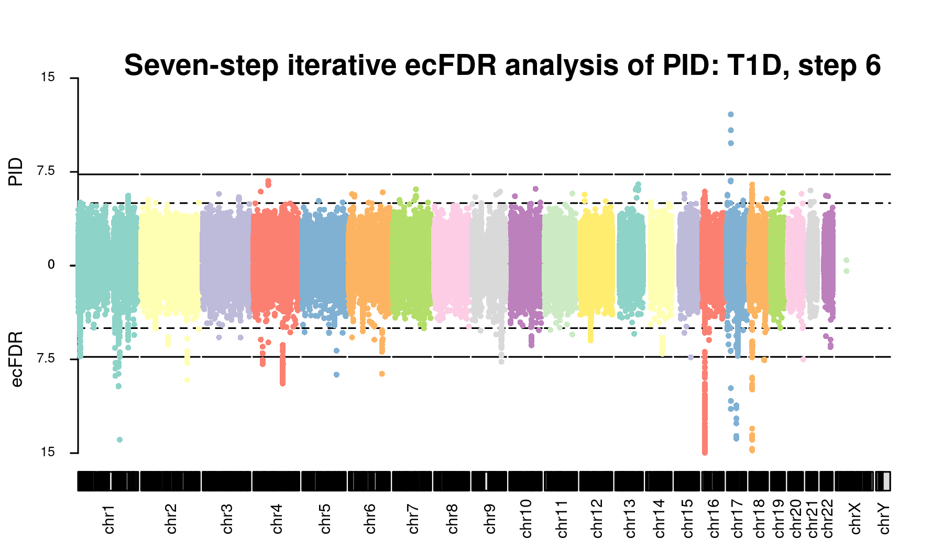
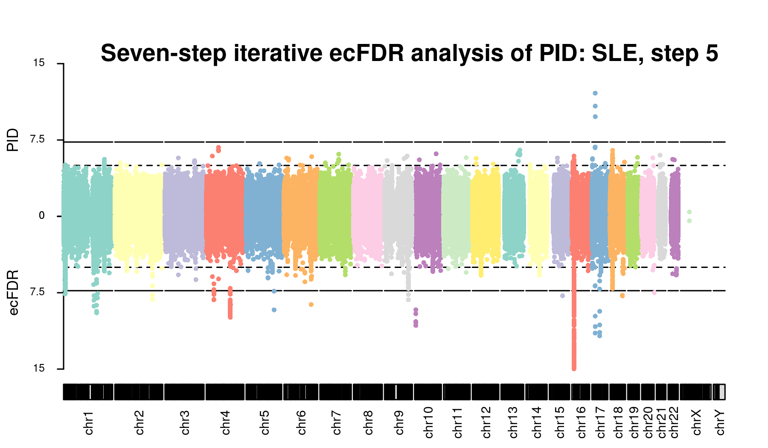
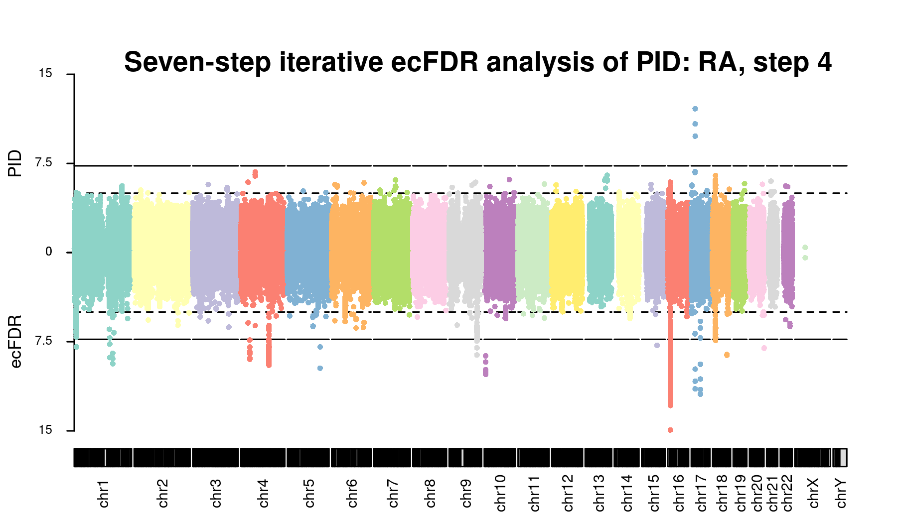
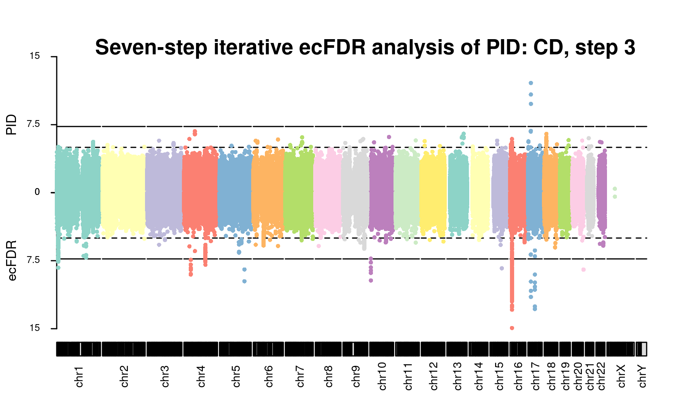
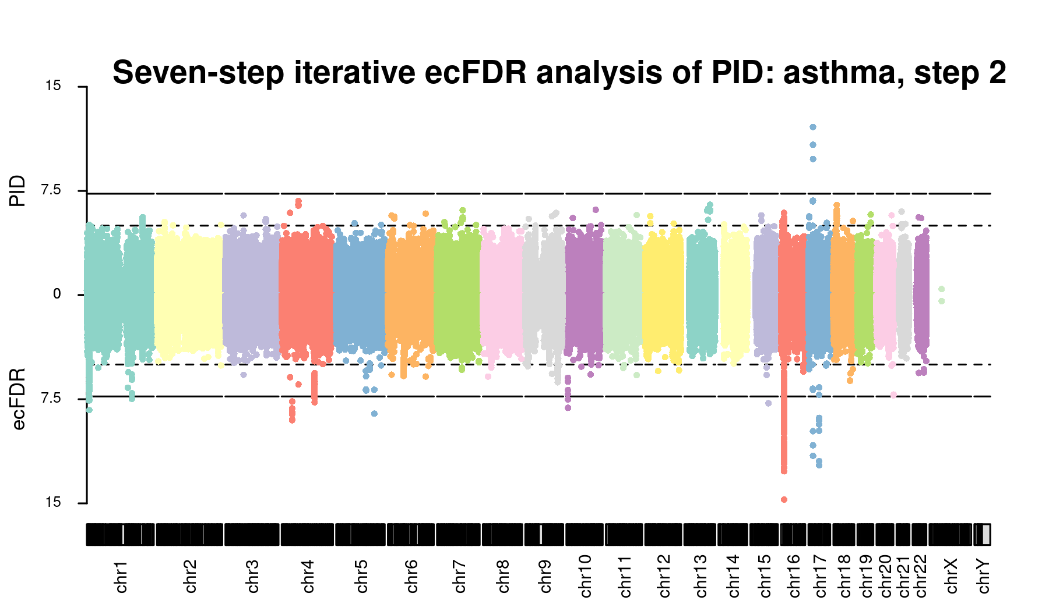

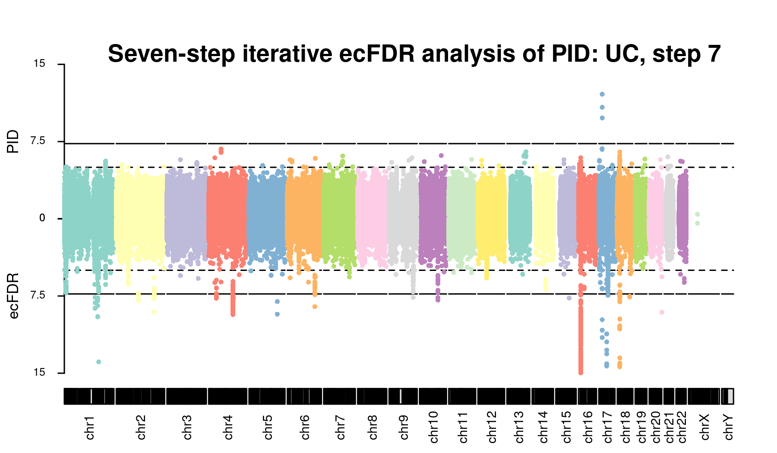
Preliminary results of leveraging seven IMD with PID

Slide 5
Preliminary results of leveraging seven IMD with PID

Slide 6
Preliminary results of leveraging seven IMD with PID

Slide 7
Preliminary results of leveraging seven IMD with PID

Slide 8
Preliminary results of leveraging seven IMD with PID

Slide 9
Preliminary results of leveraging seven IMD with PID

Slide 10
Preliminary results of leveraging seven IMD with PID

Slide 11
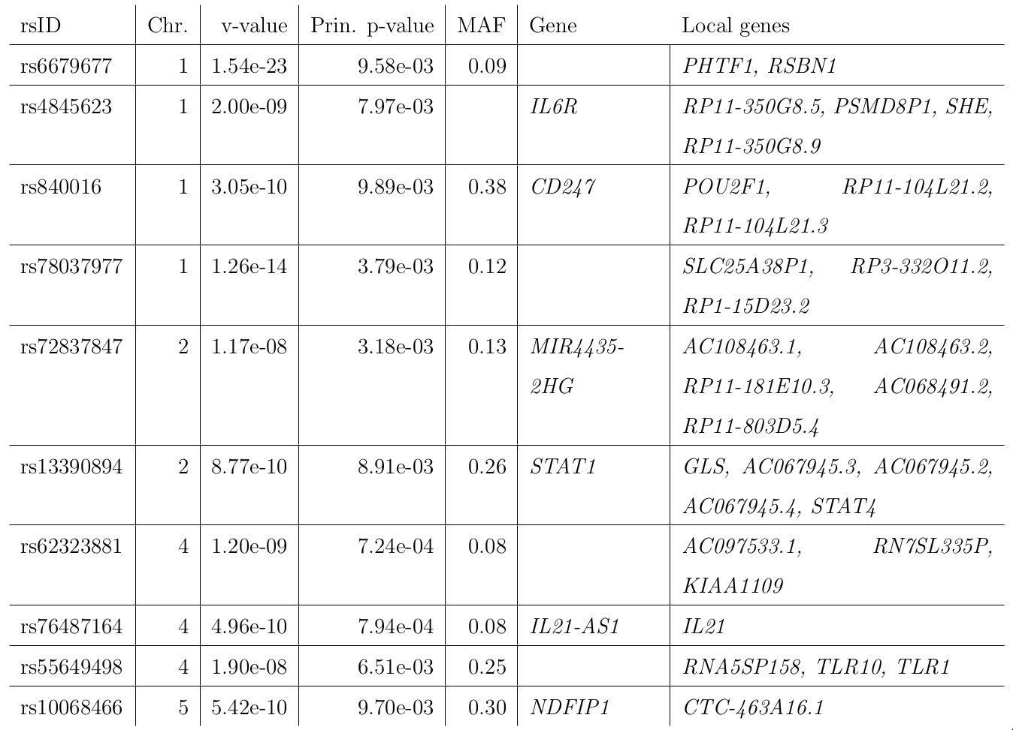

Slide 12
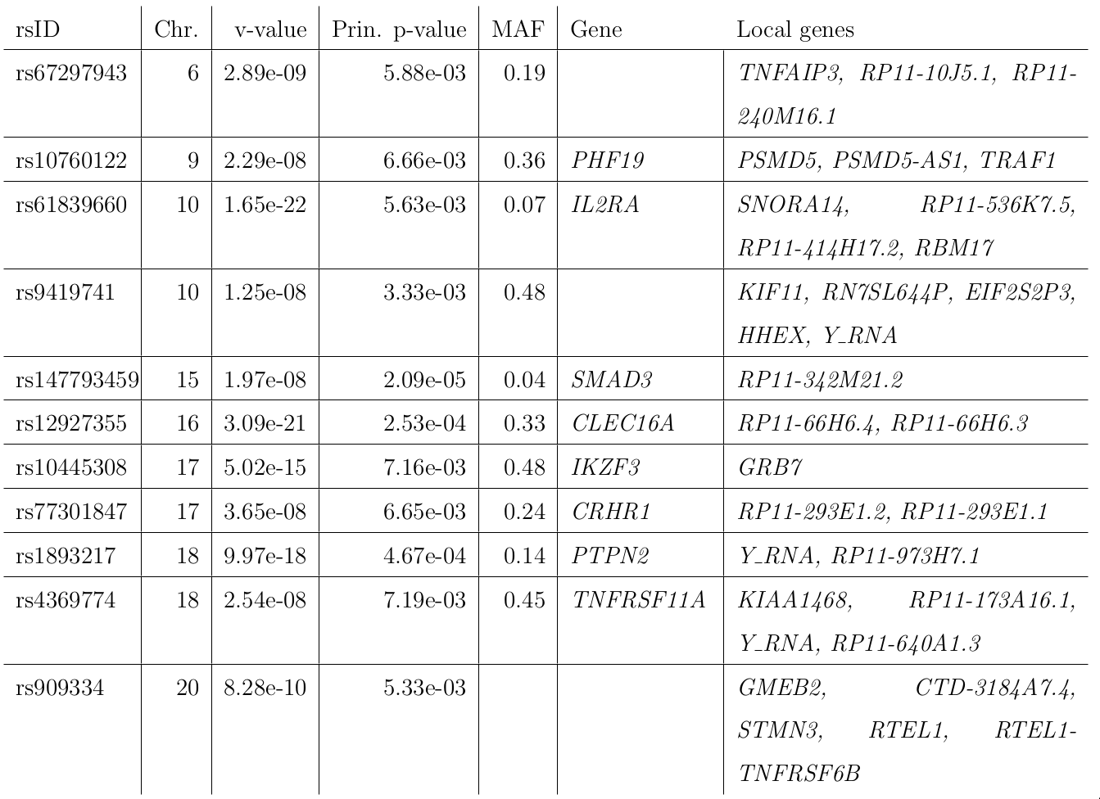

Slide 13
Choice of diseases to condition on (Task 5.1)
Can’t iterate forever: these diseases are related and we would lose control of type 1 error
Must choose a small number that are
Informative for PID
Relatively independent of each other
Genetic correlation is not useful here because PID sample size too small.

Slide 14

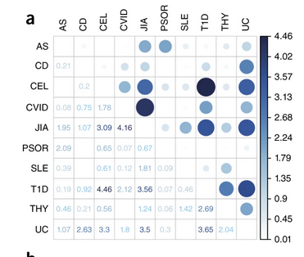
GPS statistic from Li et al (2015)

Slide 15
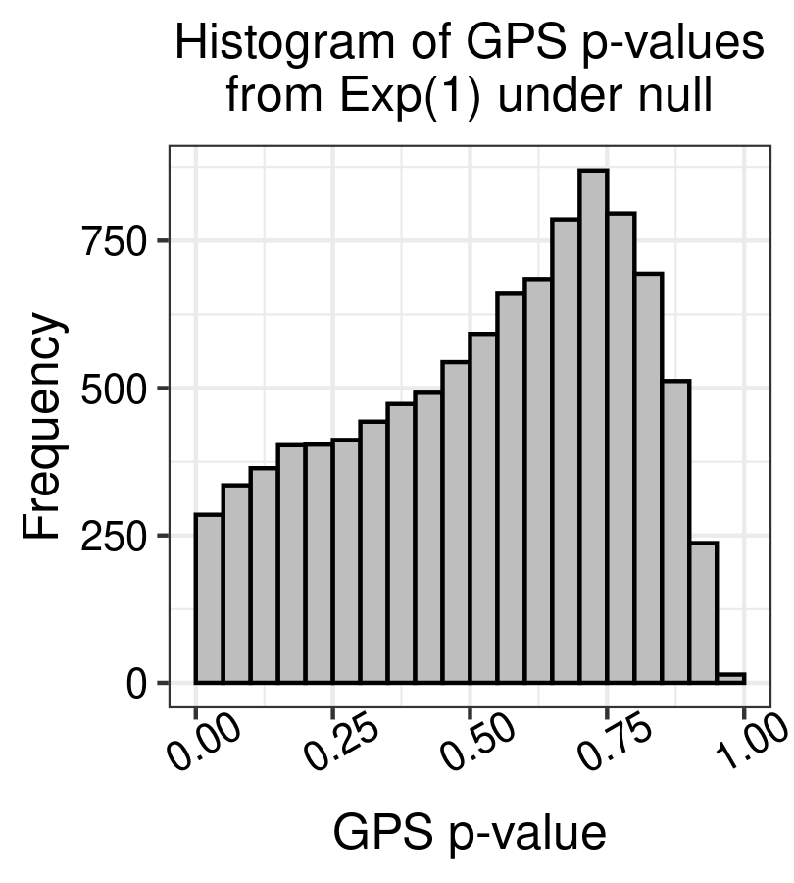
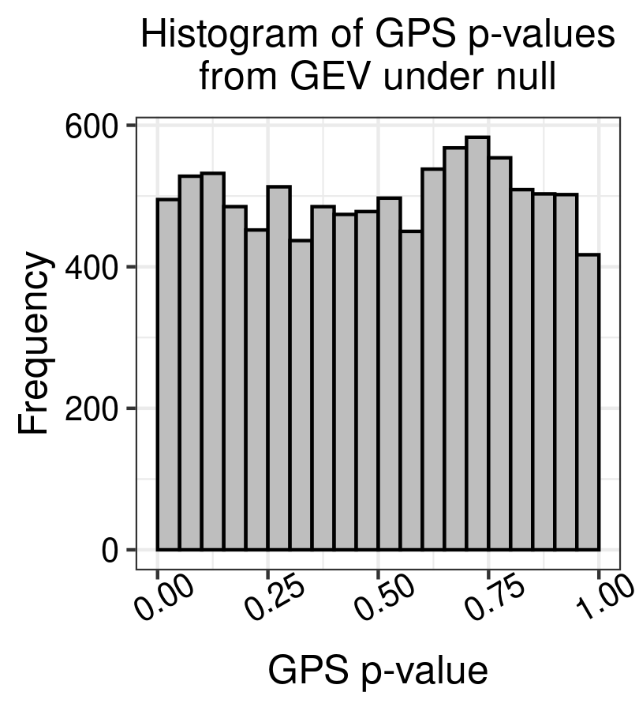
GPS statistic from Li et al (2015)

Slide 16
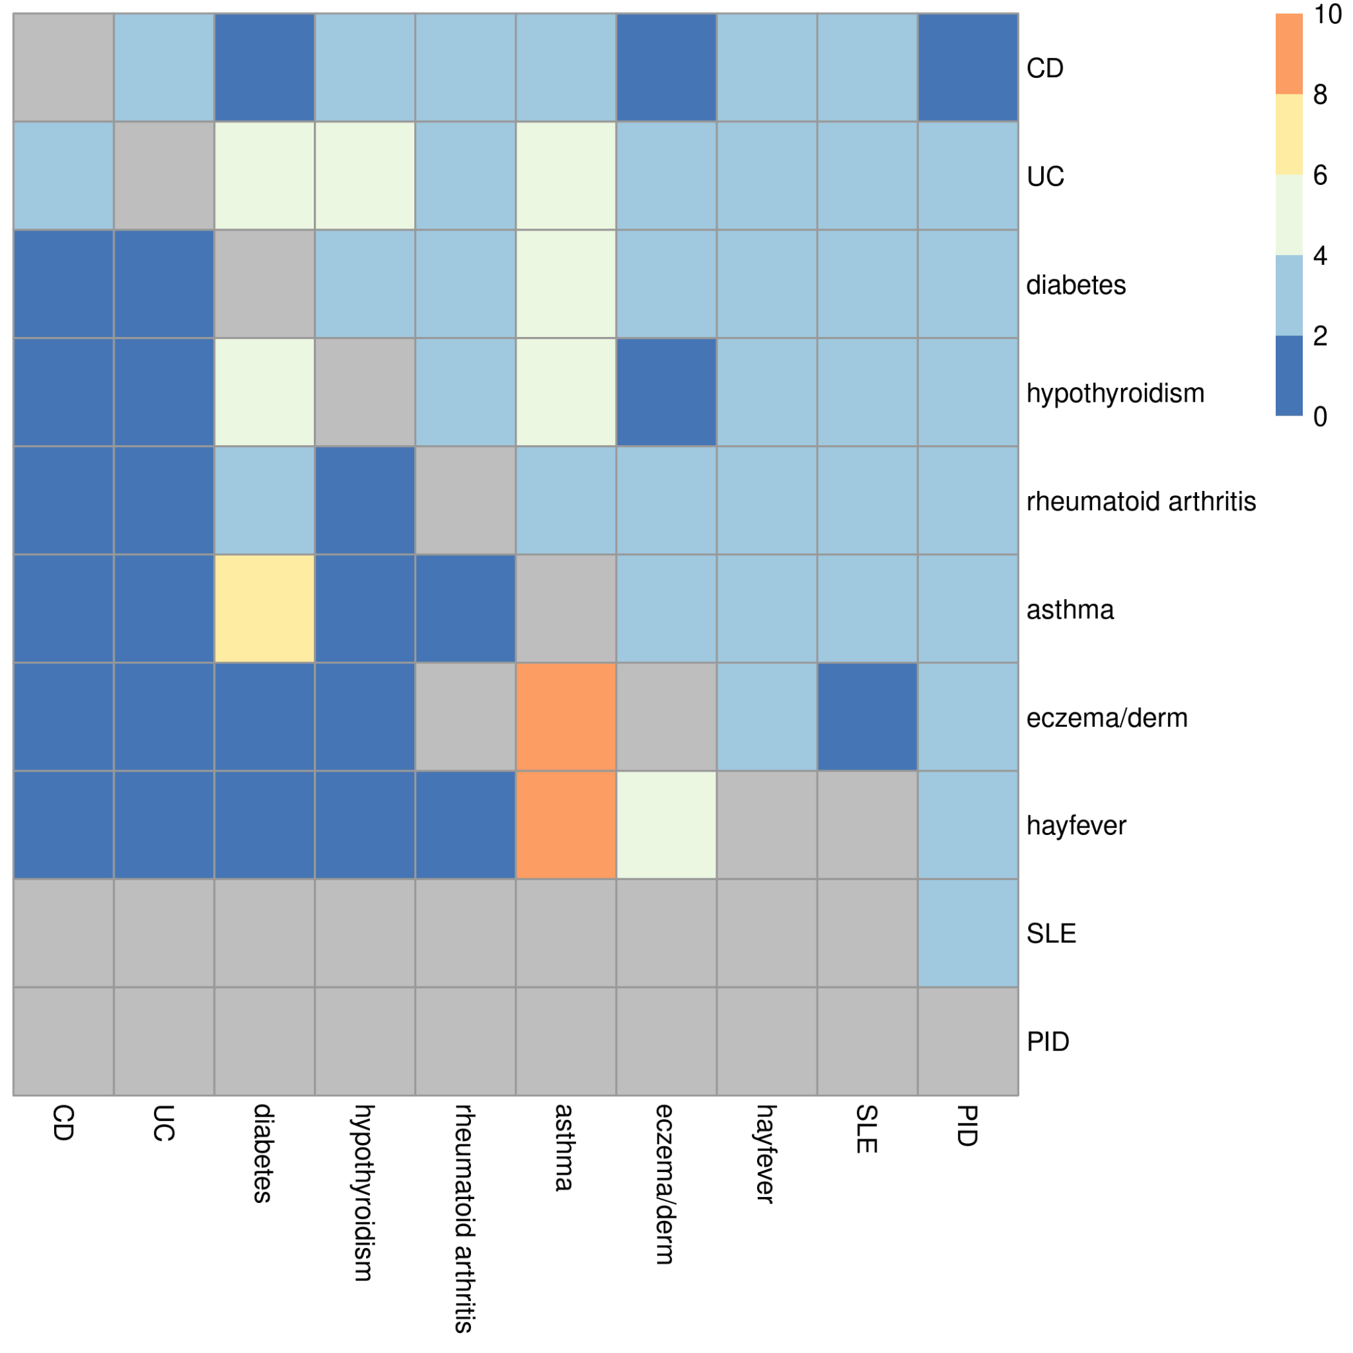
GPS statistic from Li et al (2015)
GPS p value
gives results
across range of
sample sizes
r_{g} p value
dependent on sample size

Slide 17
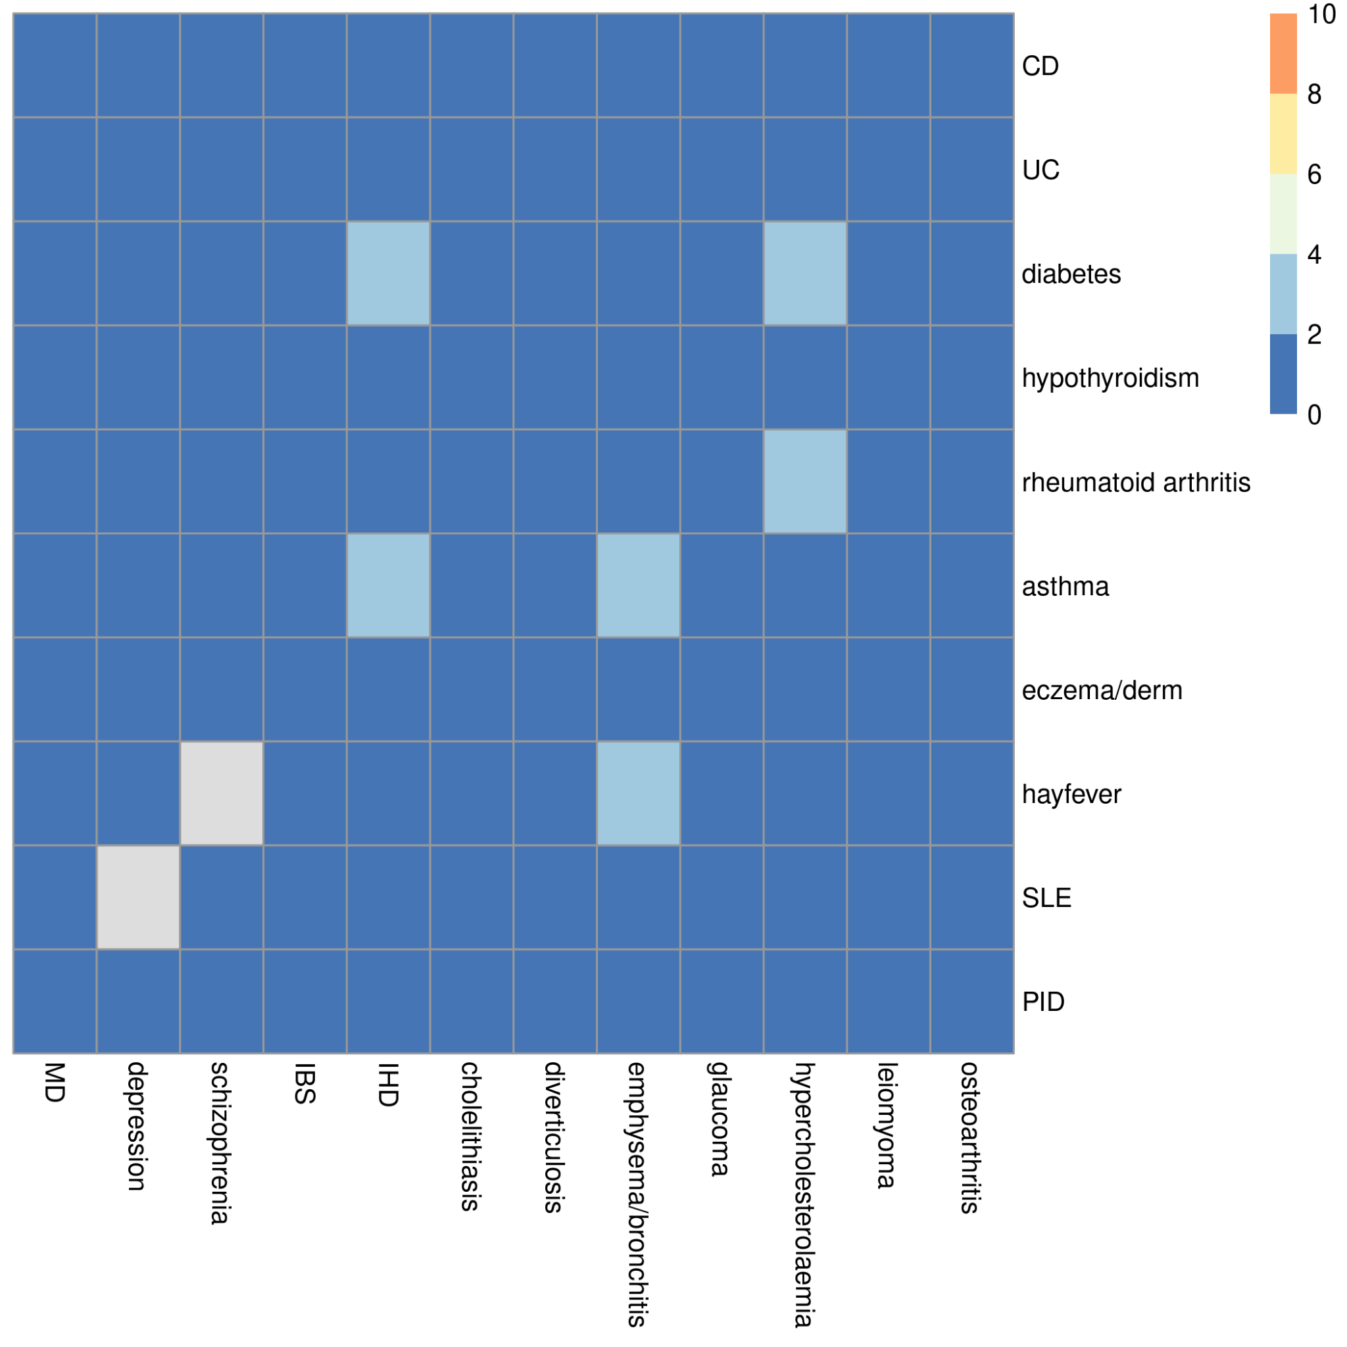
GPS statistic from Li et al (2015)
GPS p value
looks flat when comparing immune & non-immune traits

Slide 18
Next steps
Full coheritability analysis across broad range of diseases, IgG/M/A levels in 8,000 samples from EPIC-Norfolk
Select optimal subset and run cFDR using existing PID GWAS data
Update PID GWAS when additional 800 case data are available
Update coheritability and cFDR analyses
Extend method to work with rare variants, leveraging “linked” common variants

Slide 19






Acknowledgements
Tom Willis, PhD student has led the analyses presented today

Slide 20
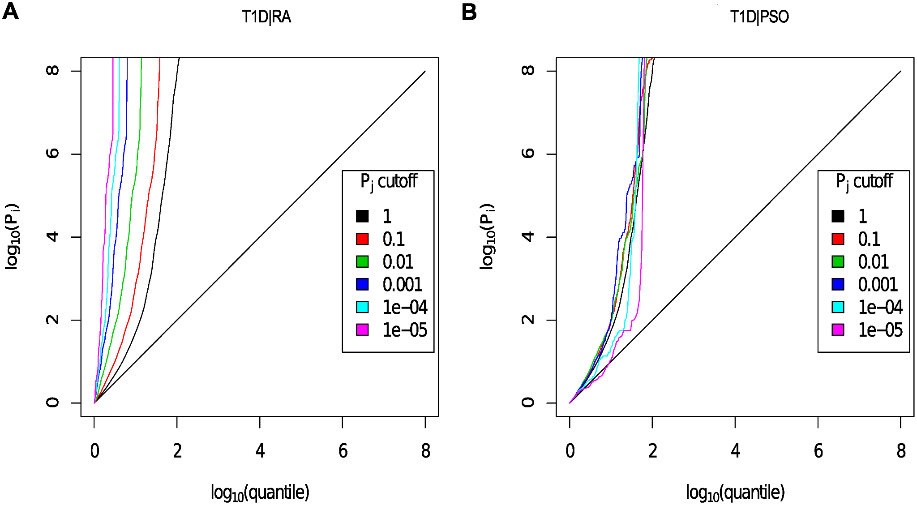
Integration of PID GWAS with other IMD (Task 5.2)
Conditional FDR is one way to leverage information from a larger GWAS
Type 1 diabetes | psoriasis
Type 1 diabetes | rheumatoid arthritis

Slide 21
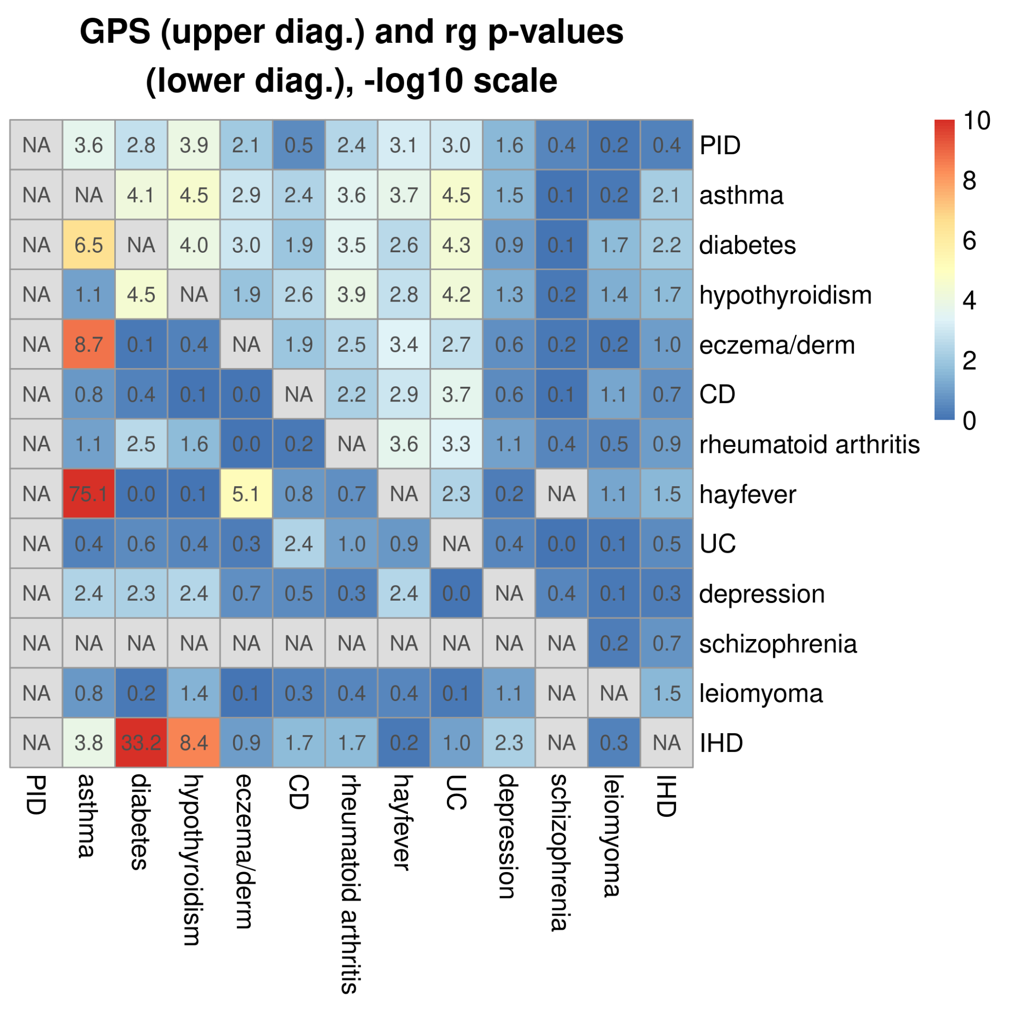
Solution: GPS statistic from Li et al (2015)

Slide 22
Solution: GPS statistic from Li et al (2015)

Slide 23
Solution: GPS statistic from Li et al (2015)

Slide 24
Solution: GPS statistic from Li et al (2015)

Slide 25
Solution: GPS statistic from Li et al (2015)

Slide 26
Solution: GPS statistic from Li et al (2015)

Slide 27
Solution: GPS statistic from Li et al (2015)

Slide 28
Choice of diseases to condition on (Task 5.1)
Can’t iterate forever: these diseases are related and we would lose control of type 1 error

Slide 29
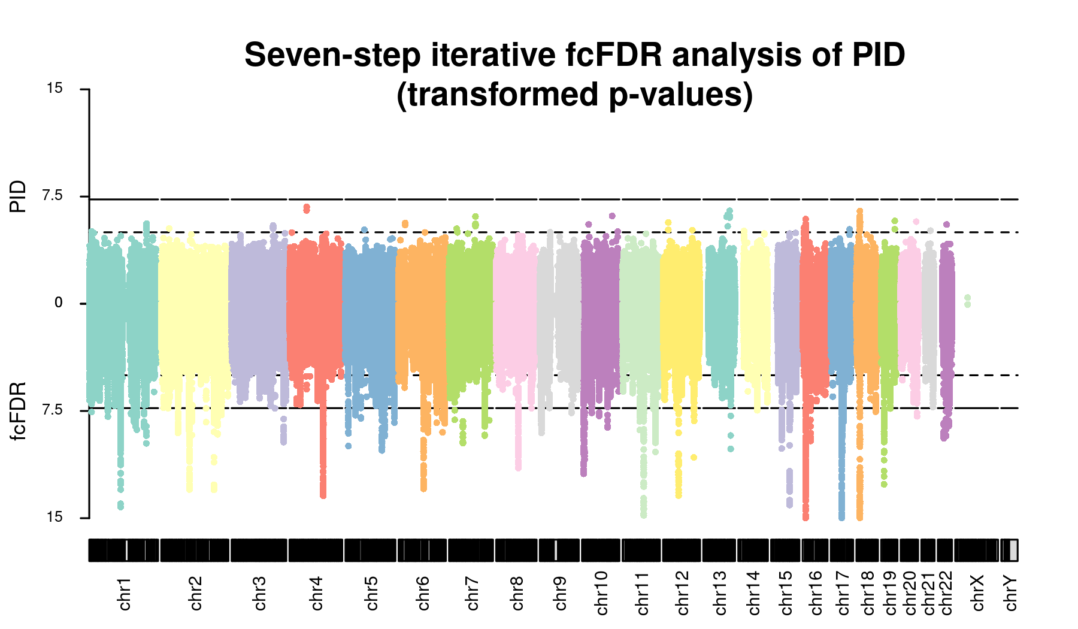
Choice of diseases to condition on (Task 5.1)

