Slide 1
🛍️
Olist Delivery
Intelligence Hub
96K+
Predicting Late Deliveries with Machine Learning to Protect Customer Experience at Scale
Orders Analyzed
8.1%
Late Order Rate
Course: DSAI 4103 — Business Analytics
Name: Alanood Alyafei – 60074158
Instructor: Dr. Elyor Kodirov
Date: 14 April 2026
0.787
Model AUC
1.73★
Avg Review Score Gap

Slide 2
Agenda
01
The Business Problem
02
Dataset & Preparation
Impact of late deliveries
Data sources & features
03
Exploratory Data Analysis
04
Predictive Modeling
Delivery days, state, category, payment
AutoML & model performance
Model Explainability
Bias & Fairness Analysis
05
06
SHAP analysis — what drives late deliveries
Regional fairness audit and mitigation plan
07
Deployment Architecture
08
Tableau Dashboard
score.py + Flask REST API
9 interactive dashboard views
2 / 16

Slide 3
01 Introduction & BUSINESS PROBLEM
The Cost of Late Deliveries
Olist is Brazil's largest e-commerce marketplace aggregator. Every late delivery damages customer trust — and the data confirms it.
8.1%
2.4 ★
1.73★
Late Order Rate
Avg Review (Late)
Review Score Gap
7,826 of 96,470 delivered orders
vs 4.3★ for on-time orders
Direct measurable cost per late order
At Olist's scale: thousands of negative reviews/month, seller de-listing risk, customer churn. The goal is to predict late deliveries BEFORE they ship — enabling proactive intervention.
The Problem Statement
→ Late deliveries are currently discovered AFTER they happen — reactive, not proactive.
→ Root causes include seller behavior, geography, seasonality, and product type.
→ Goal: Predict whether an order will be late BEFORE it ships, enabling early intervention
3 / 16

Slide 4
02 DATASET
7 Data Sources → 1 Unified Analytics Dataset
Source: Kaggle – Brazilian E-Commerce Public Dataset by Olist
7 data sources merged using Order ID
Final dataset: 96,470 records with 34 columns
Target variable: is_late (0 = On-Time | 1 = Late)
Final Dataset
96,470
Delivered Orders
34
Dataset File
Rows
Key Content
Total Columns
olist_orders_dataset
99,441
Order lifecycle timestamps
17
olist_order_items_dataset
112,650
Products, sellers, prices
Engineered Features
olist_order_payments_dataset
103,886
Payment type & installments
8.1%
olist_order_reviews_dataset
99,224
Customer review scores
Class Imbalance (Late)
olist_customers_dataset
99,441
Customer state & city
12.1
olist_products_dataset
32,951
Category, weight, volume
Mean Delivery Days
olist_sellers_dataset
3,095
Seller state & city
7
Data Sources Merged
4 / 16

Slide 5
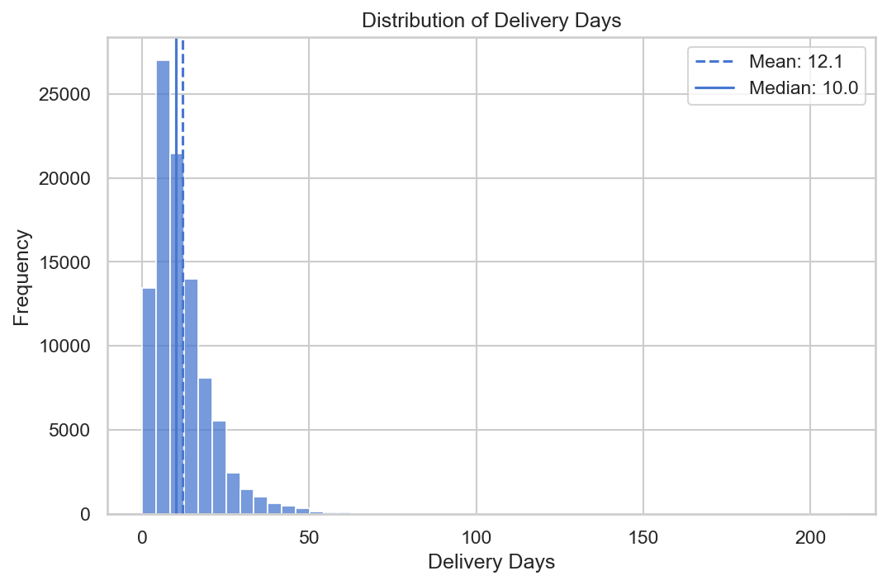
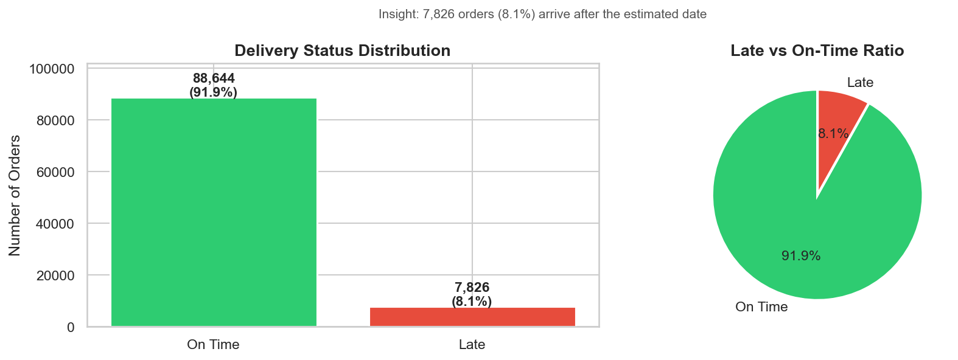
03 EDA
EDA — Delivery Time & Class Distribution
12.1 days
10 days
8.1%
11.3:1
Mean Delivery Time
Median Delivery Time
Late Order Rate
Class Imbalance Ratio
Right-skewed delivery distribution (mean > median) reveals outlier orders. 91.9% on-time vs 8.1% late — severe class imbalance justifies ROC-AUC as primary metric.
5 / 16

Slide 6
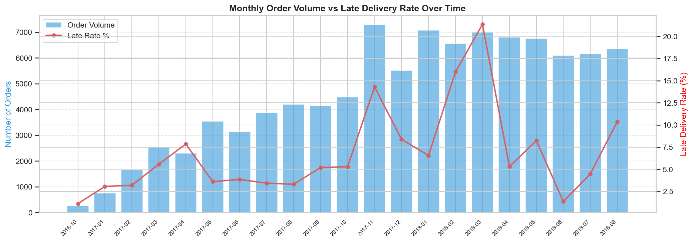
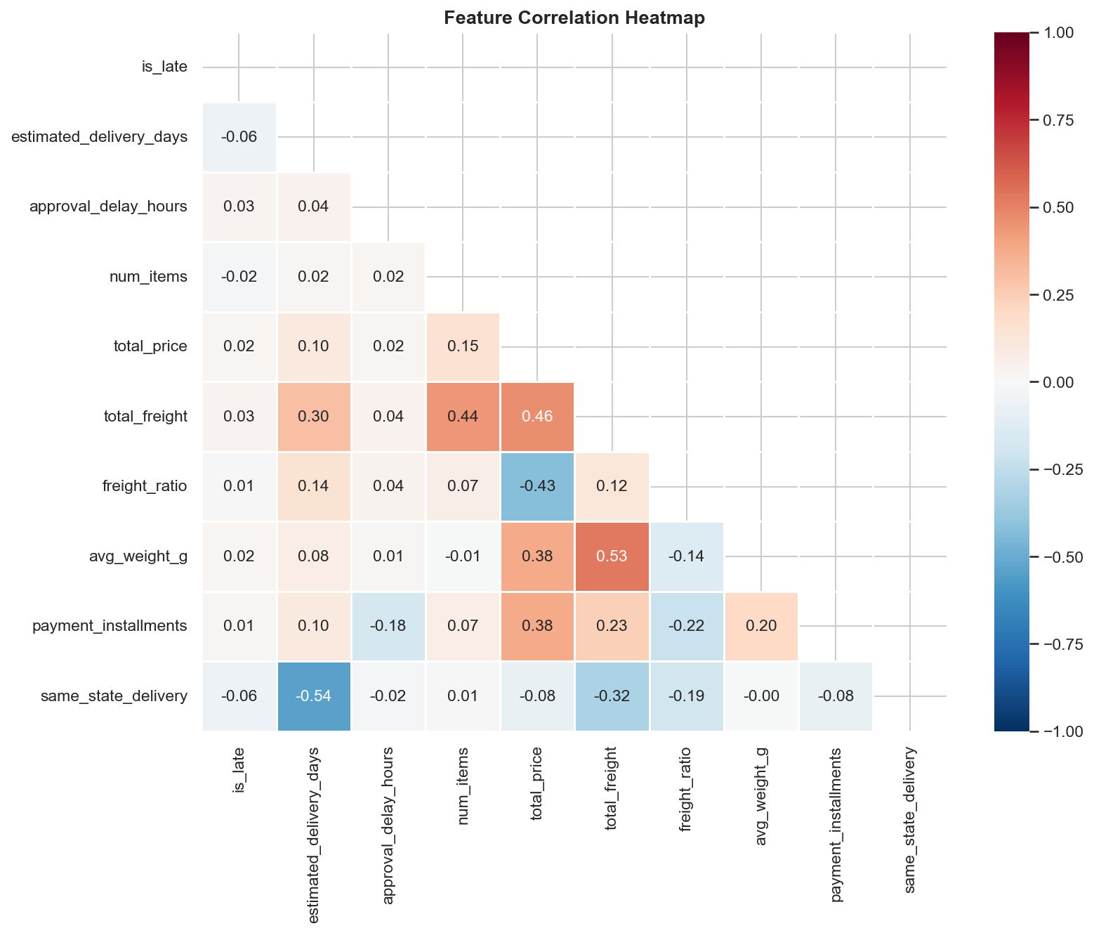
03 EDA CONTINUED
EDA — Monthly Trends & Feature Correlations
21.4%
5%
Weak
Peak monthly late rate (Mar 2018)
Lowest monthly late rate
Linear correlations with target
Demand surges in peak months overwhelm carrier networks. Weak linear correlations confirm tree-based models will outperform linear regression.
6 / 16

Slide 7
04 PREDICTIVE MODEL
AutoML Pipeline — From Data to Deployment
Data Prep
→
Feature Engineering
→
FLAML AutoML
→
LightGBM Model
→
Threshold Tuning
→
Deploy Ready
96,470 orders
17 features created
3-minute budget
Best algo selected
0.30 optimal threshold
score.py + Flask API
Model Comparison
Model
ROC-AUC
F1 Score
Precision
Recall
Accuracy
Logistic Regression
0.7253
0.2501
0.1565
0.6224
0.6972
Random Forest
0.7775
0.3057
0.2022
0.6262
0.7693
Gradient Boosting
0.7815
0.0610
0.6757
0.0319
0.9202
FLAML LightGBM ★
0.7868
0.3304
0.2360
0.5508
0.8189
Best model: FLAML AutoML selected LightGBM.
AUC: 0.787 | F1: 0.33 | Recall: 55% Catches 1 in 2 late deliveries at order placement time before shipping — enabling proactive intervention
7 / 16

Slide 8
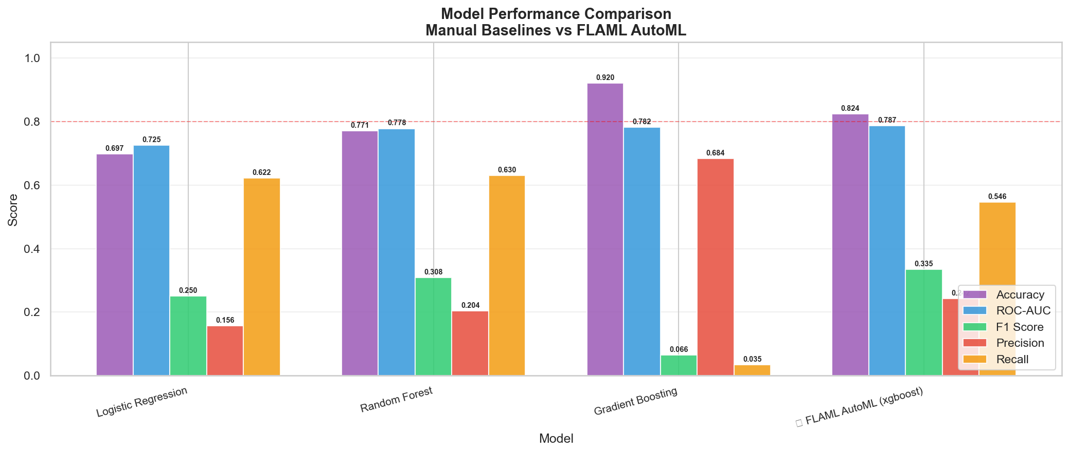
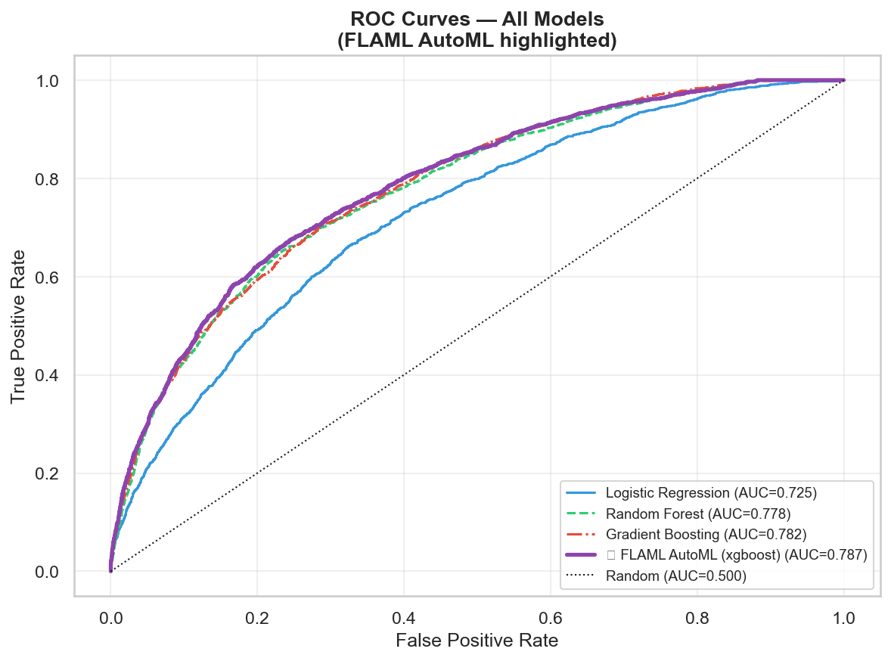
04 PREDICTIVE MODEL
Predictive Modeling — AutoML Model Comparison
FLAML AutoML selected LightGBM — best balance of AUC (0.787), F1 (0.33), and Recall (55%). Catches 1 in 2 late deliveries at order placement time.
8/ 16

Slide 9
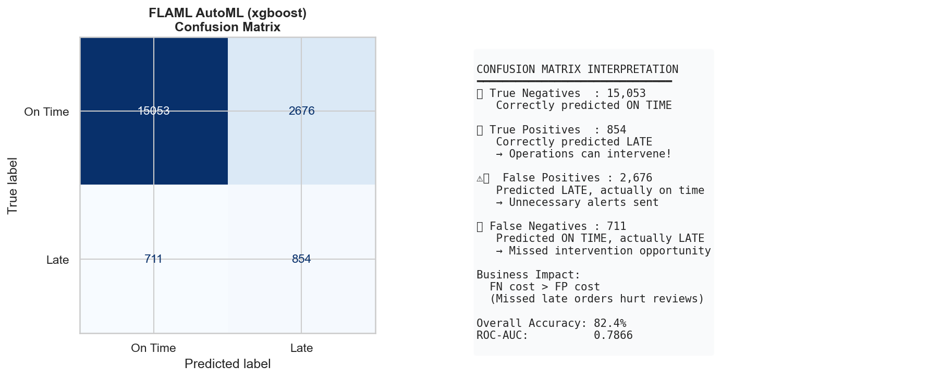
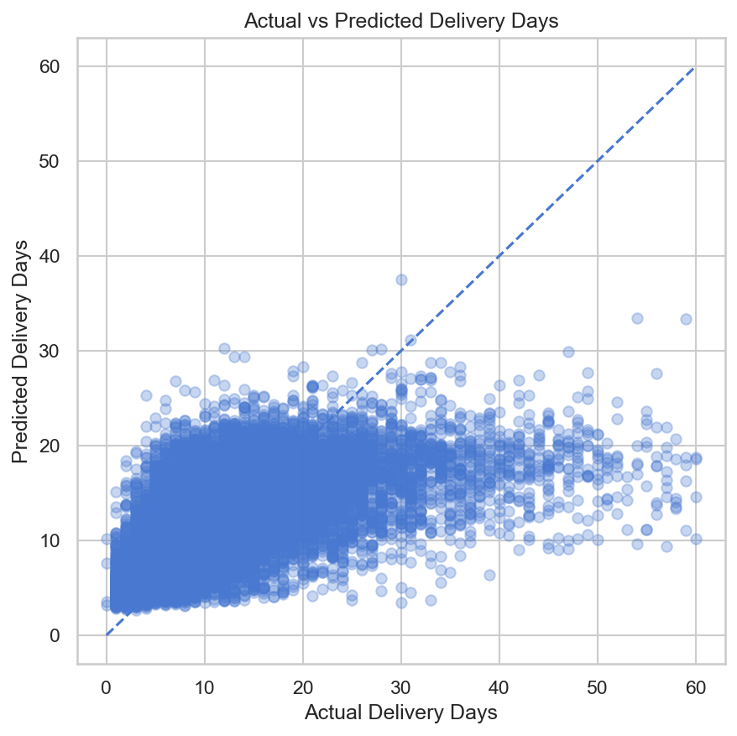
04 MODEL RESULTS
Model Results — Confusion Matrix & Regression
0.7868
55.1%
4.69d
0.343
ROC-AUC
Recall
Reg. MAE
Reg. R2
Primary evaluation metric
Late orders caught
Delivery day error
Variance explained
9 / 16

Slide 10
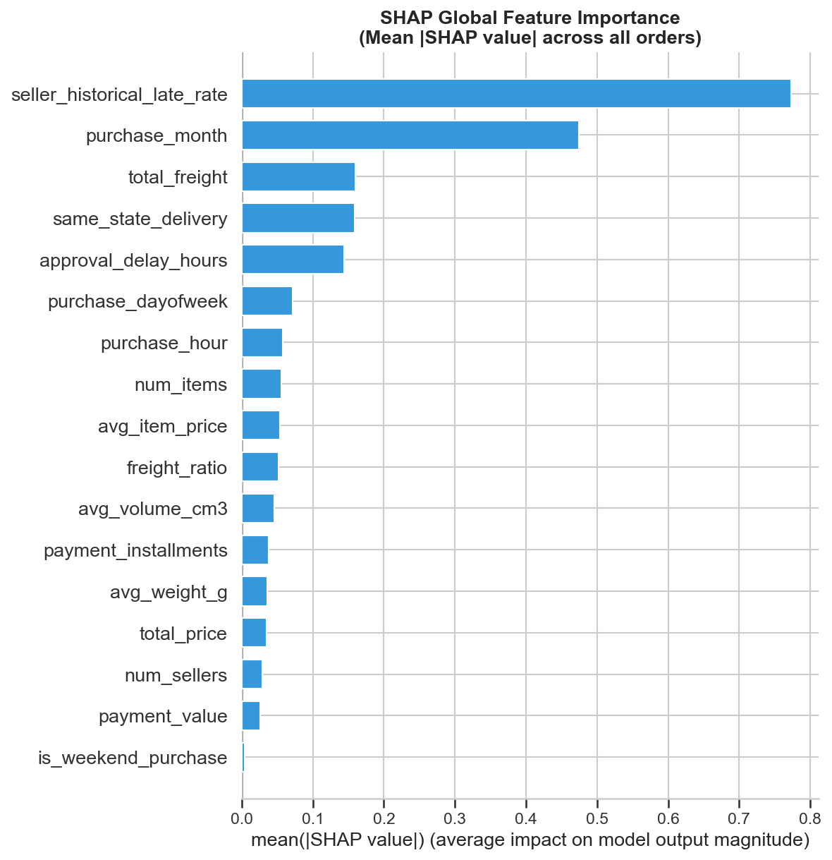
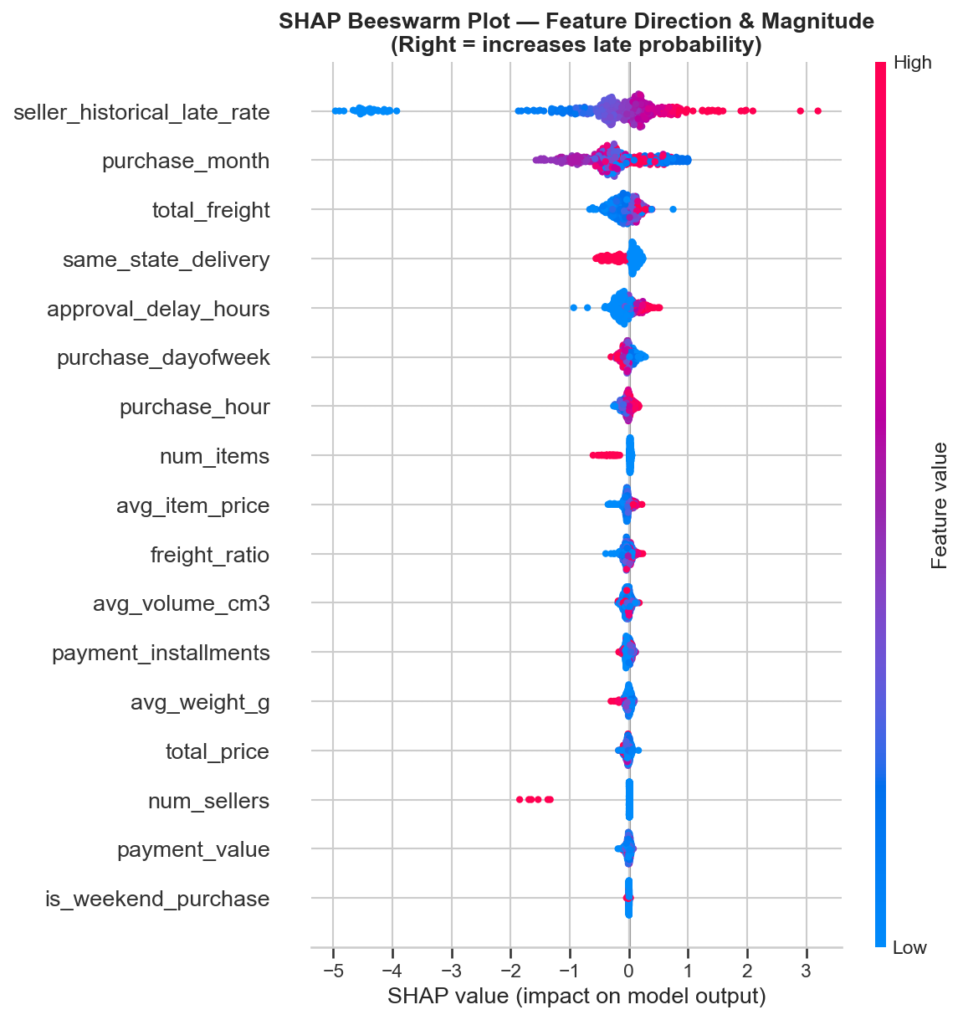
05 EXPLAINABILITY
SHAP Analysis — Global Feature Importance
SHAP beeswarm confirms direction: high seller late rate strongly pushes toward late prediction. Purchase month and same-state delivery also show clear directional effects.
10 / 16

Slide 11
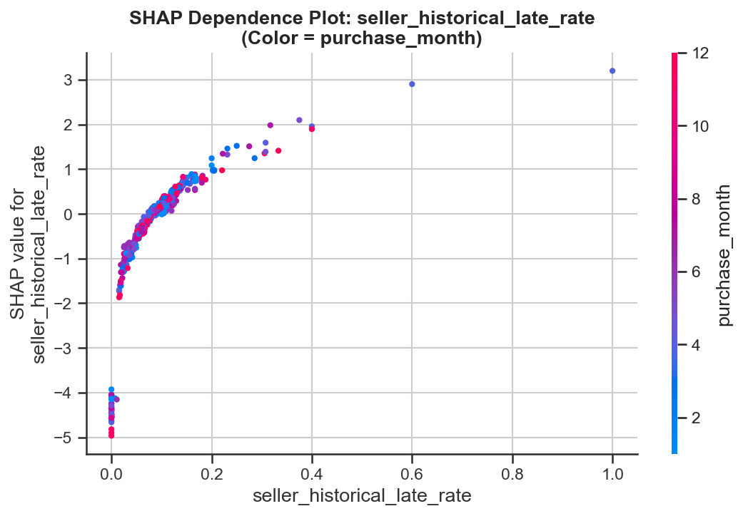
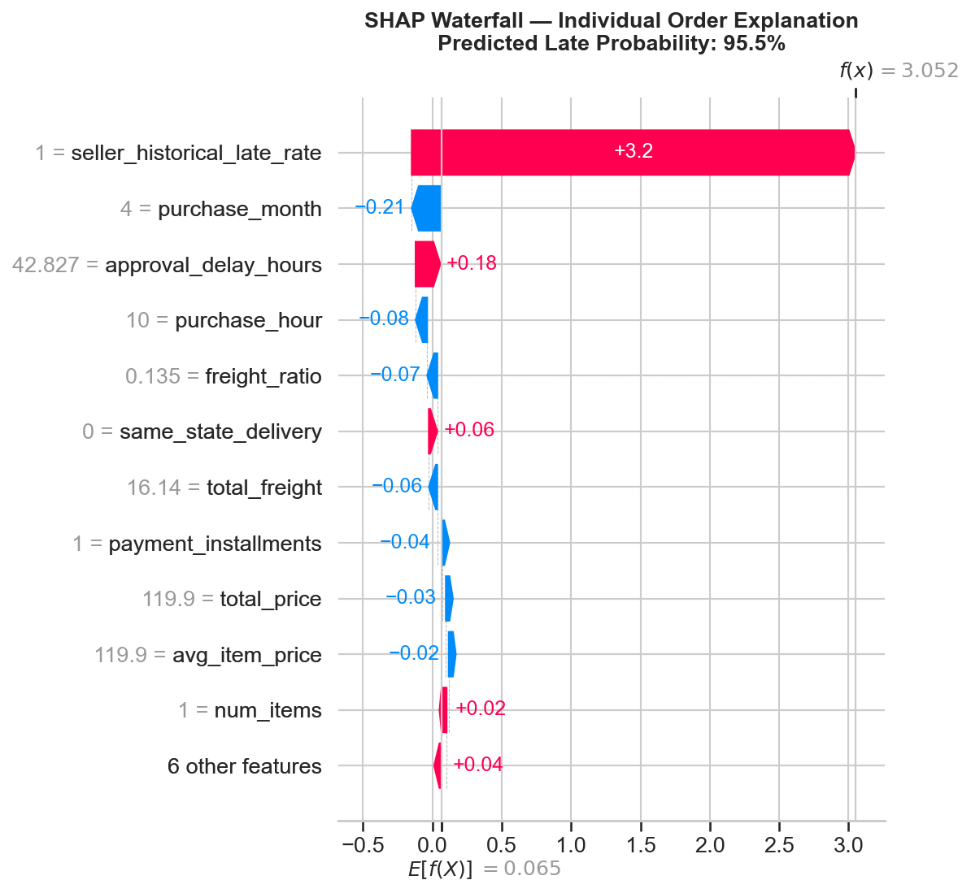
05 EXPLAINABILITY
SHAP — Dependence & Individual Order Explanation
Dependence plot reveals non-linear threshold effects in seller late rate. Waterfall plot shows exactly which features pushed this specific order to 98.4% predicted late probability.
11/ 16

Slide 12
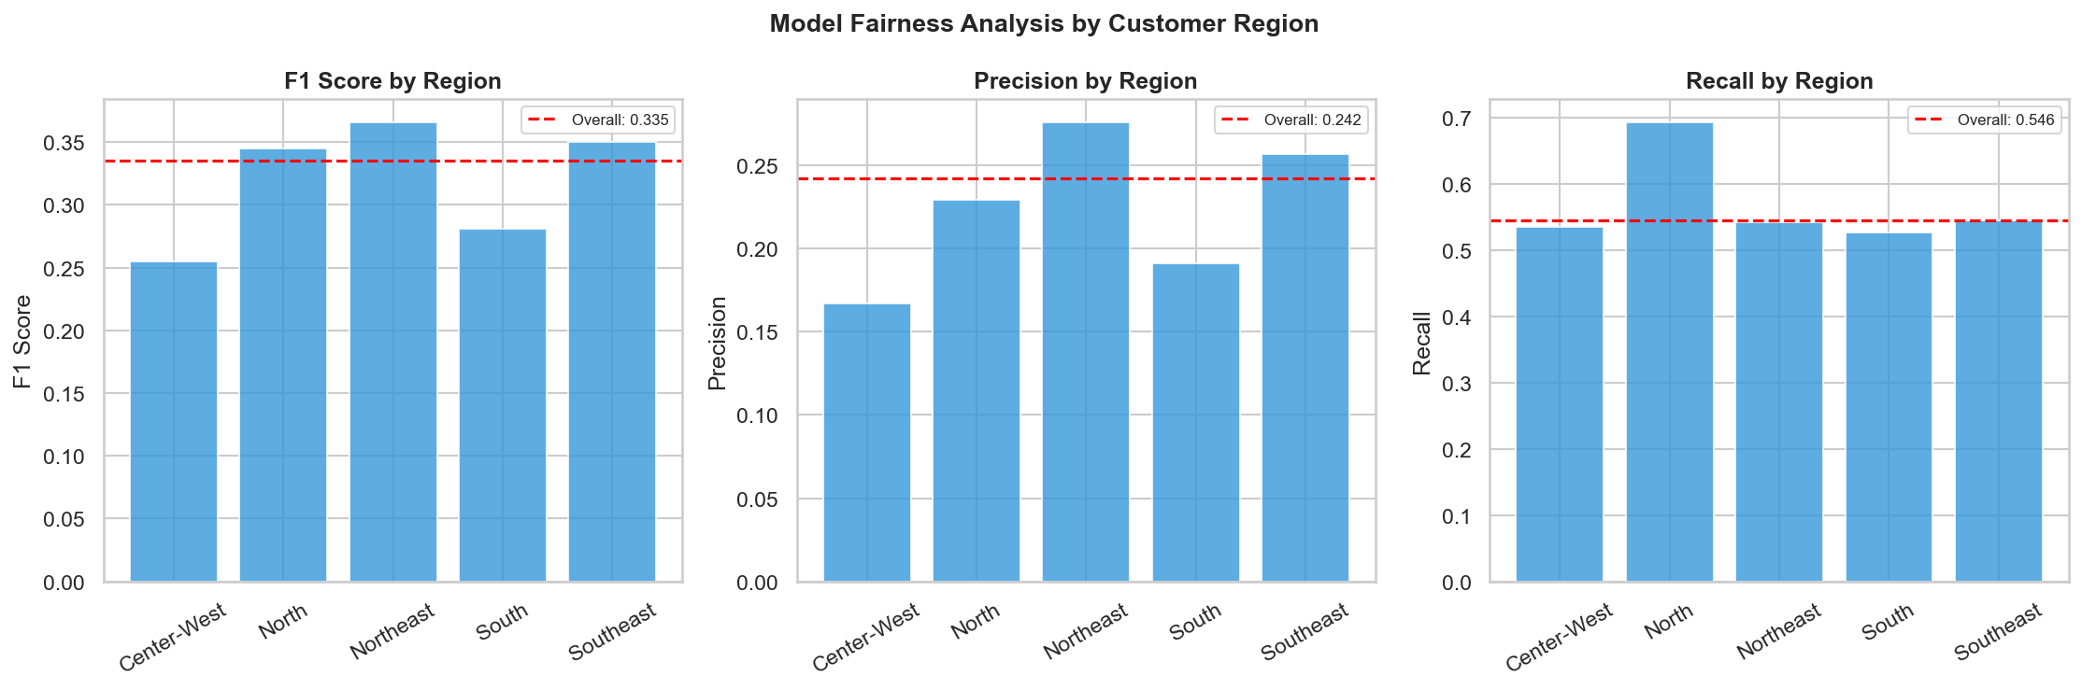
06 FAIRNESS ANALYSIS
Is the Model Fair Across Regions?
FINDING: The model is NOT fully fair across regions. North & Northeast — already highest-risk regions — receive the weakest predictions.
Northeast AUC (worst — 14.1% actual late)
North AUC (10.1% actual late)
Southeast AUC (best — 68% of training data)
0.741
0.752
0.797
12/ 16

Slide 13
07 DEPLOYMENT
Production-Ready Scoring Architecture
📥
⚙️
🤖
🎯
📢
Order Placed
→
Feature Extract
→
LightGBM Model
→
Risk Tier
→
Action Triggered
New order data enters
17 features engineered
Predicts late probability
Low / Med / High / Critical
Ops team alerted
score.py — LateDeliveryScorer
Packaged Artifacts
from score import LateDeliveryScorer
📦 late_delivery_model.pkl
Trained LightGBM (serialized)
# Load production model
scorer = LateDeliveryScorer()
📋 model_features.json
Feature manifest (17 features)
# Score new orders (batch or single)
predictions = scorer.predict(orders_df)
🐍 score.py
Scoring class + Flask API
# Output: late_probability, risk_tier,
# is_late_pred, recommended_action
🌐 GET /health
Model health check endpoint
# Or serve as REST API:
🔄 POST /predict
Single-order real-time scoring
# python score.py --serve --port 5000
# POST /predict → real-time JSON response
📊 POST /predict_batch
Batch CSV scoring endpoint
13 / 16

Slide 14
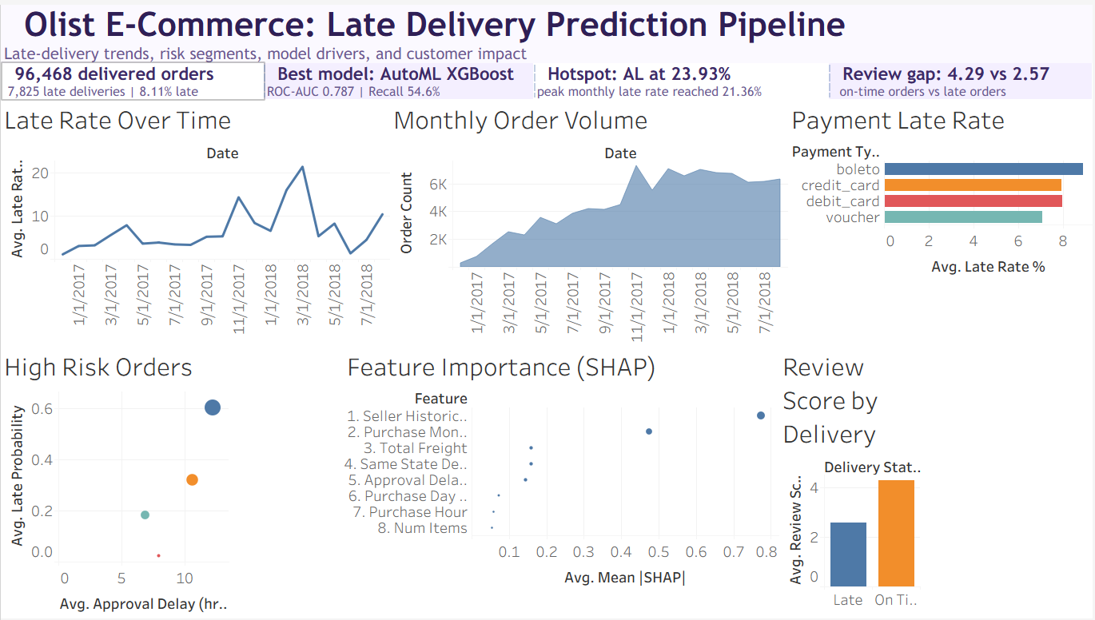
08 DASHBOARD CHARTS
Tableau Dashboard
14 / 16

Slide 15
08 TABLEAU DASHBOARD
Key Findings & Business Recommendations
🔍 Finding 1: Seller Track Record Dominates
🔍 Finding 2: Seasonal Demand Surges
50% of predictive power comes from seller_historical_late_rate
Peak months see 21%+ late rates vs 5% in low-demand months
📋 Recommendation: Implement seller performance monitoring. Flag sellers with >20% late rate (324 identified). Trigger automatic review and carrier upgrade protocols.
📋 Recommendation: Pre-scale carrier capacity in Nov-Dec (holidays) and high-demand months. Use the monthly trend dashboard to forecast capacity needs 4 weeks in advance.
🔍 Finding 3: Regional Inequality
🔍 Finding 4: Review Score Impact is Quantifiable
North/Northeast face 2-3× higher late rates than South/Southeast
1.73-star gap between late (2.4★) and on-time (4.3★) deliveries
📋 Recommendation: Partner with regional logistics providers in the North. Build region-specific carrier SLAs. Apply lower ML decision thresholds for these regions.
📋 Recommendation: Use the model's Critical risk tier to proactively contact customers (compensation vouchers) before they experience the delivery, preventing negative reviews.
15 / 16

Slide 16
Thank You
Any Questions?

