Slide 1
Predicting Bleeding Risk in ICU Patients Receiving Intravenous Heparin: A Machine Learning Approach for Early, Explainable, and Actionable Intervention
Alanoud Abdulaziz AL Turki

Slide 2
Introduction – Clinical Challenge & Need
Heparin is essential for ICU anticoagulation but carries a high risk of bleeding complications.
Clinical Challenge: Balancing anticoagulation and hemorrhage risk remains difficult.
Current Limitations: aPTT monitoring is reactive and lacks individualization.
Need: A real-time, patient-specific prediction model using EHR data.

Slide 3
Introduction – Motivation & Study Aim
Why?
Bleeding leads to longer ICU stays, higher costs, and worse outcomes.
MIMIC-IV enables modeling of labs, vitals, and interventions.
Prior studies focused on dosing/ anticoagulation response — not direct bleeding prediction.
Study Aim:
To develop and validate a machine learning model that predicts risk of bleeding within 48 hours of IV heparin using features from ICU EHR data.

Slide 4
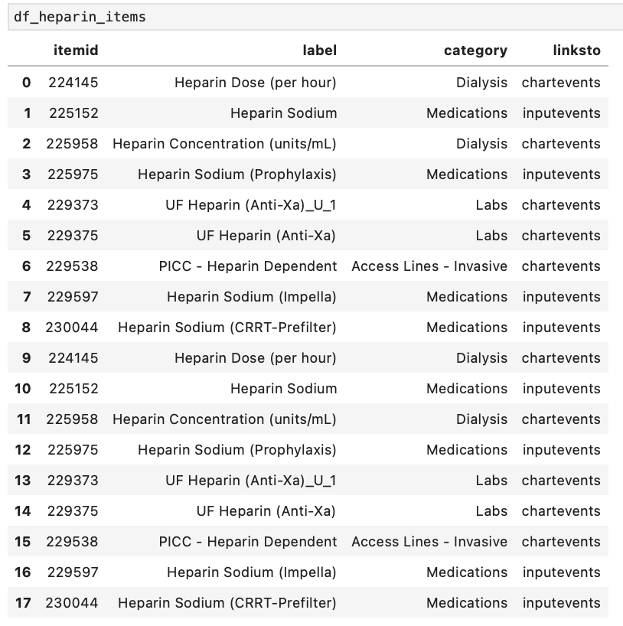
Methods - Data Source & Cohort Definition
Database: MIMIC-IV v3.1 (Johnson et al., 2023)
Cohort: Adult ICU patients receiving IV /Systemic heparin
Inclusion Criteria:
Heparin item IDs: 225152, 225975

Slide 5
Methods - Outcome Definition
Primary Outcome: Binary indicator of bleeding risk within 48 hrs.
Criteria (any met = Bleeding Event start):
Hgb ↓ ≥ 2 g/dL
Hct ↓ ≥ 6%
INR ≥ 3.0
aPTT ≥ 80 sec
Anti-Xa ≥ 1.0 IU/mL

Slide 6
Observation Window 48 or 72?

Slide 7
Observation Window 48 or 72?
Period After Heparin Initiation | Frequency of Bleeding | Findings
Within first 24 hours | 15–30% of cases | Rapid onset within 1 hr. due to immediate anticoagulant effect. High-risk patients (e.g., post-op, renal dysfunction) may bleed early.
Days 1–3 (Early Bleeding Window) | 30–50% of cases | Most common window. Peak risk in ICU and ward patients. Anti-Xa and aPTT levels are often therapeutic or high.
Median Time to First Bleed | 3–4 days (general) / (ICU/COVID) | Depends on patient group. ICU/COVID patients experience later bleeding due to prolonged exposure and systemic inflammation.

Slide 8
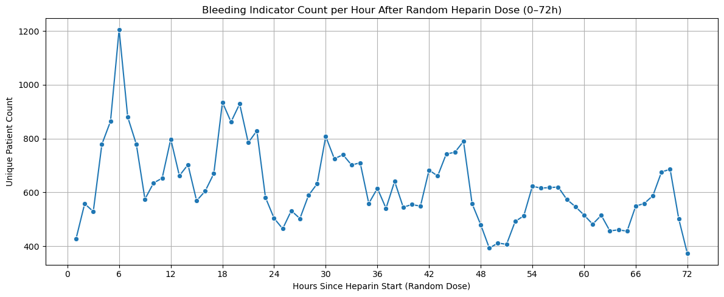

Slide 9
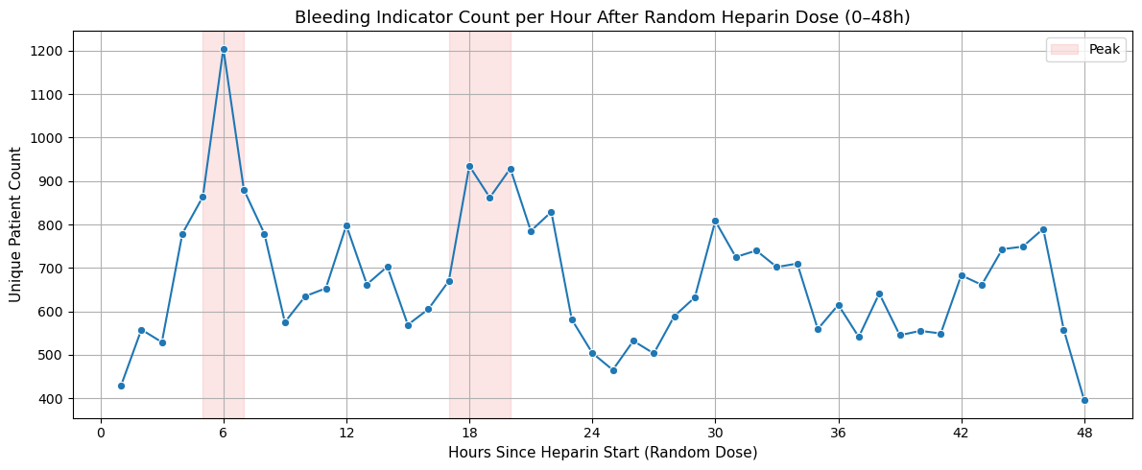
Methods - Outcome Definition

Slide 10
Observation Window 48 or 72?
Observation Window: 48 hours post heparin_start
Majority of events occurring between 6 - 48 hours post-administration.
Strong predictive performance.

Slide 11
Methods - Outcome
Full cohort Size: 1,197,966 encounters
Bleeding Event: 686,682 (57.3%)
No Bleeding Event : 511,284 (42.7%)
One random encounter per patient was sampled : 24738 dose

Slide 12
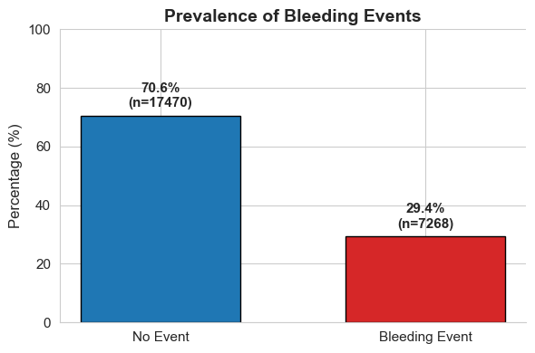
Methods - Outcome Definition

Slide 13
Methods - Feature Engineering
Feature Group | Details | Aggregation / Notes
Demographics | Gender, race, admission type, age | One-hot encoded ; Age discarded by decade
Comorbidities | ICD codes: Liver (K70–K74), Renal (N17–N18), Coagulopathy (D65–D69), Cancer (C00–C80), HTN (I10–I15) | Binary flags by 3-digit ICD prefix
Lab Values | Platelets, BUN, Creatinine, Sodium, Potassium, PT, Fibrinogen, Albumin, etc. | Aggregated using mean, min, max, std; within 48h window
Vitals | HR, SBP, DBP, RR, O₂Sat, Temp | Aggregated using mean, min, max, std; from chartevents
Medications | Warfarin, aspirin, clopidogrel, enoxaparin, apixaban, thrombolytics | Binary exposure indicators from prescriptions
Procedures | Any procedure within 48h of heparin_start | Binary flag had_surgery from procedureevents
Interaction Terms | BUN×Creatinine, Sodium×Potassium, amount×rate, Renal×Creatinine | Created based on clinical relevance and SHAP
Ratios | BUN_to_Creatinine, Sodium_to_Potassium | Derived from corresponding lab values

Slide 14

Methods - Missing Data & Preprocessing
Multiple Imputation:
IterativeImputer (Bayesian Ridge, 10 iterations)

Slide 15
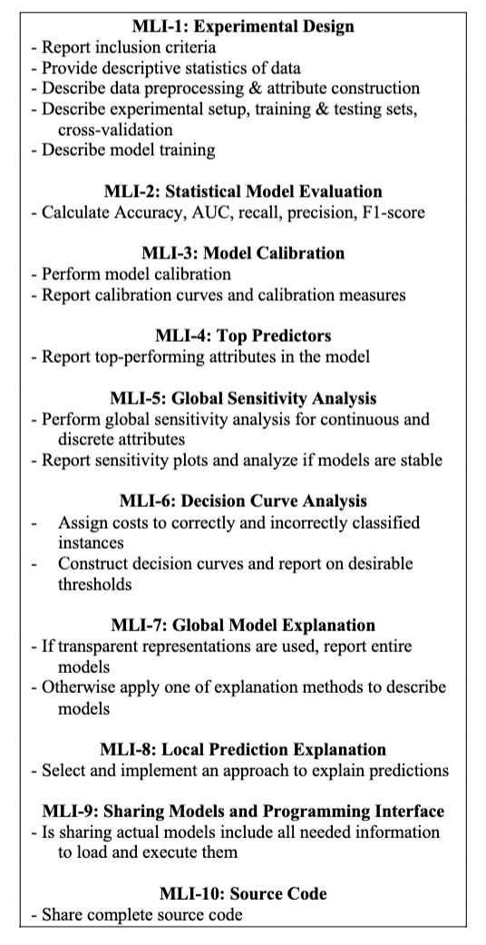
Methods
Structured Model Development and Evaluation Using the MLI Checklist (Wojtusiak, 2021)
Wojtusiak, J. (2021). Reproducibility, transparency and evaluation of machine learning in health applications. In Proceedings of the 14th International Joint Conference on Biomedical Engineering Systems and Technologies (HEALTHINF 2021) (pp. 713–720).

Slide 16
Methods – Experimental Design
Objective: Develop machine learning model to predict bleeding risk Event within 48 hours of IV heparin administration in ICU patients.
Steps:
Data Split: 80/20 stratified sampling (training/testing).
Preprocessing:
StandardScaler applied to continuous features.
Excluded identifiers and non-predictive metadata.
Classifiers Evaluated:
Logistic Regression
Random Forest
Gradient Boosting Machine
XGBoost
LightGBM
Hyperparameter Tuning:
GridSearchCV (5-fold) optimizing ROC-AUC
Parallel processing for efficiency

Slide 17
Methods - Statistical Model Evaluation
Model | ROC-AUC | Accuracy | F1 Score | Sensitivity | Specificity | Best Parameters
LightGBM | 0.905 | 0.847 | 0.719 | 0.668 | 0.921 | {'learning_rate': 0.1, 'max_depth': 5, 'n_estimators': 100, 'subsample': 0.8}
XGBoost | 0.905 | 0.848 | 0.721 | 0.671 | 0.921 | {'learning_rate': 0.1, 'max_depth': 5, 'n_estimators': 100, 'subsample': 0.8}
GBM | 0.904 | 0.848 | 0.720 | 0.667 | 0.923 | {'learning_rate': 0.1, 'max_depth': 3, 'n_estimators': 200}
Random Forest | 0.891 | 0.838 | 0.693 | 0.624 | 0.926 | {'max_depth': 10, 'n_estimators': 200}
Logistic Reg. | 0.888 | 0.834 | 0.686 | 0.618 | 0.924 | {'C': 0.1, 'penalty': 'l2', 'solver': 'liblinear'}
LightGBM and XGBoost outperformed other models in AUC and overall balance.

Slide 18
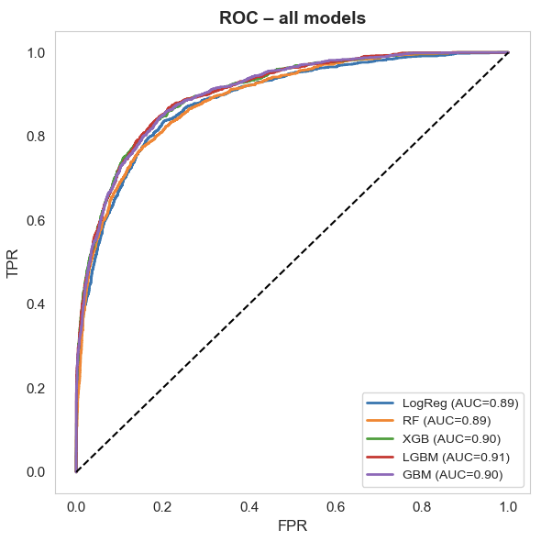
Methods - ROC Curve
ROC Curve :
LightGBM and XGBoost achieved highest AUC
Strong separation between bleeding vs. non-bleeding

Slide 19
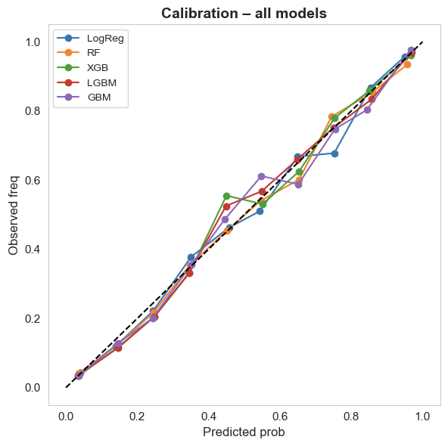
Methods - Model Calibration
Calibration Curve:
LightGBM and GBM had best probability calibration
Predicted probabilities closely matched observed outcomes

Slide 20
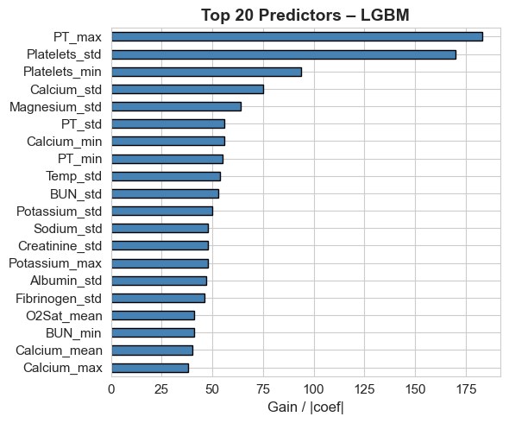
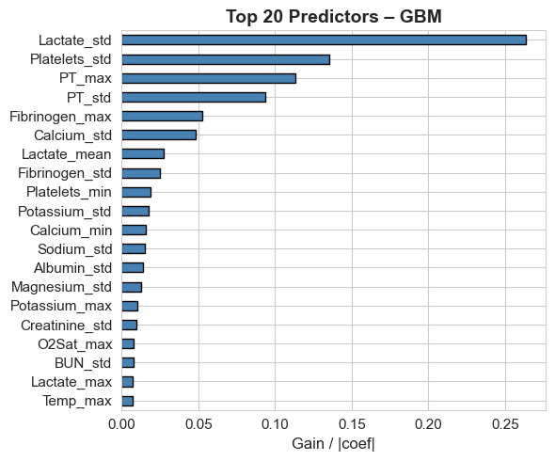
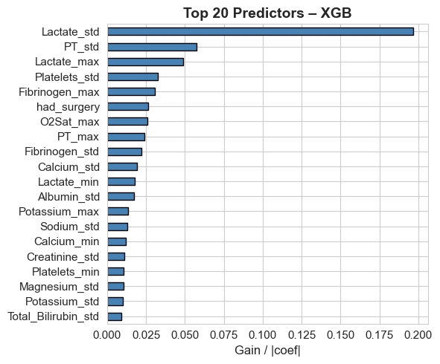
Methods - Top Predictors

Slide 21
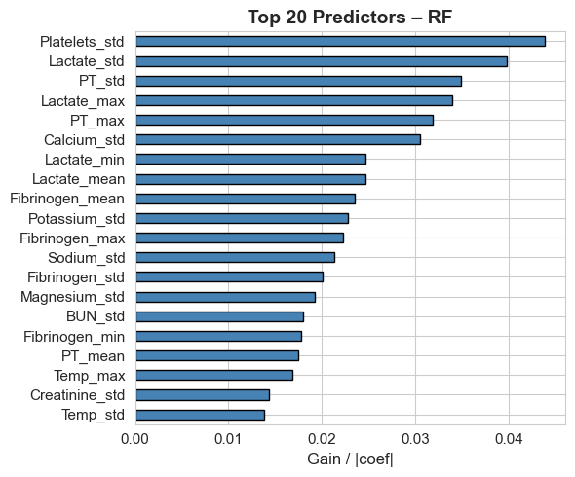
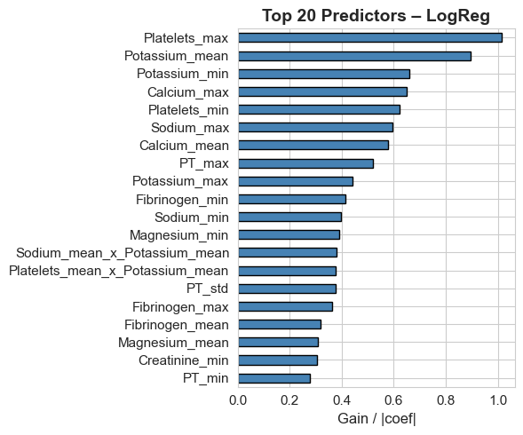
Methods - Top Predictors

Slide 22
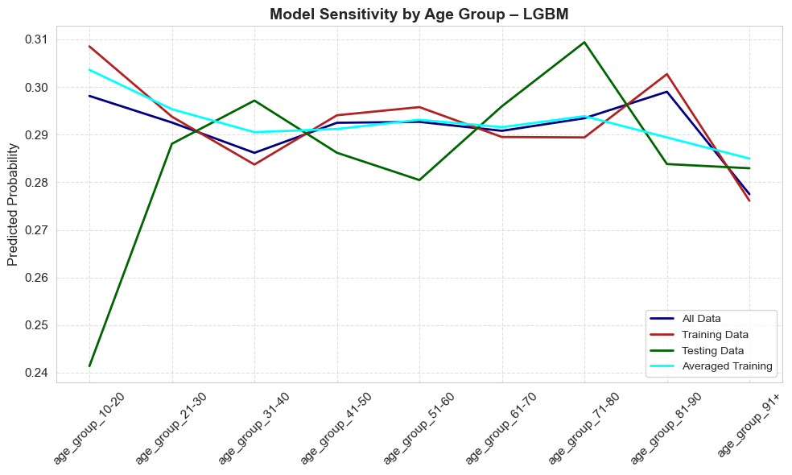
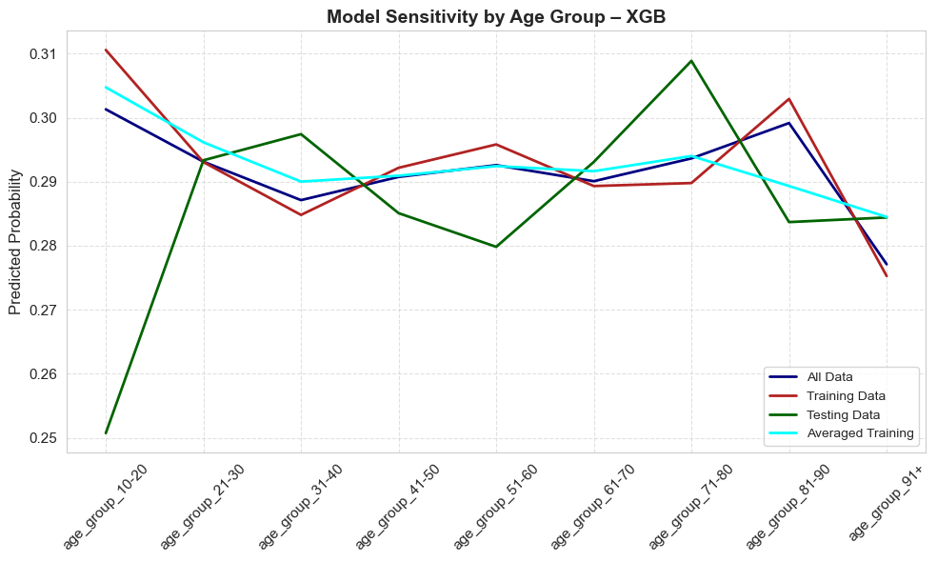
Methods - Global Sensitivity Analysis

Slide 23
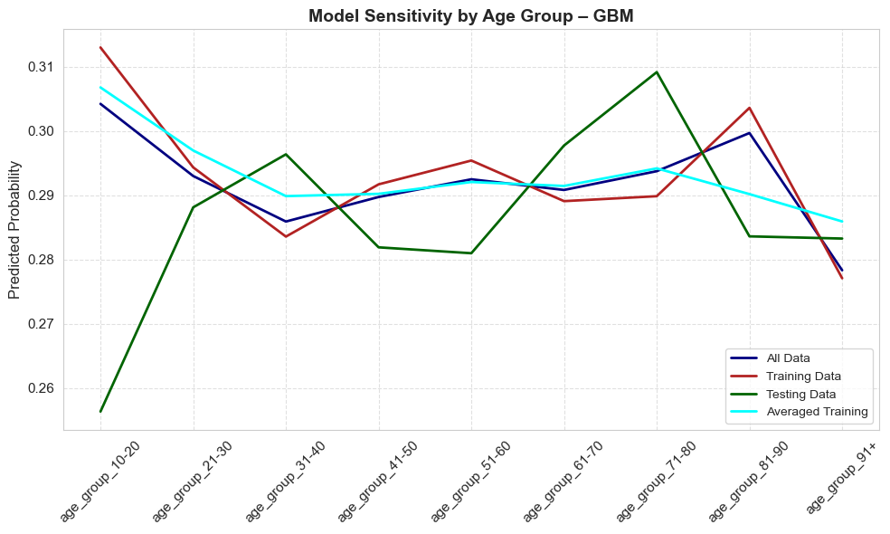
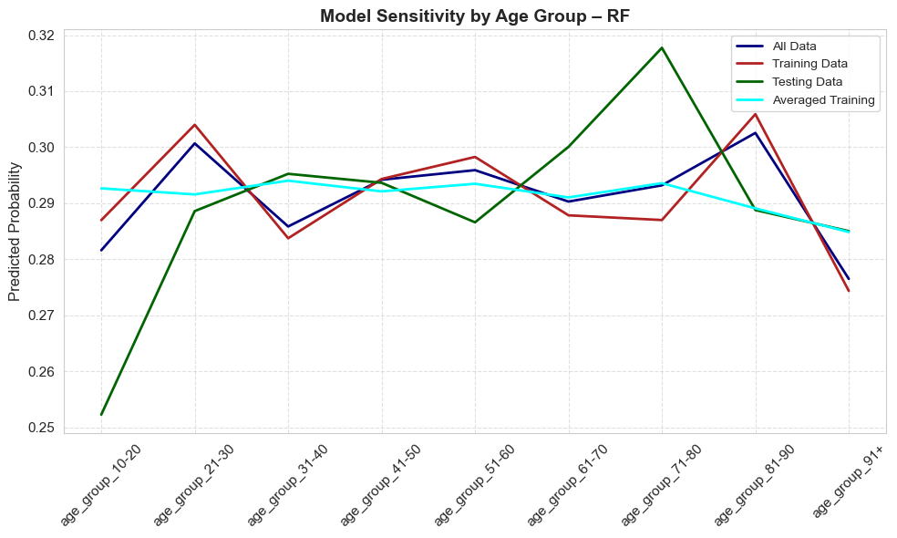
Methods - Global Sensitivity Analysis

Slide 24
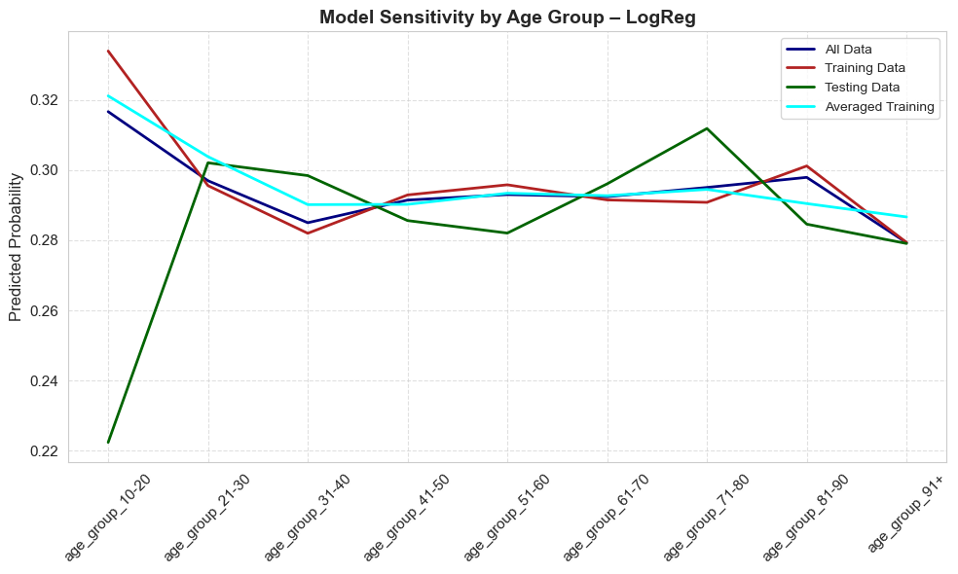
Methods - Global Sensitivity Analysis

Slide 25
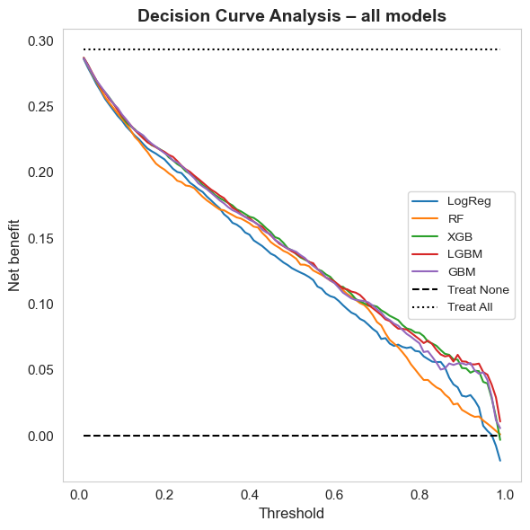
Methods - Decision Curve Analysis
GBM and LGBM models provide the highest net clinical benefit across most threshold probabilities, indicating superior decision support for identifying patients at bleeding risk.

Slide 26
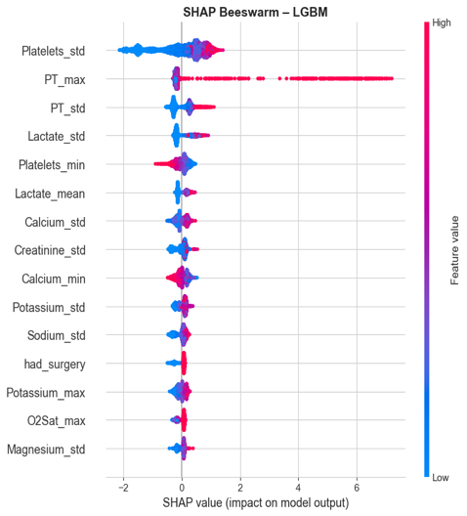
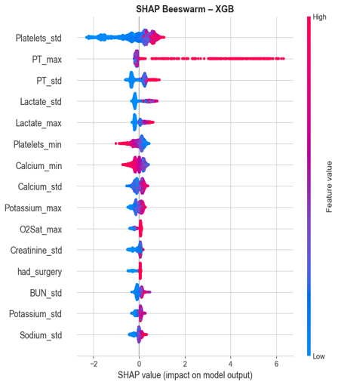
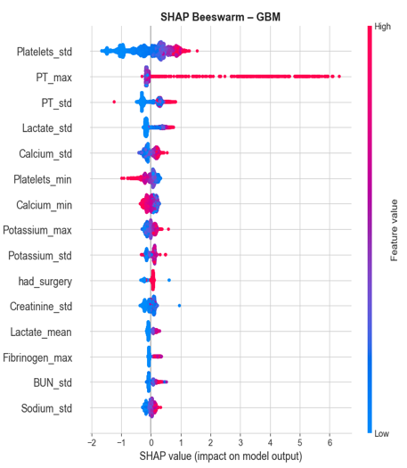
Methods - Global Model Explanation-SHAP-Based Interpretability

Slide 27
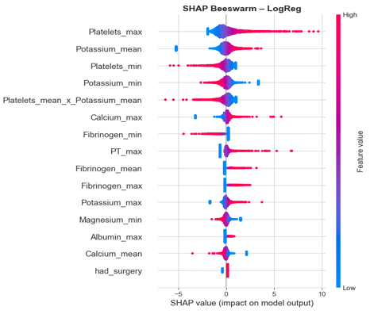
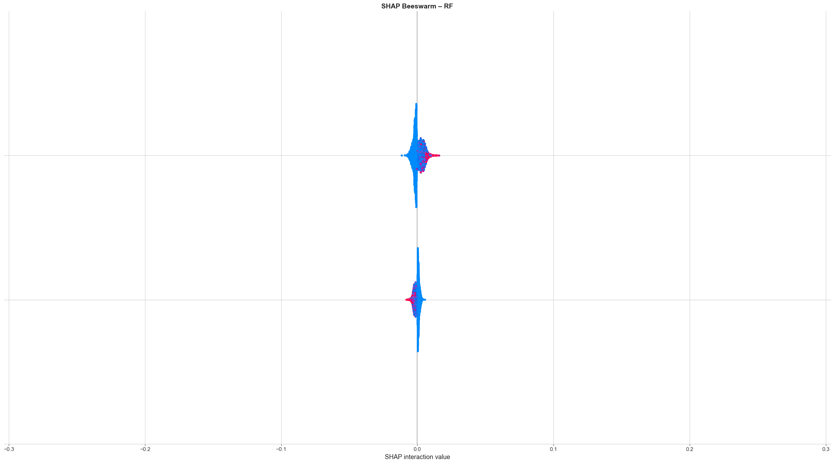
Methods – Global Model Explanation -SHAP Based Interpretability

Slide 28
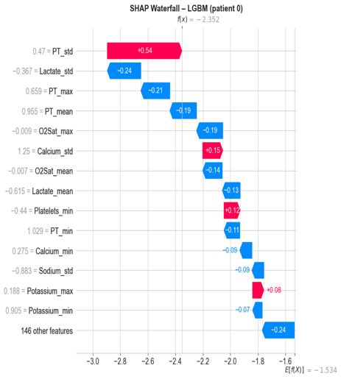
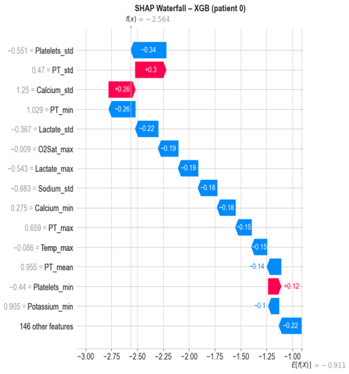
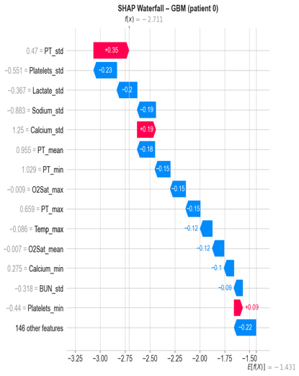
Methods - Local Prediction Explanation-SHAP Waterfall Plot for a High-Risk ICU Patient

Slide 29
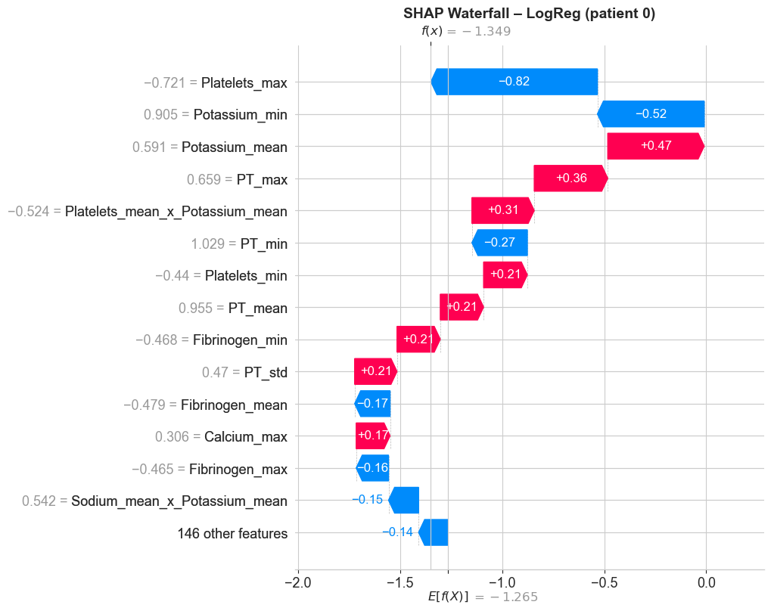
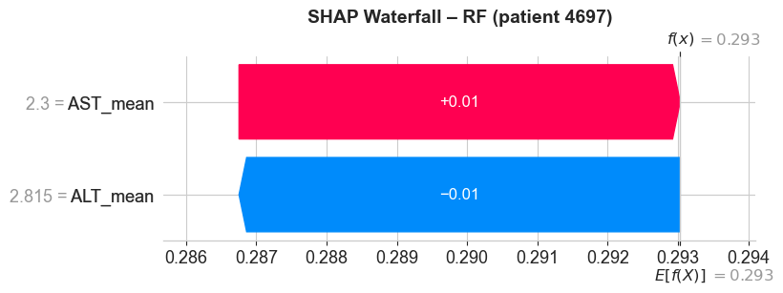
Methods - Local Prediction Explanation-SHAP Waterfall Plot for a High-Risk ICU Patient

Slide 30
Methods - Clinical Threshold Optimization & Alert Burden
Threshold Methods:
Fixed Threshold (0.05): High sensitivity, cause high alert fatigue
Optimized Threshold (Youden J): Better balance of sensitivity/specificity
Model | Threshold | Flagged Patients | False Positives | True Positives | False Negatives | True Negatives | Sensitivity | Precision | Specificity
XGB | 0.05 | 3467 | 2044 | 1423 | 30 | 1451 | 0.979 | 0.410 | 0.415
 | 0.29 | 1777 | 596 | 1181 | 272 | 2899 | 0.813 | 0.665 | 0.829
LGBM | 0.05 | 3450 | 2030 | 1420 | 33 | 1465 | 0.977 | 0.412 | 0.419
 | 0.28 | 1803 | 619 | 1184 | 269 | 2876 | 0.815 | 0.657 | 0.823
GBM | 0.05 | 3548 | 2124 | 1424 | 29 | 1371 | 0.980 | 0.401 | 0.392
 | 0.26 | 1846 | 650 | 1196 | 257 | 2845 | 0.823 | 0.648 | 0.814
RF | 0.05 | 4186 | 2743 | 1443 | 10 | 752 | 0.993 | 0.345 | 0.215
 | 0.34 | 1846 | 666 | 1180 | 273 | 2829 | 0.812 | 0.639 | 0.809
LogReg | 0.05 | 4006 | 2573 | 1433 | 20 | 922 | 0.986 | 0.358 | 0.264
 | 0.24 | 1772 | 603 | 1169 | 284 | 2892 | 0.805 | 0.660 | 0.827
Clinical Alert Flowchart:
Model Prediction ≥ 0.34 →
Trigger ICU Alert →
Clinical Action Prompted:
Review labs & vitals
Reassess heparin dosing
Consider additional monitoring or consult
Document in EHR
Conclusion: Optimized threshold reduces false positives ~60-70%.
Notes:
Clinical Alert Flowchart:
Model Prediction ≥ 0.34 →
Trigger ICU Alert →
Clinical Action Prompted:
Review labs & vitals
Reassess heparin dosing
Consider additional monitoring or consult
Document in EHR

Slide 31
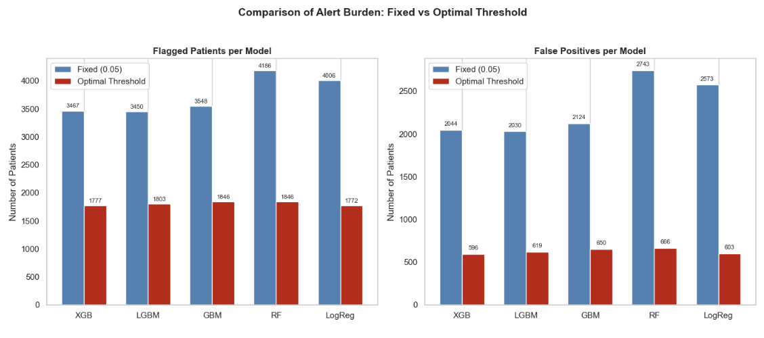
Methods - Clinical Threshold Optimization & Alert Burden

Slide 32
Clinical Deployment Recommendation
Scenario | Preferred Model | Threshold Strategy | Justification
Early Warning (safety-focused) | Random Forest | Fixed (0.05) | Maximizes sensitivity (>99%) to catch all bleeding risks. Accepts more false positives for safety.
Balanced Alerting (ICU CDS tool) | LightGBM / XGBoost | Optimized (Youden J) | Balances high sensitivity and specificity. Reduces alert burden—ideal for CDS tools.
Simple Model, High Interpretability | Logistic Regression | Optimized (Youden J) | Provides clear, interpretable results—ideal for clinical, documentation, and settings where decision transparency is essential

Slide 33
Conclusion and Future Directions
Conclusion:
ML models accurately predict bleeding risk within 48h post-heparin
LGBM/XGB are optimal for deployment
Future Work:
Prospective validation in real ICU settings
Integration with clinical decision systems

Slide 34
Thank you

