Slide 1
WIZARD: A Comprehensive Data Sanitization Tool Implementing a 3-Pass Gutmann Algorithm
GITHUB REPO: https://github.com/Alanperry1/WIZARD
NB: This project is intended for educational purposes only. I disclaim any responsibility for the unethical use of this tool.

Slide 2

DATA SANITIZATION
Data Sanitization is the process of securely erasing data from storage devices to ensure it cannot be recovered or accessed.
Methods of data sanitization include:
Overwriting (Logical Sanitization)
Cryptographic Erasure
Physical Destruction
In this project, we will focus on Logical Sanitization. Logical sanitization involves three main algorithms used for secure data wiping. These are:
Gutmann Algorithm
DoD 5220.22-M
NIST Special Publication 800-88
Data sanitization and normal formatting differ in their purpose and effectiveness. Data sanitization securely erases all data, making it irretrievable by any means.
In contrast, normal formatting simply removes references to the data, making it inaccessible but not securely erased. This means the data can still be recovered with specialized tools.

Slide 3
THE GUTMANN ALGORITHM
The Gutmann Algorithm is a data sanitization method designed to securely erase data from magnetic storage devices, ensuring that it cannot be recovered using advanced forensic tools. Developed by Peter Gutmann in 1996, this algorithm employs multiple passes of overwriting with specific patterns to obscure the original data.
Let’s see how it performs the sanitization process:
The algorithm performs 35 overwriting passes. Each pass uses different data patterns to maximize the chances of overwriting the physical remnants of the original data. The patterns are chosen based on the recording techniques of older magnetic storage technologies.
Initially designed for magnetic hard drives, the algorithm's efficacy is less critical for modern solid-state drives (SSDs) but still ensures comprehensive erasure.
With modern SSDs and flash drives, performing the full 35 passes results in an overkill process. Therefore, I optimized the process by reducing it to 3 passes and concurrently running additional operations for efficiency.

Slide 4
MODE OF OPERATION
W- Write
I- Inspect
Z- Zero
A- Analyze
R- Rewrite
D- Delete
NB: This project is designed for the Linux (Debian) file system. An alternative Windows compactible program is available in the repository (though it has not been fully tested).

Slide 5
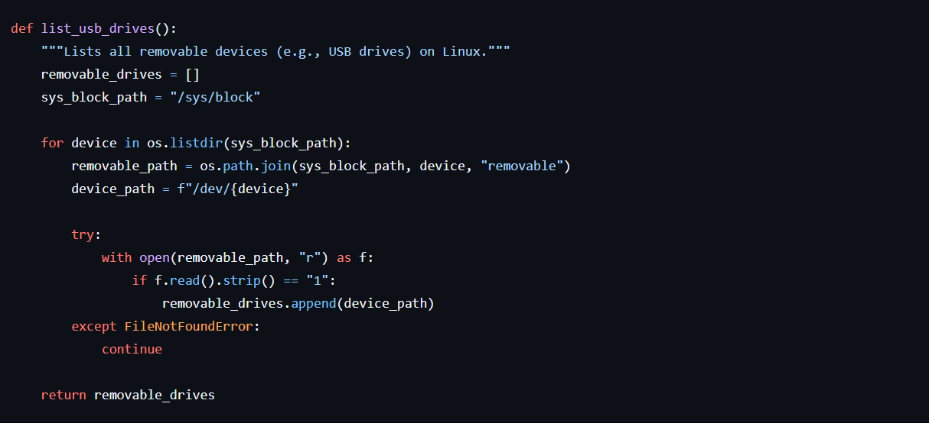
DETECTION OF REMOVABLE DRIVE(S)
The function list_usb_drives() identifies and lists all removable devices on a Linux system. It checks the /sys/block directory for devices marked as "removable" and adds their paths to a list. The function returns this list.

Slide 6
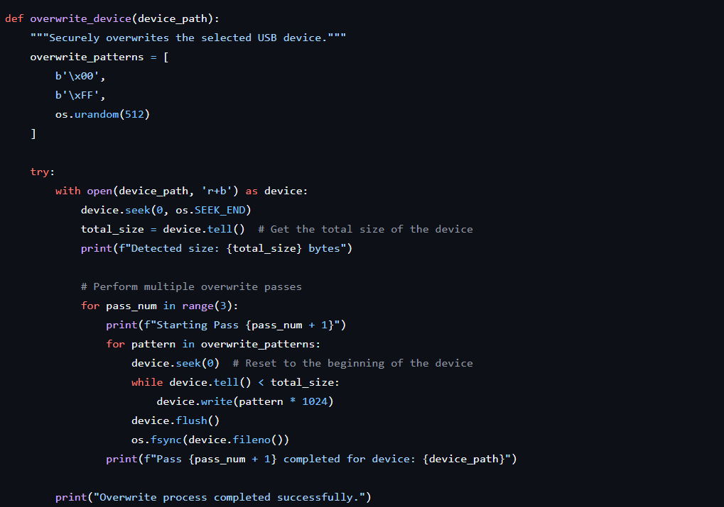
MECHANISM OF OPERATION
The overwrite_device function securely erases data on a USB device by overwriting it with different patterns. It first determines the device size, then performs three passes, each writing patterns like zeros \x00, ones \xFF, and random data to the device.

Slide 7
PROOF OF CONCEPT
This PoC aims to demonstrate the effectiveness of a data sanitization tool by combining it with FTK for disk image capture and Autopsy for forensic analysis. The goal is to verify whether data on a USB drive, after being sanitized using the tool, can be recovered using forensic tools like Autopsy.
If the sanitization tool has successfully overwritten the data, no original or recoverable data should appear during the forensic analysis. Autopsy should not find any significant remnants of the data that was originally stored on the USB drive, demonstrating that the data sanitization tool has effectively prevented data recovery.
Tools Used:
Enterro FTK Imager
Autopsy 4.21.0
1 GB Flash drive (to hasten disk image capture)

