Slide 1

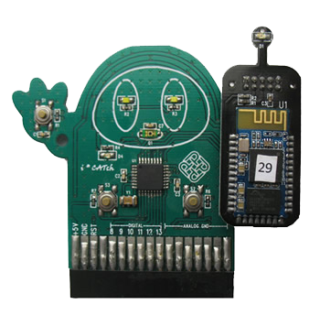

Musician Chairs
COMP 5517 Human Computer Interaction – Final Project
Subject Lecturer : Dr. Grace Ngai
Group Members : LAI Ka Man Kaman 09649980G QING Pei Edward 11500811G
TO Wai Lun Ferry 09602469G
ZHANG Yulan Elaine 11516753G

Slide 2
Agenda
Background
Interface Design
Device Feature
System Flow
State Transition Network (STN)
Hardware Specification
Software Specification (Hardware and Software)
User Feedback
Device Enhancement
Conclusion

Slide 3
Background
Our device is designed for people to enjoy music in a new way. Which is developed by iCatch toolkit for a learning room of orchestra in a music museum, users can feel the sound of different music instrument and try different combinations to feel what the sound of orchestra will looks like.

Slide 4
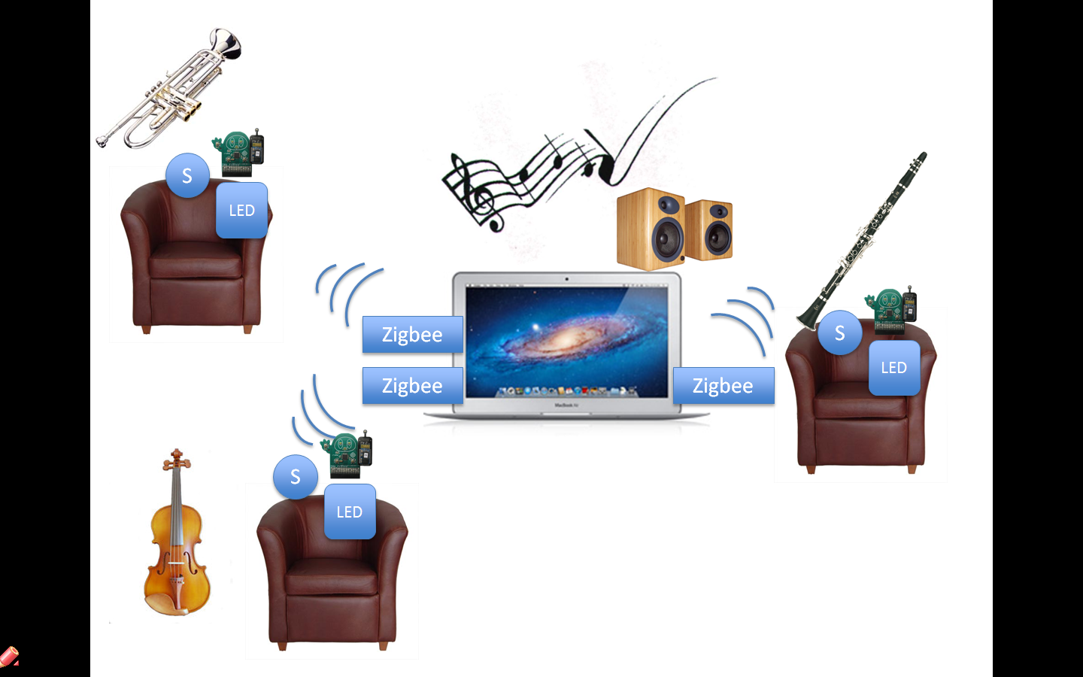
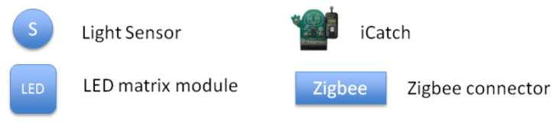
Interface Design

Slide 5
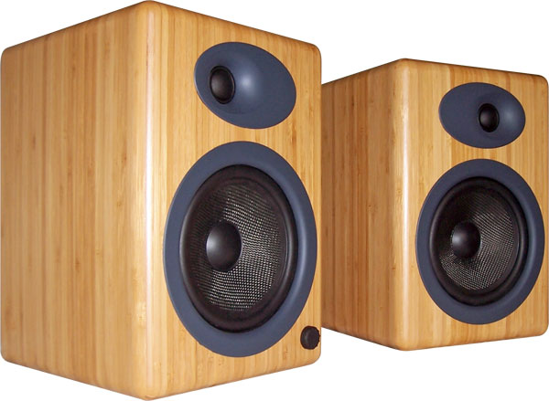
Devices Features
Voice output
Welcome greeting and briefly operating instruction in different language
English
Cantonese
Mandrian
Play different music instruments sound track

Slide 6
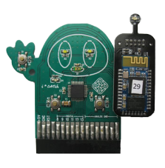
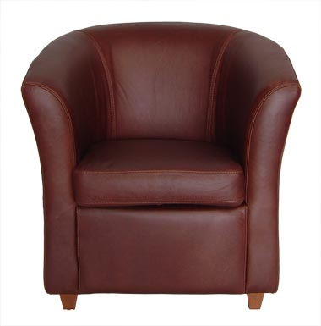
System Flow
Input
User sit down on chair
Data Transfer
Light sensor detect no more light, iCatch collects signal and transfer data to Zigee
Output
Welcome greeting and briefly operating instruction comes out
Music Sound Track(s) from speaker
Volume display from LED matrix module

Slide 7
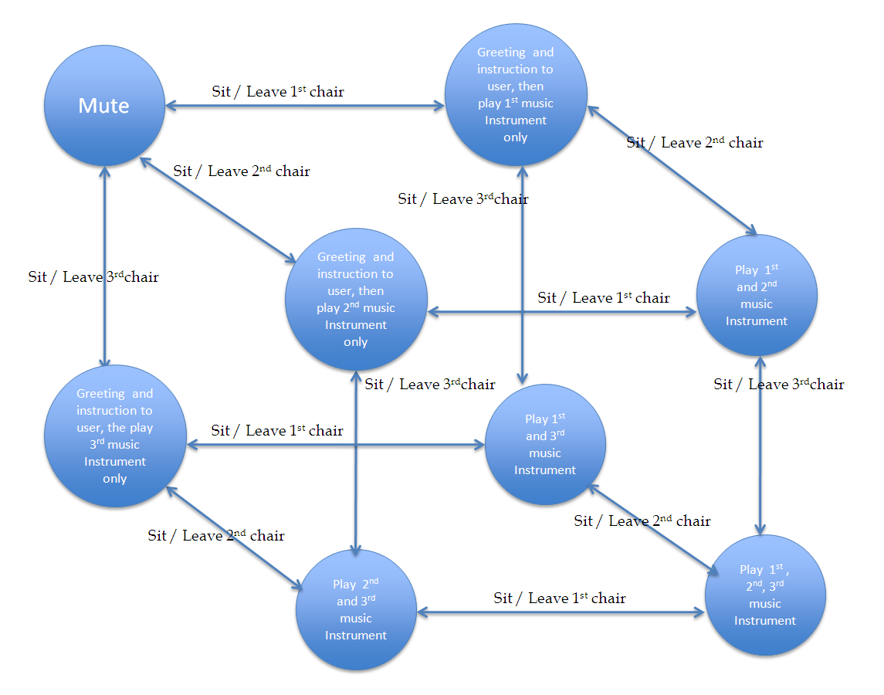
State Transition Network (STN)

Slide 8
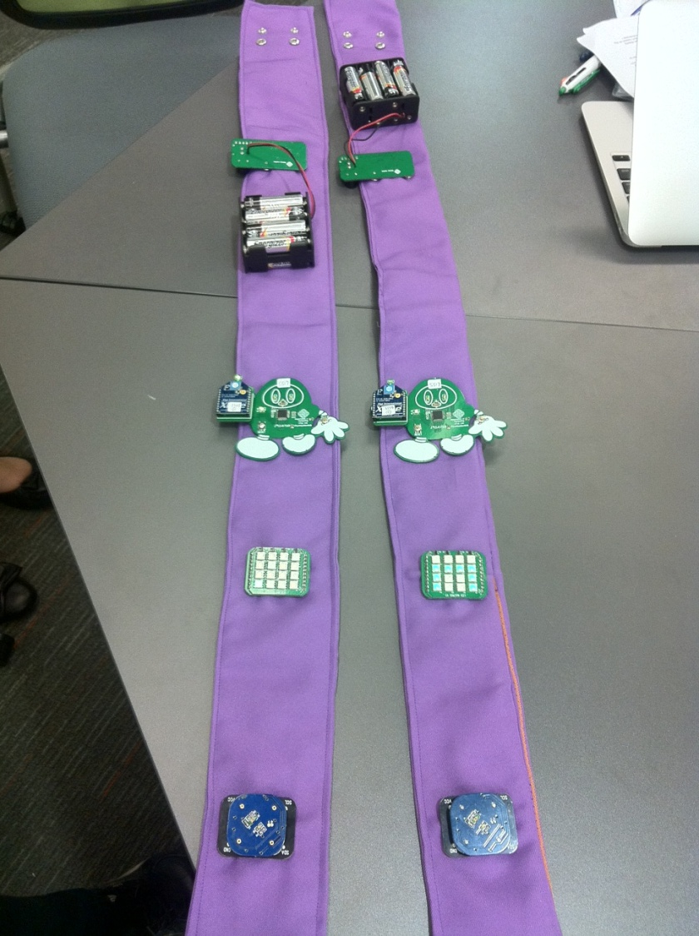
Hardware Specification
Personal Computer x 1
Zigbee connector x 3
Power supply set x 3
Light sensor x 3
LED matrix module x 3

Slide 9
Software Specification - Hardware
Java class name | Purpose
iCatchManager | To monitor all hardware network, which including iCatch, light sensor, LED matrix module and Zigbee.
iCatchManagerTask | For network communication and data transfer. Zigbee will detect and collect light sensor signal and signal strength every 2 second.
iCatchNetwork | Contain all value object

Slide 10
Software Specification - Software
Java, Java Library
For Mac OS :“say” feature
For other platform : FreeTSS Program
Java Interface name | Purpose
MyTTSEngine | It has a speak() function that to speak English, Cantonese and Mandarin language
WavPlayer | It store sound track and control the sound track to “play”, “mute”, “set volumn”, “set pan”(left or right of the speaker) and “stop”.

Slide 11
User Feedback
75% user tested the system in normal status
100% users expected the music will be stopped when they leave the chair
100% users experienced what they expected from the device
50% users feel fun ; 75% feels interesting.

Slide 12
User Feedback (cont’)
100% users think suitable for children for fun; 75% think suit for those who love music 75% think suit for education to understand different music instrument combination.
100% users express that they will use our device again and willing to recommend to others people.

Slide 13

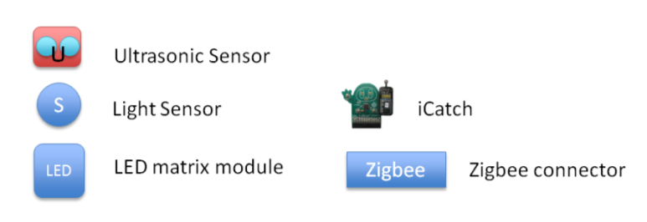
Device Enhancement
Volume Control and Sound Surrounding
Music Instrument Selection

Slide 14
Conclusion
Our device work properly in testing stage for two chairs and can be potentially developed to be for chairs as much as the user needs by simply increasing the number of music tracks and iCatch sets.
The comments form users are positive; our device ca meet our design goal and bring out an enjoyable and interesting music listening experience.

Slide 15
Q & A

Slide 16
Thank You
Enjoy our musical lab

Slide 17
Musician Chairs
COMP 5517 Human Computer Interaction – Final Project
Subject Lecturer : Dr. Grace Ngai
Group Members : LAI Ka Man Kaman 09649980G QING Pei Edward 11500811G
TO Wai Lun Ferry 09602469G
ZHANG Yulan Elaine 11516753G

Slide 18
Welcome to our Musical Lab
Please take a seat
After you sit on a chair, you can hear the welcome greeting , briefly operation instruction and music.
When you leave your chair, your music instrument sound track will be stopped.
Please invite your friends to join it and let us enjoy you all performance.

