Slide 1
Inter-domain Routing and Border Gateway Protocol
Dr. Rocky K. C. Chang 22 November 2010

Slide 2
What does the Internet look like?
AS-graph vs router-graph (from [1])
Large corporation
“
Consumer
”
ISP
Peering
point
Backbone service provider
Peering
point
Consumer
“
”
ISP
“
Consumer
”
Large corporation
ISP
Small
corporation

Slide 3
Autonomous systems
Autonomous system (AS): A set of networking resources governed by a single administrative authority.
AS’s can be classified into
Stub AS: has only a single connection to one other AS, and it only carries local traffic.
Multihomed AS: has connections to more than one other AS, but refuses to carry transit traffic.
Transit AS: has connections to more than one other AS, and is designed to carry both transit and local traffic.
AS number: 4616 for PolyU
Nodes: AS; links: peer-peer, provider-consumer

Slide 4
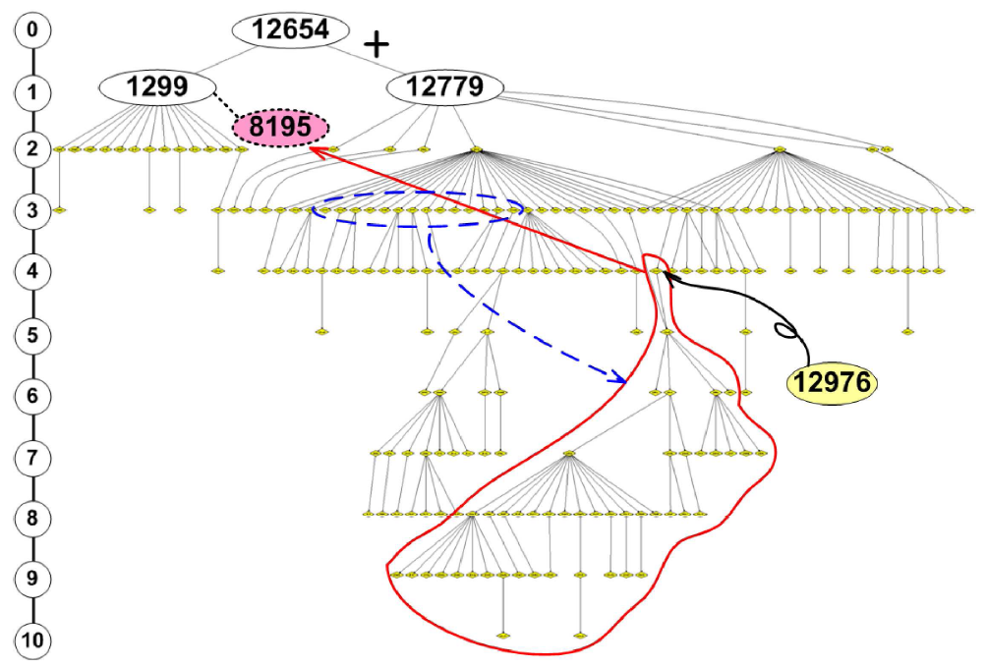

Slide 5
Levels of routing
Intra-domain routing (inside AS) vs inter-domain routing (inter-AS)
Not all routers are equal.
Interior routers: Only know how to route datagrams to destinations within the same AS.
Border routers: Interface between its AS and other AS’s:
A nonbackbone router usually has a “default route” to another “more knowledgeable” router for “unknown destinations.”
A default-free router is supposed to know every “IP network” in the Internet.

Slide 6
Requirements for interdomain routing
Accuracy
Accurately reflect the forwarding states of the network (e.g., avoiding forwarding loops)
Local changes in physical networks or policies cause the routing system to recompute the new routing states.
Scalability
Static nature: the number of routing entries, the number of AS, etc.
Dynamic nature: routing update rates, adding andv withdrawing routes, etc.

Slide 7
Requirements for interdomain routing
The growth trend in the inter-domain routing space do not appear to have well-defined upper limits.
Policy expressiveness
Determining a path and the best path
Ingress routing policies: how a domain learns and selects routes.
Egress routing policies: how a domain announces routes to its adjacent neighbors.

Slide 8
Requirements for interdomain routing
Robust predictable operational characteristics
Minor variations in the state of the network should not cause large-scale instability across the network.
Recomputation of the routing states must always halt and the halting point must be reached quickly.
Efficiency
The routing system should be efficient in terms of the bandwidth and processing.
Trade off with the accuracy requirement.
The security of the routing information must be reasonably protected.

Slide 9
Possible approaches
Distance vector approach
Exterior Gateway Protocol (EGP)
Each EGP router announces reachability information (list of destinations and “distances”)
Designed for tree-structured topology, no policy routing support, slow convergence, etc.
Link state approach
Interdomain policy routing (IDPR)
Each IDPR maintains an AS-level map.
Setting a path between a source and a destination.

Slide 10
Border gateway protocol version 4
Exchange routes with neighbor routers in other AS’s.
No periodic routing updates to ensure the neighbors’ liveliness.
Attach a path vector to each route for routing loop detection.
Attach a path with different attributes to facilitate local routing policies.
Provide facilities for route aggregation.

Slide 11
BGP4 speakers, peers, and sessions
Two BGP speakers (hosts or routers) may establish a BGP session between them.
If the two speakers are from two different AS’s, they must be connected directly.
A BGP session uses TCP for transport.
The two sides initially exchange their routes.
The TCP connection assures to each side that the other side is alive.
BGP therefore does not require periodic route refreshing.
BGP has its own keepalive messages.

Slide 12
Internal and external BGP sessions
All BGP speakers representing the same AS must give a consistent image of the AS to the outside.
Internal BGP (I-BGP) sessions vs. intradomain routing protocols.
To avoid routing loops, each BGP speaker can only advertise the routes it has learned from external BGP (E-BGP) sessions to other internal speakers.
There are two types of BGP sessions:
I-BGP: Exchanging routes within the same AS.
E-BGP: Exchanging routes with another AS.

Slide 13
Internal and external BGP sessions (from [3])
AS 2
AS 1
AS 3
R
R1
R3
R
R2
R
I-BGP
E-BGP
AS 4

Slide 14
Routing policies
BGP provides the capability for enforcing policies based on various routing preferences and constraints.
Policies are provided to BGP in the form of path attributes.
A multihomed AS can refuse to act as a transit AS for other ASs.
It does so by only advertising routes to destinations internal to the AS.
A multihomed AS can become a transit AS for a restricted set of adjacent ASs.

Slide 15
Routing policies
It does so by advertising its routing information to this set of ASs.
An AS can favor or disfavor the use of certain ASs for carrying transit traffic from itself.
An AS can minimize the number of transit ASs.
Shorter AS paths are preferred over longer ones.
Fundamental to BGP is the rule that an AS advertises to its neighboring ASs only those routes that it uses.

Slide 16
Route selection
A BGP speaker
evaluates different paths from itself to a set of destination covered by an address prefix,
selects the “best” one,
applies appropriate policy constraints,
and then advertises it to all of its BGP neighbors.
The path selection can be based on
Information explicitly present in the full AS path.
A combination of information that can be derived from the full AS path and information outside the scope of BGP.

Slide 17
Route selection

Slide 18
Route selection
AS count: paths with a smaller AS count are generally better.
Presence or absence of a certain AS or ASs in the path
Path origin: A path learned entirely from BGP is generally better.
AS path subsets
Link dynamics. Stable paths should be preferred over unstable ones.
Other policy considerations

Slide 19
Transit vs nontransit
Local routing policies: which routes to accept from neighbors and which routes to advertise to each neighbor.
An inappropriate use is for Customer1 to reach Customer3 by going through ISP2.
For ISP1,
it must make sure that other ISPs can reach Customer1 by announcing routes for any prefixes used by Customer1 to ISP2 and ISP3, and
However, ISP1 should be careful about announcing ISP2’s routes to ISP3.

Slide 20
For example (from [3])
ISP1
ISP3
ISP2
Customer1
Customer3
Customer2

Slide 21
Examples for PolyU (from [2])

Slide 22
Examples for PolyU (from [2])

Slide 23
BGP4 protocols
BGP4 messages serve the following purposes:
Open a BGP message with a neighboring BGP speaker (OPEN).
Inform the neighbor about new routes that are active (UPDATE).
Inform the neighbor of old routes that are no longer active (UPDATE).
Inform the neighbor that the connection is still viable (KEEPALIVE).
Report unusual conditions before terminating the TCP connection (NOTIFICATION).

Slide 24
Route updates
When a BGP speaker A advertises a route to its neighbor, the information is considered valid until
A explicitly advertises that the information is no longer valid (route withdrawals), or
the BGP session itself is lost.
Each update message can include a number of prefixes that share all attributes.

Slide 25
BGP update messages

Slide 26
Route attributes
In BGP, the route to a prefix is attached with a number of attributes.
Well-known mandatory: ORIGIN, AS-PATH, NEXT-HOP
Well-known discretionary: LOCAL_PREF and ATOMIC_AGGREGATE
Optional nontransitive: MUTI_EXIT_DISC
Optional transitive: AGGREGATOR
The ORIGIN attribute describes how a prefix came to be routed by BGP at the origin AS.
IGP, EGP, INCOMPLETE

Slide 27
AS-PATH attribute
The AS-PATH attribute contains the numbers of AS’s through which the announcement for the prefix has passed.
Detect routing loops and aid routing decisions.
Two path segment types: AS-SEQUENCE and AS-SET
(Sequence(1, 2, 3)) and (Set(1, 2), Sequence(3))
AS1
AS1
AS2
AS3
AS3
AS2

Slide 28
NEXT-HOP attribute
The NEXT-HOP attribute indicates the address of the next hop node, which the data packets should be sent to for the prefix.
UPDATE message through BGP
Traffic to 140.12.0.0/16
140.12.0.0/16
R1
R2
R3
LAN
R3 is not a BGP speaker.

Slide 29
MUTI_EXIT_DISC attribute (from [3])
If two AS’s connect to each other in more than one place, this attribute helps select an optimal link to a particular prefix in or behind that AS.
Link A
AS 3
AS 1
AS 2
Link B
AS 4

Slide 30
MUTI_EXIT_DISC attribute
The BGP speaker in AS2 on link A may advertise the routes to AS3 and internal prefix that is closer to link A with a smaller MUTI_EXIT_DISC value.
One AS sets the MUTI_EXIT_DISC values and the other uses the values to decide the best route.
The MUTI_EXIT_DISC attribute is therefore more suitable for provider-to-subscriber, not for provider-to-provider.

Slide 31
LOCAL_PREF attribute
In this example, AS4 receives the route to 138.39.0.0/16 from both AS2 and AS3.
The MUTI_EXIT_DISC attribute cannot be used for selecting the path.
There is only a single link between AS2 and AS4 and between AS3 and AS4.
AS4 wants to control the path selection itself.
AS4 can implement its own preference by configuring the value of the LOCAL_PREF attribute which is used only in I-BGP sessions.

Slide 32
LOCAL_PREF attribute (from [3])
138.39.0.0/16
AS1
AS2
AS3
AS4

Slide 33
ATOMIC_AGGREGATE attribute
If a BGP speaker A hears both 138.39.0.0/16 and 138.39.12.0/24 (overlapped) from router B, and the path attributes are not the same.
If A uses 138.39.0.0/16, it should attach the ATOMIC_AGGREGATE attribute to the prefix when advertising it to other speakers.
When a speaker receives such a route, it must not deaggregate into more specific entries.

Slide 34
AGGREGATOR attribute
The attribute contains
the last AS number that formed the aggregate route, followed by
the IP address of the BGP speaker that formed the aggregate route.

Slide 35
Summary
BGP provides an very effective interdomain routing solution for the last decade.
BGP achieves a number of requirements in a single protocol, such as routing loop detection, support for policy routing, efficiency, etc.
However, the Internet is still growing rapidly and the suitability of BGP is currently under review.
Meanwhile, many new development for BGP has been under way.

Slide 36
References
Larry Peterson and Bruce Davie, Computer Networks: A Systems Approach, Second Edition, Morgan Kaufmann, 2000.
J. Stewart III, BGP4: Inter-Domain Routing in the Internet, Addison Wesley, 1999.
http://bgp.potaroo.net/cidr/
G. Huston, “An Examination of the Internet’s BGP Table Behaviour in 2001.”
C. Huitema, Routing in the Internet, Prentice Hall PTR, Second Edition, 1999.
G. Huston, “Scaling Inter-Domain Routing--A View Forward,” The Internet Protocol J., 2001.
Y. Rekhter and P. Gross, “Application of the Border Gateway Protocol in the Internet,” RFC 1772, March 1995.

