Slide 1
The Classic Internet Protocol (RFC 791)
Dr. Rocky K. C. Chang 20 September 2010

Slide 2
IPv4 header

Slide 3
IPv4 datagrams
0
4
8
16
19
31
V
ersion
HLen
TOS
Length
Identification
Flags
Fragment offset
Time to live (TTL)
Protocol
Header checksum
Source address
Destination address
Options (variable)
Pad
(variable)
Data

Slide 4
IPv4 header
Version: 4 for the current IP.
Type of service (TOS) for specifying how a router should handle this datagram.
Recently replaced by a 6-bit differentiated services codepoint (RFC 2474) and
a 2-bit explicit congestion notification (RFC 3168)
Header length handles a variable-length header.
20-byte IP header without IP options

Slide 5
IPv4 header
A 16-bit length (count in bytes) limits the size of an IP datagram to 65,535 bytes, including the IP header.
Identification, flags, and offset are used for packet fragmentation and reassembly.
Time to live (TTL) limits the number of times that a datagram processed by routers
Packets caught in routing loops
Packet scoping, especially for multicast packets.
Initial TTL value?

Slide 6
IPv4 header
Protocol specifies the type of payload.
Protocol messages on the network layer, such as ICMP (1) and IGMP (2)
TCP data (6) and UDP data (17)
Checksum is a 16-bit word checksum for header’s error detection
IP options: Source routing, record route, timestamp, etc, but they are rarely used today in practice.

Slide 7
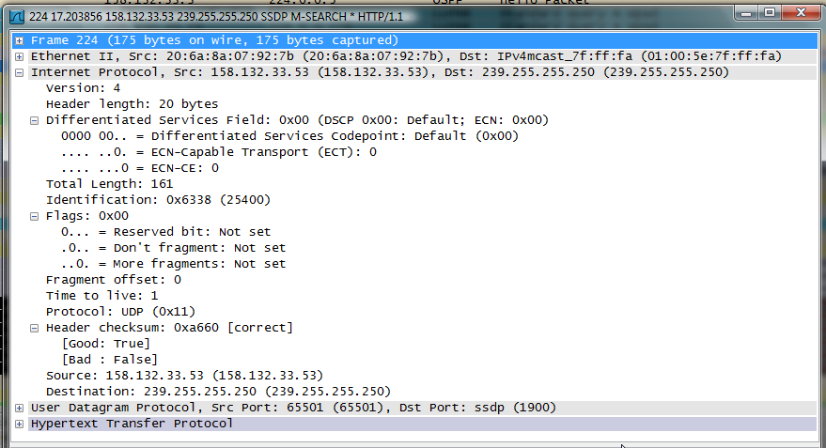

Slide 8
Implementing IP fragmentation
Support unambiguous fragment reassembly.
Support multiple fragmentations.
Support the options of fragmentation.
Cater for packet reordering.
Detect fragment losses.

Slide 9
Fragment reassembly
Each fragment must share the same identity.
This identity should not rely on other protocol information.
The identification field is incremented after sending an IP packet.
Each fragment should include its position in the original packet.
Fragment offset: the offset of this fragment from the beginning of the original packet.
Fragments are counted in units of 8 octets, why?

Slide 10
Fragment reassembly
As a result of using the fragment offset to indicate the fragment’s position, need to identify the last fragment.
If the More-Fragment bit (the last flag) is off, this fragment is the last fragment.
If any fragment does not arrive within a certain time, other received fragments in the same datagram will be discarded.
Need a fragment timer.

Slide 11
Fragment reassembly
Should allow the source to have some control over IP fragmentation.
A Don’t Fragment flag (the second flag) indicates whether the datagram should be fragmented.

Slide 12
IP fragmentation: An example
H1
R1
R2
R3
H8
ETH
IP
(1400)
FDDI
IP
(1400)
PPP
IP
(512)
ETH
IP
(512)
PPP
IP
(512)
ETH
IP
(512)
PPP
IP
(376)
ETH
IP
(376)

Slide 13
Start of header
Ident
= x
0
Offset
= 0
(a)
Rest of header
1400 data bytes
Start of header
Ident
= x
1
Offset
= 0
(b)
Rest of header
512 data bytes
Start of header
Ident
= x
1
Offset
= 512
Rest of header
512 data bytes
Start of header
Ident
= x
0
Offset
= 1024
Rest of header
376 data bytes

Slide 14
How to reduce the IPv4 header’s complexity?
More items in an IP header ➔ higher computation
No options
Remove the 4-bit header length field
No hop-by-hop fragmentation in the network
Remove the 4 bytes of identification, flags and offset.
Instead, support end-to-end fragmentation.
No error detection for headers
Remove the 16-bit checksum.

Slide 15
IPv6 header

Slide 16
ICMP

Slide 17
Internet control message protocol (ICMP)
RFCs 792 and 950
The main services provided by ICMP are:
Error reporting (error)
Reachability test (query)
Congestion control (error)
Route-change notification (error)
Time stamping (query)
Subnet addressing (query)
Router advertisement and solicitation (query)

Slide 18
ICMP messages
ICMP messages, protected by 16-bit checksums, are encapsulated in IP datagrams.
ICMP messages are classified into error messages and query messages.
Query messages include
echo request and reply (Ping)
router advertisement and solicitation
timestamp request and reply
address mask request and reply
The rest are error messages

Slide 19
ICMP error messages

Slide 20
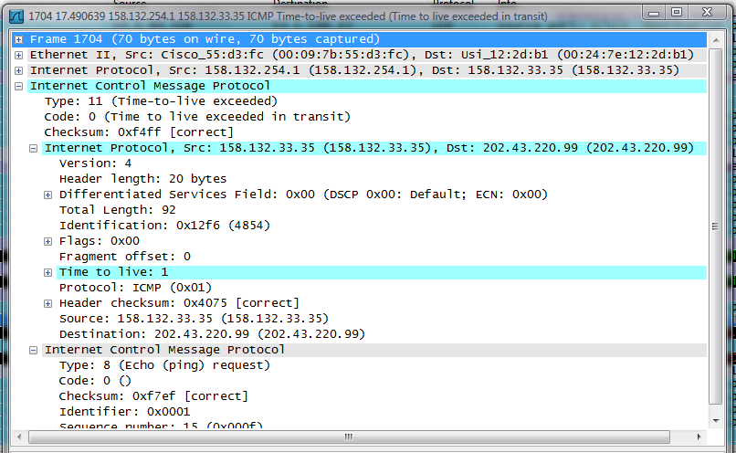

Slide 21
ICMP error messages
An ICMP error message always contains
the IP header and the first 8 bytes of the IP datagram that caused the ICMP error to be generated.
An ICMP error message is never generated in response to
An ICMP error message
A datagram destined to an IP broadcast address or an IP multicast address
A datagram sent as a link-layer broadcast
A fragment other than the first

Slide 22
Summary
The IPv4 header contains sufficient information for implementing the IP service.
But there are rooms for IPv4 to simplify the header structures.
ICMP provides some useful feedbacks (queries and error reporting) for IP and the transport layer.

Slide 23
References
“Special-Use IPv4 addresses,” RFC 3330, Sept. 2002.

